Slide 1
Change the beginning and you change the whole story

Slide 2
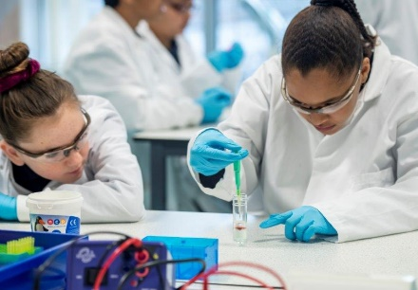
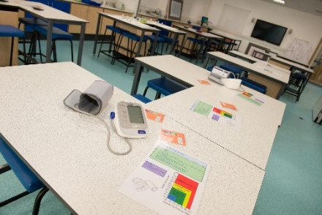
Me, My Health & My Children’s Health
LifeLab developed as a collaboration by
University of Southampton (Education and Medicine)
NIHR Nutrition Biomedical Research Centre
University Hospital Southampton
Maths & Science Learning Centre South East
MRC Lifecourse Epidemiology Unit
Supported by key stakeholders, particularly local authorities and schools
Located at University Hospital Southampton, comprising of a seminar area and a laboratory for hands-on experiments.
Programmes are tailored for students of all abilities, initially focusing on 12-14 year olds

Slide 3
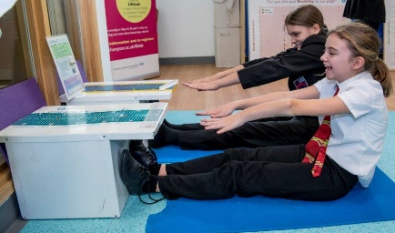
Educational intervention based on research evidence:
Education:
Students need to understand the science behind health issues to make informed judgements about their health
Increasing scientific literacy to increase health literacy
Medical:
A healthy lifestyle in early life
=
Better health in later life and for future generations
Notes:
Behavioural risk factors largest contributor to the non-communicable disease burden

Slide 4
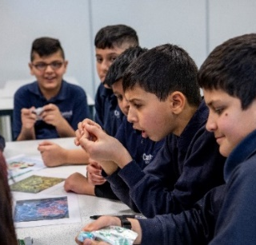
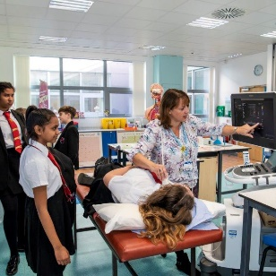
What is LifeLab?
State-of-the-art teaching laboratory, at the heart of the hospital, supporting young people to learn the science behind health messages.
Over 14,000 students, >90 schools and >500 teachers across the South Coast, UK have participated
3-component educational programme; Teacher CPD, a fully resourced, science curriculum-linked, hands-on, immersive experience for young people; peer-learning programme

Slide 5
LifeLab aims to provide school students with opportunities to:
Learn how they can improve their health and the health of their future children through increased health & science literacy
Become enthusiastic about science, and consider further study and careers in scientific disciplines

Slide 6
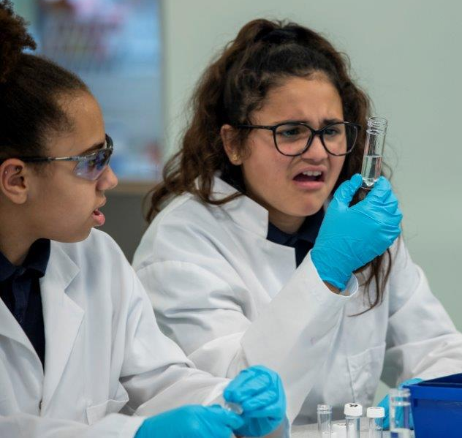
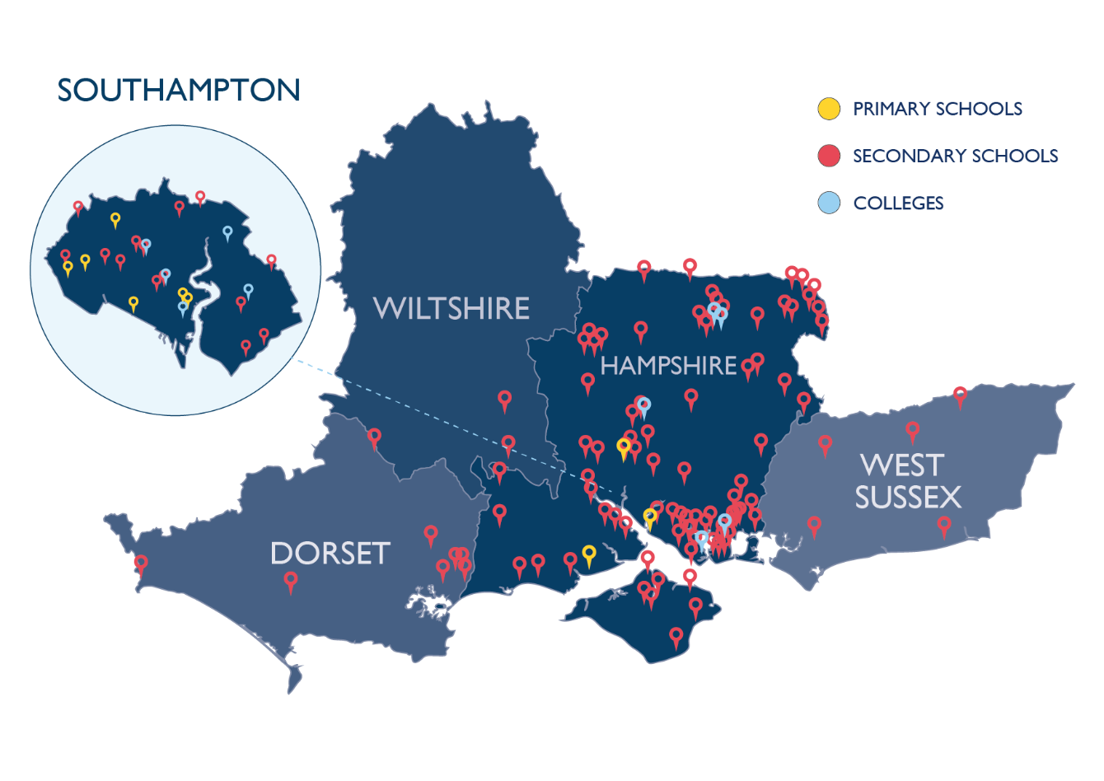
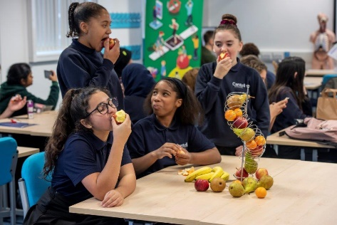
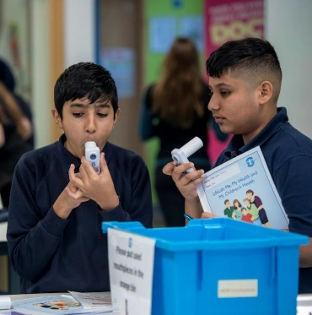
LifeLab Research:
42 schools recruited and randomised to our randomised controlled trials (RCTs) (funded by the BUPA foundation and the British Heart Foundation)
50 schools recruited for new NIHR funded RCT – ‘Engaging Adolescents with Changing Behaviour’
To date, over 14,000 school students have attended
Primarily years 8/9, but also 11-18 yrs

Slide 7
Secondary school intervention programme
‘Me, my health and my children’s health’

Slide 8
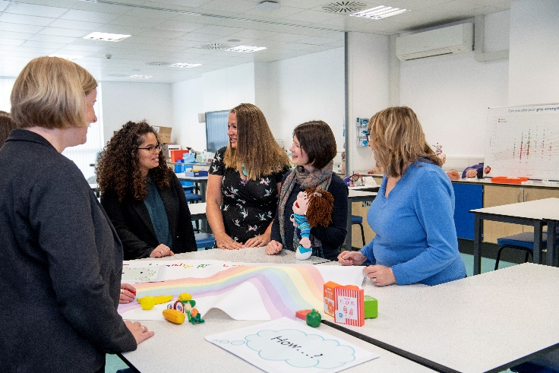
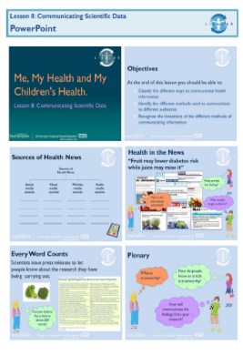
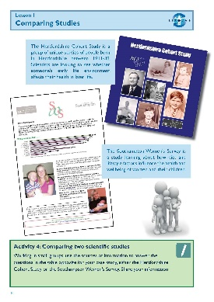
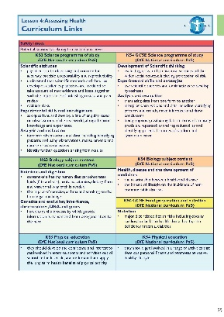
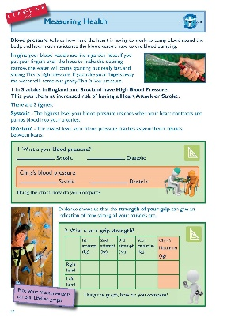
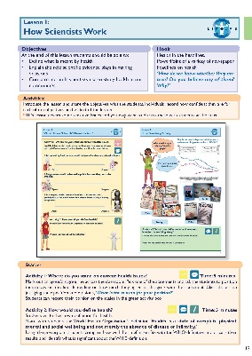
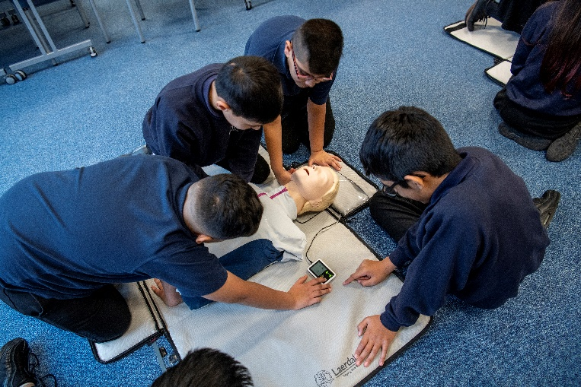
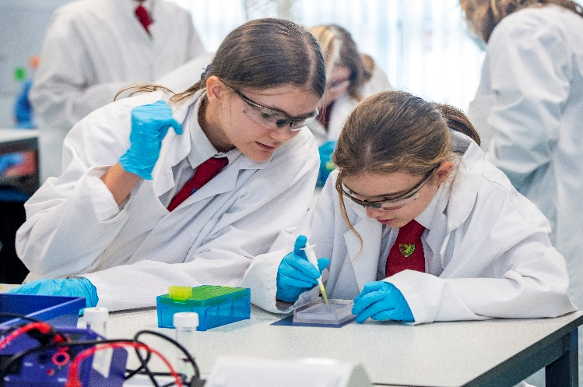
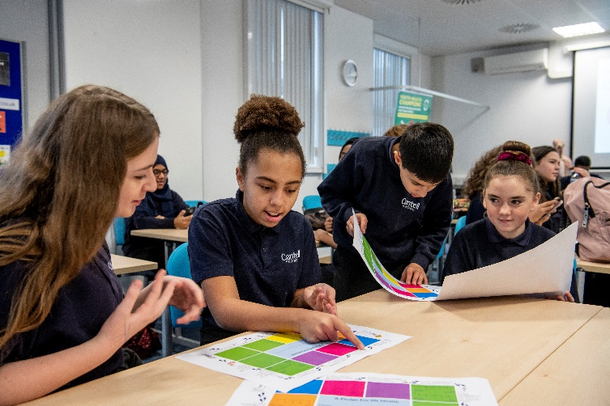
What…..
How…..

Slide 9
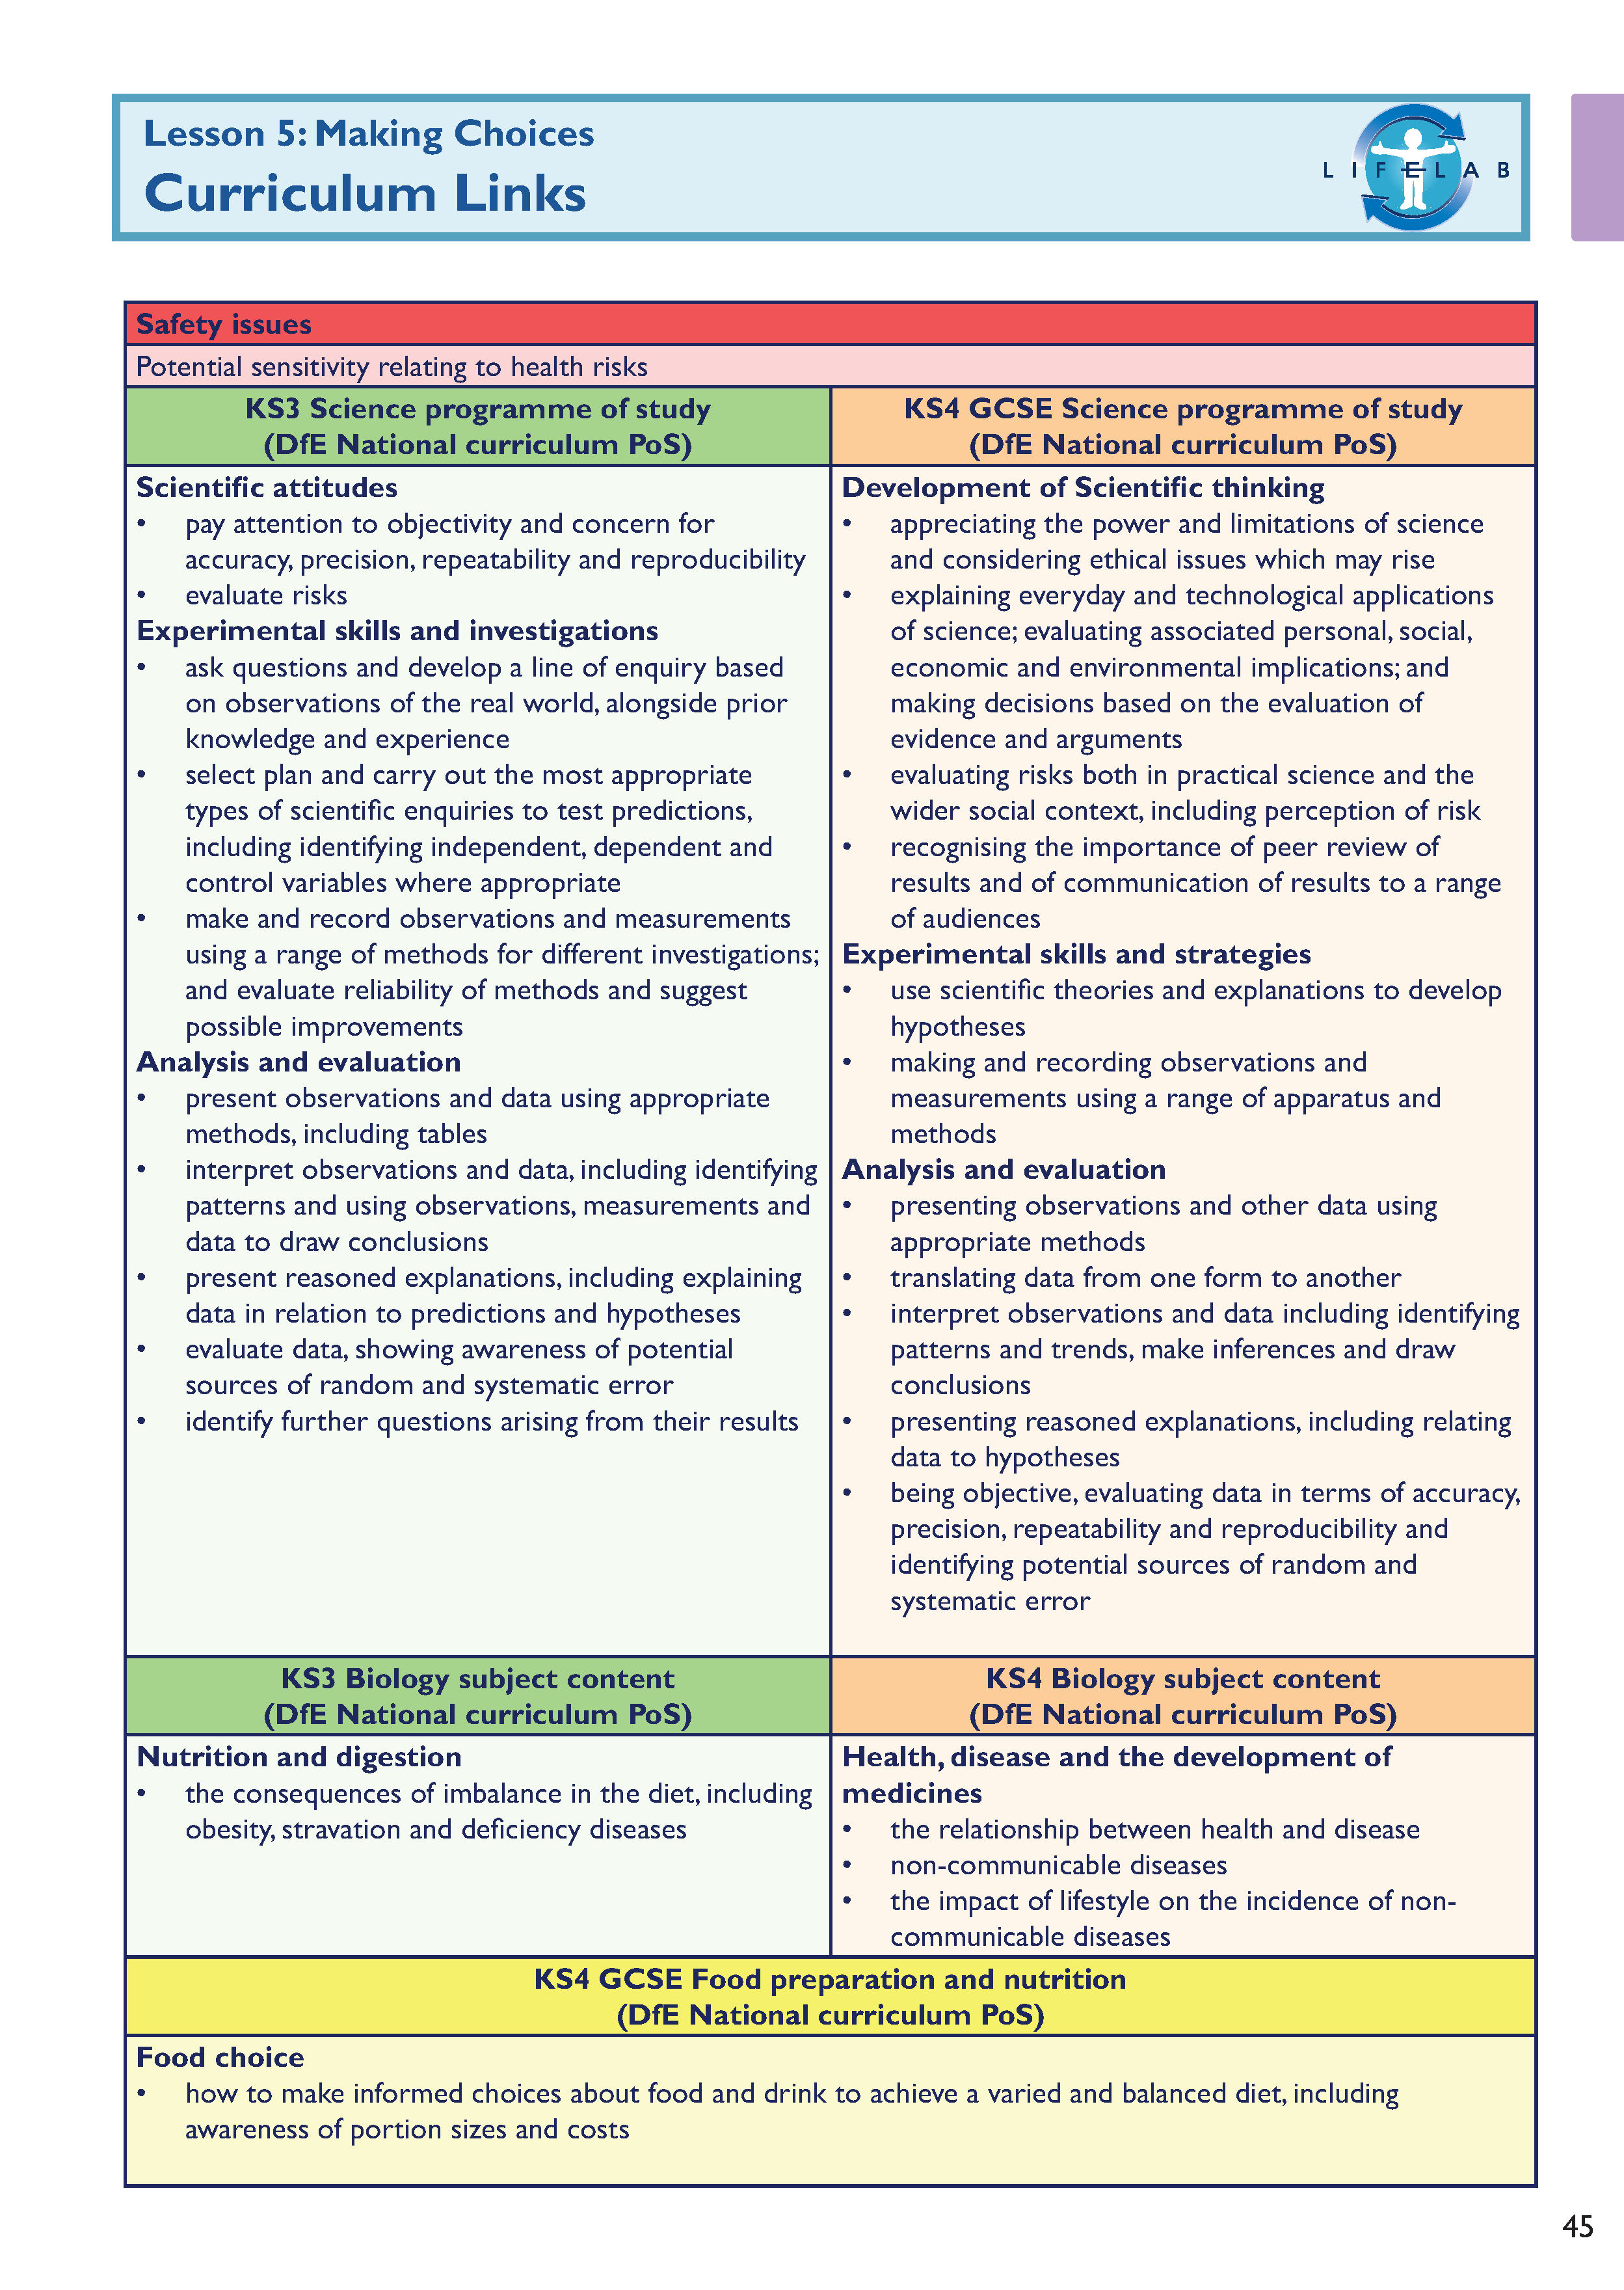
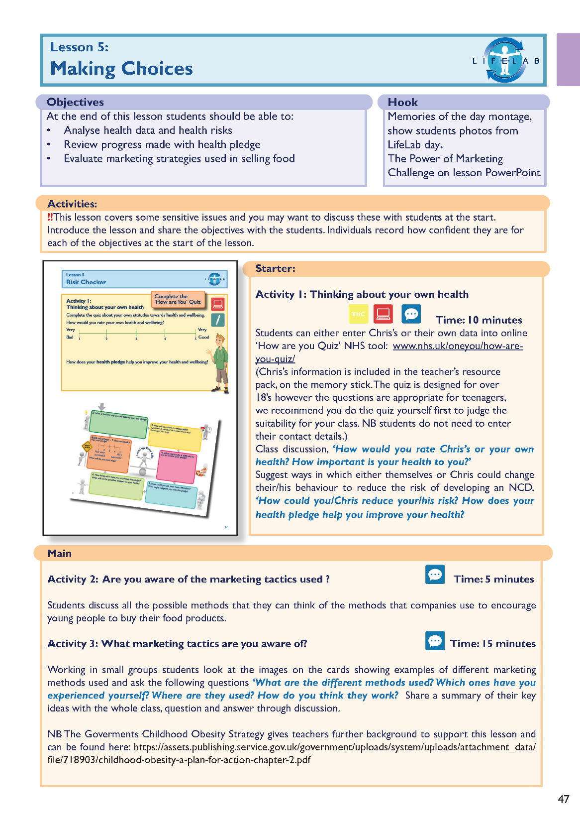
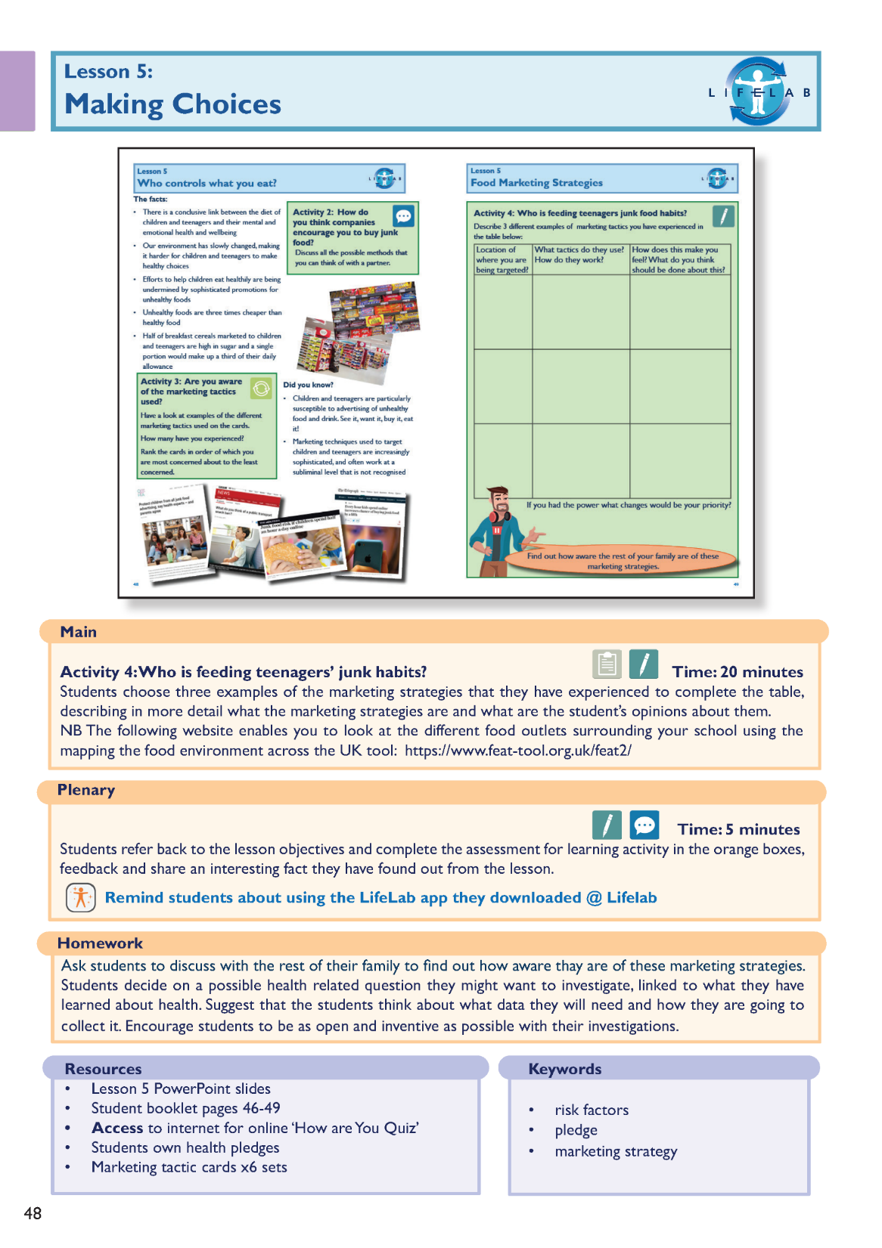
The lessons

Slide 10
Can you name them?

Slide 11
How well did you do?

Slide 12
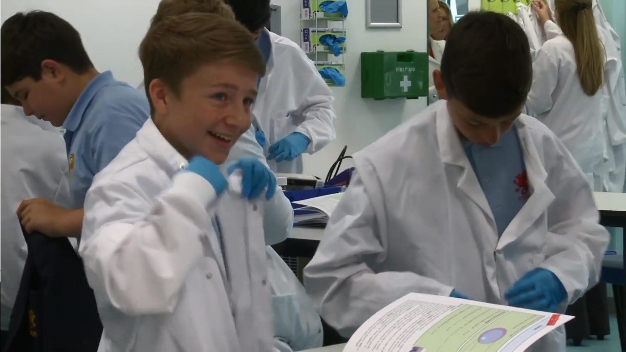
What happens at LifeLab….
http://www.youtube.com/watch?v=u0qvxsdm-fY

Slide 13
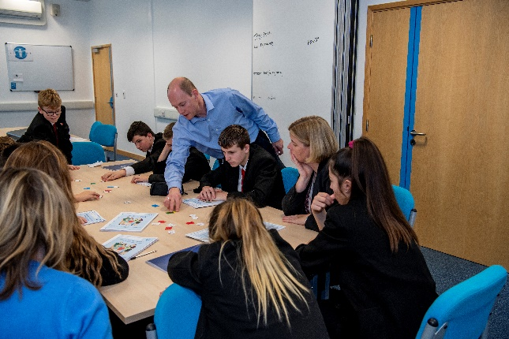
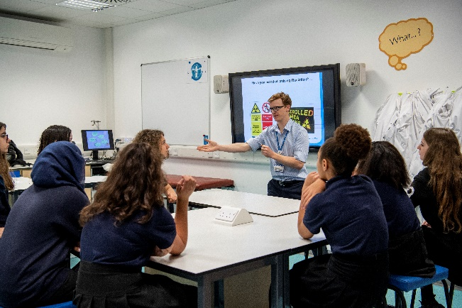
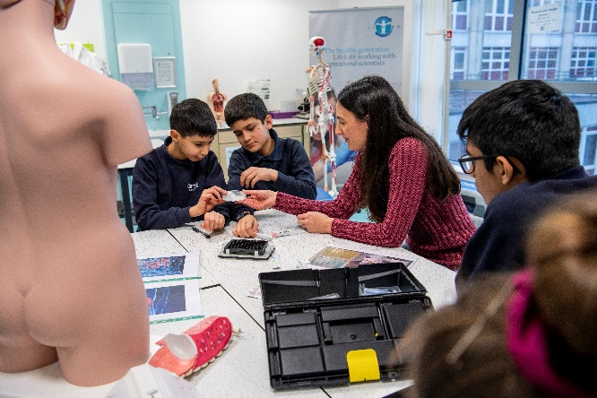
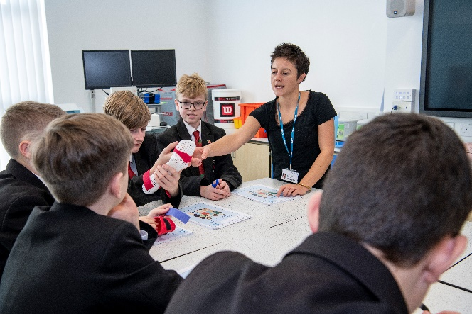
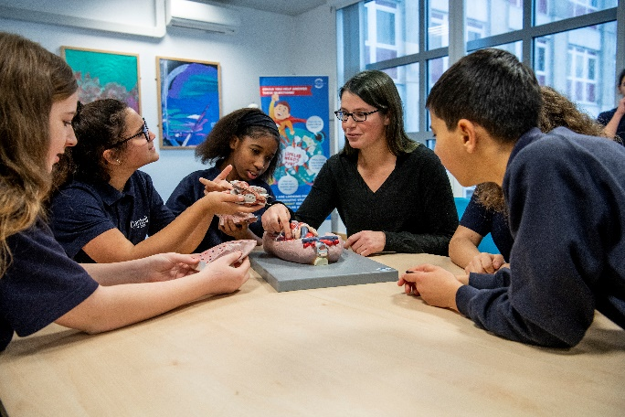
Meet the Scientists - STEM Ambassadors

Slide 14
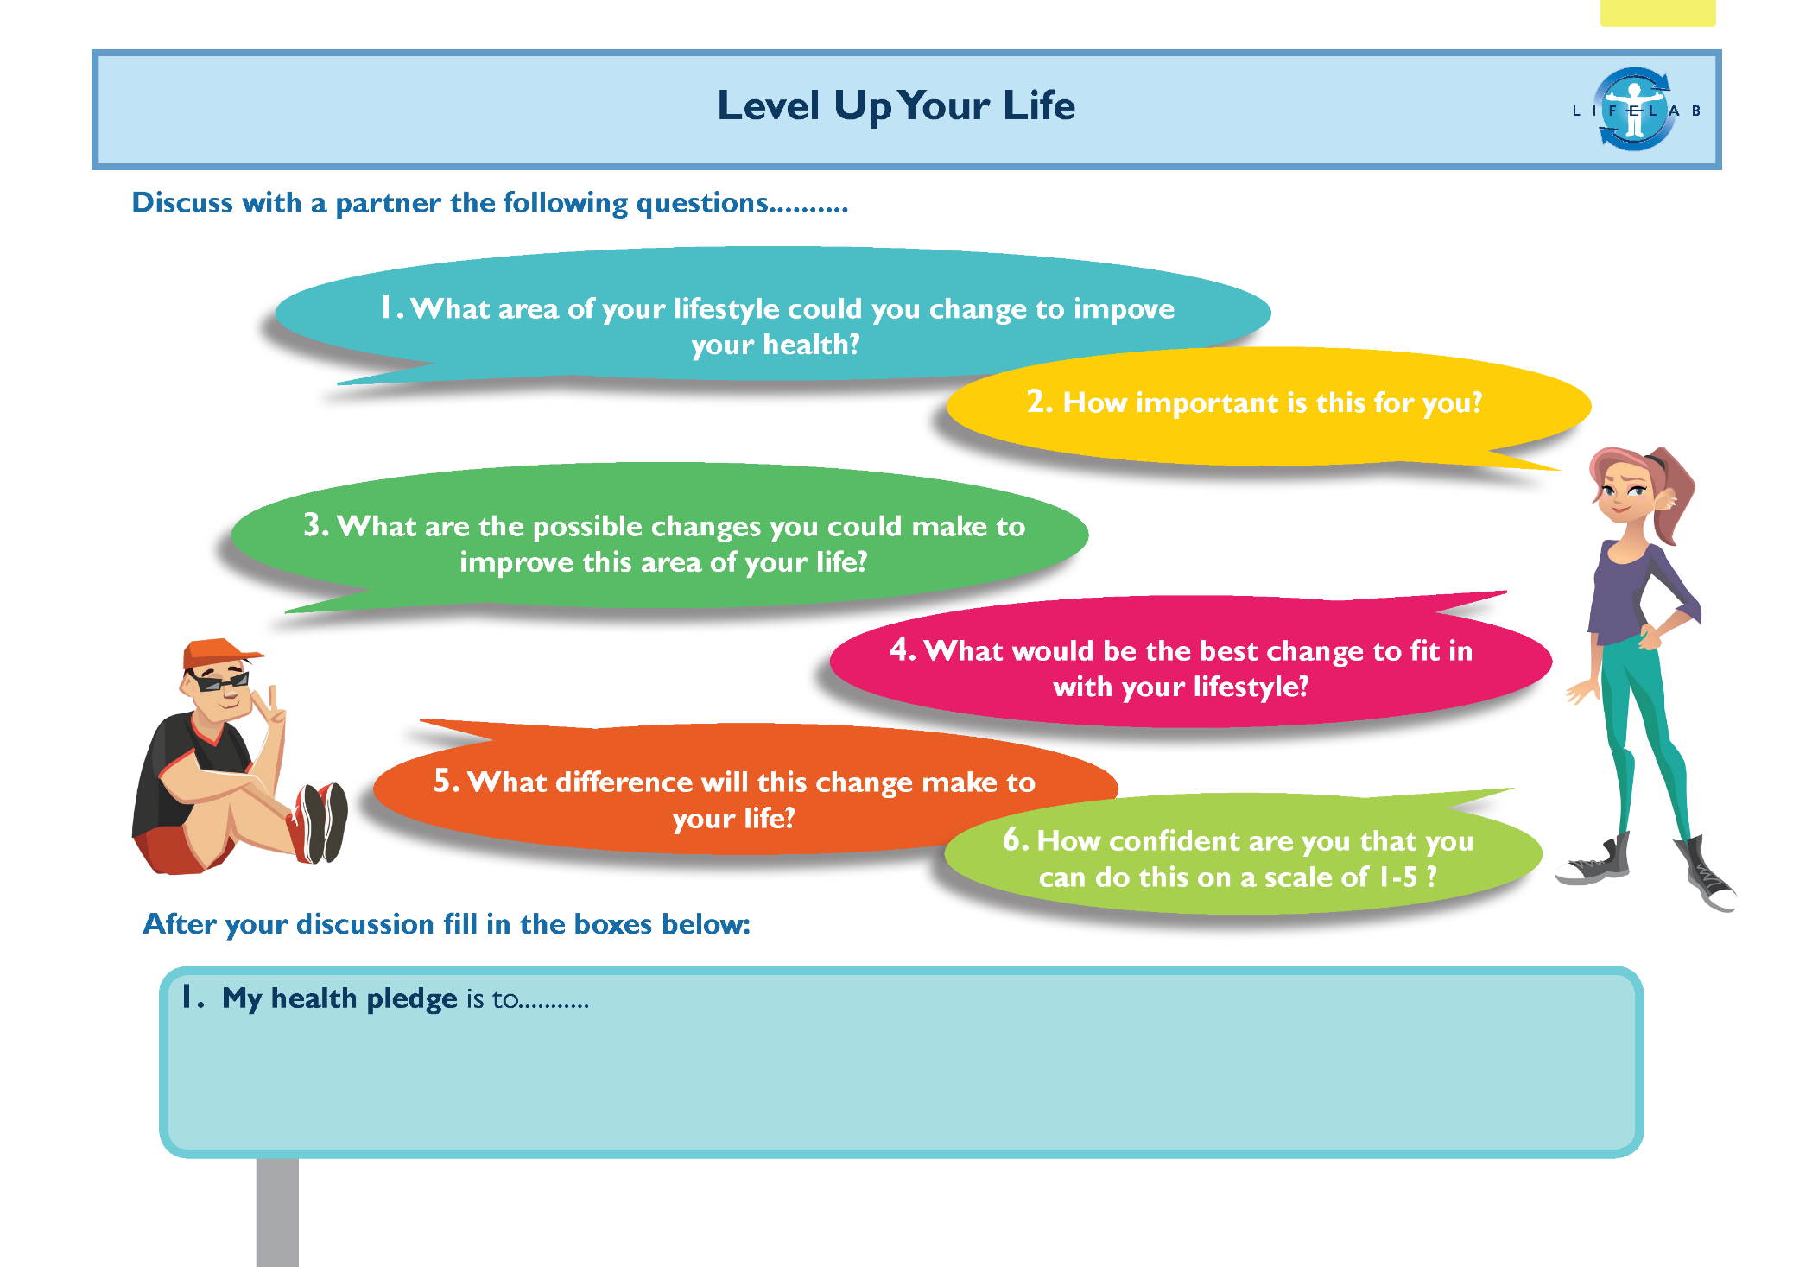
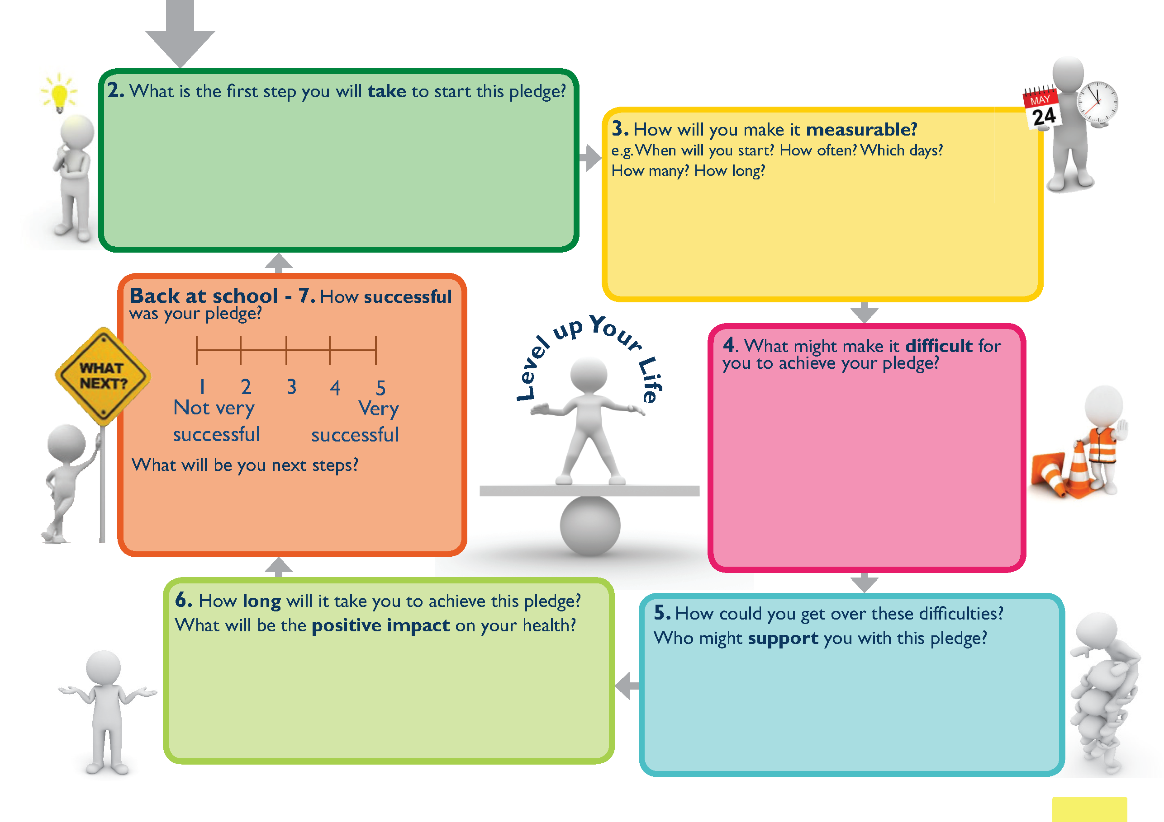
Health Pledge

Slide 15
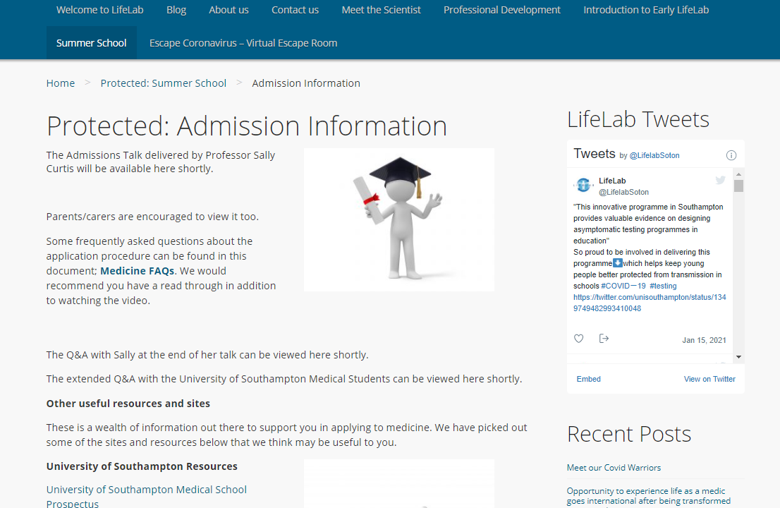
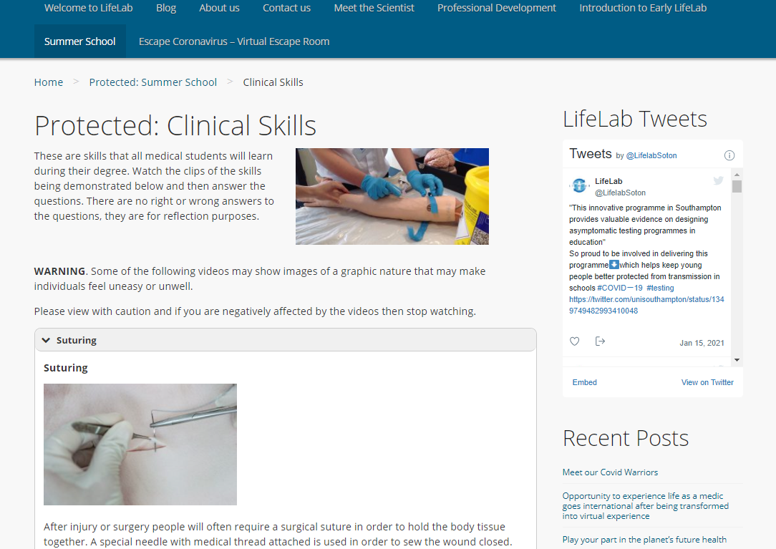
Outreach Activities
Summer School for prospective medics
Work experience opportunities for prospective medics

Slide 17
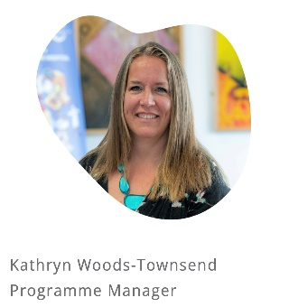
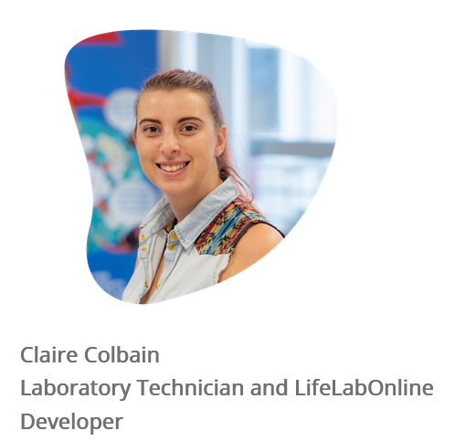
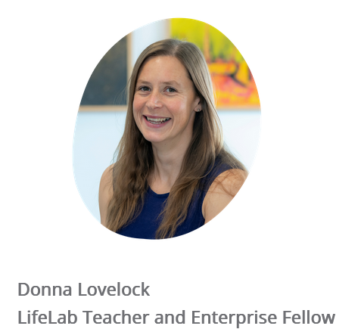
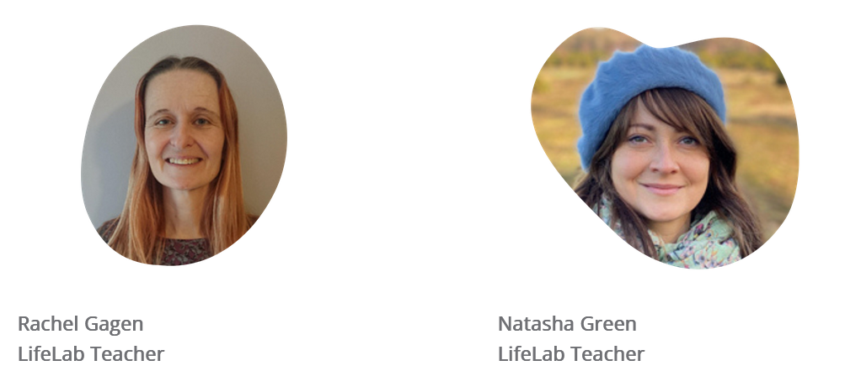
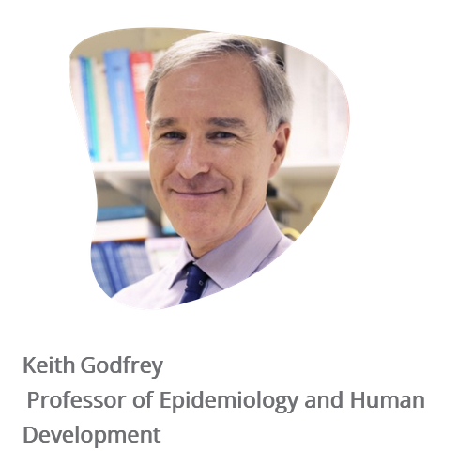
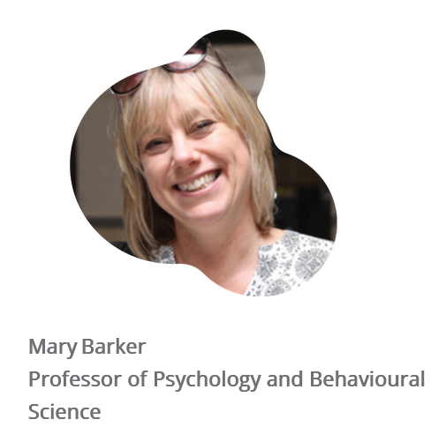
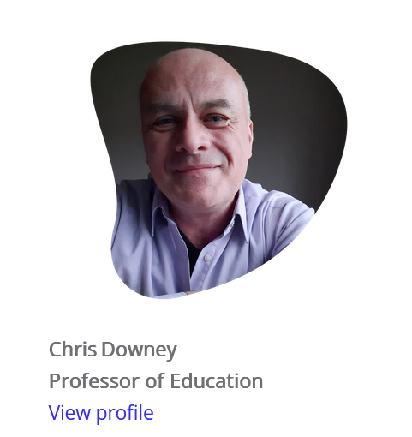
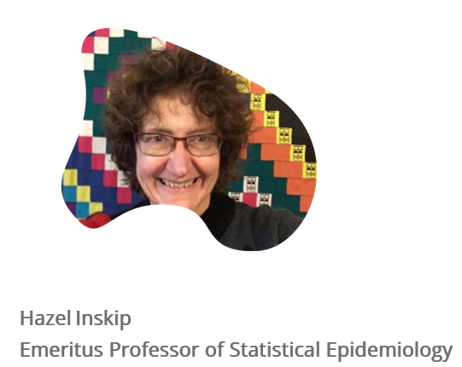
Southampton Team
Rachel Drewer
Communication Manager
Beth White
LifeLab Technician
Funding
NIHR Southampton BRC
AHRC Pathways to Health
NIHR EACH-B Project
Southampton City Council
HEIF (Vaping)
PERu
WPSM

Slide 18
Further information & resources
www.lifelabonline.org
For enquiries and bookings please email:
Lisa Bagust l.j.Bagust@soton.ac.uk

