Slide 1
SENK Project Science
Autumn 2022 Session 1

Slide 2
Rational for this project
This project is a continuation of two previous projects:
The SENK Project 2021-22 led by Beverly Murtagh
The Improving Exam Outcomes with Cognitive Science Approaches Project led by Kev Neil
Notes:
Schein question model diagram
Some sample questions for use within deaprtments
Starting point – Which strategies and techniques are most widely/consistently used in this subject and why are they favoured? By implication – which are not used that might be and why is this?

Slide 3
Aims of this project
To improve understanding, engagement, and outcomes for SEN pupils through cognitive science approaches.
To use the EEF SEN 5-a-day guidance as the foundation to deepen teachers understanding of working and long-term memory and curricular/pedagogical techniques to aid SEN in science.
To develop teacher expertise in delivery of focused and effective practical work to SEN pupils.
Notes:
Schein question model diagram
Some sample questions for use within deaprtments
Starting point – Which strategies and techniques are most widely/consistently used in this subject and why are they favoured? By implication – which are not used that might be and why is this?

Slide 4
Impact of this project
Impact:
Teachers’ expertise in cognitive science approaches to SEN will increase
Outcomes for SEN pupils in science formative and summative assessments will improve compared to before the project
Evidence of impact:
Pupil and teacher voice, data from any summative assessment, observations at start and end of project time frame, pupil and teacher surveys
Notes:
Schein question model diagram
Some sample questions for use within deaprtments
Starting point – Which strategies and techniques are most widely/consistently used in this subject and why are they favoured? By implication – which are not used that might be and why is this?

Slide 5
How will the findings of this project be shared:
Via a detailed article in the Hampshire Powerful Science Magazine
Via the Heads of Science Network meetings
Centrally through a SEN project conference in the Summer which will pull together all the work in this project and others running at same time.
Notes:
Schein question model diagram
Some sample questions for use within deaprtments
Starting point – Which strategies and techniques are most widely/consistently used in this subject and why are they favoured? By implication – which are not used that might be and why is this?

Slide 6
Proposed timeline
Two workshops with teachers. Approximately 2 hours each Tuesday 11th and Monday 17th October
Teachers choosing and trialling a range of cognitive science-based approaches in the classroom with identified SEN pupils . From after half term
KN to visit each school to observe teachers with SEN pupils at start of project. From half term
Two to three catch up meetings to evaluate progress. Most likely virtual- End November, end December and end Jan 2023
KN to visit each school to observe teachers with SEN pupils at end of project. February 2023
Surveys, data accumulation and review of project. March 2023
Notes:
Schein question model diagram
Some sample questions for use within deaprtments
Starting point – Which strategies and techniques are most widely/consistently used in this subject and why are they favoured? By implication – which are not used that might be and why is this?

Slide 7
This week
An overview of the EEF five-a-day and what it could look like in the classroom

Slide 8
Next week
A look at how we can incorporate approaches into practical work to lead to effective understanding of disciplinary knowledge and deepen understanding of substantive knowledge

Slide 9
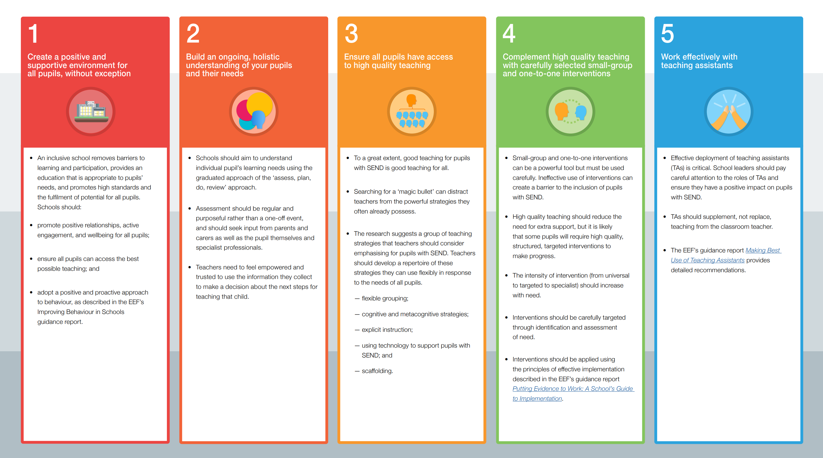

Slide 19
Direct Instruction
Evidence dating back over 60 years shows that DI is the most effective teaching methodology.
However, new teachers are often indoctrinated that DI bad and constructivism good, even though the evidence doesn’t support this.
DI is often confused with didactic teaching, which it is not.
DI, when followed correctly lowers cognitive load, avoids split attention and redundancy effect.
It incorporates, retrieval, dual coding etc.
Notes:
This highly scientific evidence informed process of teaching is often absent in most teacher training programmes.

Slide 20
Direct Instruction
The Direct Instruction method is based on two core principles:
1. All students can learn when taught correctly, regardless of past history and background.
2. All teachers can be successful, given effective teaching materials and presentation techniques.
​
Lessons are:
Explicit, with purposeful instruction designed to develop skilled and confident learners.
Consistent, allowing students to focus on the material they are learning.
Interactive, with quick pacing and group responses that keep all students engaged to tackle new challenges
Notes:
This highly scientific evidence informed process of teaching is often absent in most teacher training programmes.

Slide 21
How does direct instruction work?

Slide 22
How does direct instruction work?

Slide 23
Introduction/ Review
A short set of questions which test the memory of what was taught in the last lesson.
This activates prior knowledge (or allows the teacher to close gaps in that knowledge before beginning new learning

Slide 24
How does direct instruction work?

Slide 25
Within a classroom there is a spectrum of existing prior knowledge when approaching any new concept.
Novice
Mastery
High quality explanations take advantage of prior knowledge and use it to lead them towards mastery of new knowledge

Slide 26
Mastery
Novice

Slide 27
Osmosis is the movement of water molecules from an area of high concentration to low concentration across a partially permeable membrane
Okay, write that down.
Right who can give me some examples of where this might happen?
Mastery
Novice

Slide 28
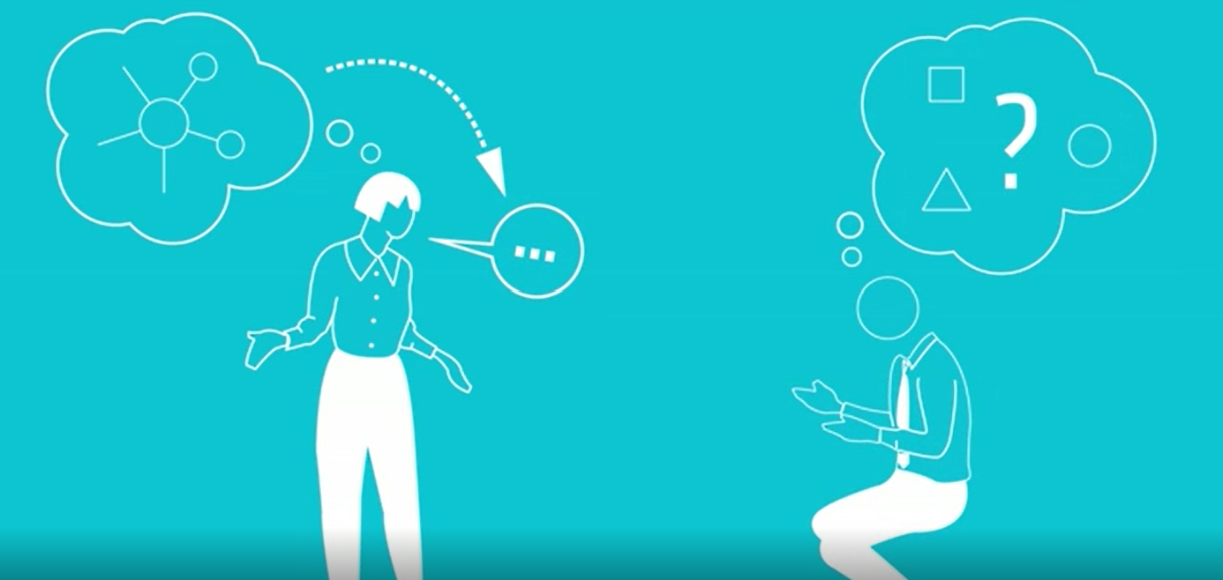
Osmosis is the movement of water molecules from an area of high concentration to low concentration across a partially permeable membrane
Okay, write that down.
Right who can give me some examples of where this might happen?
Mastery
Novice
The problem with having mastery as a teacher is it can lead to “expert blindness”.

Slide 29
What is dual coding?
In 1971, Canadian researcher, Allan Paivio, formulated his dual coding theory.
He then spent the next four decades researching it, trying to ‘break it’
He was unsuccessful.
It stands as one of the strongest evidence supported learning theories today

Slide 30
What is dual coding?
Paivio discovered that when new information is being encoded into the brain, there are two channels that deal with different stimuli
The verbal stimuli channel
The visual stimuli channel

Slide 31
The modality effect
The modality effect suggests it is possible to decrease cognitive load by using both auditory and visual channels to increase the capacity of the working memory

Slide 32
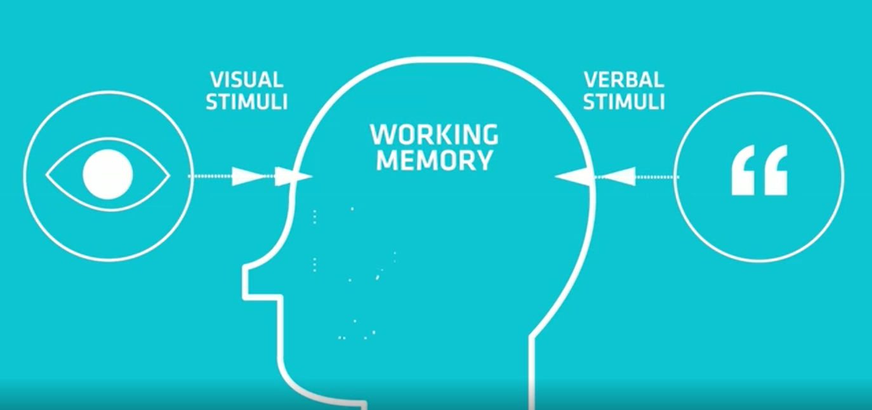
What is dual coding?

Slide 33
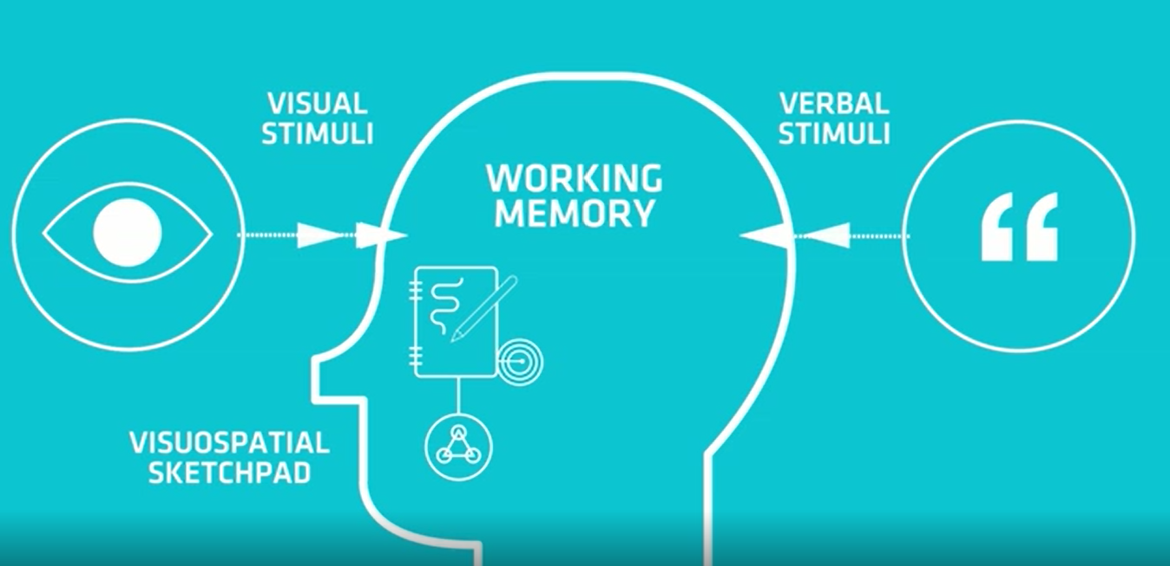
What is dual coding?

Slide 34
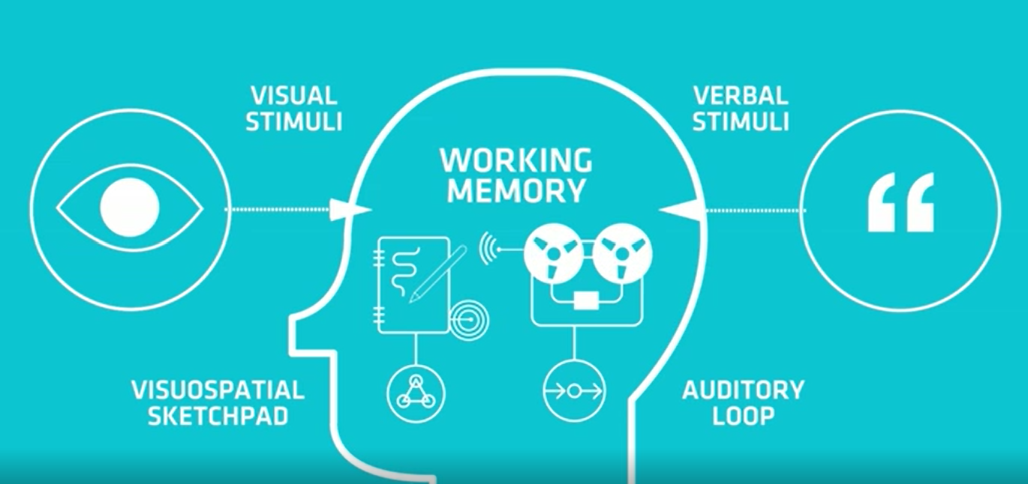
What is dual coding?

Slide 35
What is dual coding?
These are independent of each other
However, they are also able to create what Paivio called “associative connections” between them.
So, they are both apart from one another but can cooperate in forming linked pairs of words and images.

Slide 36
What is dual coding?
These processing centres can link to form stronger connections making the memory stronger and easier to retrieve.
But only if the information is presented in the correct way.
So dual coding is not something teachers do, it’s something that happens in the mind of children
Two forms of encoding enter the mind to create a stronger memory.

Slide 37
Clear instruction and explanations
Use your subject knowledge to take the students on a journey.
Try to link from the familiar to the unfamiliar in your explanations. Start with something concrete and go from there.
You will begin to lose the familiarity but you now have something concrete that all students know about to build upon and introduce the new knowledge.

Slide 38
How does direct instruction work?

Slide 39
Guided Practice
When moving on from development we often present pupils with problems to attempt.
Commonly teachers with show an example question (usually on PowerPoint) which might flash through some animated text on how to attempt the problem and then straight into independent student practice.
What then usually happens next is pupils get stuck very quickly and require more support or disengage from the activity.
Or in examples where there is a variation on a theme (rearranging questions, units conversion) the teacher will move on too quickly.

Slide 40
Developing Fluency in Science
A number of ways to approach this but the….
“I do, we do, you do” methodology
This approach in science is particularly effective when it comes to mathematics and equation work or procedures like tables or graphs.
Promoted by the excellent Doug Lemov in his books Teach like a champion

Slide 41
I do
Teacher models, explains and shows worked examples.
First supporting domain knowledge must be secure and checked.
The challenge of a task is a combination of level of domain knowledge and level of support
NOT on PowerPoint! Visualiser is a teachers best friend, but at least on the white board.
Clear, step by step, explaining your metacognitive process.
Pupils watch, listen and then can ask questions after.

Slide 42
We do
Teacher and pupils work through a number of problems together. Following the same process as the teacher modelled before.
With each we do problem the teacher should gradually remove their instruction and guidance until the last one is almost independently done by pupils.
Finally one problem is given to children to do by themselves following the method you have modelled and practiced.
This should be done on whiteboards and the answer should be clear to the teacher so they can see who has got it and who has not.
If low success rate, step back and do more we do. Looking for about 80% success rate

Slide 43
Checking for understanding
After delivering clear, well-structured modelling and guided practice you need to make sure it has been understood before the handover to independent practice.
This is a key moment in the process, especially for SEN pupils.
This is where high quality checking or understanding comes in.
We need to have clarity that the majority have grasped the concept and are ready to be independent otherwise we risk a large number crashing and burning almost straight away.

Slide 44
Checking for understanding
There are three main ways we can do this.

Slide 45
Checking for understanding
Written work (usually in books or worksheets)
Verbal response
Mini whiteboards

Slide 46
Checking for understanding
Written work (In books or worksheets)
Book work or worksheets stuck in provide permanence to the activity.
Pupils work at their own pace
Good for extended writing
However, it is hard to monitor the participation in the work, difficult to see who is actually engaging in thinking.
Whole class data is limited within the real time lesson environment.
This type of activity is best suited to independent practice not for the handover check

Slide 47
Checking for understanding
Verbal response
Specific or random sampling?
Cold calling
Wait time

Slide 48
Checking for understanding
Mini Whiteboards
Provides an instant snapshot of whole class
High participation
Requires well established routines and expectations, takes time but worth it 100%

Slide 49
How does direct instruction work?

Slide 50
You do SLOP
SLOP stands for Shed Loads of Practice
Pupils who successfully completed the final we do problem can begin to work on lots and lots of practice questions that will increase in challenge.
The remaining pupils who are not quite there can be gathered together and a more focused “we do” can happen.

Slide 51
How does direct instruction work?

Slide 52
Closure
The first thing to remove here is the idea of lessons.
Teach to the content not the bell
Some things can encoded successfully inside an hour but not many.
Half way through guided practice when the bell goes? Pick up where you left off last lesson.
Only bring a learning episode to closure when you are confident the information has been encoded and/or mastery has been developed by the majority.

Slide 53
Closure
There are a number of ways you can bring about closure to a learning episode.
Exit tickets at the end of an activity/lesson
Summaries completed at the bottom of the Cornell notes page

Slide 54
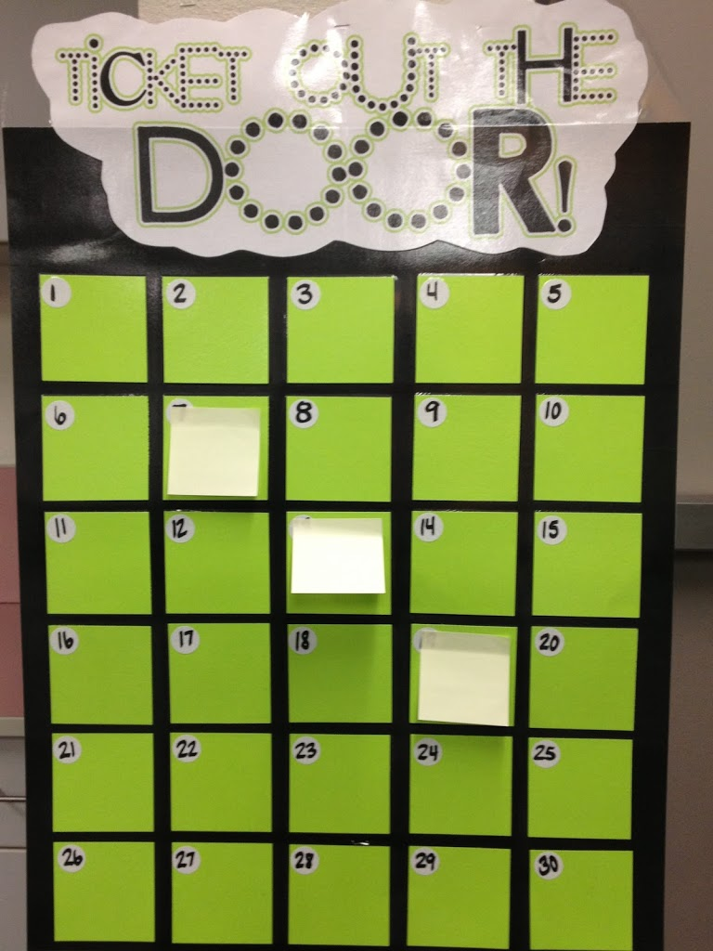
Exit tickets
A variety of ways they can be used.
Keep them simple, focused on the knowledge that was encoded.
Sticky notes- write the question on the board. Pupils write the answer and stick it to the board to check their understanding

Slide 56
Dylan William said “Cognitive load theory is the single most important thing teachers can know about”

Slide 57
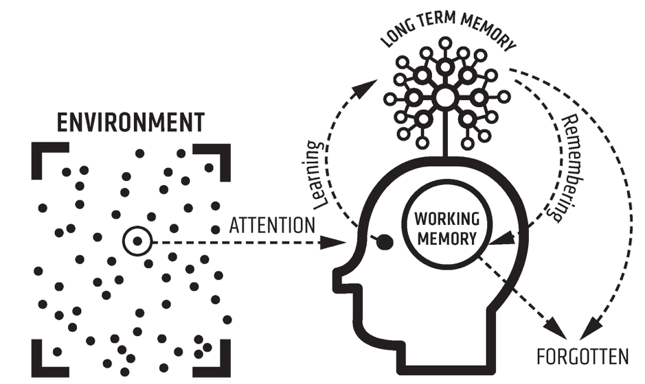
Intrinsic Load
Extraneous Load
Notes:
This is where we got to last time

Slide 58
Intrinsic Load
Extraneous Load
Notes:
This is where we got to last time

Slide 59
Intrinsic overload
SEN pupils find their working memory very easily overloaded.
Break content down into small precise chunks of knowledge
Share that learning intent and keep it visible all lesson.
Narrate the learning journey in the lesson

Slide 60
Explicit knowledge intent
The content you want to instruct needs to be explicit to the teacher via the curriculum and to the pupils.
In the curriculum it must be more than a learning objective. The specific knowledge you want to instruct must be clear.
If this knowledge isn't clear then this can lead to different interpretations by teachers leading to different outcomes across classes.

Slide 61
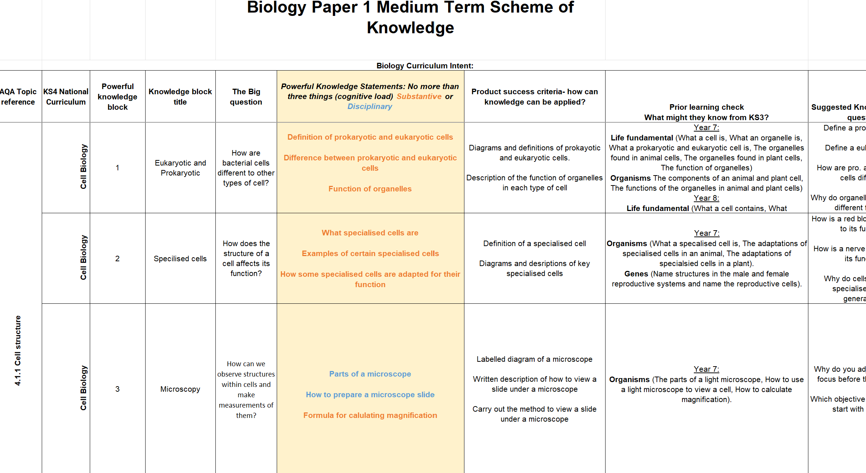
Specific knowledge intent in the curriculum

Slide 62
Specific knowledge intent in the classroom

Slide 63
New Knowledge
Currently Processing
Ready for Retrieval
What radioactive decay is
The three types of radioactive decay
The properties of each type of decay

Slide 64
New Knowledge
Currently Processing
Ready for Retrieval
What radioactive decay is
The three types of radioactive decay
The properties of each type of decay

Slide 65
New Knowledge
Currently Processing
Ready for Retrieval
What radioactive decay is
The three types of radioactive decay
The properties of each type of decay

Slide 66
New Knowledge
Currently Processing
Ready for Retrieval
What radioactive decay is
The three types of radioactive decay
The properties of each type of decay

Slide 67
New Knowledge
Currently Processing
Ready for Retrieval
What radioactive decay is
The three types of radioactive decay
The properties of each type of decay

Slide 68
New Knowledge
Currently Processing
Ready for Retrieval
What radioactive decay is
The three types of radioactive decay
The properties of each type of decay

Slide 69
New Knowledge
Currently Processing
Ready for Retrieval
What radioactive decay is
The three types of radioactive decay
The properties of each type of decay

Slide 70
Explicit knowledge intent
Sharing clear knowledge intent and the learning journey
For the pupils this segmenting of the lesson into knowledge chunks and then focusing on that specific chunk optimises the intrinsic load.
It also makes it clear what they must know at the end of this sequence so it aids metacognition in terms of assessing their own progress towards understanding
It aids formative assessment by the teacher in the class as only when you know exactly what knowledge you want them to know can you assess if that knowledge is secure.

Slide 71
Cornell Notes
Developed by Cornell University in 1950s as an effective model for note taking and organisation of thought and information.
Strong evidence base behind it
Leads to very clear and well structured note taking and aids metacognitive thought.
Books evolve to become pupil’s own knowledge organiser/ revision tool.
Can link to retrieval practice or as exit tickets

Slide 72
Cornell notes involves splitting the page into four sections.
The top of the page is the space for the learning intentions (Big question/LO
The main notes area is where general work is done, questions attempted diagrams are drawn.
The Key facts column This is where the key information is recorded. Facts , laws, equations. This isolates it from the main notes, making it focused and emphasises its importance
4. The summary section is left blank and returned to at a future date ( no sooner than two weeks). Or can be completed at the end of a learning sequence, e.g. answering the big question

Slide 73
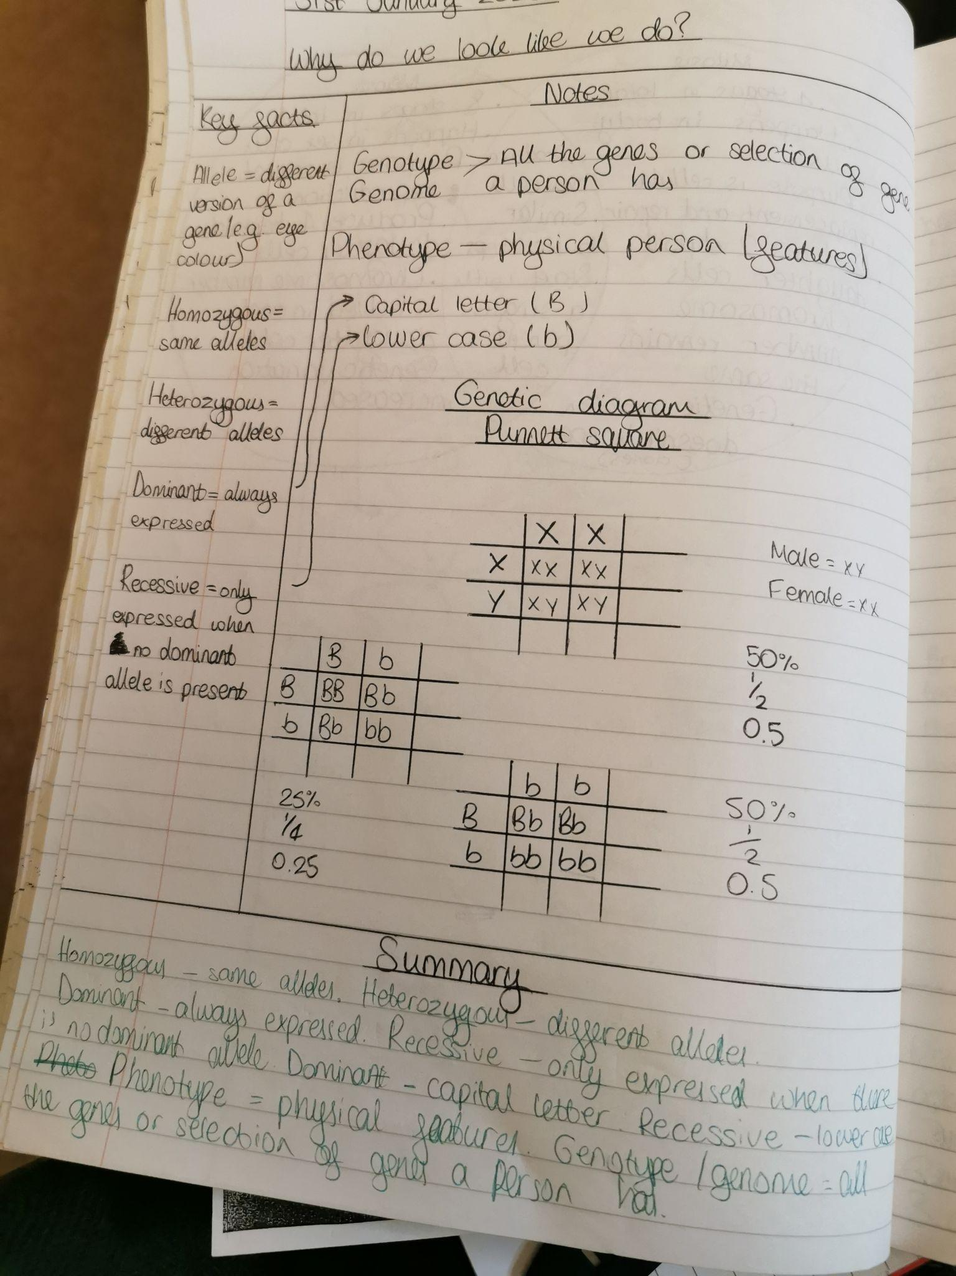
Example

Slide 74
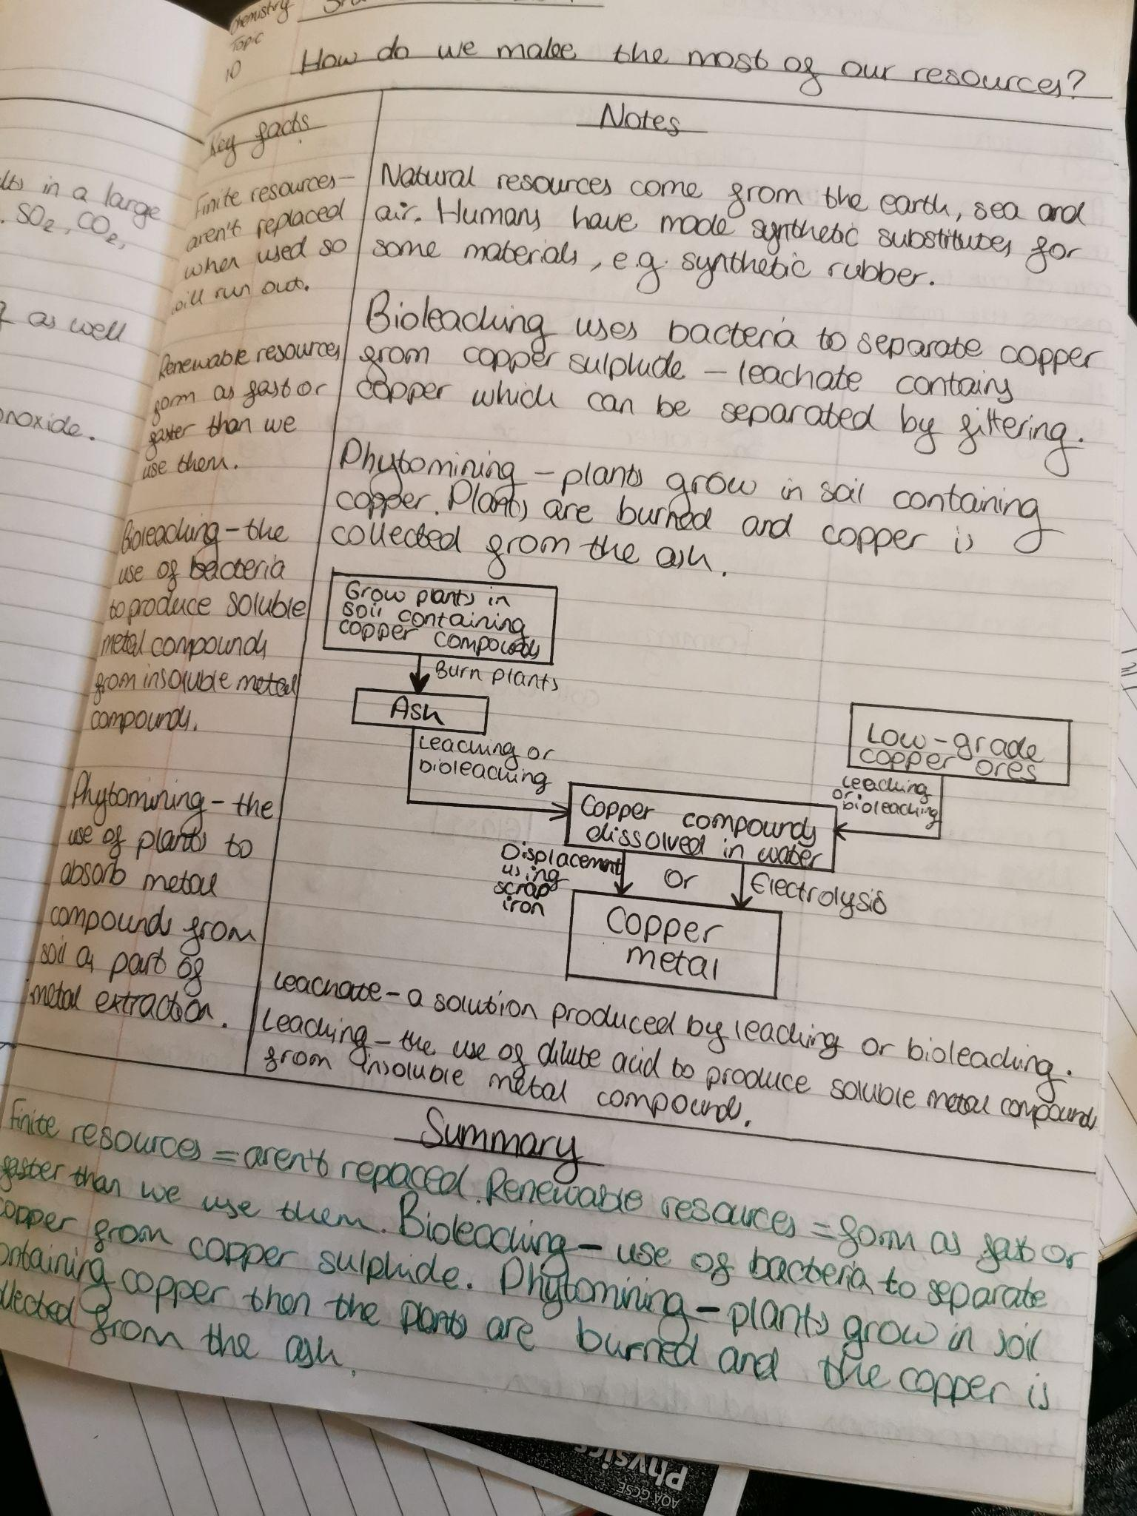
Example

Slide 75
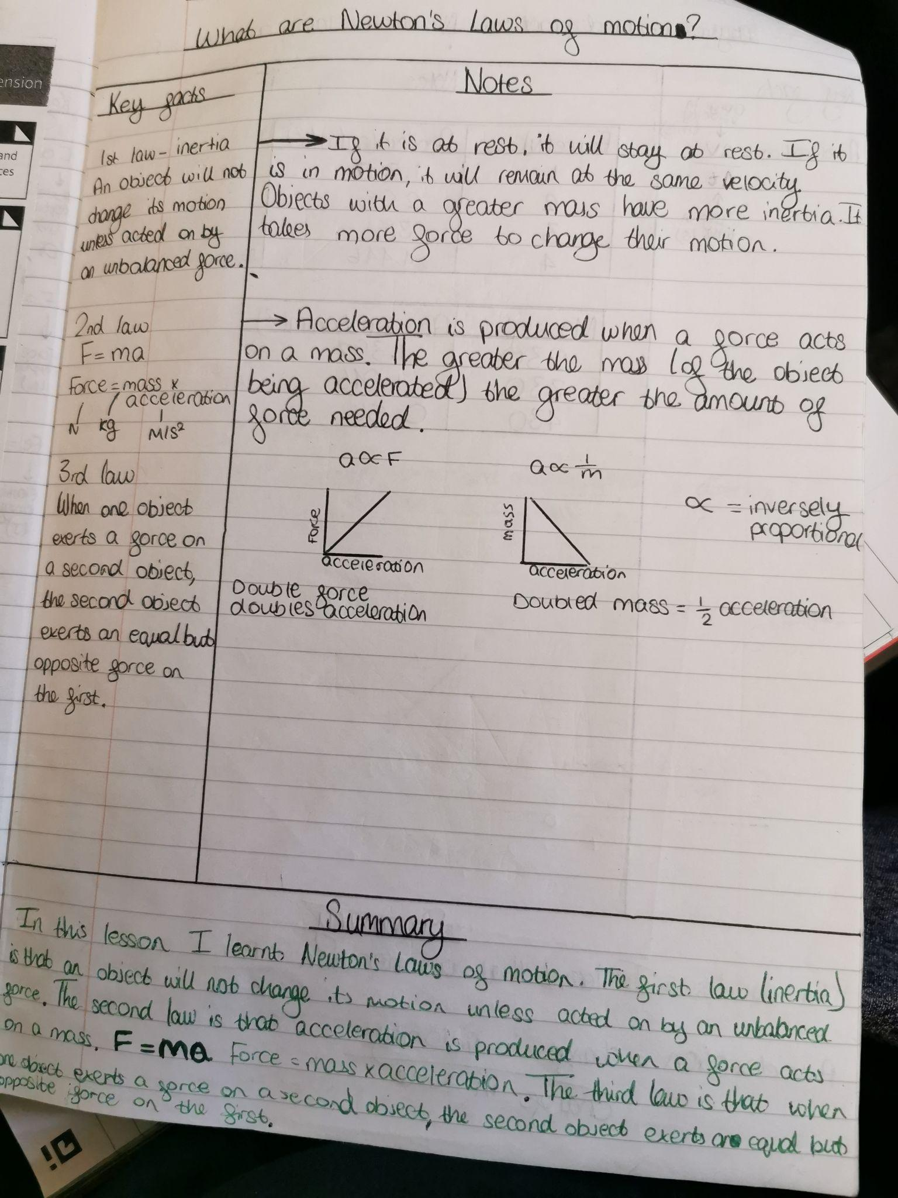
Example

Slide 76
How does direct instruction work?

Slide 77
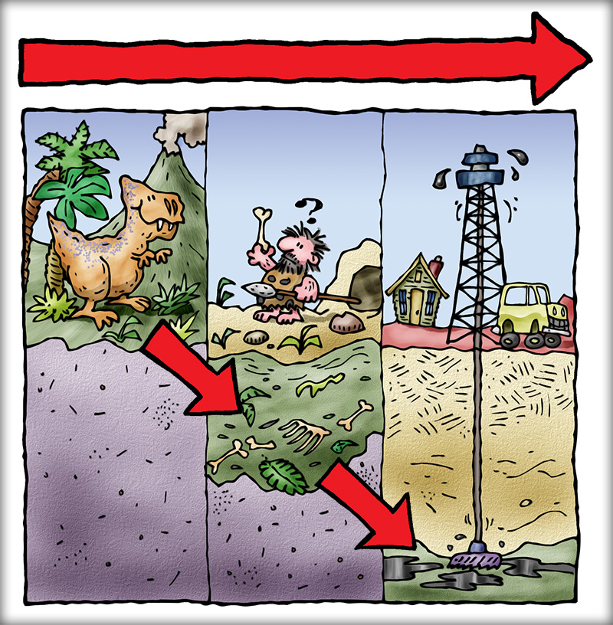
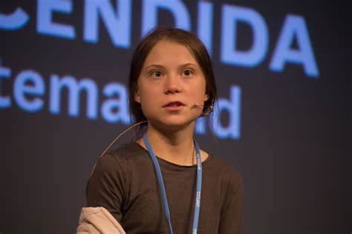
Adding to extraneous load
Examples of increasing extraneous load include during instruction:
Too many words on a PowerPoint slide
Excessive PowerPoint animations
The teacher talking about something else whilst students do a task
Repeating written down instructions orally (this can create redundancy as people read and listen at different speeds)
Split attention effect- presenting information that takes working memory resources away from intrinsic load

Slide 78
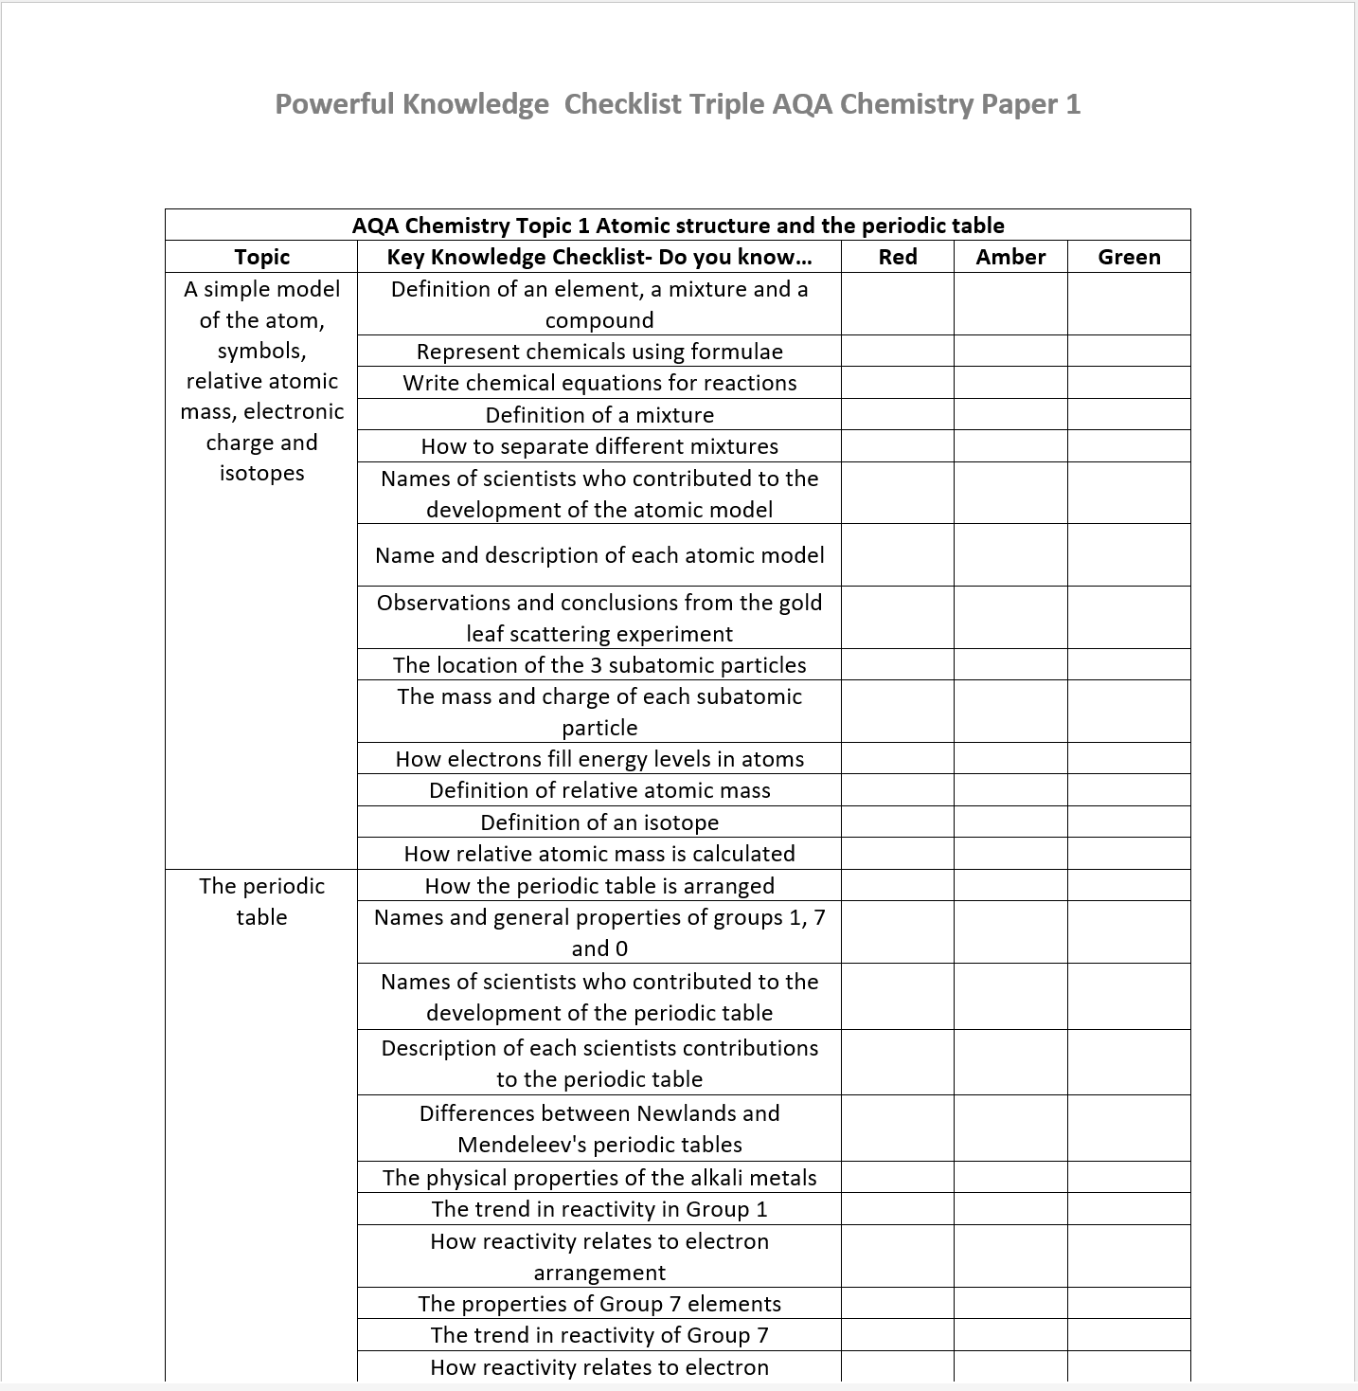
Metacognition
Give pupils regular opportunities to review and evaluate their knowledge and understanding.
Summary boxes in Cornell notes or knowledge checklists that are reviewed and revisited regularly.

Slide 80
Dual coding combined with Cornell notes provides opportunities for scaffolding.
The I do we do you do approach for guided and independent practice provides scaffolding and developmental support for SEND pupils.
Provide Practice materials (SLOP) with worked examples and half complete answers and slowly reduce this support until fully independent.

Slide 81
When teaching is strong the teacher is viewed as the expert in the room.
Scaffolding comes from the guidance and explanations the teacher provides.
Explicitly showing how an expert attempts problems. This links with the I do, we do approach but applies to any problem or question or activity you want pupils to do (ultimately independently)

Slide 83
When carrying out the we do part of guided practice you will be providing opportunities to assess the pupils development towards the ability to do independent practice.
There will be some who require further time on the we do phase.
This is where you can bring those together to work with them, delivering further more focused instruction but the aim must be to get them to re-join the flow of the lesson. Isolating groups for too long and too often is not helpful for their progress and self belief.

Slide 85
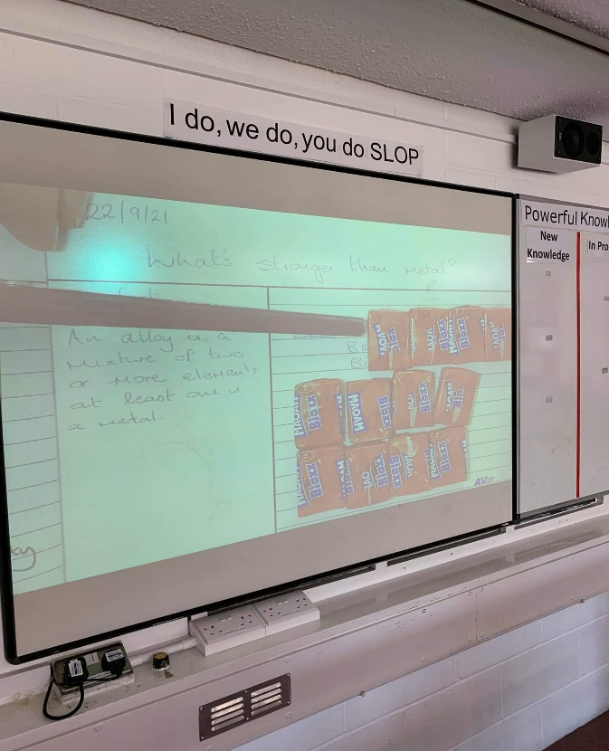
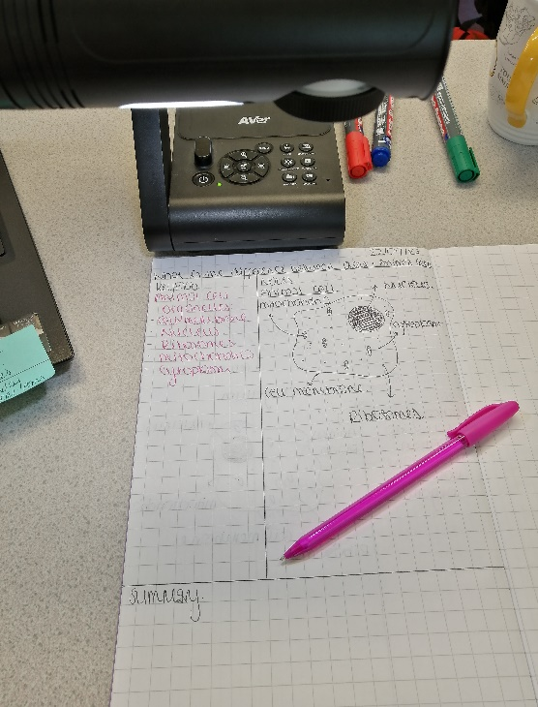
Visualisers are a powerful tool for many areas of instruction but in particular for SEN pupils. Using the Cornell notes structure to model note taking supports them in this.

