Slide 1
Heads of Science Network Meeting
2023/2024- Summer 1
23/5/24
Kev Neil
Science

Slide 2
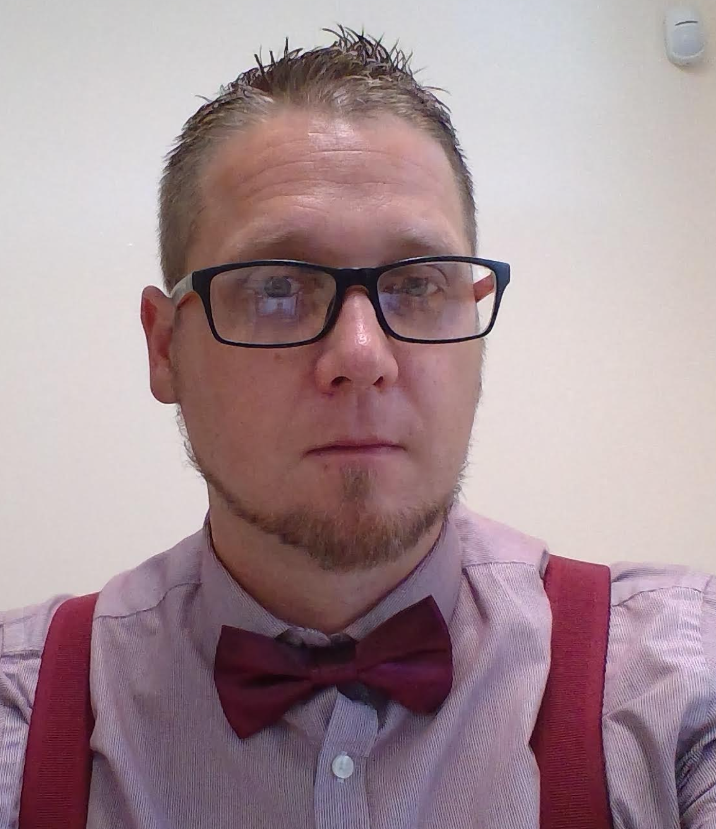
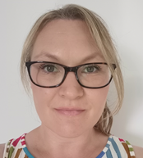
Welcome
The HIAS Science Team:
Kevin Neil
(County Science Inspector/Adviser)
Radiation Protection Officer
kevin.neil@hants.gov.uk
Emma Cooper (General Inspector/Advisor for Science)
emma.cooper3@hants.gov.uk

Slide 3
HIAS on Twitter
@HIAS_today
@Mrneil1859
@emmahantsprisci

Slide 4
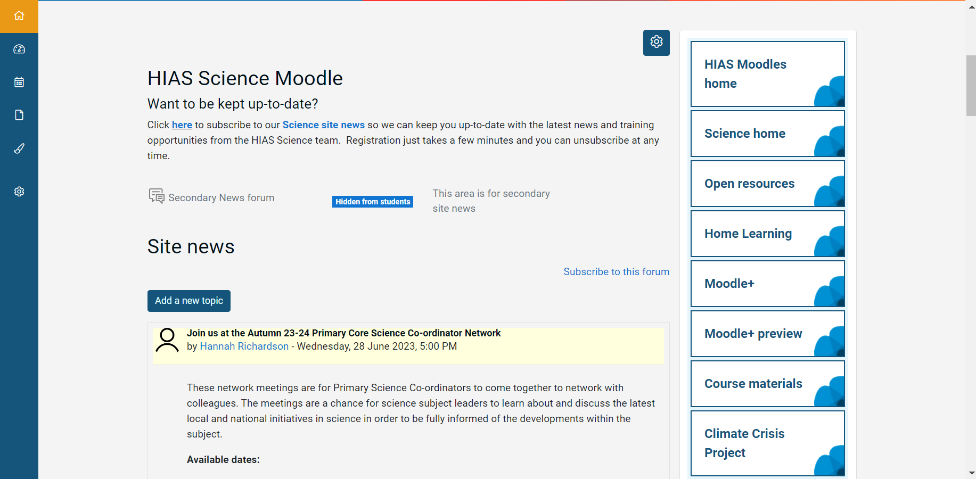

Slide 5
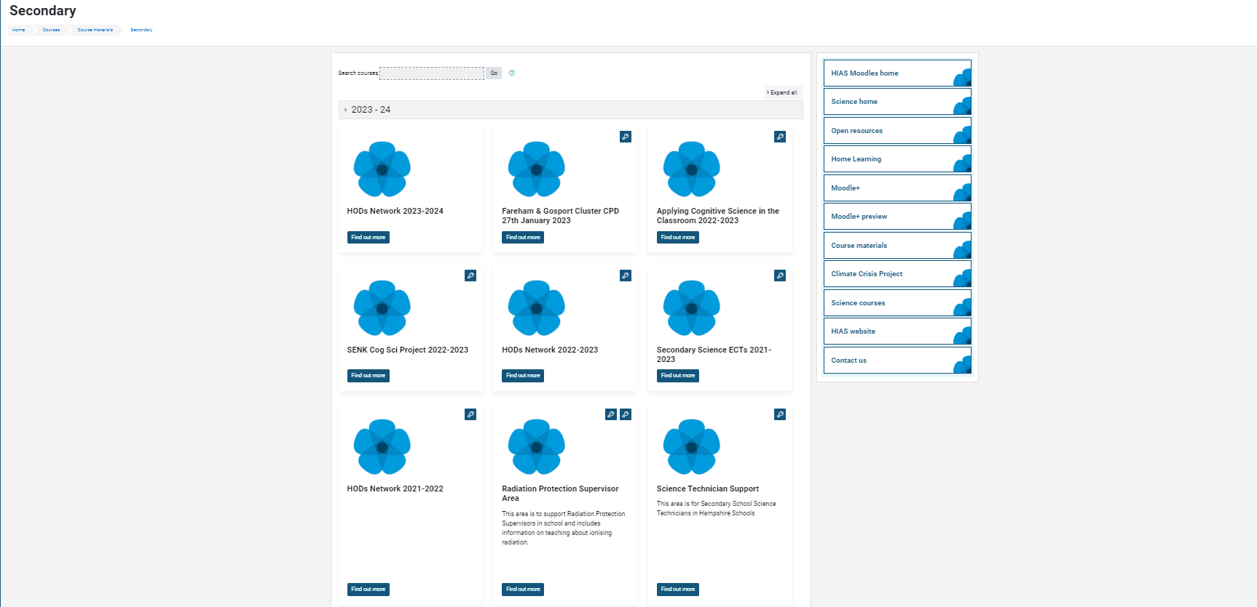

Slide 6
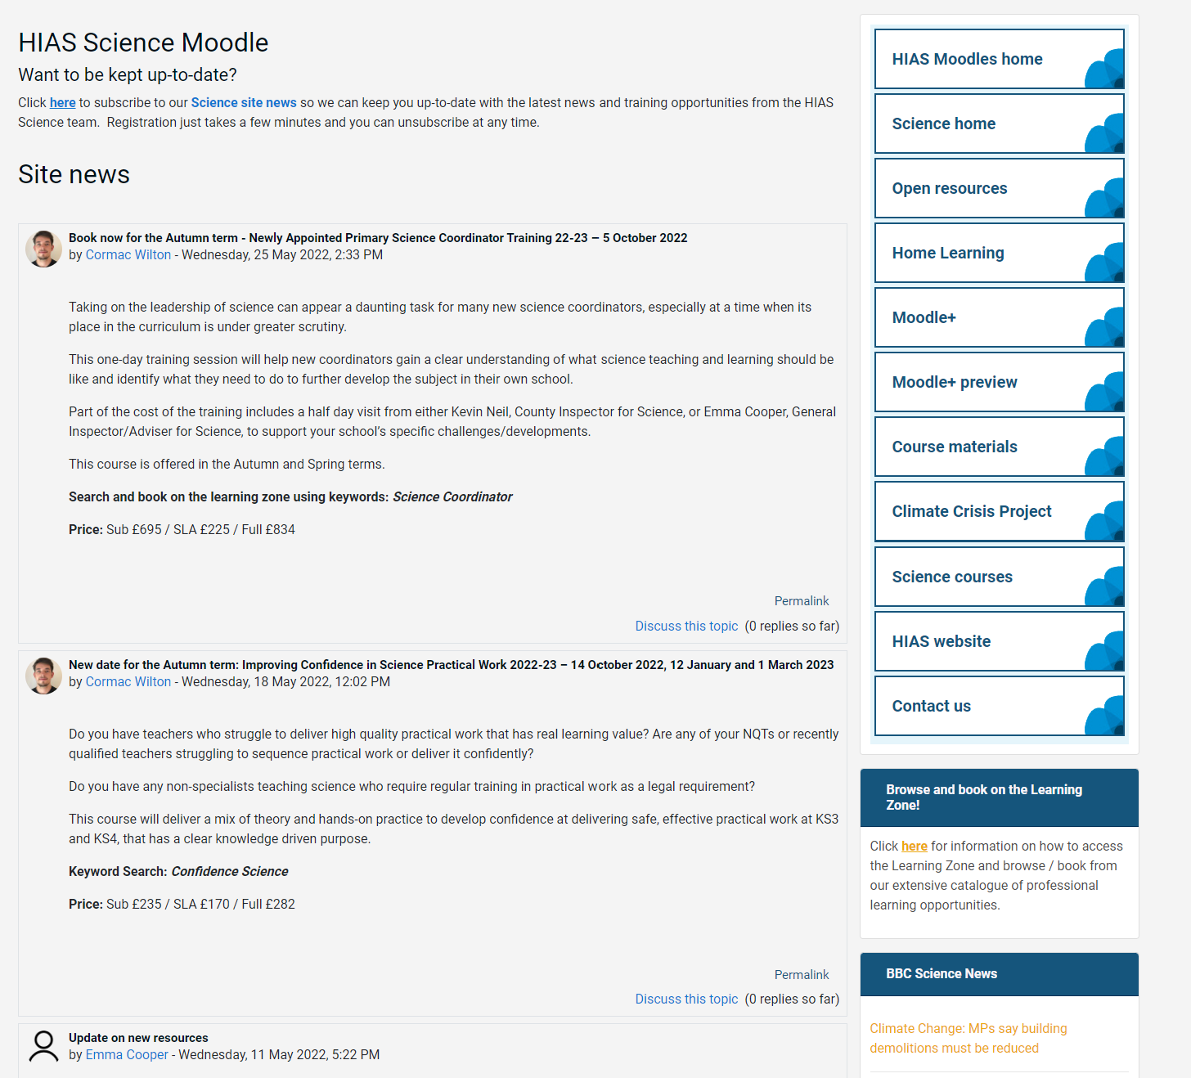
resources in the open access site.
Notes:
Kevin, I updated this slide- Emma

Slide 7
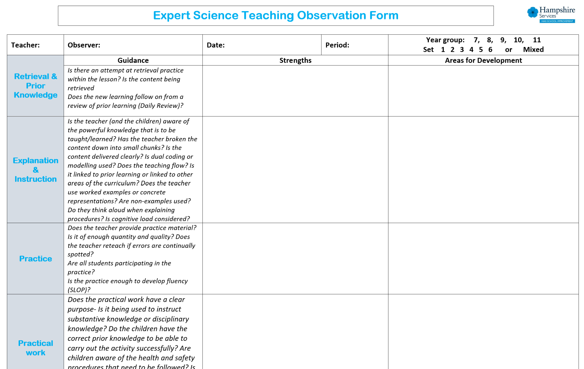
Notes:
Kevin, I updated this slide- Emma

Slide 9
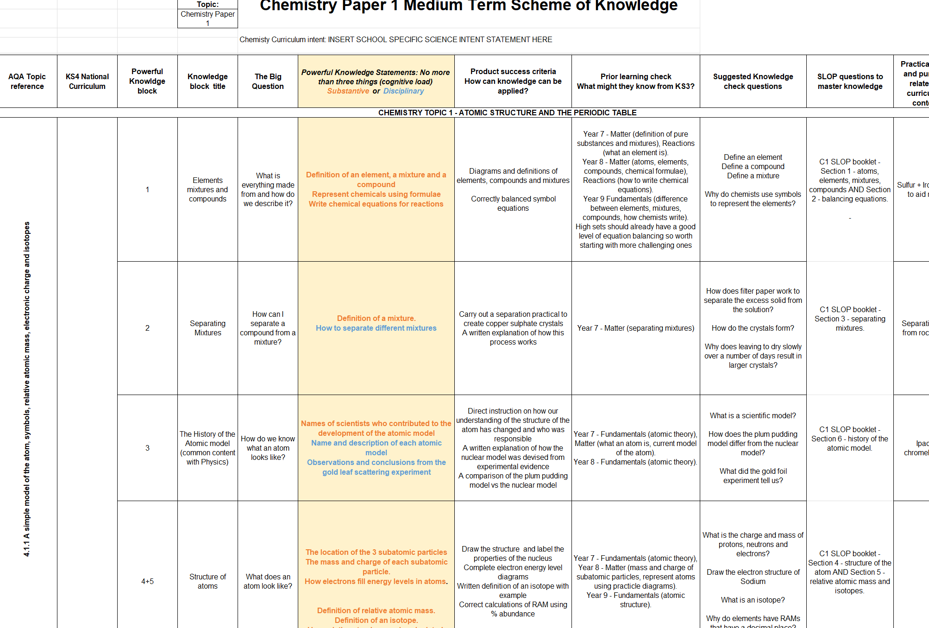

Slide 10
New resources uploaded into the open access site. SLOP booklets, learning walk proforma for expert teaching.
New Moodle+ resources
Notes:
Kevin, I updated this slide- Emma

Slide 11
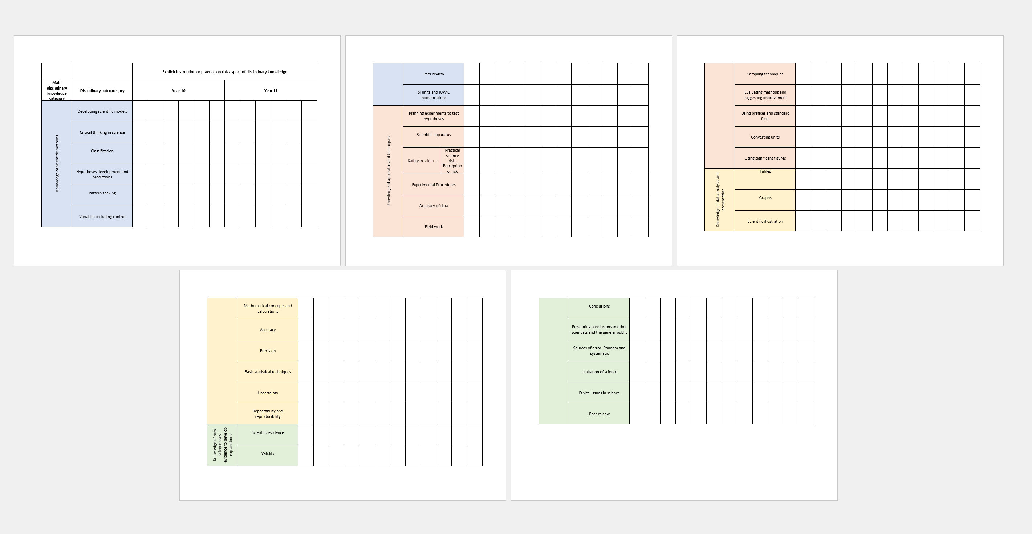
Tracking disciplinary knowledge instruction across KS3 & 4

Slide 12
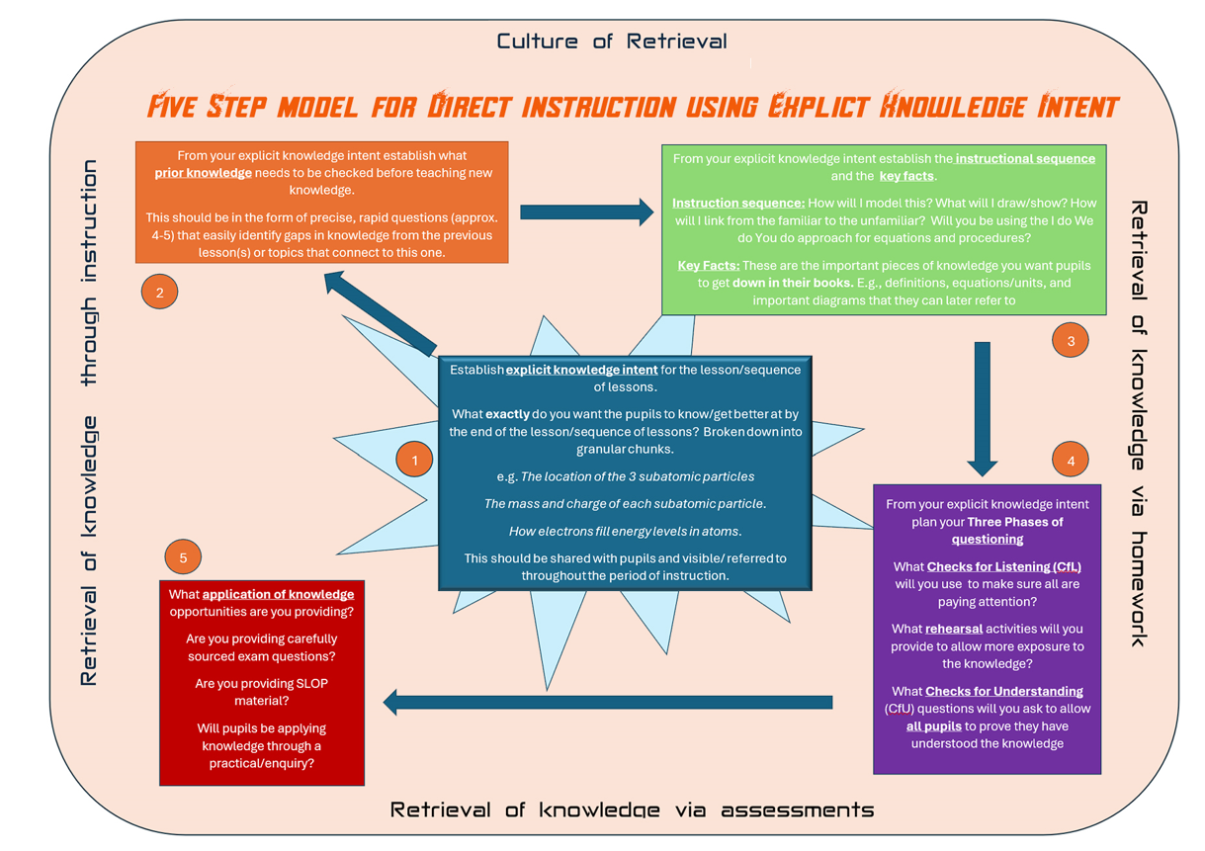
5 Steps for Expert Science Teaching

Slide 13
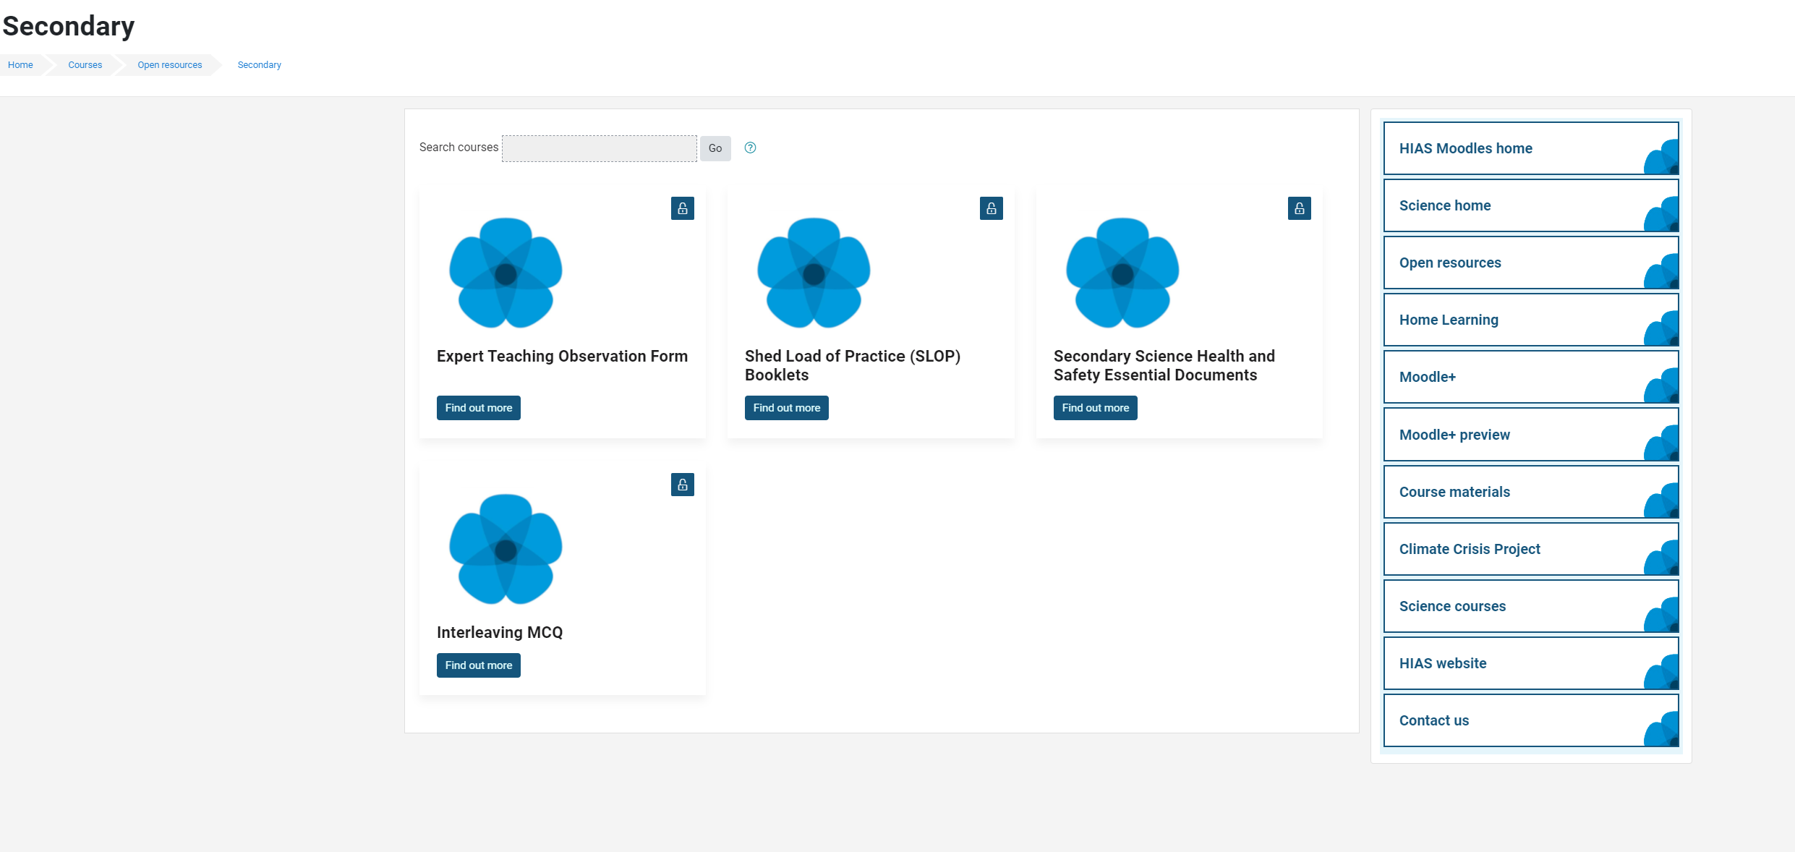
Updated Safety in Secondary Science documents

Slide 14
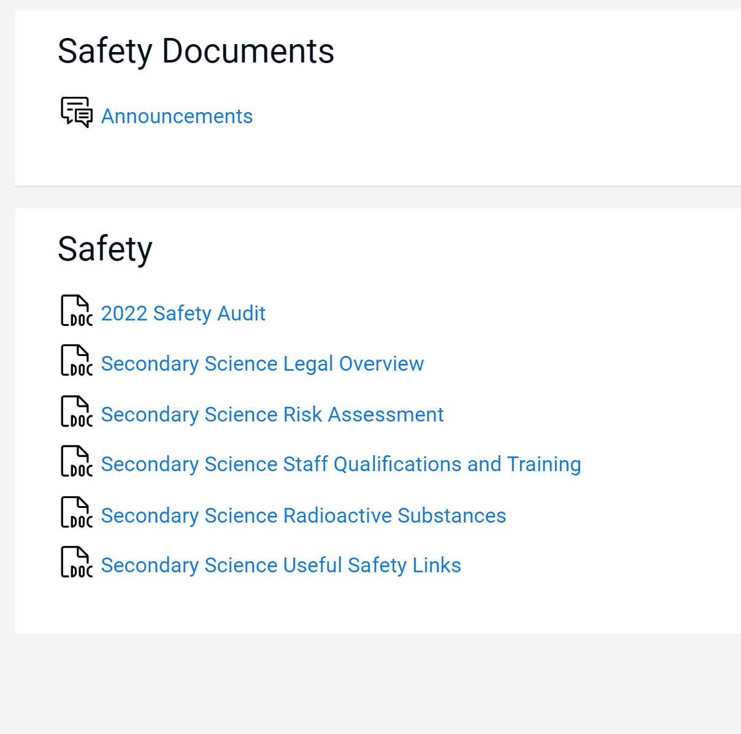
Updated Essential Safety in Secondary Science documents

Slide 15
Agenda for this afternoon
Catch up- Sharing positives and challenges
Science updates
Risk assessments procedures for all science teachers
Year 11 Exams so far- Discussion
Year 11 24/25 planning ahead
Oracy in science
Steering group update- BCM
AOB
Notes:
Welcome back- Share course details with new sci-cos
Open discussion for 5 minutes to share the good things that have been happening
Ofsted review paper for science-learning journeys link- Who has read this? What did you think? Share key points- discuss. …’ majority no. of primary schools- reduced amount of curriculum time to teach science which led to a narrowing of the curriculum.’
Unpick the reason for the remodel and explain their importance in this first draft

Slide 16
Catch up
Welcome back.
Share some positives from the term so far.
What have been the challenges of the term so far?
Try not to talk about year 11 issues. We will share these later..

Slide 17
Science updates

Slide 18
Updates for RPS and Radioactive sources
The HSE is continuing to do inspections this term and into the summer so making sure your sources, storage and paperwork are up to date is vital.
New edition of L093 published end of February. When you receive an email with a request for a visit, we will send you an inventory document that you need to fill in and send back to us. We will keep this on file. If your inventory changes you will need to send us a new one of these, not a new FORM 1. Form 1 is only used when first joining the RPO scheme.

Slide 19
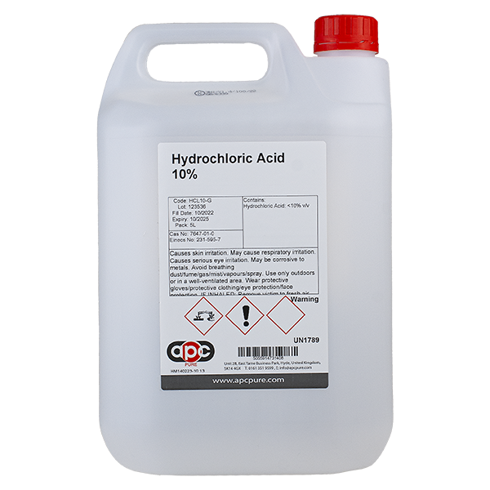
Incidents
A school in Hampshire recently had an incident where a technician accidently poured a large container of HCl all over her head and torso.
Upon investigation the storage of these chemicals was not correct and this along with poor quality containers led to this accident. Please ensure that chemical storage conforms to CLEAPSS Laboratory Handbook Section 7 requirements .

Slide 20
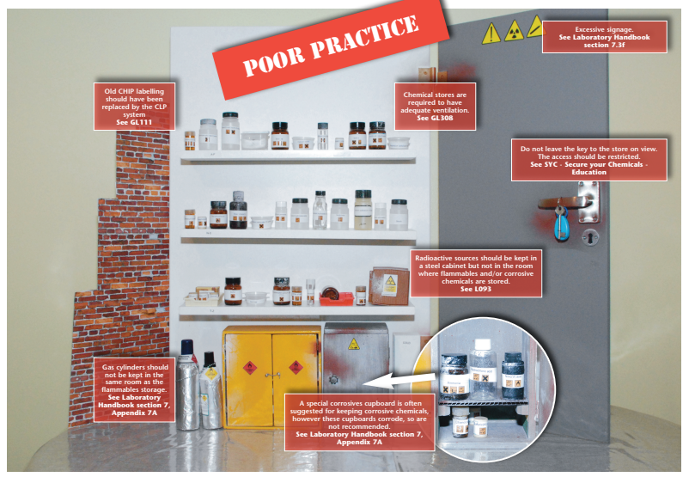
Incidents

Slide 21
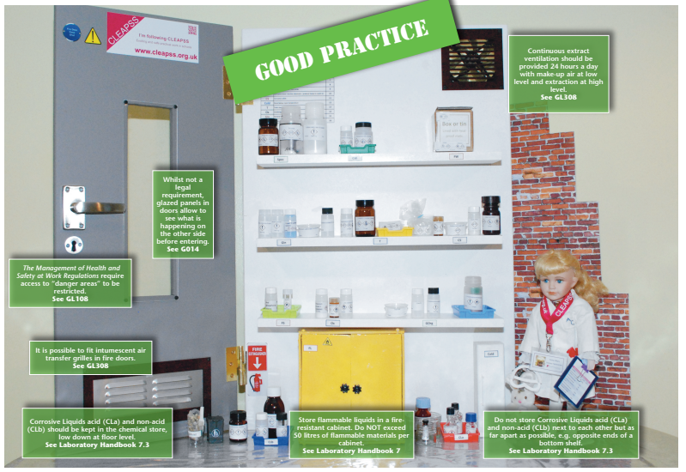
Incidents
Search for chemical store poster on CLEAPSS

Slide 22
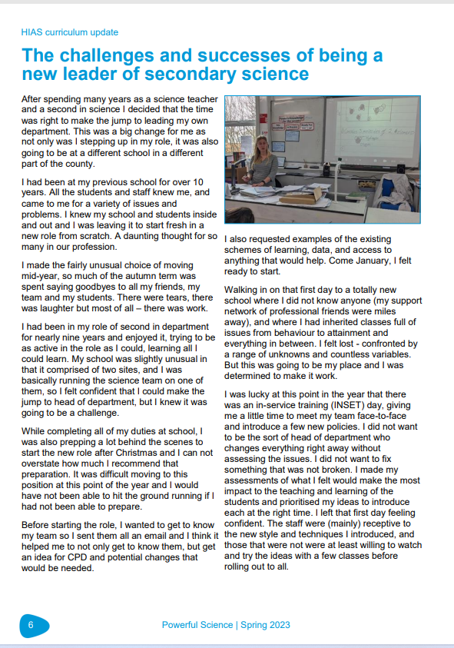
Powerful Science magazine

Slide 23
Powerful Science magazine
Rowhill School
Greenwood School
Alderwood School
The Westgate School
The Toynbee School
The Hamble School
The Hayling College
Swanmore College of Technology
Aldworth Science College
Crookhorn College
Horndean Technology College
Henry Beaufort School
The Vyne Community School
Crestwood Community School
The Wavell School
The Henry Cort Community College
Kings' School
Park Community School
Warblington School
Testbourne Community School
Applemore College
Osborne School
Prospect School
Oak Lodge School
The Mark Way School
Hollywater School
Brookfield Community School and Language
Spring edition out now
Secondary articles include:
High quality use of exam questions in lessons at Swanmore College
KS3 assessment
AI tools

Slide 24
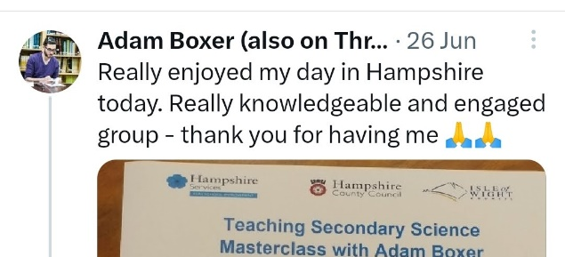
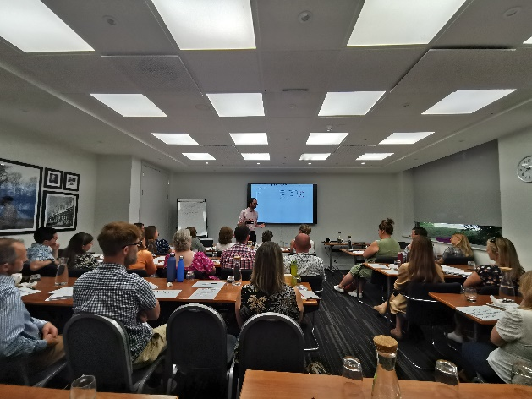
Adam will be back next year
Now bookable on the Learning Zone
Monday 24th June 2024
Full day of CPD on the chapters of his best-selling book- Teaching Secondary Science. A Complete Guide.

Slide 25
Risk assessment procedures for all teachers

Slide 26
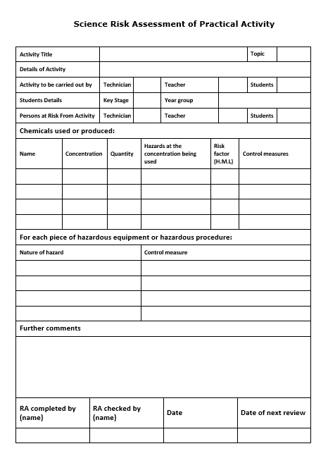
Risk assessments procedures
Most common issue in H&S inspections.
More important than ever in world of non-specialists, worsening behaviour and SEN needs.
What is required by all teachers?

Slide 27
Risk assessments procedures
All departments should have full risk assessments for the practical's in their schemes of work. These are best stored in a regularly visited place- e.g. SOL, lesson plans , shared PPT resources
These can be supplied, e.g. from CLEAPSS or AQA if the HOD approves that they are of the expected standard.
These should be easily accessible and frequently visited and used. HOD is responsible for monitoring of this

Slide 28
Risk assessments procedures
CLEAPPS doesn’t think that most of the risk assessment advice supplied by resource packs e.g. Kerboodle is good enough but it’s ultimately up to the HOD to decide if what supplied is comprehensive and appropriate enough
These should be easily accessible and frequently used.

Slide 29
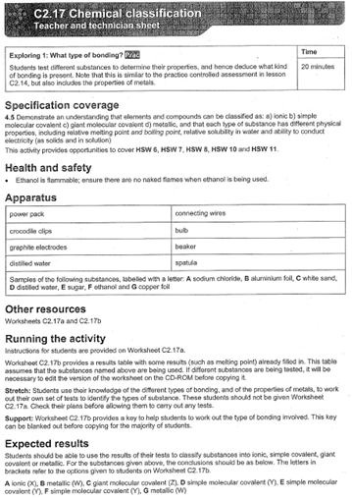
Risk assessments procedures
CLEAPPS doesn’t think that most of the risk assessment advice supplied by resource packs e.g. Kerboodle is good enough but it’s ultimately up to the HOD to decide if what supplied is comprehensive and appropriate enough
These should be easily accessible and frequently used.

Slide 30
Risk assessments procedures
Teachers are required to read the risk assessment in advance of completing the experiment.
If no risk assessment exists, then one must be created for the planned experiment and then approved by the Head of Department, this also applies if the experiment is modified any way from what the original risk assessment covers).

Slide 31
Risk assessments procedures
However, this is not all that is required.
The key part of the process is that teachers should make personalised additions to this risk assessment based upon the specific class (and classroom) the practical is for.
This should be done in their teacher planner or on a printed copy of risk assessment
It must be visible throughout the duration of the activity.

Slide 32
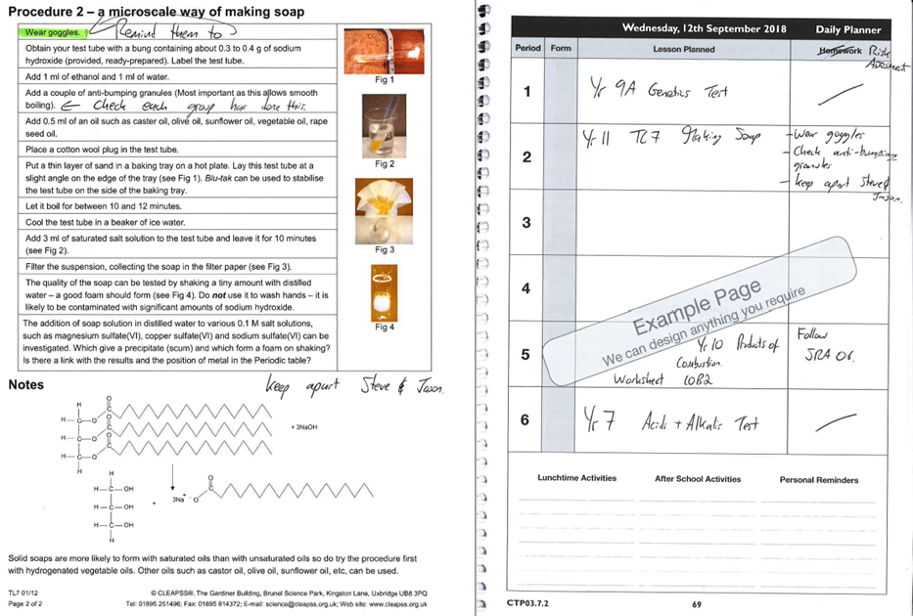
Risk assessments procedures
However, this is not all that is required.
The key part is that teachers should make personalised addtions to this risk assessment based upon the specific class (and classroom) the practical is for.
This should be done in their teacher planner or on a printed copy of risk assessment
It must be visible throughout the duration of the activity.

Slide 33
Support with H&S
HIAS Science can support you with safe and effective practical work.
Health and Safety Inspection and advice visits.
Confidence in practical science CPD package

Slide 34
Year 11 GCSE Exams

Slide 35
Year 11 exams so far
Paper 1 exams are now behind us.
In groups:
How have they gone?
How have pupils responded to them?
How are you planning on maintaining enthusiasm after half term?
Did anyone use predicted papers? How close have they been?
We will come back together to share with the wider group

Slide 36
Year 11 24/25 planning ahead

Slide 37
Year 11 24/25
Early intervention and strategy development is key driver for success.
In groups discuss how you are thinking ahead regarding the current year 10:
When is your year 10 mock? What are you including in this? How will you use this data?
What early interventions can you put in place for specific groups or individuals?

Slide 38
Year 11 24/25
Some actions to consider if you haven’t already…………

Slide 39
Year 11 24/25

Slide 40
Oracy in science

Slide 41
How do we get pupils talking more…..
“Reading and writing float on a sea of talk” James Britton
Oracy is vital to high quality learning and retention.
Since the pandemic there has been a significant decrease in the oracy levels of younger children, particularly disadvantaged pupils

Slide 42
How do we get pupils talking more…..
Great teaching involves many areas:
High quality instruction from an expert
Linking to pre-existing knowledge
Scaffolding complex tasks and processes
Adaptive approaches
Opportunities to consolidate and apply knowledge
But pupils need lots of opportunities to talk throughout this process.
We need to interleave phases of dialogic teaching with our authoritative teaching to ensure this is regularly happening.

Slide 43
How do we get pupils talking more…..
In your groups share what strategies you/your team already use to aid the development of oracy/scientific oracy. We will come back together to share ideas…..

Slide 44
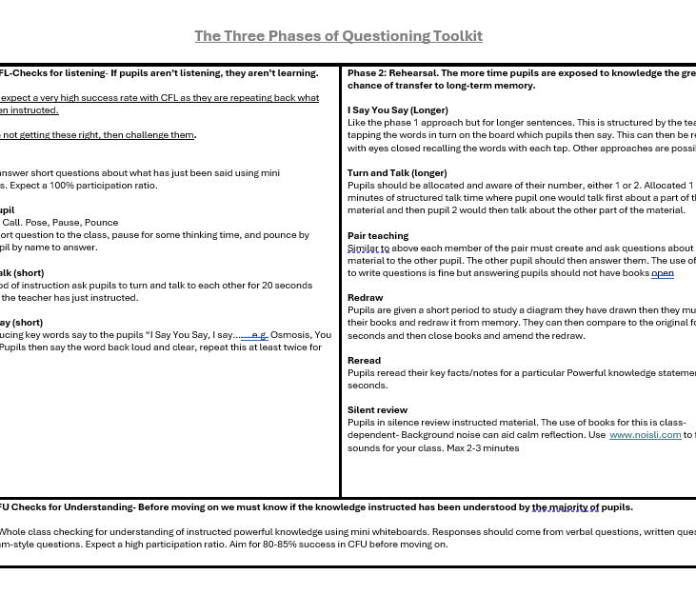
How do we get pupils talking more…..
I have been developing my Five Steps model a lot this past term and a half to integrate high quality oracy approaches into the steps from research and best practice seen. Especially into the three phases of questioning section with lots of opportunities for pupils to talk and rehearsal key words and knowledge.
One school who have fully adopted the five-steps model will be sharing more on this at the meeting in July.

Slide 45
Steering Group Focus

Slide 46
Steering Group Focus: Dual coding and blank canvas modelling
HIAS Science Steering group
Wanted to have one area which was a repeated focus for a period.
Dual coding and blank canvas modelling was requested to be the first.

Slide 47
Steering Group Focus: Dual coding and blank canvas modelling
Discuss, try, review
HIAS Science Moodle
Course Materials
Secondary
HODs Network 2023-2024
Section of the chapter on Dual Coding and BCM

Slide 48
Steering Group Focus: Dual coding and Blank canvas modelling
Discuss, try, review
Have a go if you are interested.
Members of the steering group will continue to be sharing at the next face to face meeting in July we will review and discuss some more.

Slide 49
Book of the Term
A promising book discussing the reasons why learning can often fail even with great curriculums and great teachers.
Presents eight different reasons for failure of learning and whys to combat them.
My half term reading

Slide 50
In School CPD offer
Delivered in your own school at times that suit you and your team.
Bespoke to your needs
Flexible timings-afterschool, inset days, etc.
Coaching model also available.
Email me directly to enquire
further about these or to book.
I now have better clarity over what exactly to teach and checking for understanding. I have some new strategies to use including the visualiser .
My own practice has improved, and I have more confidence. Kevin invites you to try something, explains the rationale, models it, live coaches you, then is there to ask questions as you dissect your experience
Wish I had had this intelligent mentoring in 2004
Thanks, just thanks!
Thanks, just thanks!

Slide 51
Adam will be back next year
Now bookable on the Learning Zone
Monday 24th June 2024
Teaching Secondary Science. A Complete Guide.

Slide 52
AOB

Slide 53
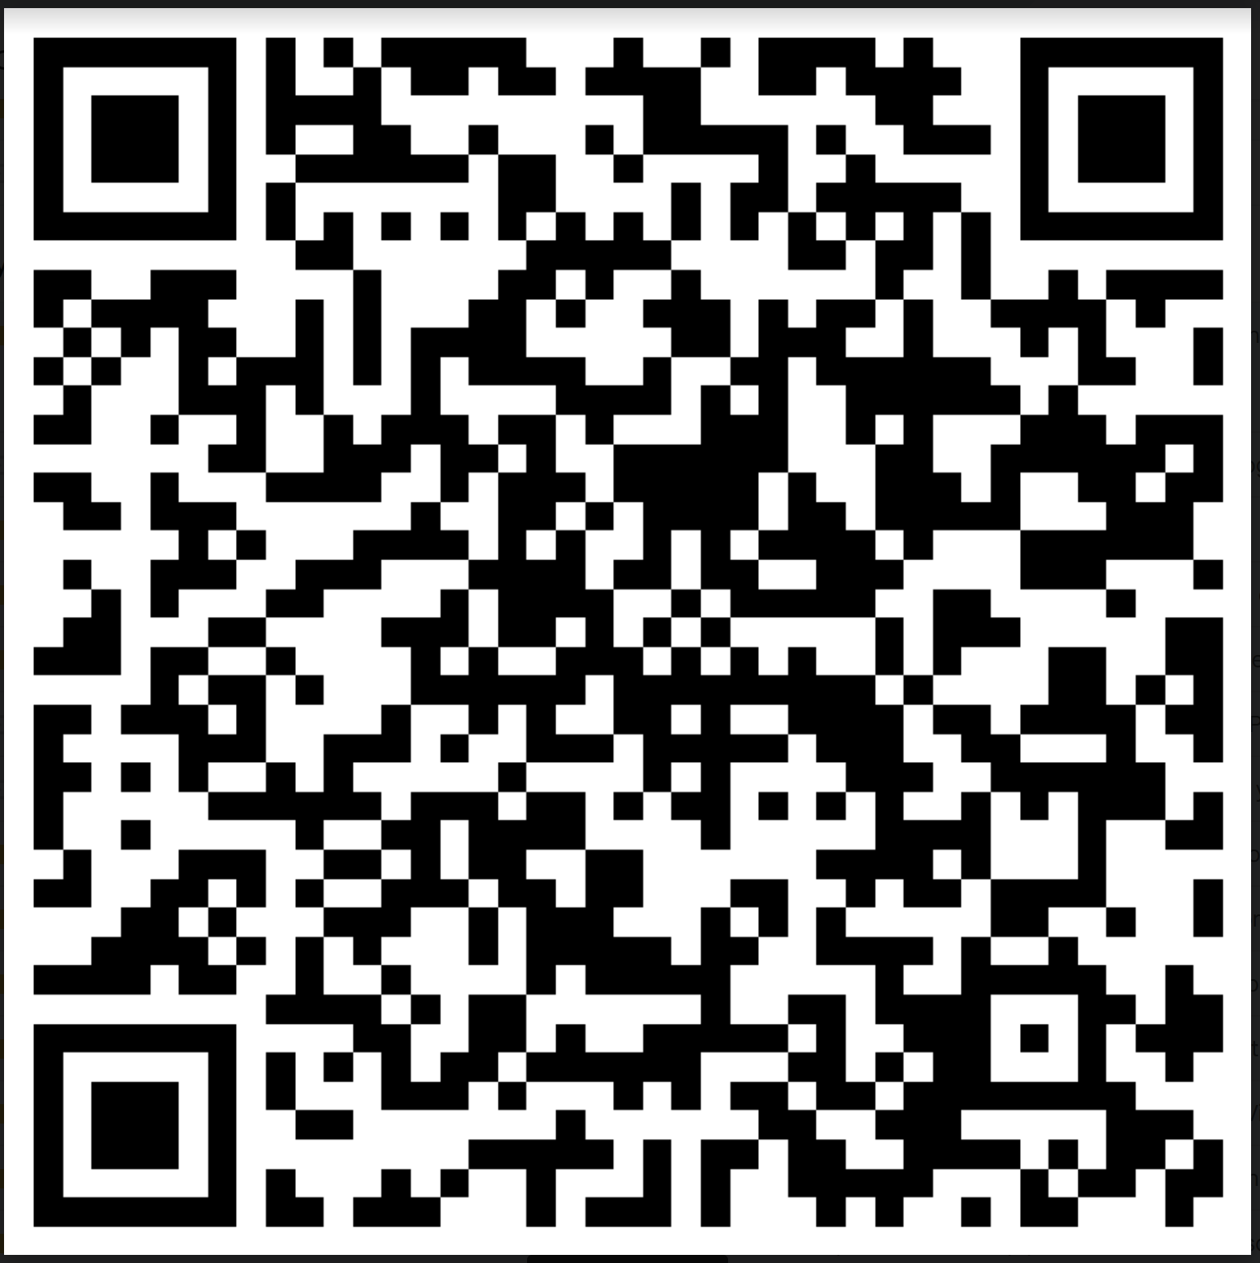
Thank you
Have a great half term break.
I hope the rest of the exam season is positive for you and your pupils.
Summer is coming!
See you face to face on 4th of July.
1.30pm New Life Church, Stanmore,
Winchester
Please complete the feedback form for this session
All 24/25 network sessions now bookable on
Learning Zone

