Slide 1
Heads of Science Network Meeting
2023/2024- Summer 2
04/7/24
Kev Neil
Science

Slide 2
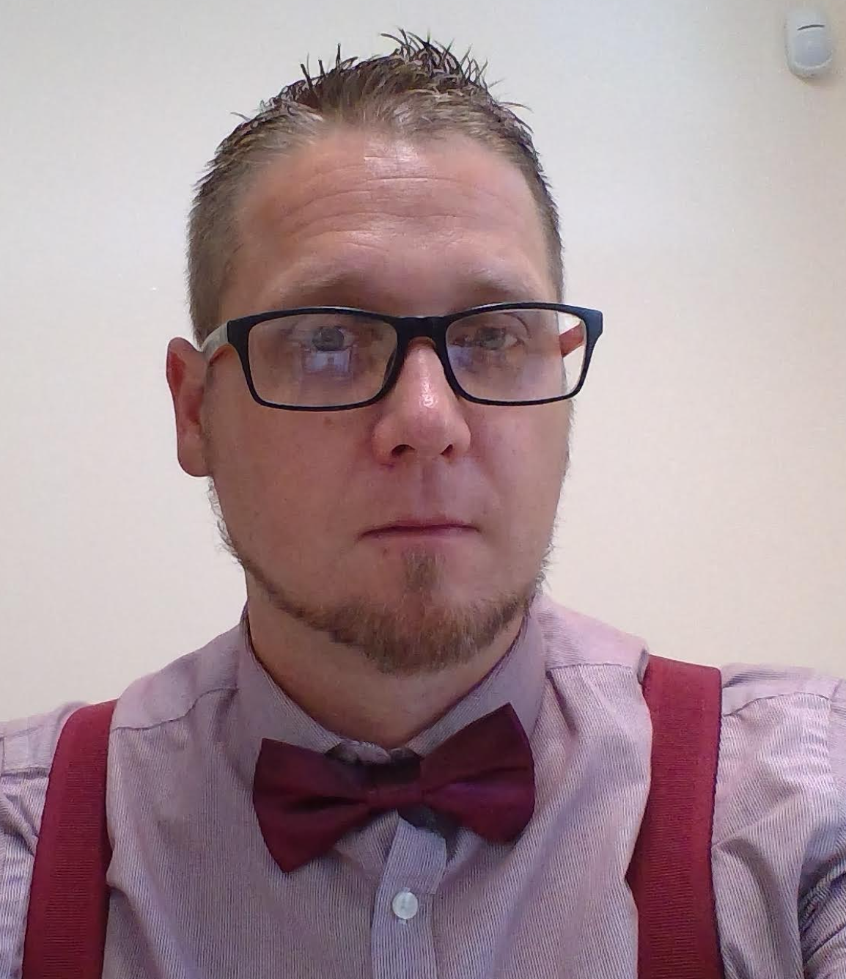
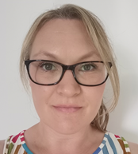
Welcome
The HIAS Science Team:
Kevin Neil
(County Science Inspector/Adviser)
Radiation Protection Officer
kevin.neil@hants.gov.uk
Emma Cooper (General Inspector/Advisor for Science)
emma.cooper3@hants.gov.uk

Slide 3
HIAS on Twitter
@HIAS_today
@Mrneil1859
@emmahantsprisci

Slide 4
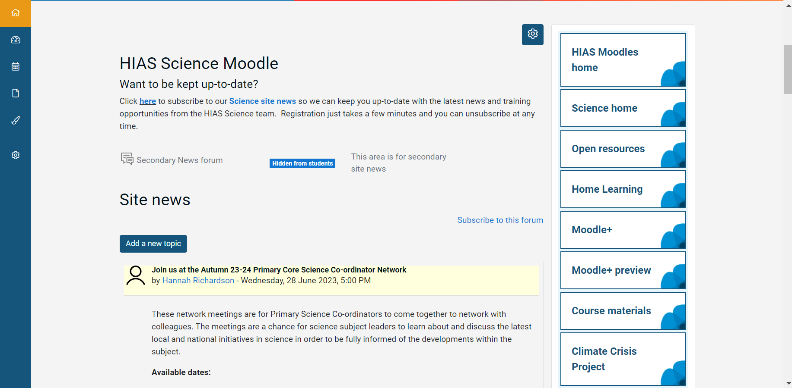

Slide 5
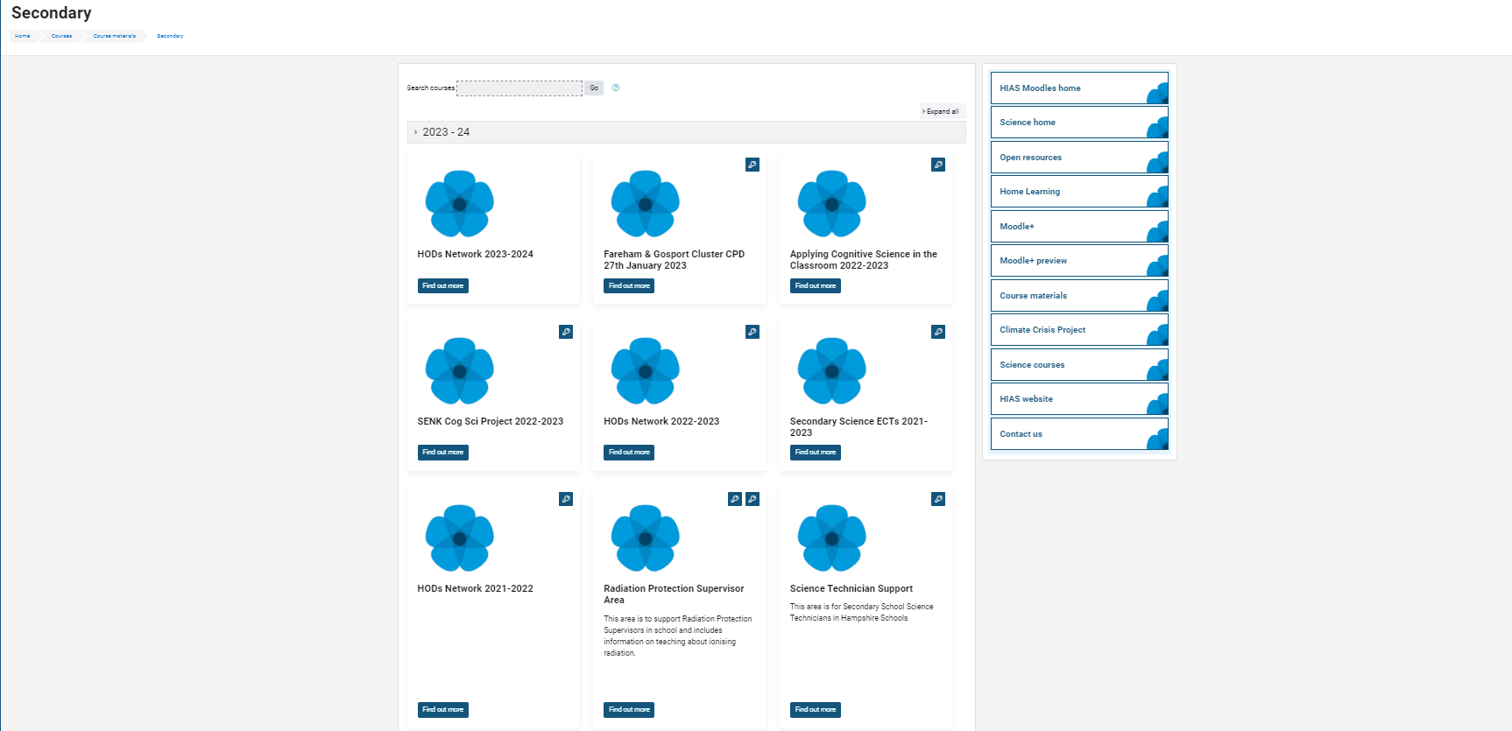

Slide 6
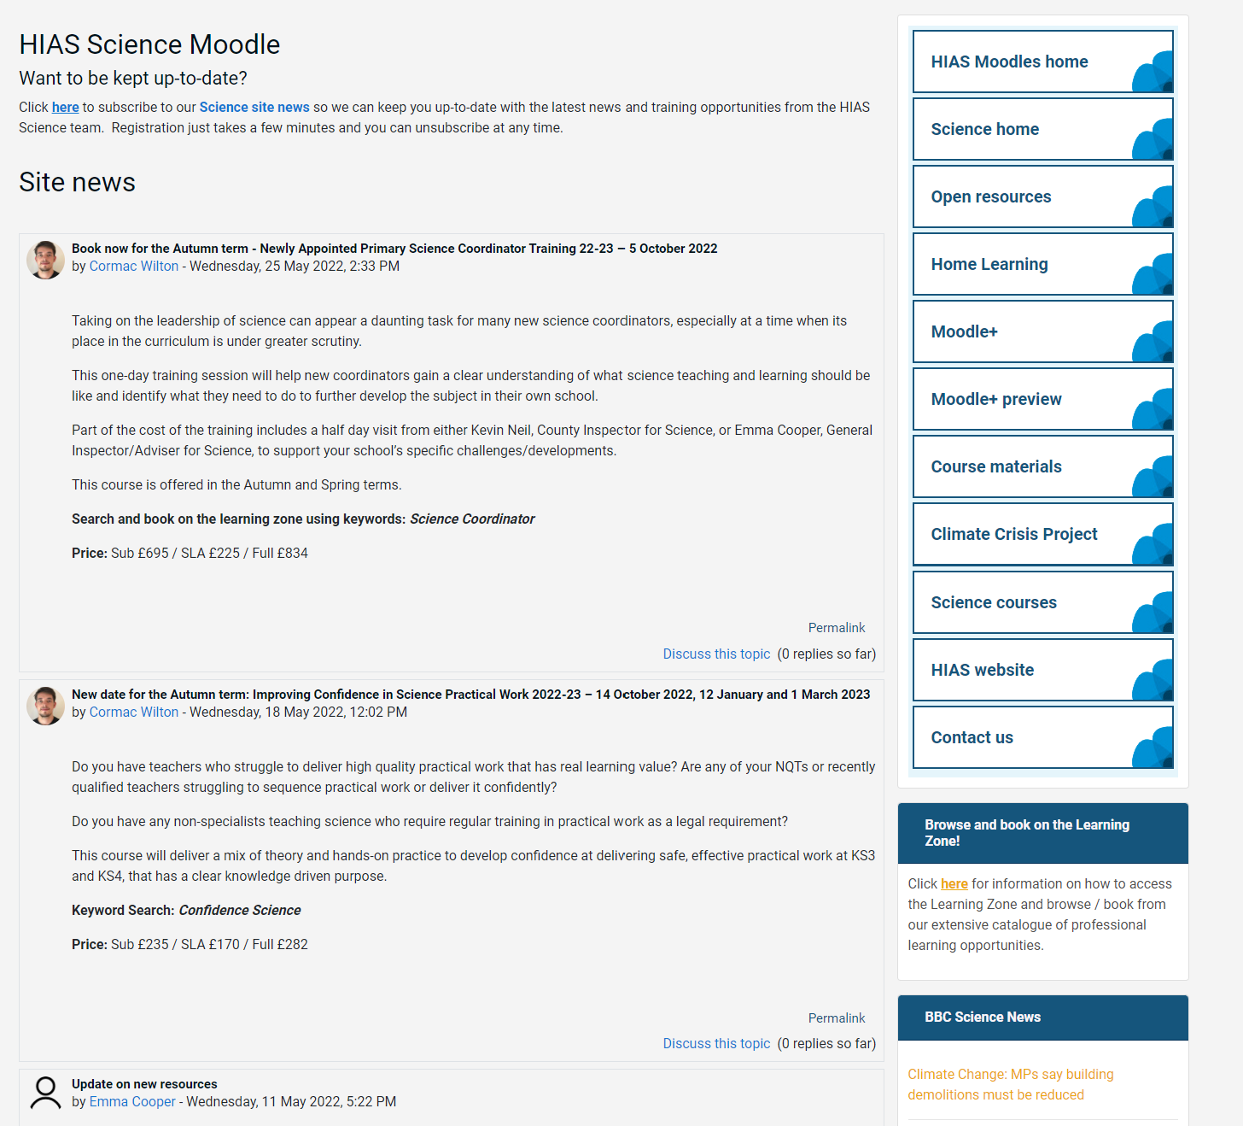
resources in the open access site.
Notes:
Kevin, I updated this slide- Emma

Slide 7
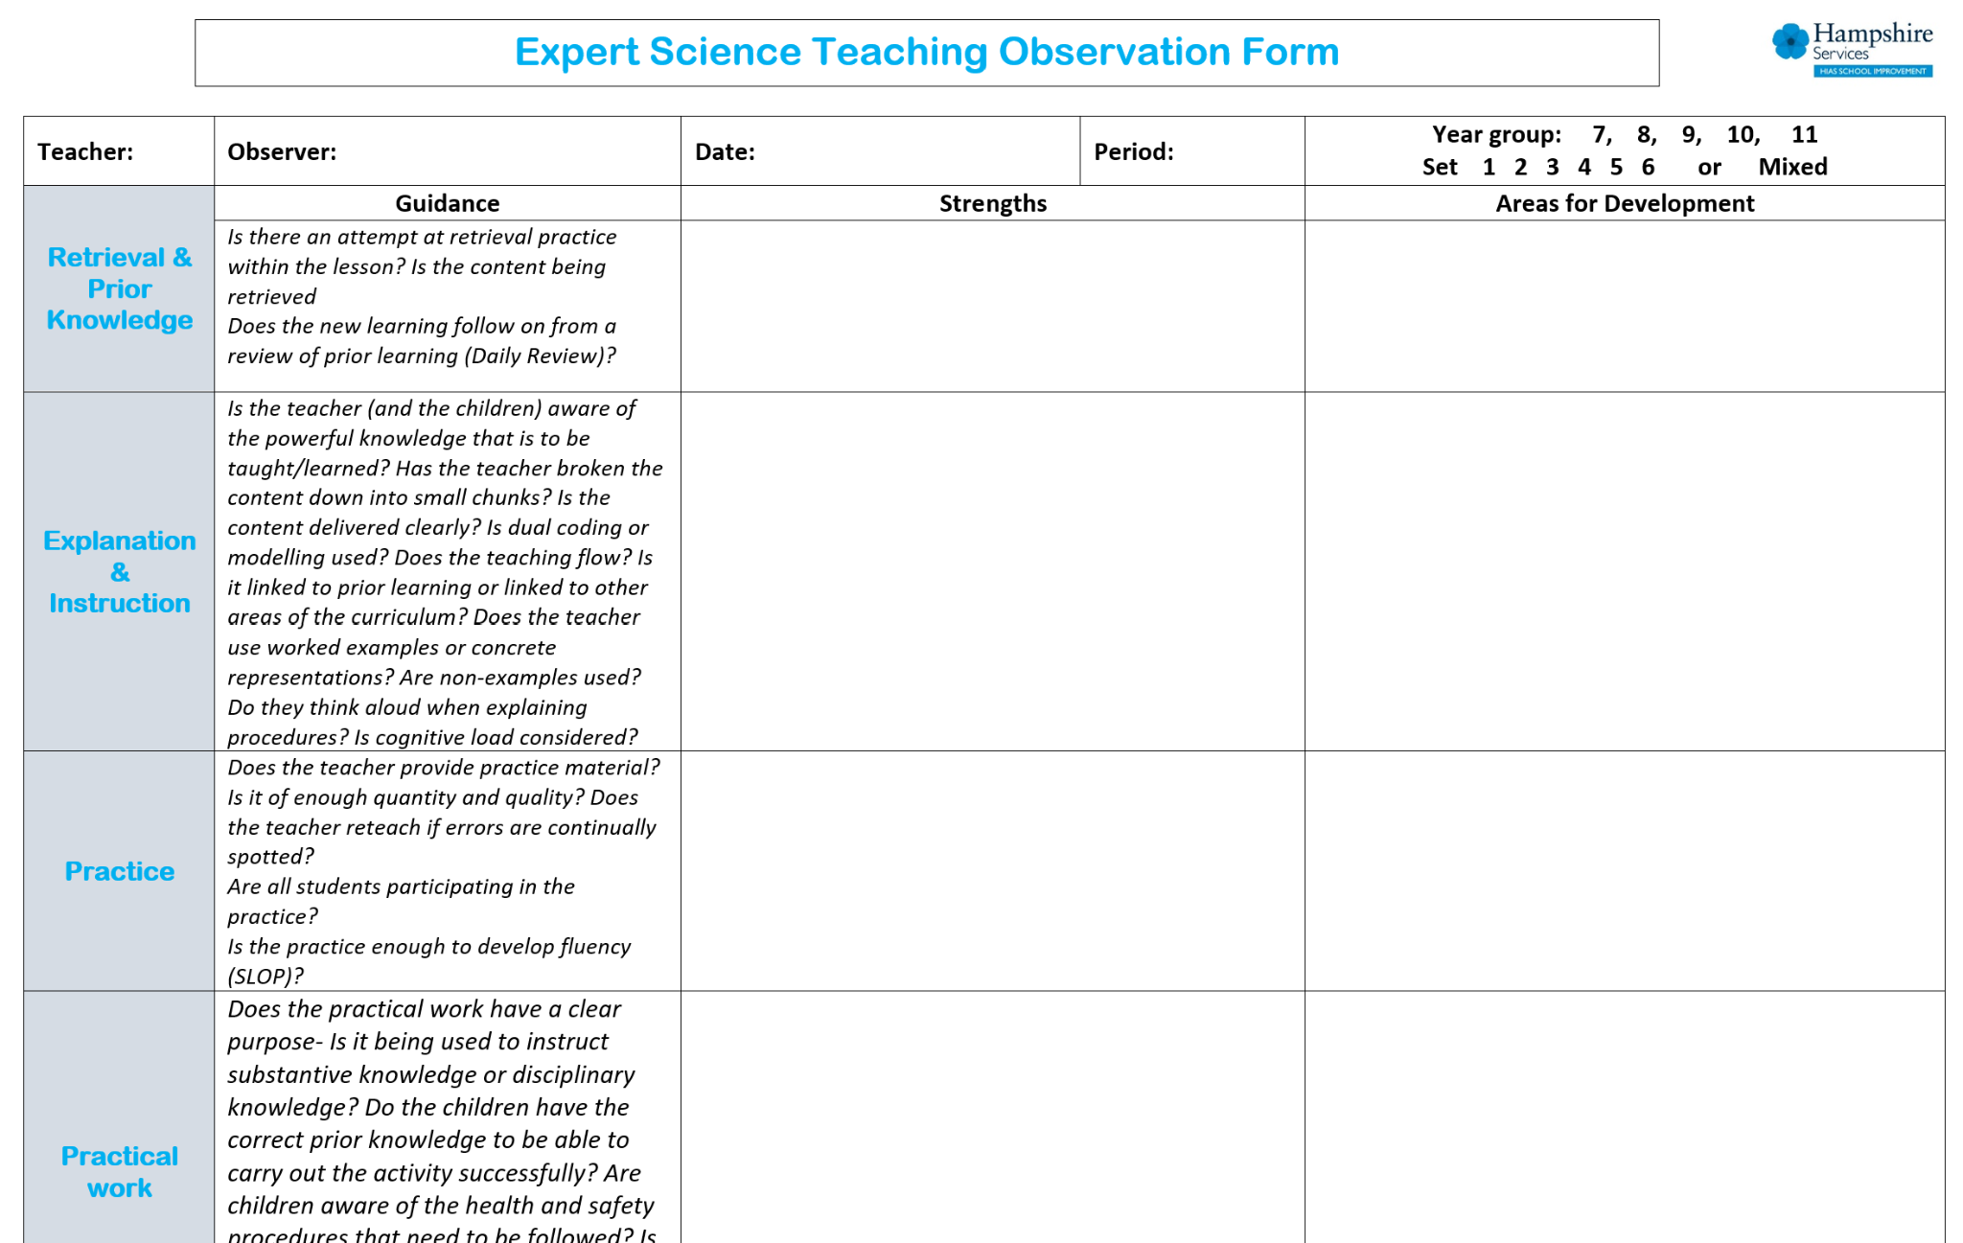
Notes:
Kevin, I updated this slide- Emma

Slide 9
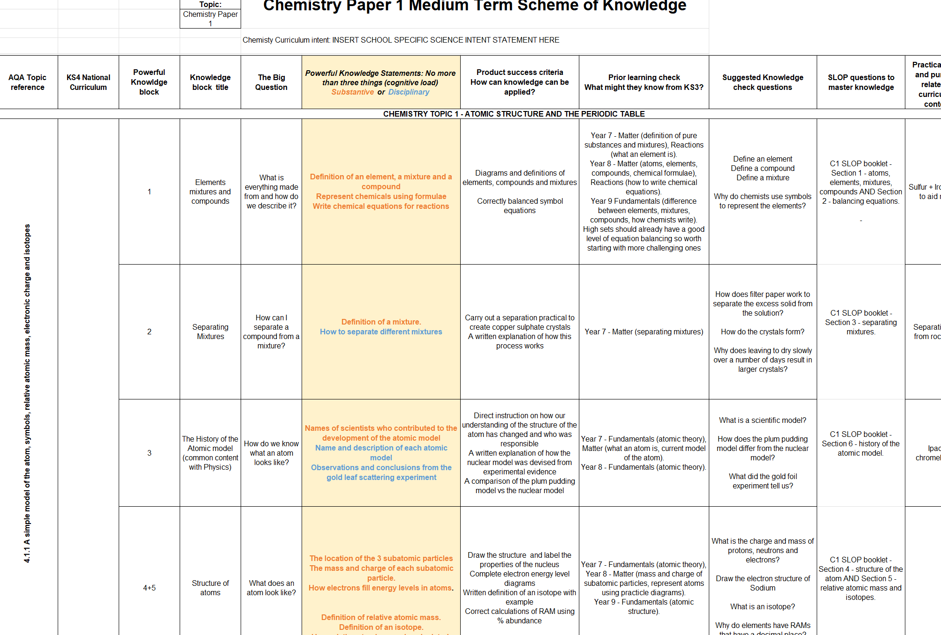

Slide 10
New resources uploaded into the open access site. SLOP booklets, learning walk proforma for expert teaching.
New Moodle+ resources
Notes:
Kevin, I updated this slide- Emma

Slide 11
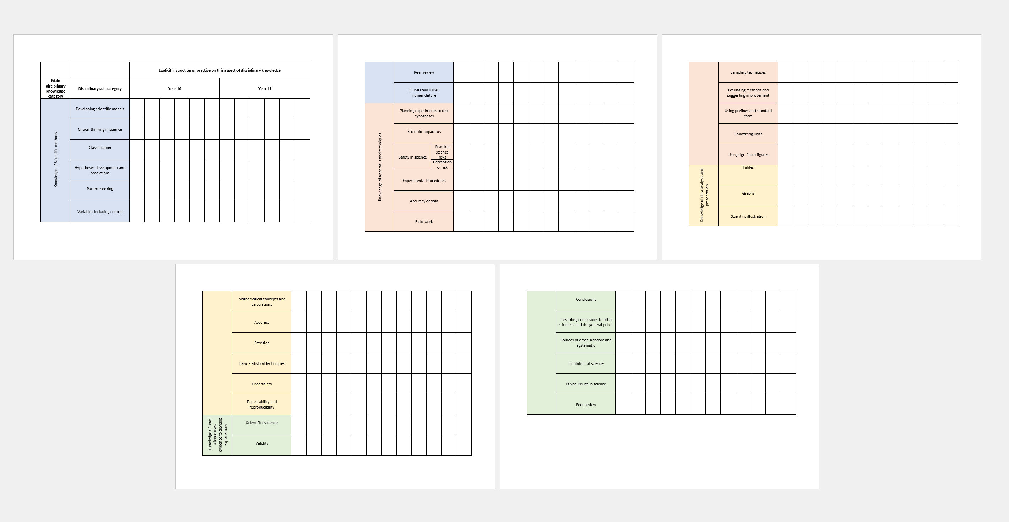
Tracking disciplinary knowledge instruction across KS3 & 4

Slide 12
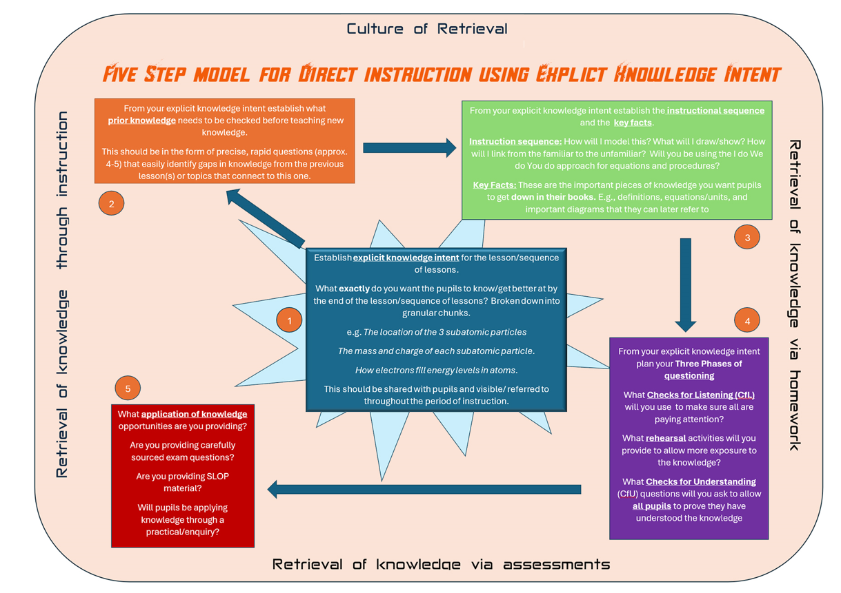
5 Steps for Expert Science Teaching

Slide 13
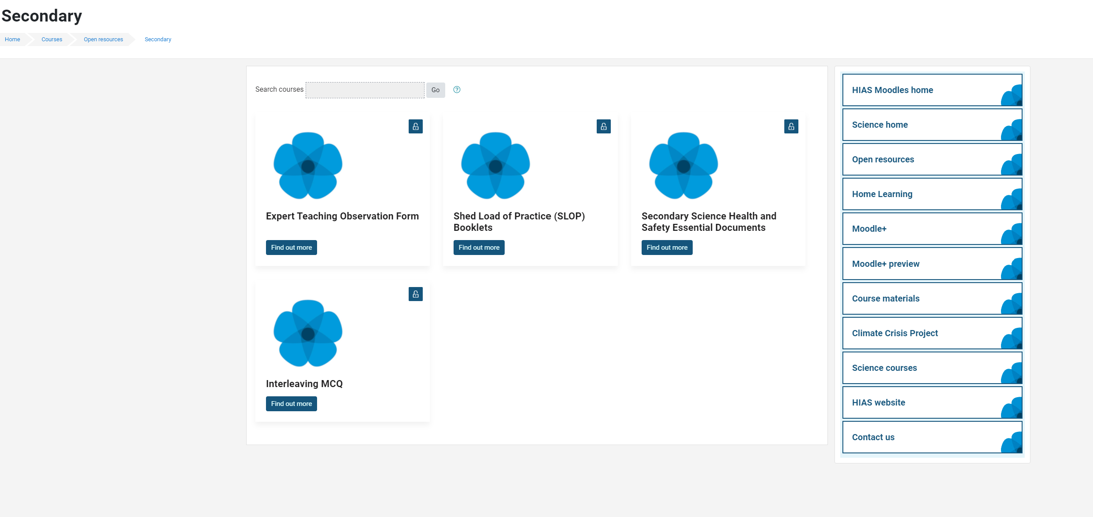
Updated Safety in Secondary Science documents

Slide 14
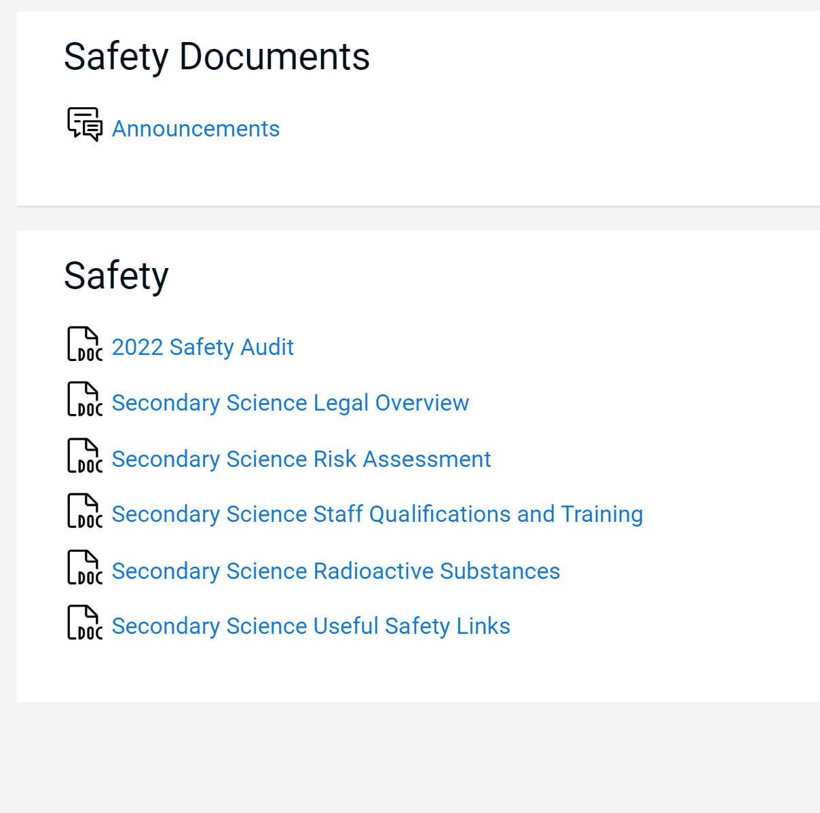
Updated Essential Safety in Secondary Science documents

Slide 15
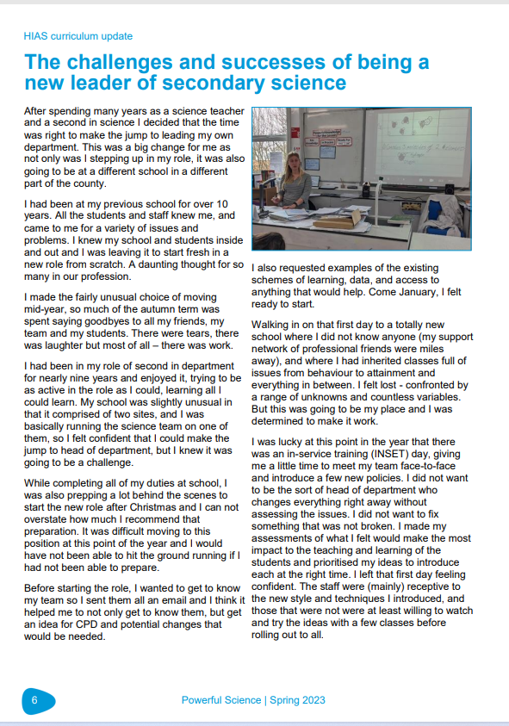
Powerful Science magazine

Slide 16
Powerful Science magazine
Rowhill School
Greenwood School
Alderwood School
The Westgate School
The Toynbee School
The Hamble School
The Hayling College
Swanmore College of Technology
Aldworth Science College
Crookhorn College
Horndean Technology College
Henry Beaufort School
The Vyne Community School
Crestwood Community School
The Wavell School
The Henry Cort Community College
Kings' School
Park Community School
Warblington School
Testbourne Community School
Applemore College
Osborne School
Prospect School
Oak Lodge School
The Mark Way School
Hollywater School
Brookfield Community School and Language
Spring edition out now
Secondary articles include:
High quality use of exam questions in lessons at Swanmore College
KS3 assessment
AI tools

Slide 17
Agenda for this afternoon
Catch up- Sharing positives and challenges
Science updates
AQA Update
Discussion-Summer 2024 exams- lessons moving forward.
Inclusion – Jo Sinclair, Applemore
An improvement journey- Matt Doe, Warblington
Discussion- Excellence in KS3 Science
AOB
Notes:
Welcome back- Share course details with new sci-cos
Open discussion for 5 minutes to share the good things that have been happening
Ofsted review paper for science-learning journeys link- Who has read this? What did you think? Share key points- discuss. …’ majority no. of primary schools- reduced amount of curriculum time to teach science which led to a narrowing of the curriculum.’
Unpick the reason for the remodel and explain their importance in this first draft

Slide 18
Catch up
Welcome back.
Share some positives from the term so far.
What have been the challenges of the term so far?
Try not to talk about year 11 issues. We will share these later..

Slide 19
Science updates

Slide 20
Secondary Science Conference
Secondary Science Conference | STEM

Slide 21
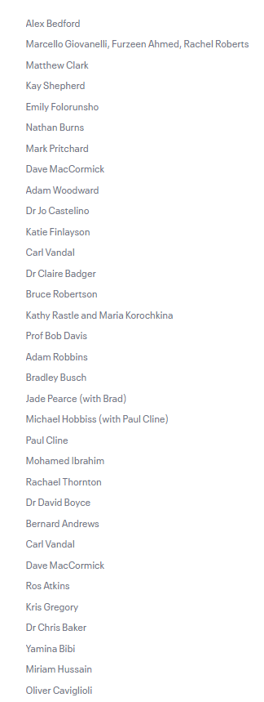
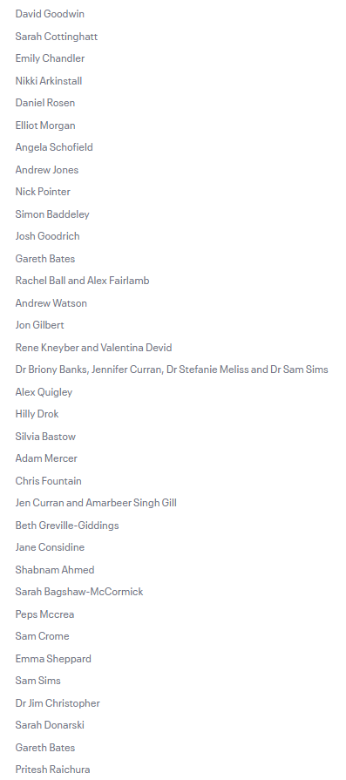
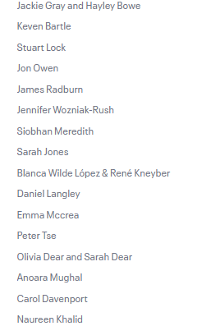
ResearchED National Conference
researchED National Conference 2024 | ResearchED

Slide 22
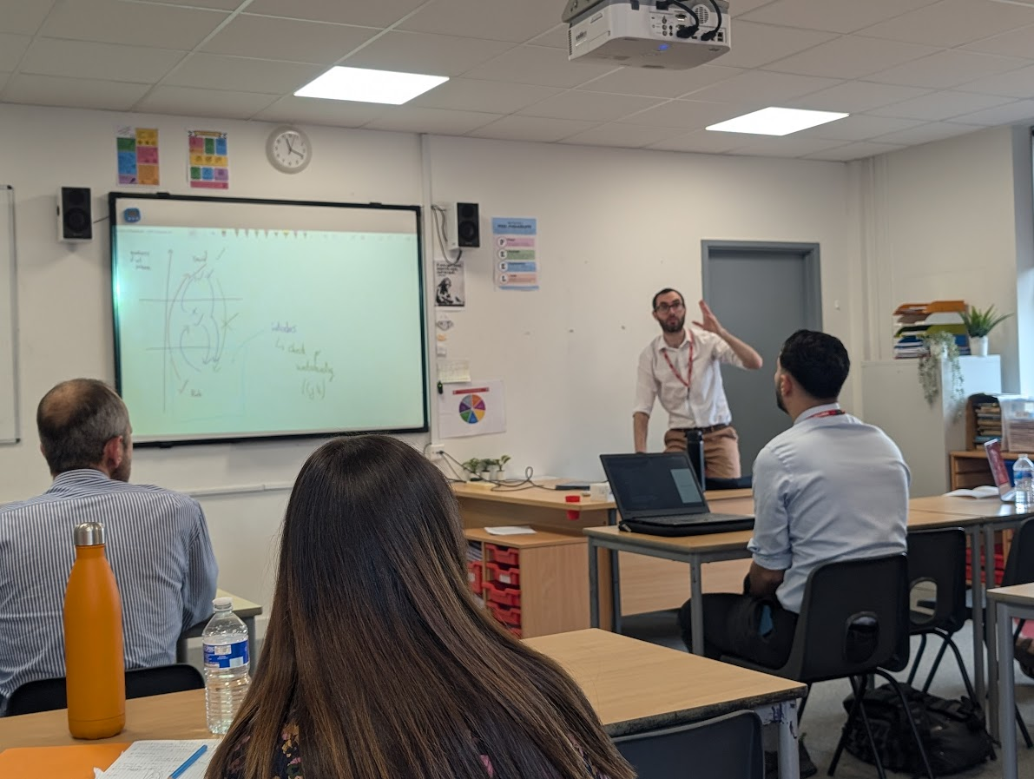
Adam Boxer session
Monday 24th June 2024
Great session
Questioning
Modelling- including blank canvas

Slide 23
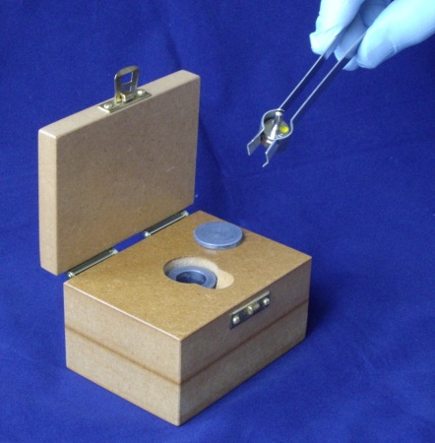
RPO visits
Ongoing academy visits
A few LA Schools in next two weeks
The rest in September and October
Make sure you have printed the newest
L93 edition and filled in the sections listed on front cover

Slide 24
AQA

Slide 25
Year 11 GCSE Exams Summary

Slide 26
Year 11 exams
2023 exams are now behind us.
In groups:
What lessons can we take from this year?
What will we have to do different next year- formulas?
Any successful strategies you can share regarding revision, intervention etc.

Slide 27
Intervention- Jo Sinclair Applemore college

Slide 32
Things to try…
Recognise students’ effort and reasoning, not just correct answers.
Use cold calling / Use think-pair-share
Use mini whiteboards
Use role cards for practical and group work.
Literacy mat/Frayer model
Discussion cards – scripted roles
Use a visualiser
Use high colour contrast in resources
Use Science Capital Teaching Approach

Slide 33
resources
J.sinclair@applemore.hants.sch.uk

Slide 35
Things to try…
Find out which students attend any after-school activities (such as science clubs, optional field trips etc).
Sketch a map of your classroom and create a tally chart of the quality of your interactions with students in different parts of the room.
Look at your school's posters and teaching resources, and check that they represent the diversity of your school's population and wider society.
Interview a small number of students to find out how they feel about science compared to other subjects

Slide 36
An Improvement Journey at Warbington Science Department Matt Doe

Slide 37
Our Journey from “Consistently Inconsistent” m.doe@warblingtonschool.co.uk

Slide 38
The starting point
HoD ‘long term absent’.
Faculty leaderless.
Generic AQA schemes of work used.
Teachers left to teach in their own way.

Slide 39
The Faculty
Two experienced teachers.
One ECT trained during COVID.
One experienced key stage 2 teacher transferred into secondary.
One HLTA.
HoD covered long term by cover supervisor.
I was appointed as HoD during lockdown – Teacher → HoD.

Slide 40
My inexperience showed
Worked with HIAS on how to create a curriculum.
Created schemes of work that were overly detailed.
Far too little time to cover everything.
4/6 of teachers became lost in the minutia.

Slide 41
When did the journey start?
LLP visit while we were in the Ofsted window.
One scathing sentence started it all…
“Science is consistently inconsistent.”
Everything had to change, but no experience in the Faculty to facilitate this.

Slide 42
Post LLP
HIAS recommendation – ‘see an outstanding department’.
Change needed to happen… Still no tools.
Kevin started…

Slide 43
Then…
Ofsted visited!!
Requires improvement.
Big themes:
Inconsistent delivery of curriculum
Teachers do not pick up on misconceptions
Students unclear of what they are supposed to be learning and move on without firm understanding
Low expectations of student behaviour in lesson leading to low level disruption.
Science clearly had a significant role in the RI verdict.

Slide 44
How it unfolded
Phase 1 - Structures
Phase 2 - AfL
Phase 3 - BfL

Slide 45
Phase 1 - Structures
The Warblington Way – Our operational handbook.
Overarching ‘powerful knowledge’ scheme.
Big questions and powerful knowledge.
Prerequisite check → Teach → Check → Repeat → Independent practise.
Lessons vs learning blocks.
Book monitors.
Cornell notes.
Tassomai.
Visualisers and mini whiteboards (+ pens at door).

Slide 47
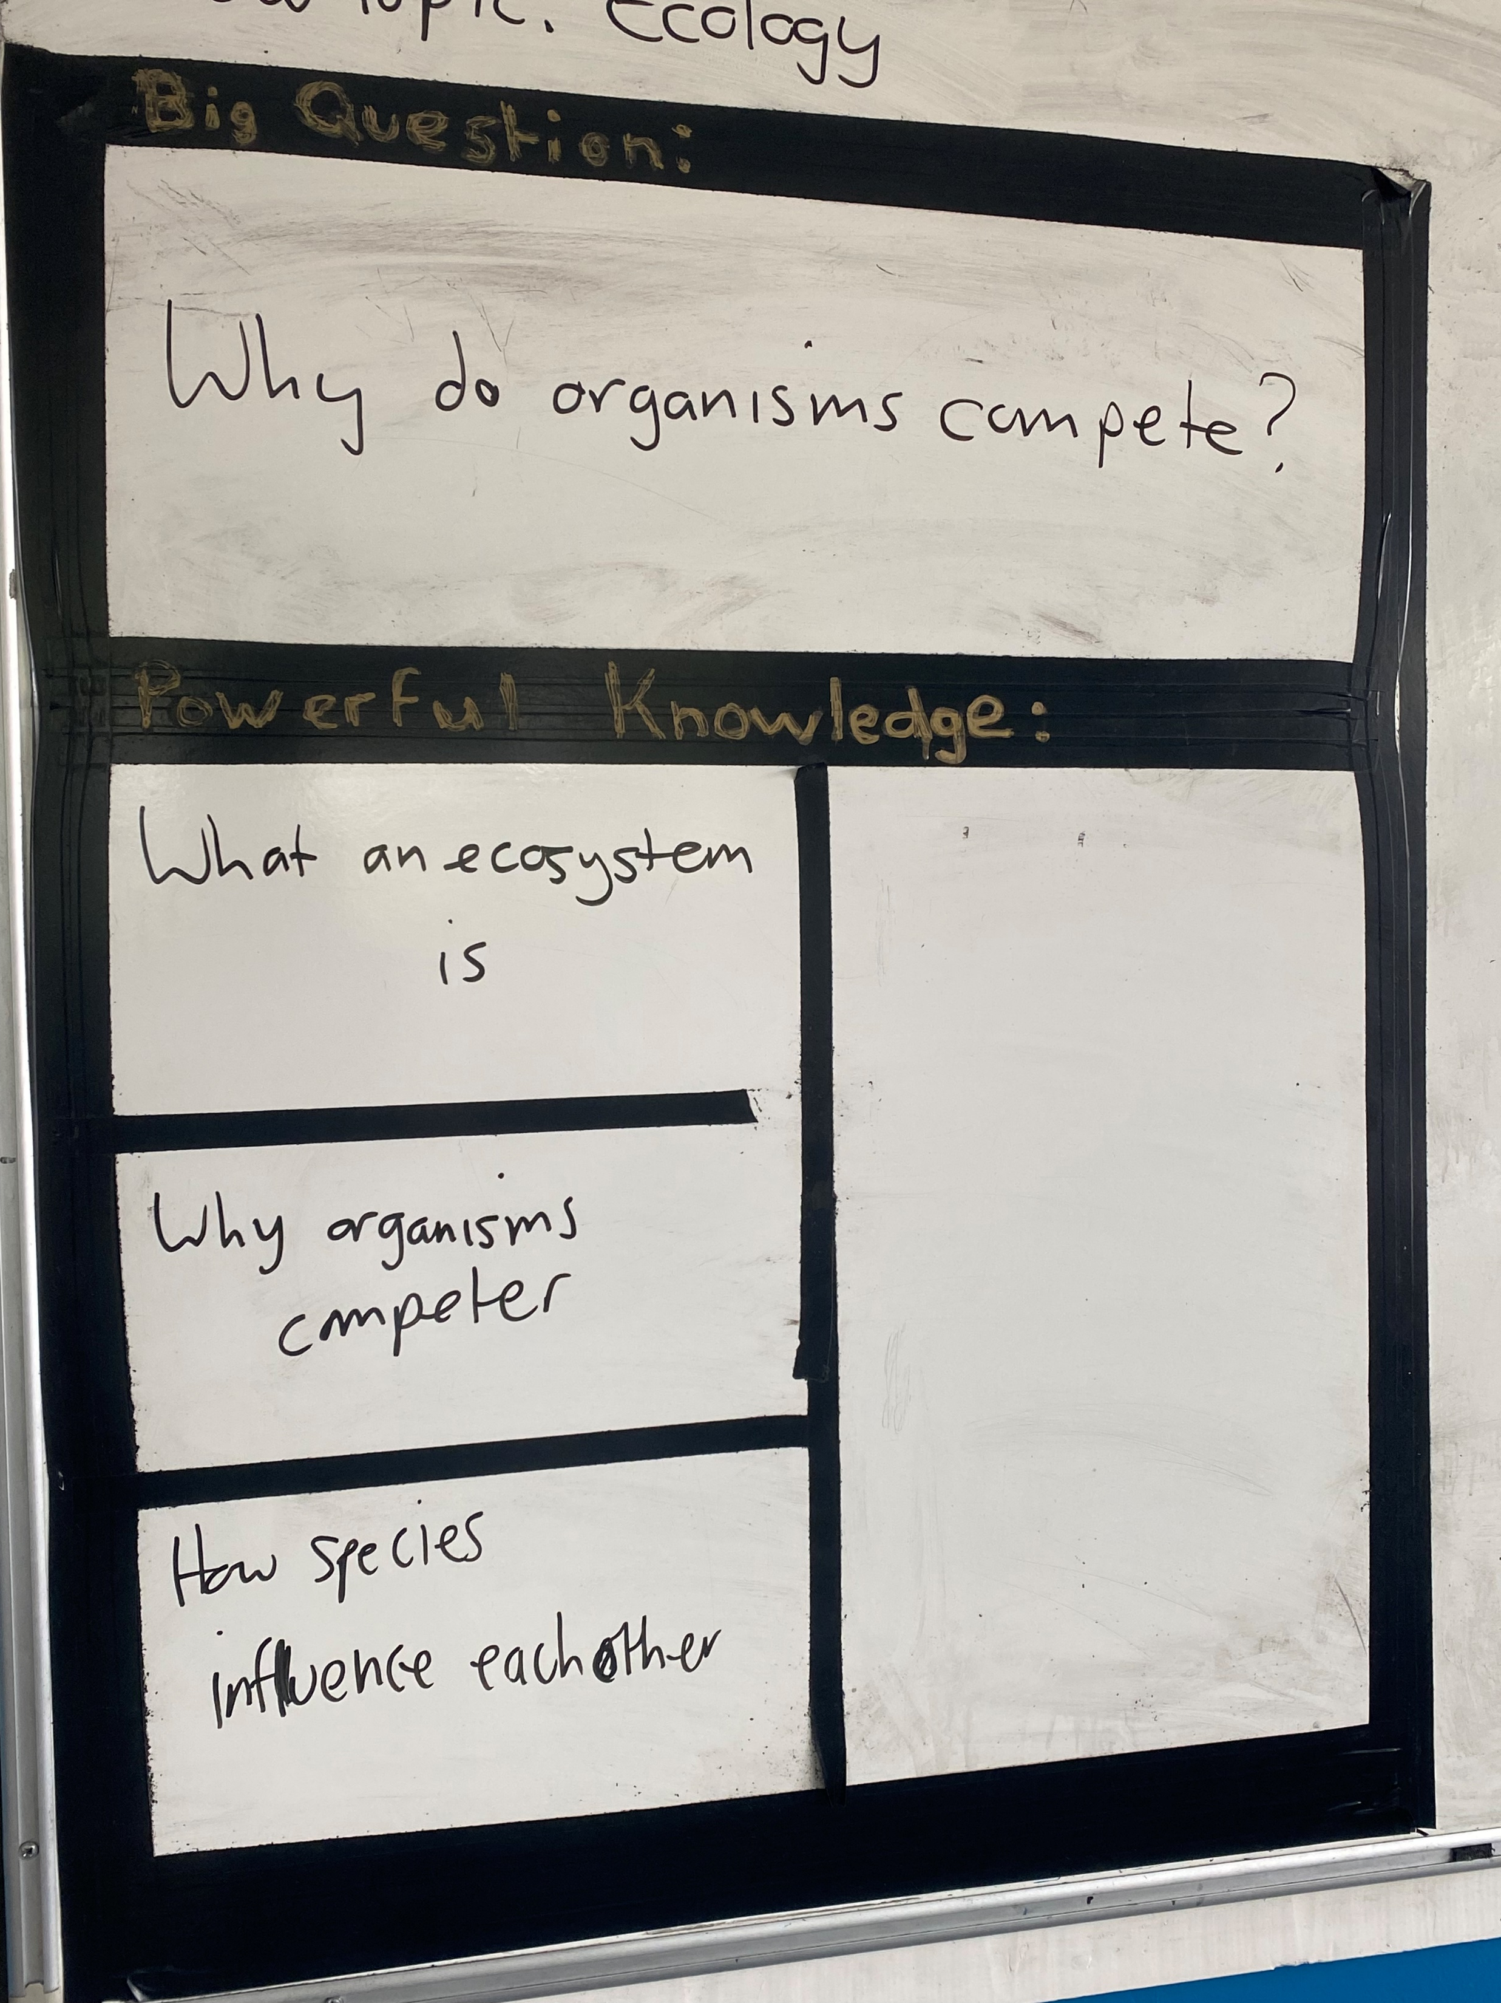

Slide 48
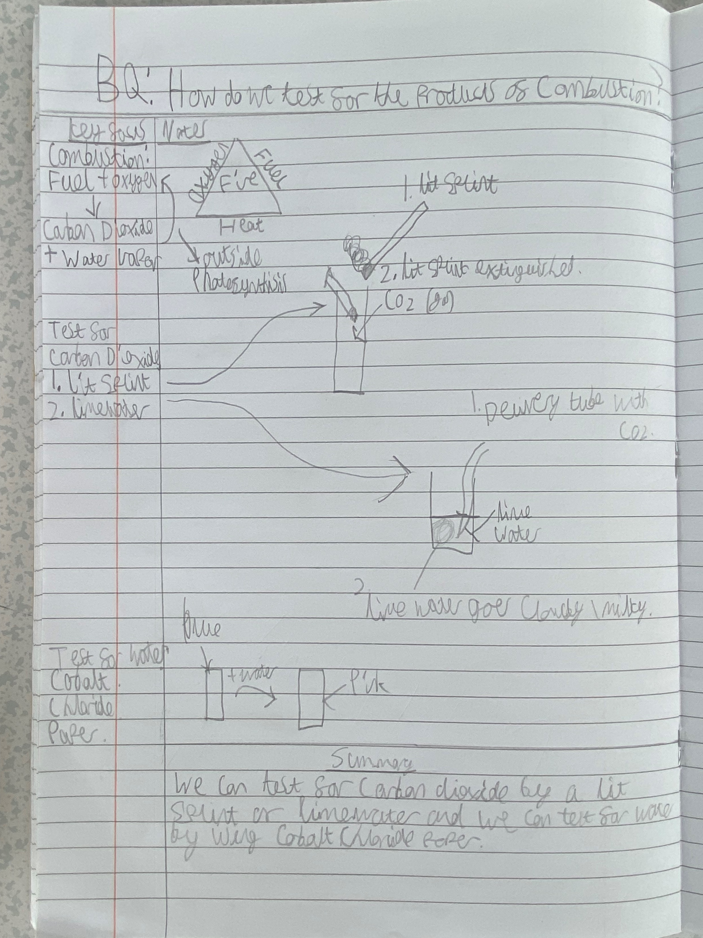

Slide 49
Phase 2 - AfL
Implementation of rehearsal.
Bespoke coaching… Transformational!!
Created an AfL toolkit, incorporating:
Checks for listening
Rehearsal
Checks for understanding
Visited an outstanding school.

Slide 51
Ark Soane - What were we exploring?
Consistency across the Science department:
Teaching strategies (CfL, rehearsal, CfU)
Expectations and behaviour
Ark Soane well-regarded for being an outstanding school for this purpose.

Slide 52
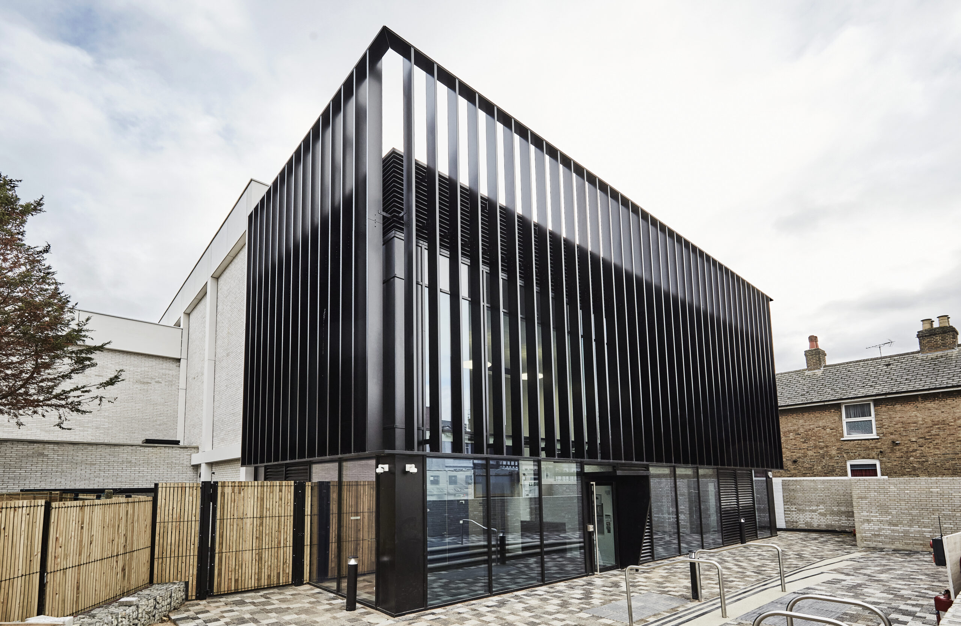
Who are Ark Soane?
New build school.
West London.
Y7-9 at the moment.

Slide 53
What was it like?
Politest tour guides ever!
Quiet corridors.
All classes focussed.
The noise from every class was consistent.
Lunchtime… A whole world of different!

Slide 54
What did we pick out of the visit?
All hands up.
Count downs for everything (attention, pens up, ruler on text, detailed responses).
Everything noticed – so much glancing around.
High expectations for behaviour and standards of responses.
Heaps of praise.
Body modelling.
‘Eyes on’ what the students need to be focussed on.

Slide 55
What did we pick out of the visit?
Scaffolding verbal responses.
WAGOLL verbally and under visualisers.
Every member of staff on it at all times.
Off task time almost non-existent.
Pupils allowed to struggle.
Booklets with structured tasks (drills for key words, comprehension, diagrams, turn and talk questions).

Slide 56
Permeating acronyms
SLANT
Sit up, Listen, Ask and answer, No talking, Track speaker.
SHAPE (how we speak)
Sentences, Hands away from faces, Articulate, Project, Eye contact.
STEPS (how we speak to adults)
Sir or Miss, Thank you, Excuse me, Please, Smile.

Slide 57
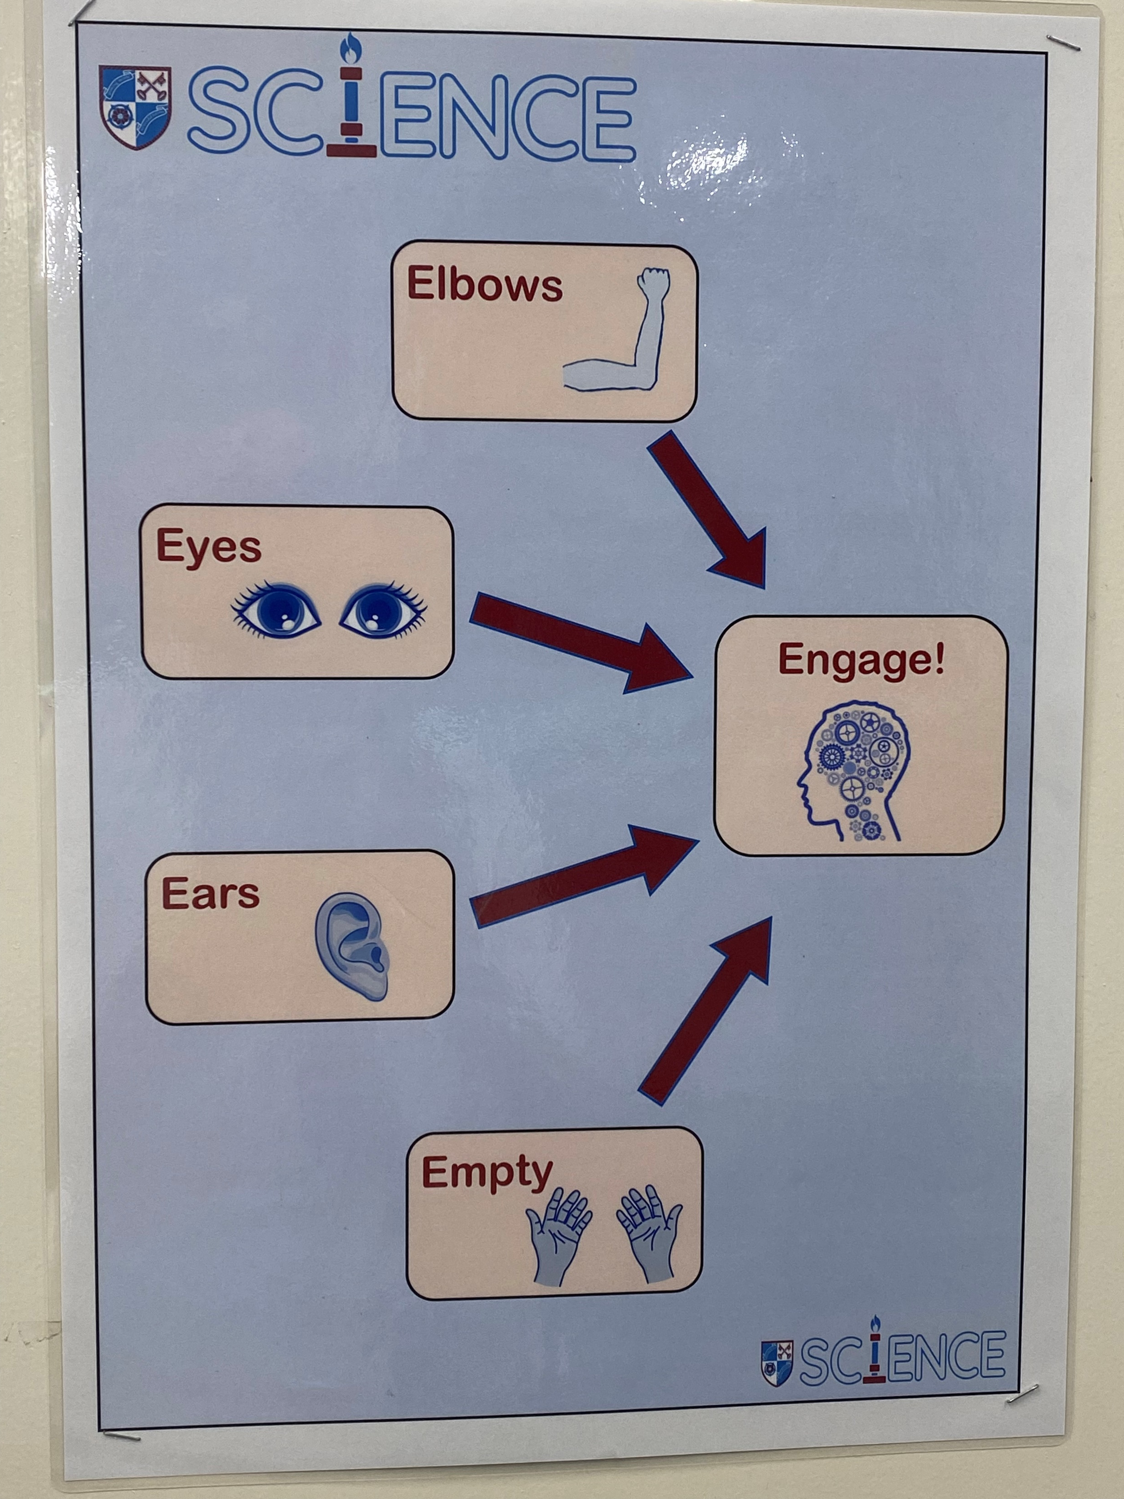
Phase 3 - BfL
Easy wins
Hover boards.
Reading rulers.
Holding up equipment.
Volume 0-1-2-3.
Equipment monitors.
Four Es to ‘engage’
Elbows.
Eyes.
Ears.
Empty.

Slide 58
Summary
Has teaching and learning improved?
Has our work had an impact of student outcomes?
Are we consistent?

Slide 59
Excellence in KS3 Science

Slide 60
Excellence in KS3 Science
What does excellence look like?
KS4 we are given a quantifiable measure to judge excellence by.
But in KS3 we don’t have that.
In groups share your thoughts about what you think excellence in KS3 science is like. Share books and ideas and we will then share as a larger group.

Slide 61
Book of the Term
A promising book discussing the reasons why learning can often fail even with great curriculums and great teachers.
Presents eight different reasons for failure of learning and whys to combat them.

Slide 62
AOB

Slide 63
In School CPD offer
Delivered in your own school at times that suit you and your team.
Bespoke to your needs
Flexible timings-afterschool, inset days, etc.
Coaching model also available.
Email me directly to enquire
further about these or to book.
I now have better clarity over what exactly to teach and checking for understanding. I have some new strategies to use including the visualiser .
My own practice has improved, and I have more confidence. Kevin invites you to try something, explains the rationale, models it, live coaches you, then is there to ask questions as you dissect your experience
Wish I had had this intelligent mentoring in 2004
Thanks, just thanks!
Thanks, just thanks!

Slide 64
Autumn Network sessions now bookable on the Learning Zone

Slide 65
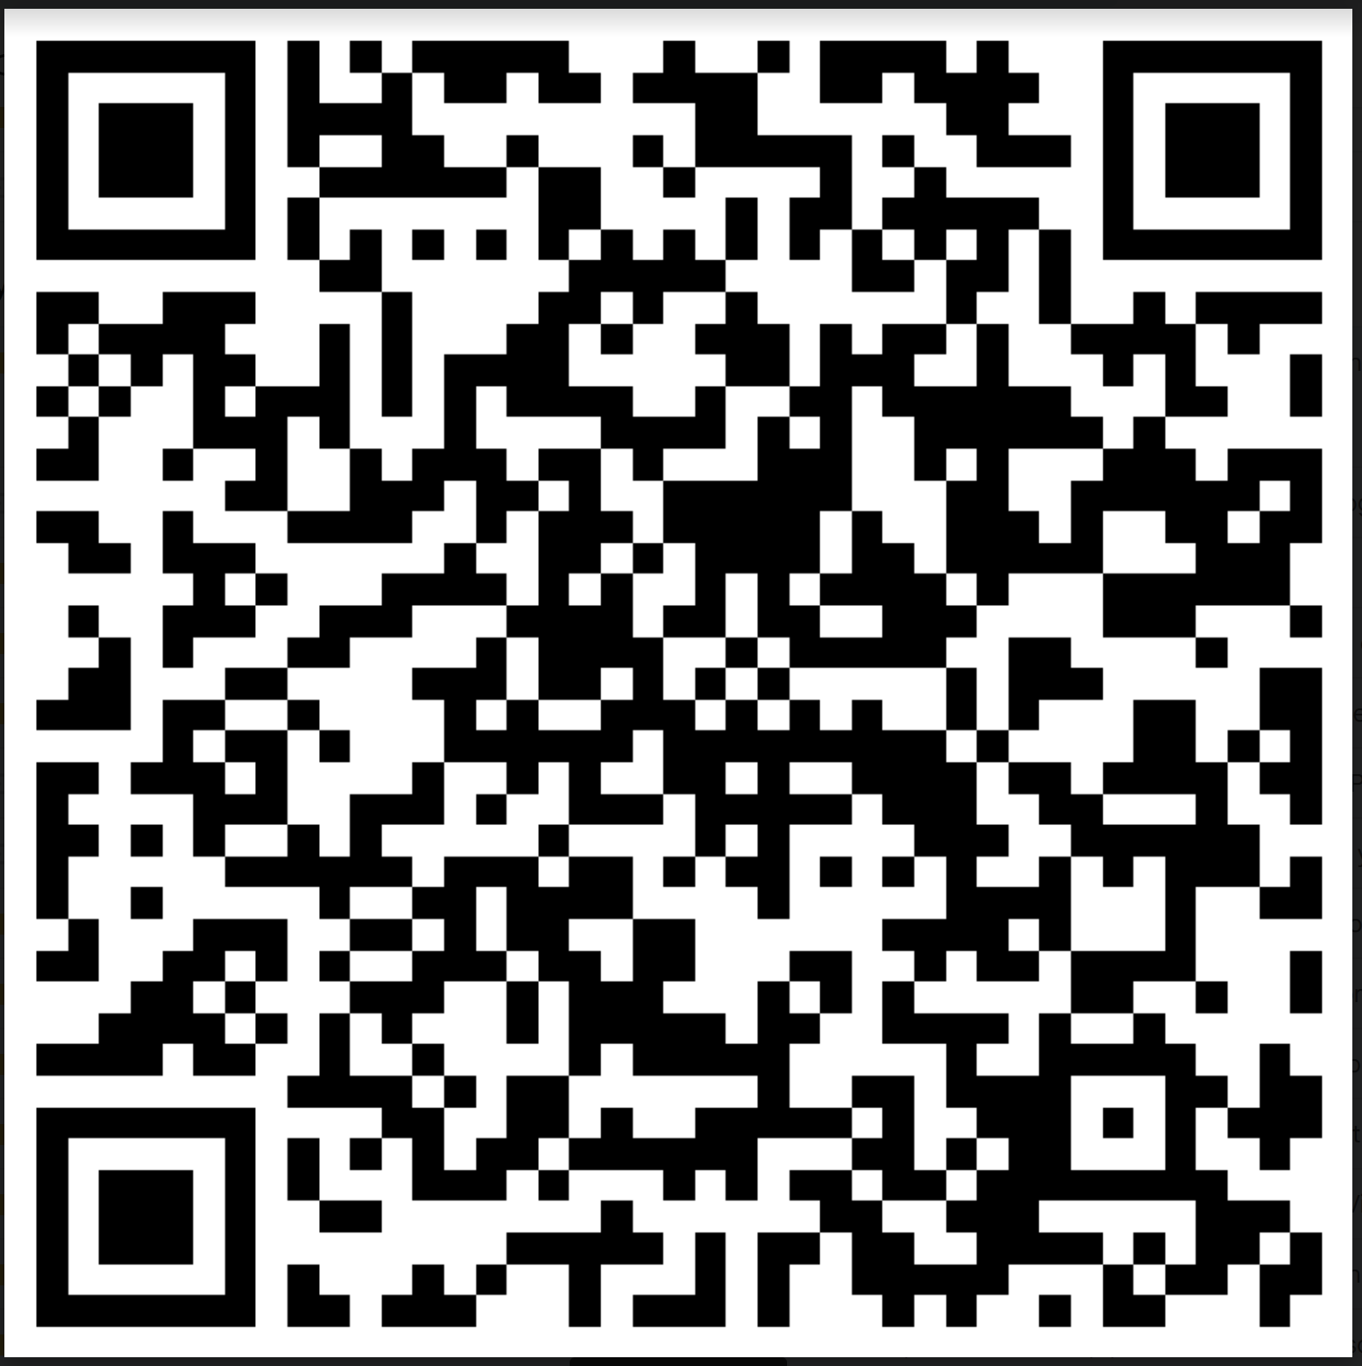
Thank you
Please complete the feedback form for this session
See you again on 24th October
Venue to be confirmed
Have a great summer break

