Slide 1
Heads of Science Network Meeting 2023-24
Spring 2024 Session 1

Slide 2
Welcome
The HIAS Science Team:
Kevin Neil
(County Science Inspector/Adviser)
Radiation Protection Officer
kevin.neil@hants.gov.uk
Emma Cooper (General Inspector/Advisor for Science)
emma.cooper3@hants.gov.uk

Slide 3
HIAS on Twitter
@HIAS_today
@Mrneil1859
@emmahantsprisci

Slide 4
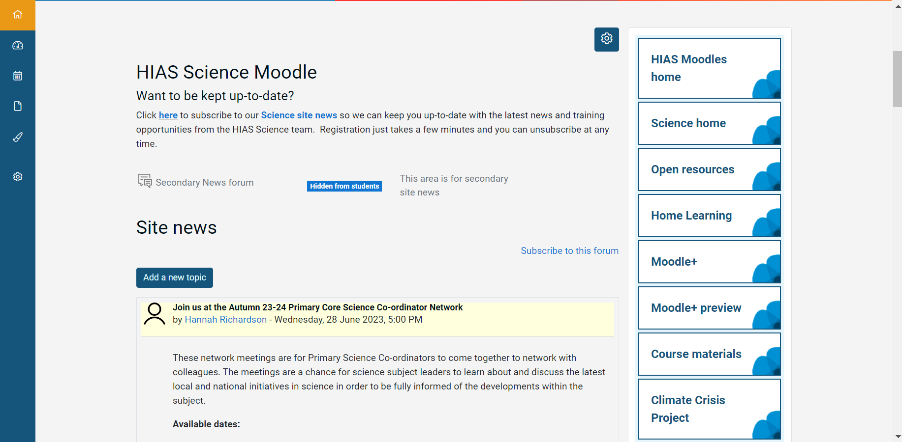

Slide 6
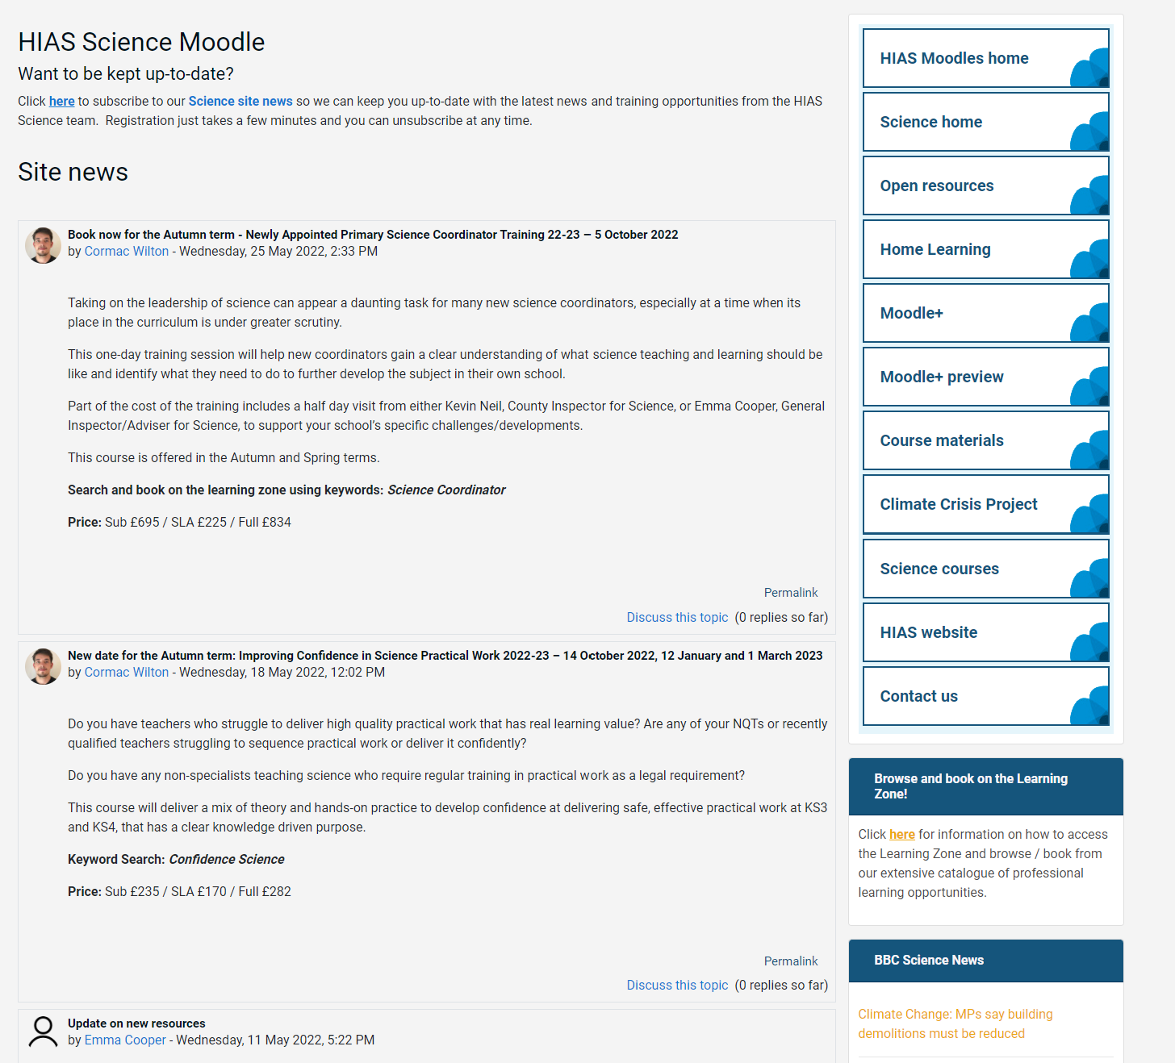
resources in the open access site.
Notes:
Kevin, I updated this slide- Emma

Slide 7
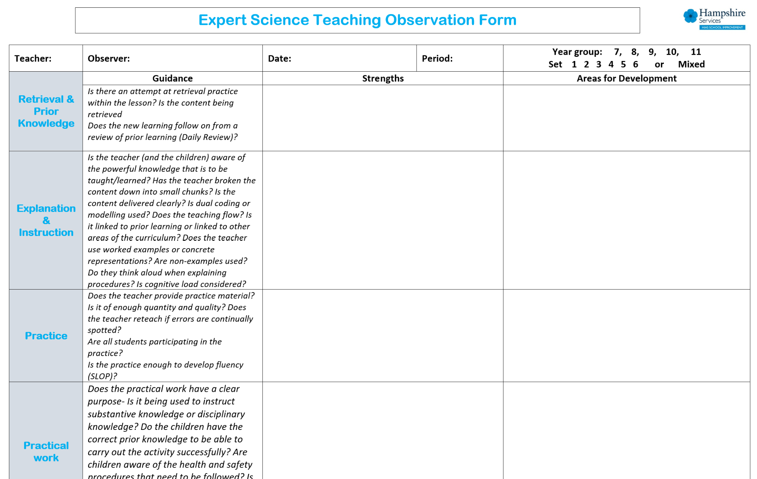
New resources uploaded into the open access site. SLOP booklets, learning walk proforma for expert teaching.
New Moodle+ resources
Notes:
Kevin, I updated this slide- Emma

Slide 8
Notes:
Kevin, I updated this slide- Emma

Slide 10
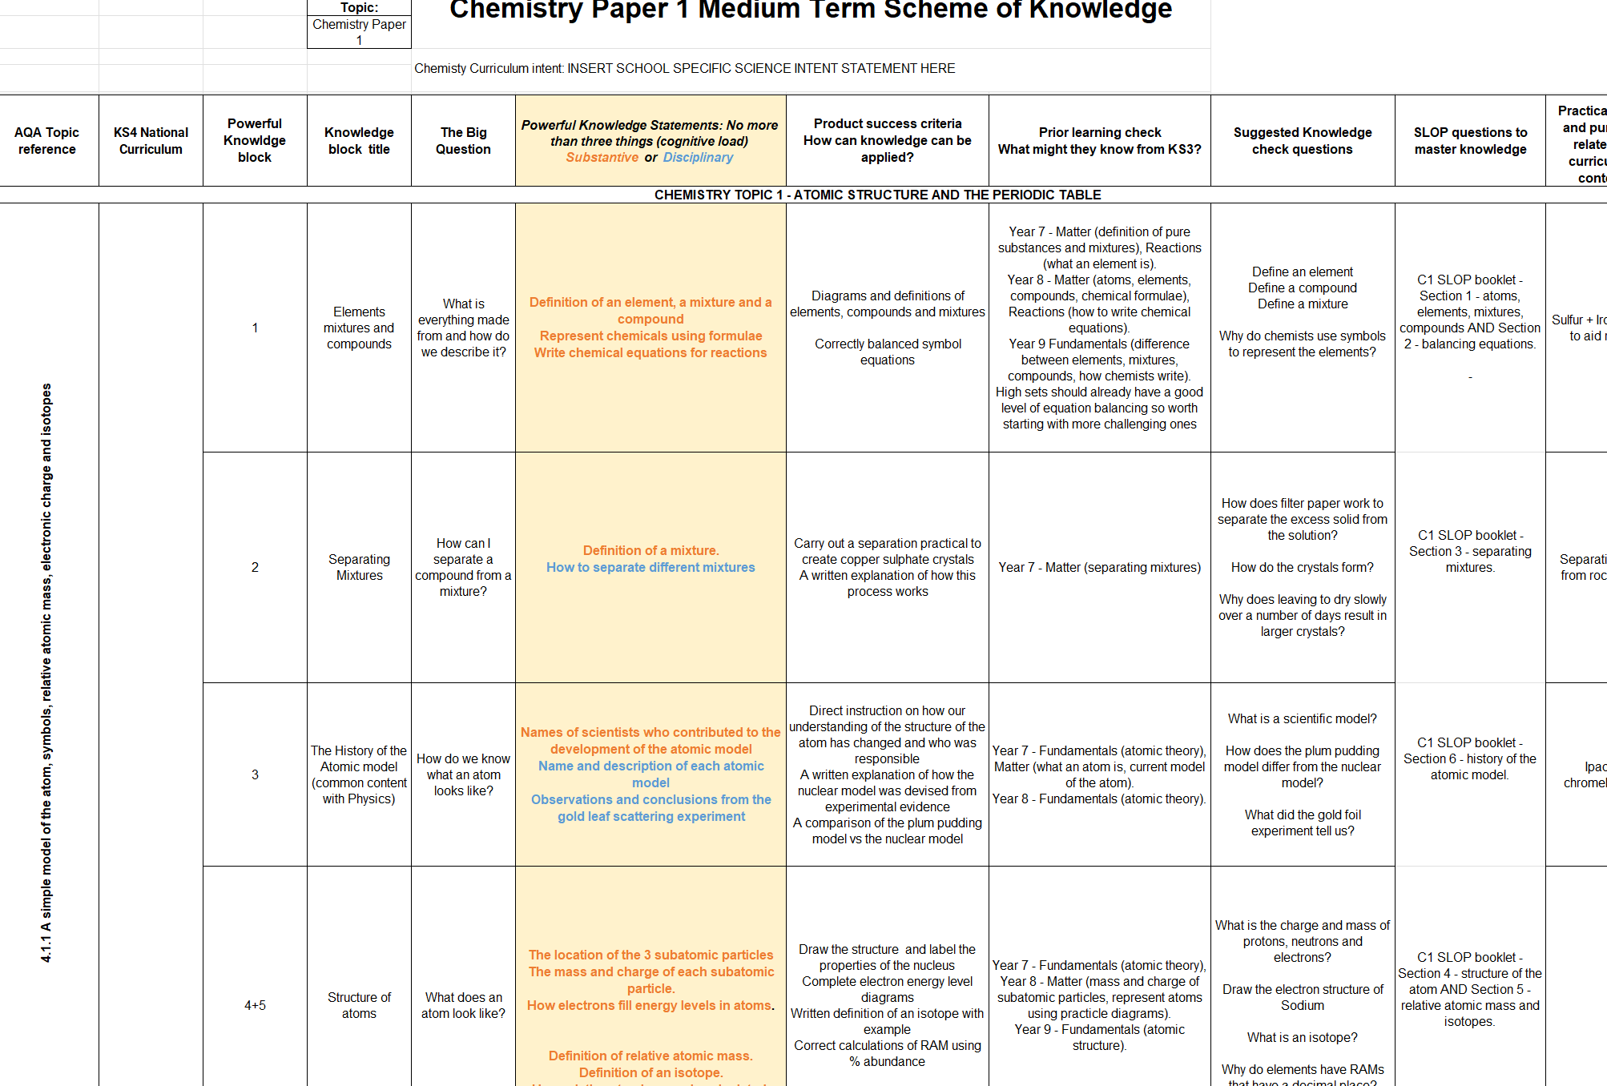

Slide 11
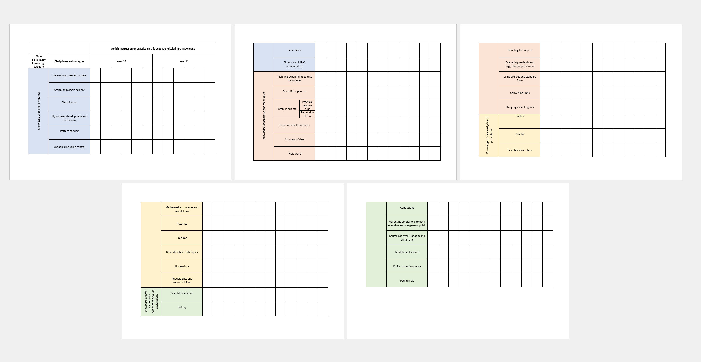
Tracking disciplinary knowledge instruction across KS3 & 4

Slide 12
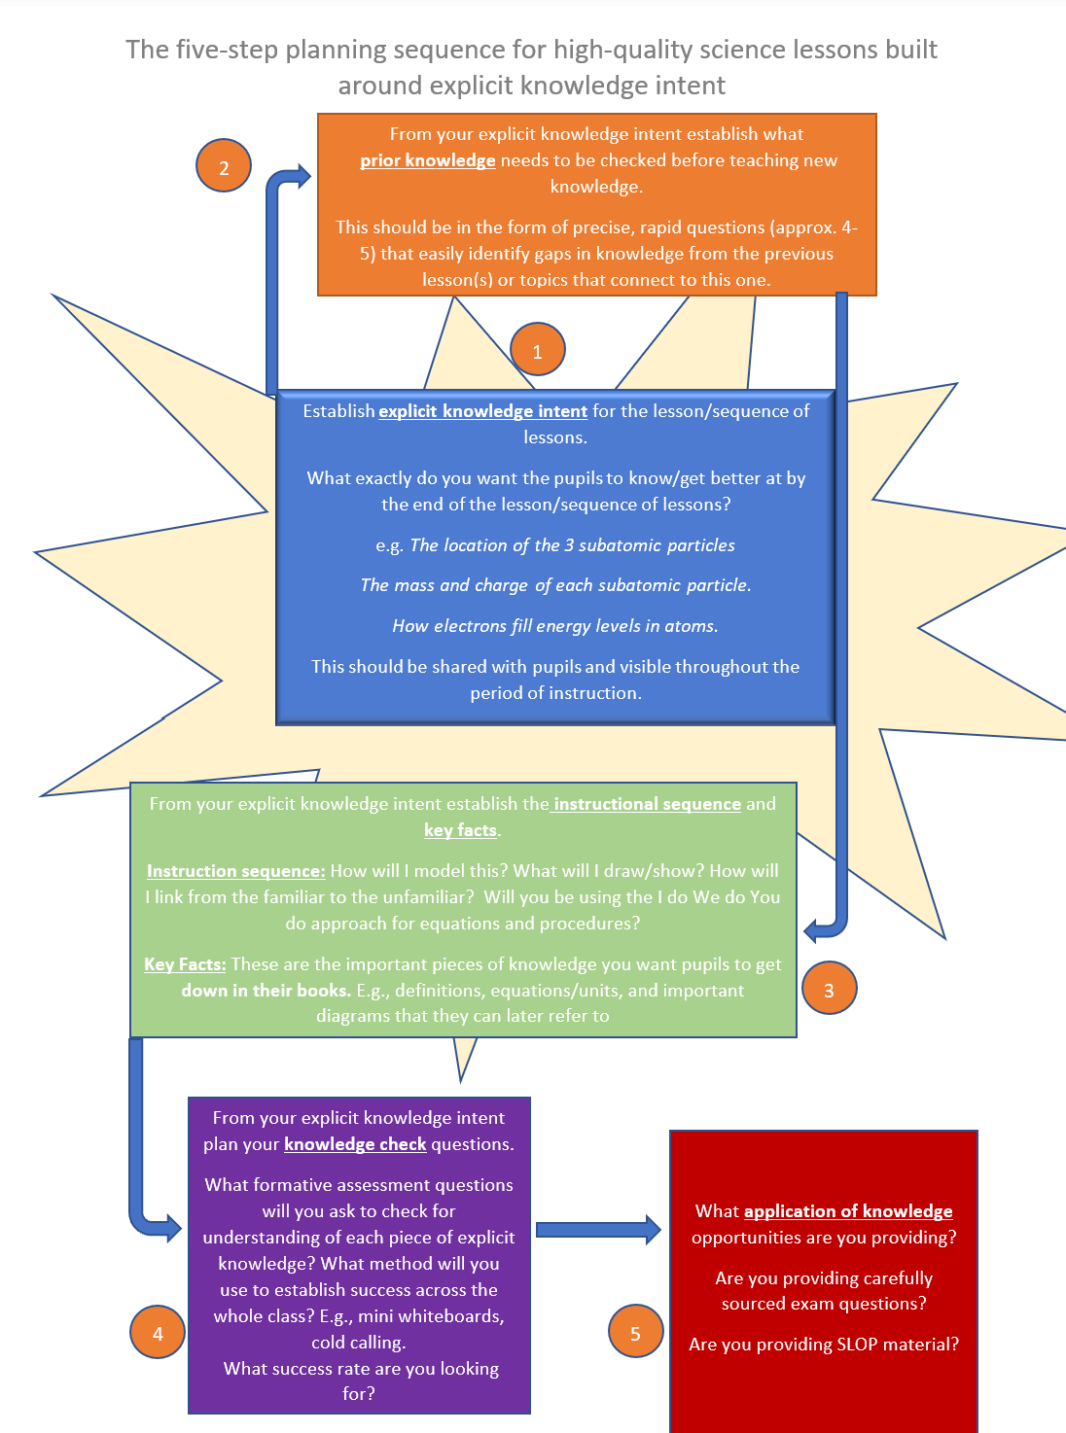
5 Steps for Expert Science Teaching

Slide 13
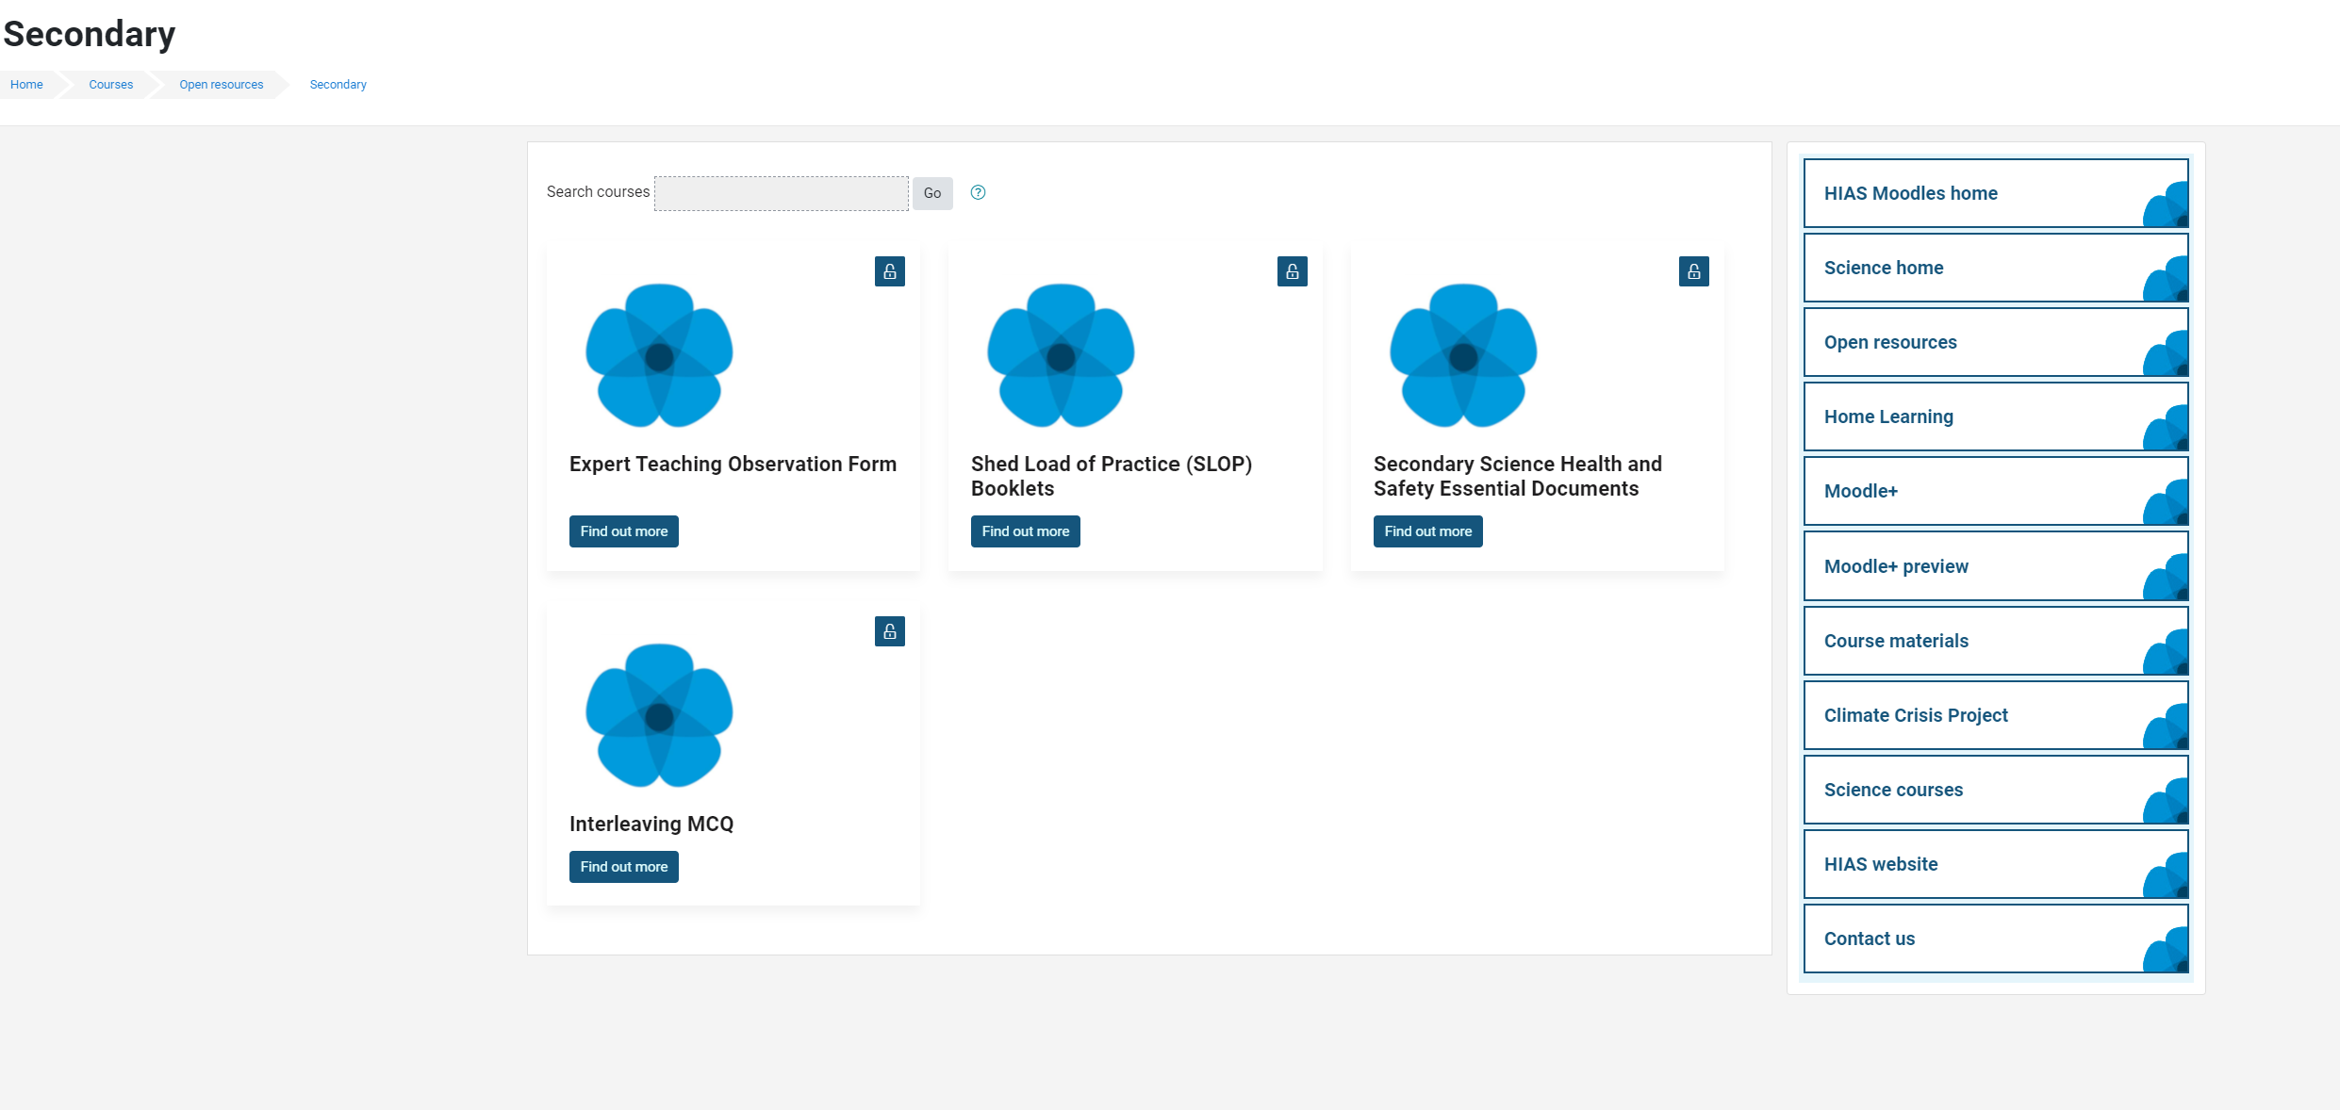
Updated Safety in Secondary Science documents

Slide 14
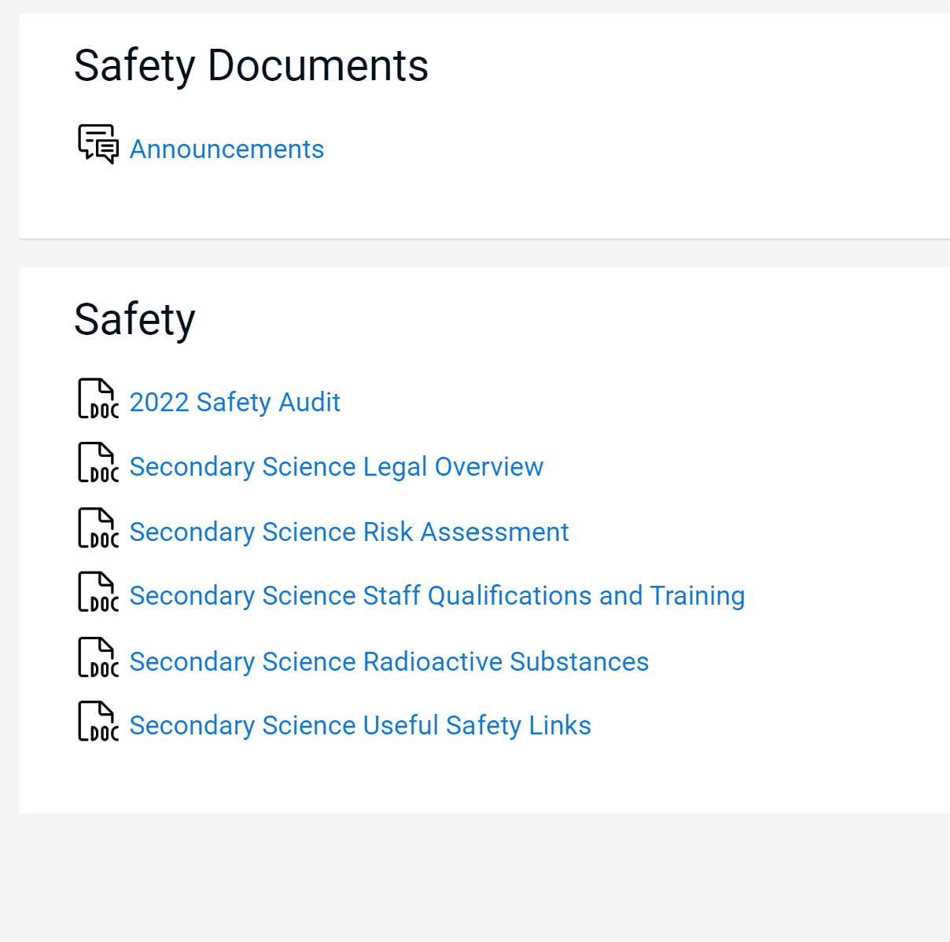
Updated Essential Safety in Secondary Science documents

Slide 15
Agenda for this afternoon
AQA- Martin Hanney
Springboard Science -Hodder
Science updates
Year 11 progress review
KS3 Assessment
Steering group agenda BCM
AOB
Notes:
Welcome back- Share course details with new sci-cos
Open discussion for 5 minutes to share the good things that have been happening
Ofsted review paper for science-learning journeys link- Who has read this? What did you think? Share key points- discuss. …’ majority no. of primary schools- reduced amount of curriculum time to teach science which led to a narrowing of the curriculum.’
Unpick the reason for the remodel and explain their importance in this first draft

Slide 16
Catch up
Welcome back.
Share some positives from the term so far.
What have been the challenges of the term so far?

Slide 17
AQA presentation

Slide 18
Springboard Science

Slide 19
What is Springboard?
An integrated suite of resources in print and digital
Knowledge Book – student reference
Practice Books – independent practice. LOTS of it!
Teacher Handbooks – brilliant teaching…!
Boost – all the resources teachers and students need
Notes:
Series Editor is Adam Boxer and his team of authors have created something different for KS3

Slide 20
What’s included?
7 print books (4 student-facing and 3 teacher-facing) + Boost
1 Knowledge Book for all 3 years of Key Stage 3
£14.99 128 pages (also eBook £4.00)
3 Practice Books £8.99 each
c.144 pages each
3 Teacher Handbooks
£75 each
c. 180 pages each
Boost £390 Core
£725 Premium* (pre-VAT)
*includes unlimited copies of Knowledge Book eBook

Slide 21
5 ways that Springboard helps teachers and students
It has a carefully sequenced, highly coherent curriculum that focuses especially on the KEY things students need to know.
It delivers knowledge through clear narrative-driven explanations, and secures it with the use of extensive independent practice and constant checking for understanding
It pays particular attention to “working scientifically” skills
4. It supports all teachers (including non-specialists) and reduces workload
5. It focuses on retrieval practice, and this is stringently organised
Notes:
Ensuring students arrive at KS4 with all the core skills they need to be successful at GCSE

Slide 22
What’s inside
Knowledge Book – student reference
Practice Books – independent practice
Teacher Handbooks – teacher support
Boost – all the resources teachers and students need

Slide 23
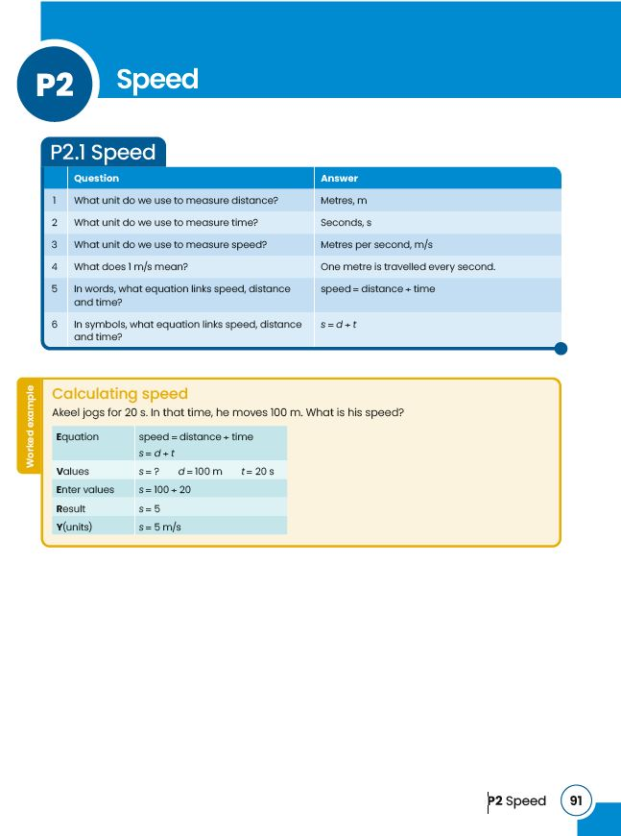
Knowledge Book
the all-in one student textbook
Reduce cognitive load
Every topic is explained through a succinct and focused table of questions and answers, capturing all the essential knowledge pupils need.
Notes:
● Aims to reduce cognitive load and FOCUSES ON WHAT THEY REALLY NEED TO KNOW and is presented ass q’s and a’s, because this is the best way for students to REMEMBER,

Slide 24
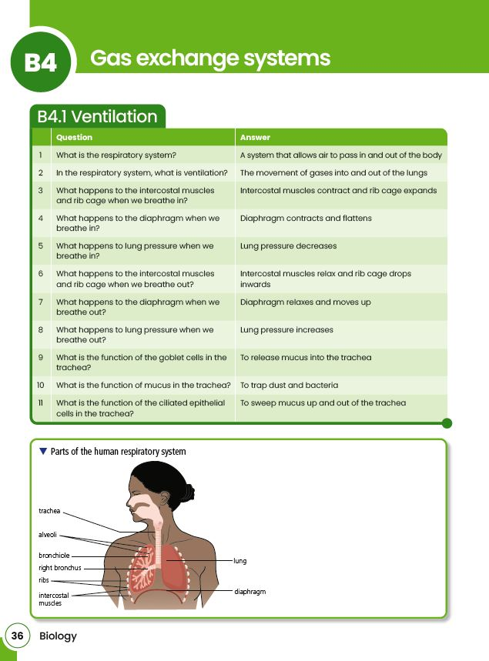
Knowledge Book
the all-in one student textbook
Use visual aids to further understanding
Complex topics are paired with annotated diagrams and other explanations to illustrate key skills and calculations in further detail.
Notes:
annotated diagrams and worked examples illustrate key skills

Slide 25
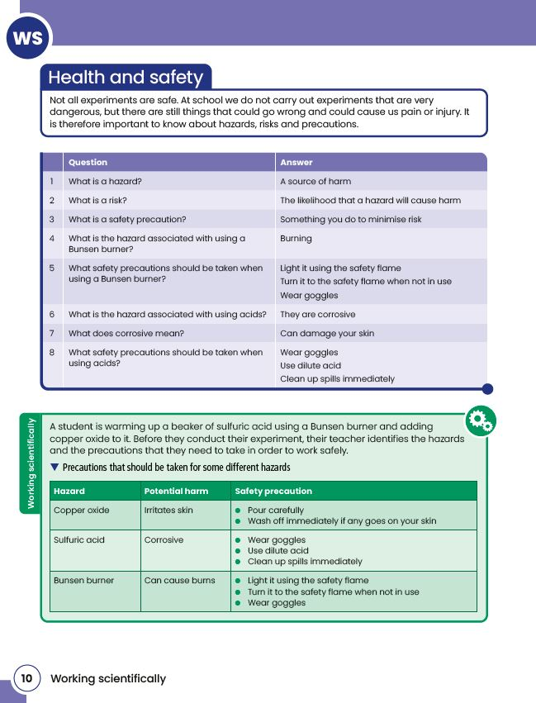
Knowledge Book
the all-in one student textbook
Strengthen scientific skills
'Working Scientifically' pages integrate principles and concepts into students' understanding, using questions and answers, diagrams, tables, and more.
Notes:
WS skills are integrated throughout

Slide 26
Practice Books
Designed to be used alongside our Knowledge Book, our Practice Books provide questions for students to consolidate, apply and extend their knowledge.
With over 1000 questions in each Book
One book per year > Improve students' long-term retention. > Build confidence in the key skills. > Support every student. > Prepare for the next step.
Notes:
Interleaving is built in throughout each Practice Book
Questions include working scientifically skills
Links to the relevant worked examples in the Knowledge Book are highlighted throughout.
Questions increase in difficulty throughout each topic

Slide 27
Teacher Handbooks
Our Teacher books will help you deliver more effective, dynamic and engaging lessons, whatever your level of experience. Everything is fully integrated with the other resources.
Feel fully supported. Supports teaching through guided explanation, modelling, and demonstration
Overcome common misconceptions. Prerequisite knowledge checks for students help you identify any missing knowledge or misconceptions before a topic is started
Tailor teaching to the class in front of you. 'Check for understanding' questions allow you to adapt your delivery to meet students' needs, with suggested questions and responses to start the process.

Slide 28
Springboard KS3 Science Boost
94 Classroom-ready PowerPoint presentations - the class presentation slides -
94 Interactive Knowledge Tests (quizzes), developed with our partners Carousel
Differentiated worksheets: Support, Stretch, and Retrieval ( and answer – files for each) one of each per unit
Worksheets to test understanding on working scientifically and on core practicals. WS worksheets; Core Practical worksheets
Stories worksheets and Careers worksheets (ALL these worksheets have a teacher version with answers) one each per unit ALL worksheets have teacher and student versions
end of unit and end of year assessments two per year
eBooks of Teacher Handbooks + Knowledge Book (unlimited eBooks in Premium)
Notes:
ALL worksheets have teacher and student versions

Slide 29
PD to support implementation
Springboard Science – Implementation experience
March 6th
Free
Adam Boxer
What products are on offer in the Springboard?
How do they solve current classroom issues?
Claudia Allen
Case study – how Claudia has implemented Springboard in her centre
How has it changed her teaching practice?
What do students think of the approach?

Slide 30
PD to support implementation
Implementing a Key Stage 3 Science curriculum underpinned with cognitive science principles
Delivered by Adam Boxer
London – Monday 17th June 2024
In-venue workshop fee: £275+VAT
Discounts for Springboard purchasers
Sessions covering:
Questioning in the Science classroom
Mastering modelling – live demo
Instruction in the science classroom
Retrieval practice
Sign up here
Sign up here

Slide 31
Sales And Marketing
Spring and Summer Term Discounts (up until the end of July)
Print only Discounts
Orders to the value of £2,000 = 20% Discount
£2,001 - £4,000 = 25% Discount
£4,001 - £6,000 = 30% Discount
Contact Stephanie.Brownbridge@hoddereducation.co.uk
For in-school and Teams appointments, BOOST demos, eInspections, trials, quotes and further information
Notes:
I’m around today with copies of the books and a selection of the Boost resources and will be happy to book appointments for more information about implementation and Boost

Slide 32
Science updates

Slide 33
Hampshire Education Awards
The 12 categories are:
Laying the Foundations Award
Education Leadership Award
Teaching Support Award
Wider Support Contribution Award
Outstanding Contribution to Education Award
Flying Colours Award
Apprentice Award
Teaching and Learning Award
Community Impact Award
Governance Award
Improving Life Chances Award
Futures Award
https://www.hants.gov.uk/educationandlearning/awards/how-to-enter
https://www.hants.gov.uk/educationandlearning/awards/categories

Slide 34
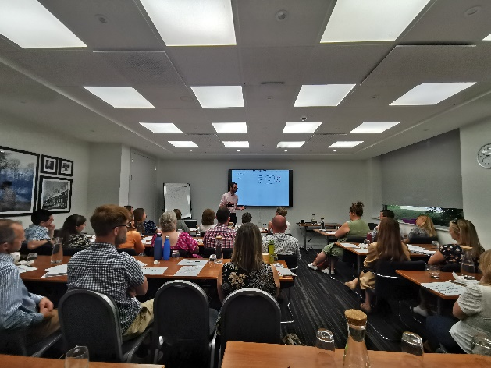
Adam will be back next year
Now bookable on the Learning Zone
Monday 24th June 2024
More in depth focus on one or two areas from his book: Teaching Secondary Science. A Complete Guide.

Slide 35
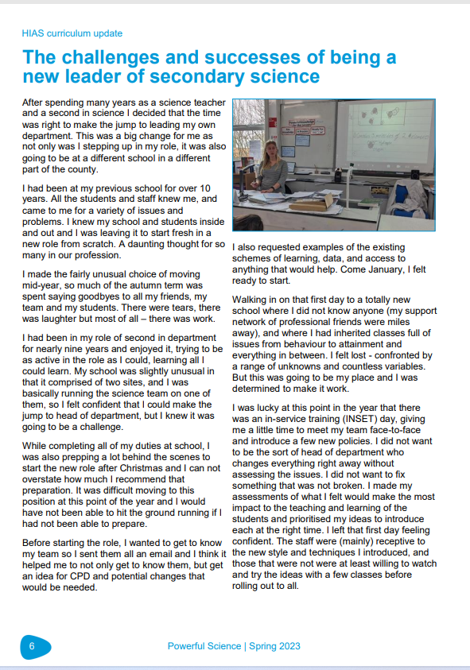
Powerful Science magazine

Slide 36
Powerful Science magazine
Establishment Name
Aldworth Science College
Applemore College
Brookfield Community School and Language
Crestwood Community School
Crookhorn College
Fernhill College
Hamble Community Sports College
Harrow Way Community School
Henry Beaufort School
Horndean Technology College
Hounsdown Academy
Kings' School
Park Community School
Portchester Community School
Swanmore College of Technology
Testbourne Community School
The Hayling College
The Henry Cort Community College
The Mountbatten School
The Toynbee School
The Vyne Community School
The Wavell School
Thornden School
Warblington School
Wildern School
Autumn edition out now.

Slide 37
Year 11 Progress Review

Slide 38
Year 11 updates
In small groups – share thoughts and experiences on these areas regarding Year 11.
How are Year 11 progressing? What successes are you having? What issues are you coming across with this cohort?
What other strategies are you using and are they impactful?
What intervention are you running/planning on running?

Slide 39
KS3 assessment

Slide 40
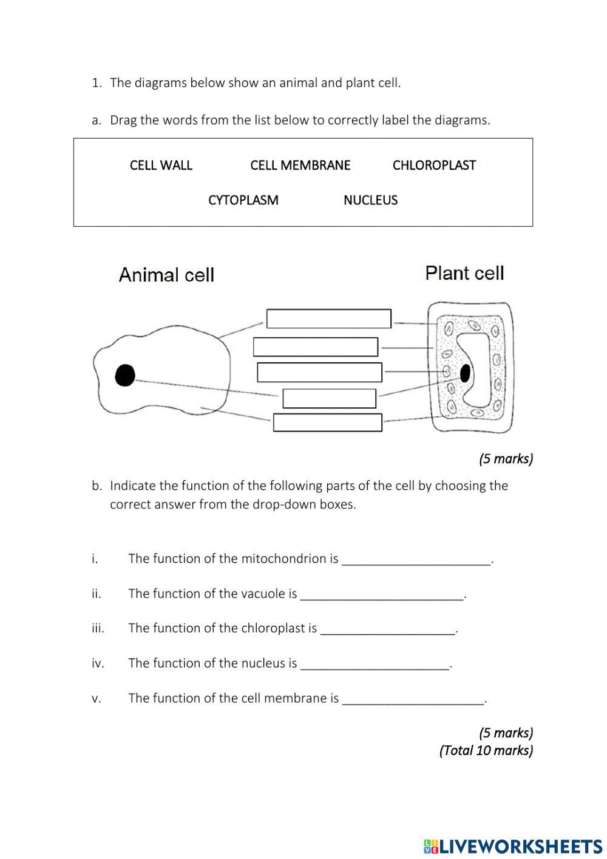
KS3 Assessment
One of the hardest things to get right
Often overlooked but important.

Slide 41
KS3 Assessment
What should great assessment at KS3 look like?
How frequently should we assess pupils in KS3?
Share on your tables what you currently do for KS3 assessment
What are your strengths and what are your developments?

Slide 42
KS3 assessment
Principles of great KS3 assessment
1. Assessment should assess the most important knowledge we want pupils to know. The key facts/concepts, end points.
Therefore, it’s key that these are identified somewhere.

Slide 43
KS3 assessment
Principles of great KS3 assessment
2. Make sure that disciplinary knowledge progression is clear in curriculum and then assessed at appropriate intervals. Sequencing of disciplinary knowledge and modes of assessment are key here.

Slide 44
KS3 assessment
Principles of great KS3 assessment
3. Assessments should revisit content from previous terms/ years. 60/40 new to old is recommended.
This forms part of the “culture of retrieval in a department”

Slide 45
KS3 assessment
Principles of great KS3 assessment
4. Sample across the domain. Not everything can or should be assessed.
If possible, sampling should be double blind.

Slide 46
KS3 assessment
Principles of great KS3 assessment
5. Questions should have clarity about what's being assessed.
Avoid over complicating questions. Questions that may rely on knowledge outside of the domain should be avoided.

Slide 47
KS3 assessment
Principles of great KS3 assessment
6. Use un-tiered exams/tests. Have a mix of low demand, standard demand, and high demand. 30, 40, 30 percent respectively
Ramping up each question and the paper provides the right challenge for all.

Slide 48
KS3 assessment
Principles of great KS3 assessment
7. Assessments should be effective but workload sensitive.
Use multiple choice, short answer, diagrammatic questions.
One per term with shorter low stakes MCQ assessment throughout. E.g. Find out Fortnights
Low stakes marked by pupils. Possible marking of low demand questions by pupils too.

Slide 49
KS3 assessment
Principles of great KS3 assessment
1. Assessment should assess the most important knowledge we want pupils to know. The key facts/concepts, end points.
2. Make sure that disciplinary knowledge progression is clear in curriculum and then assessed at appropriate intervals.
3. Assessments should revisit content from previous terms/ years. 60/40 new to old is recommended. 4. Sample across the domain. Not everything can or should be assessed.
5. Questions should have clarity about what's being assessed.
6. Use un-tiered exams/tests. Have a mix of low demand, standard demand, and high demand. 30, 40, 30 percent respectively
7. Assessments should be effective but workload sensitive.
Share your thoughts with your table on these points and which of these your KS3 assessment currently meets or does not meet.

Slide 50
Steering Group Focus

Slide 51
Steering Group Focus: Dual coding and Blank canvas modelling
HIAS Science Steering group
Wanted to have one area which was a repeated focus for a period.
Dual coding and blank canvas modelling was requested to be the first.

Slide 52
Steering Group Focus: Dual coding and Blank canvas modelling
Discuss, try, review
HIAS Science Moodle
Course Materials
Secondary
HODs Network 2023-2024
Section of the chapter on Dual Coding and BCM

Slide 53
Steering Group Focus: Dual coding and Blank canvas modelling
The Science Steering groups have been experimenting with aspects of BCM
Brigette -Thornden

Slide 54
Steering Group Focus: Dual coding and Blank canvas modelling
Discuss, try, review
Have a go if you are interested.
Members of the steering group will also be sharing at the next face to face meeting in February we will review and discuss some more.

Slide 55
Book of the Term

Slide 56
In School CPD offer
Delivered in your own school
Bespoke to your needs
Flexible timings-afterschool, inset days, etc.

Slide 57
Thank you
All 23/24 network sessions now bookable on
Learning Zone
Have a restful and half term break.
See you March 21st
Please complete the feedback form for this session

