Slide 1
Heads of Science Network Meeting
2023/2024- Spring 2
21/3/24
Kev Neil
Science

Slide 2
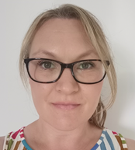
Welcome
The HIAS Science Team:
Kevin Neil
(County Science Inspector/Adviser)
Radiation Protection Officer
kevin.neil@hants.gov.uk
Emma Cooper (General Inspector/Advisor for Science)
emma.cooper3@hants.gov.uk

Slide 3
HIAS on Twitter
@HIAS_today
@Mrneil1859
@emmahantsprisci

Slide 4
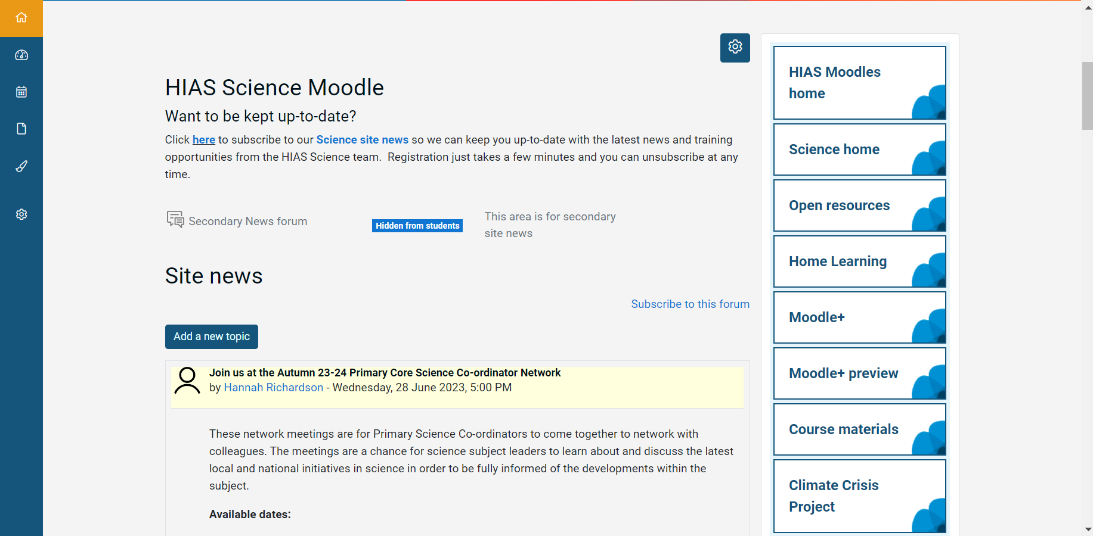

Slide 5
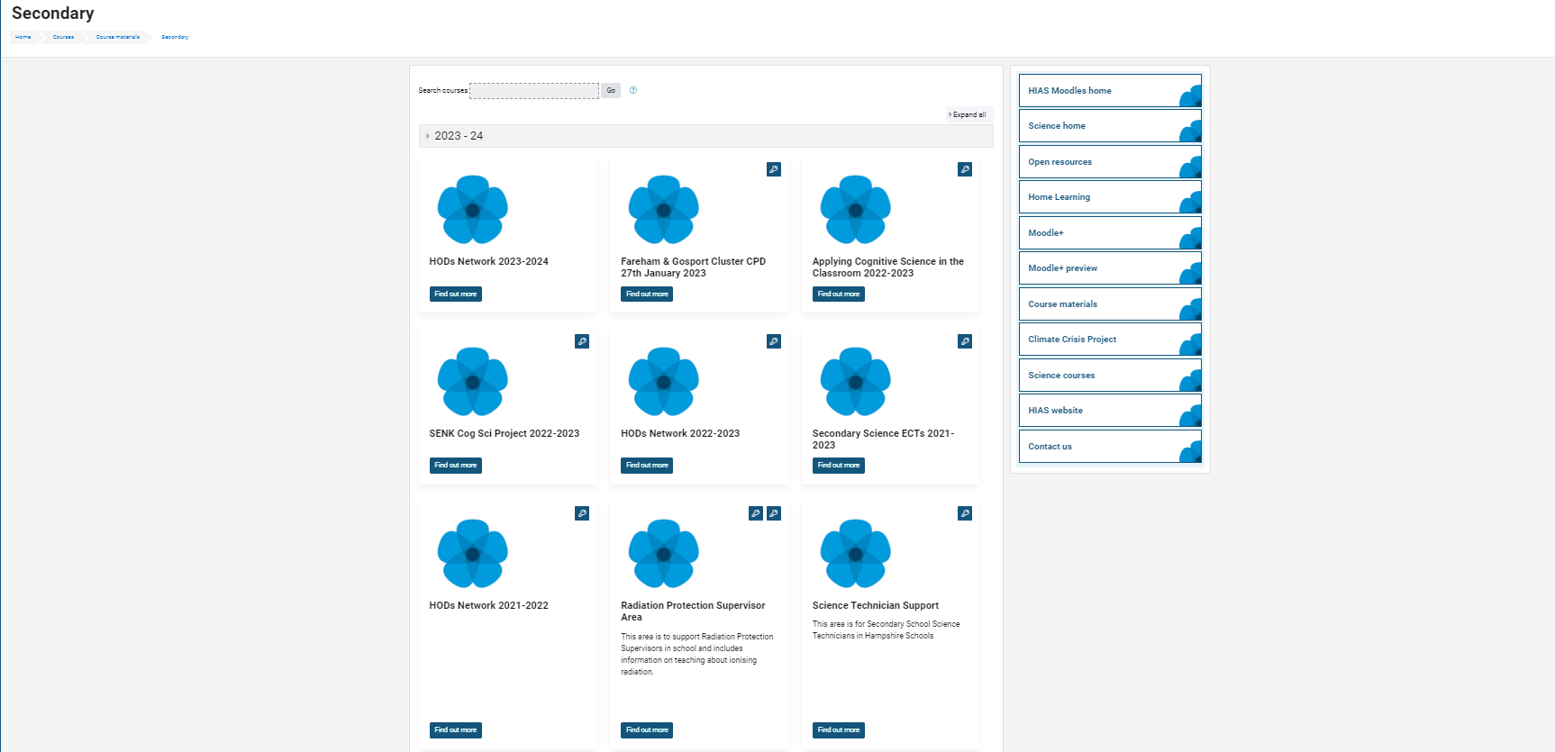

Slide 6
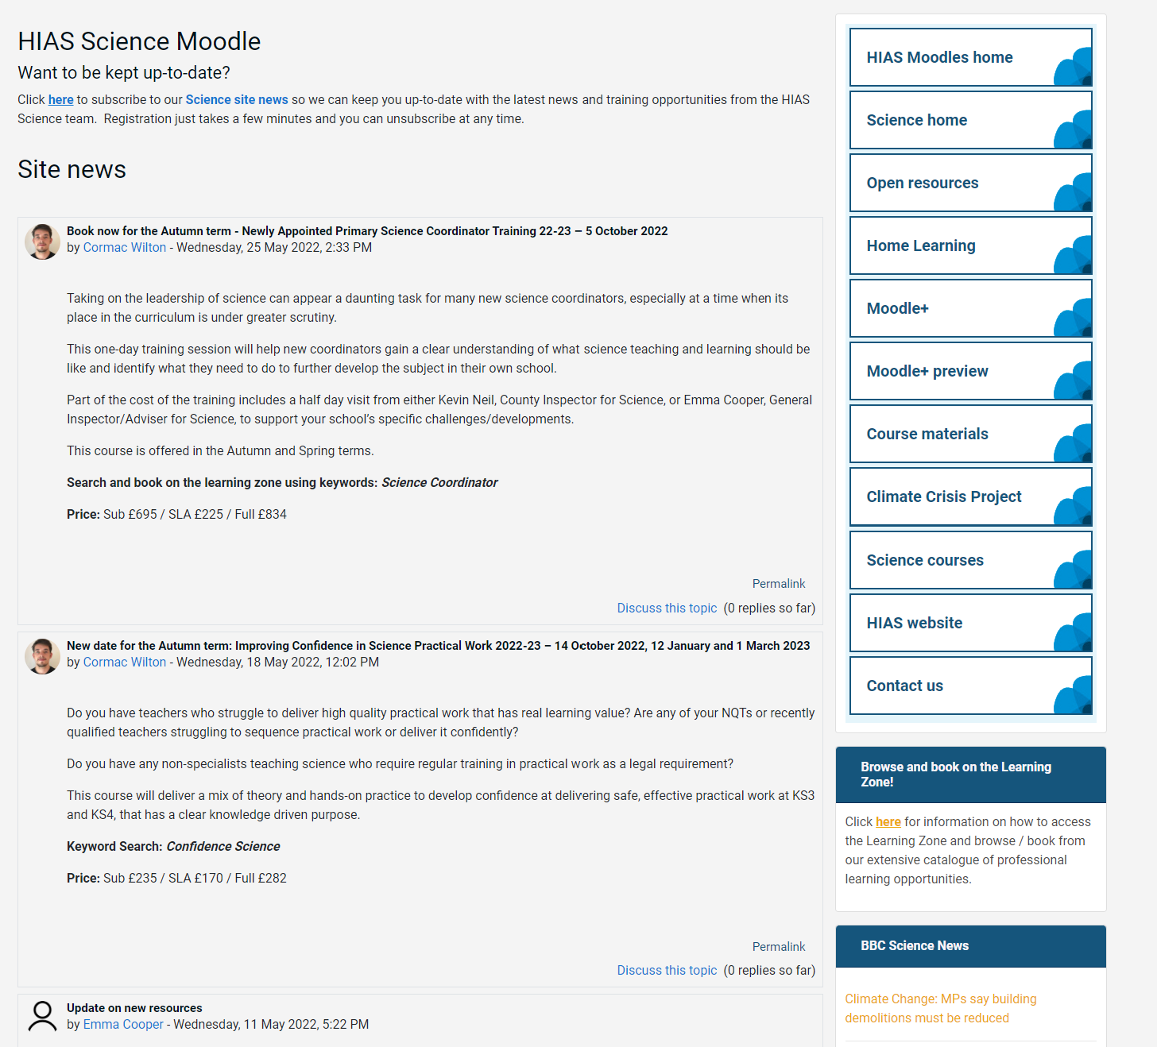
resources in the open access site.
Notes:
Kevin, I updated this slide- Emma

Slide 7
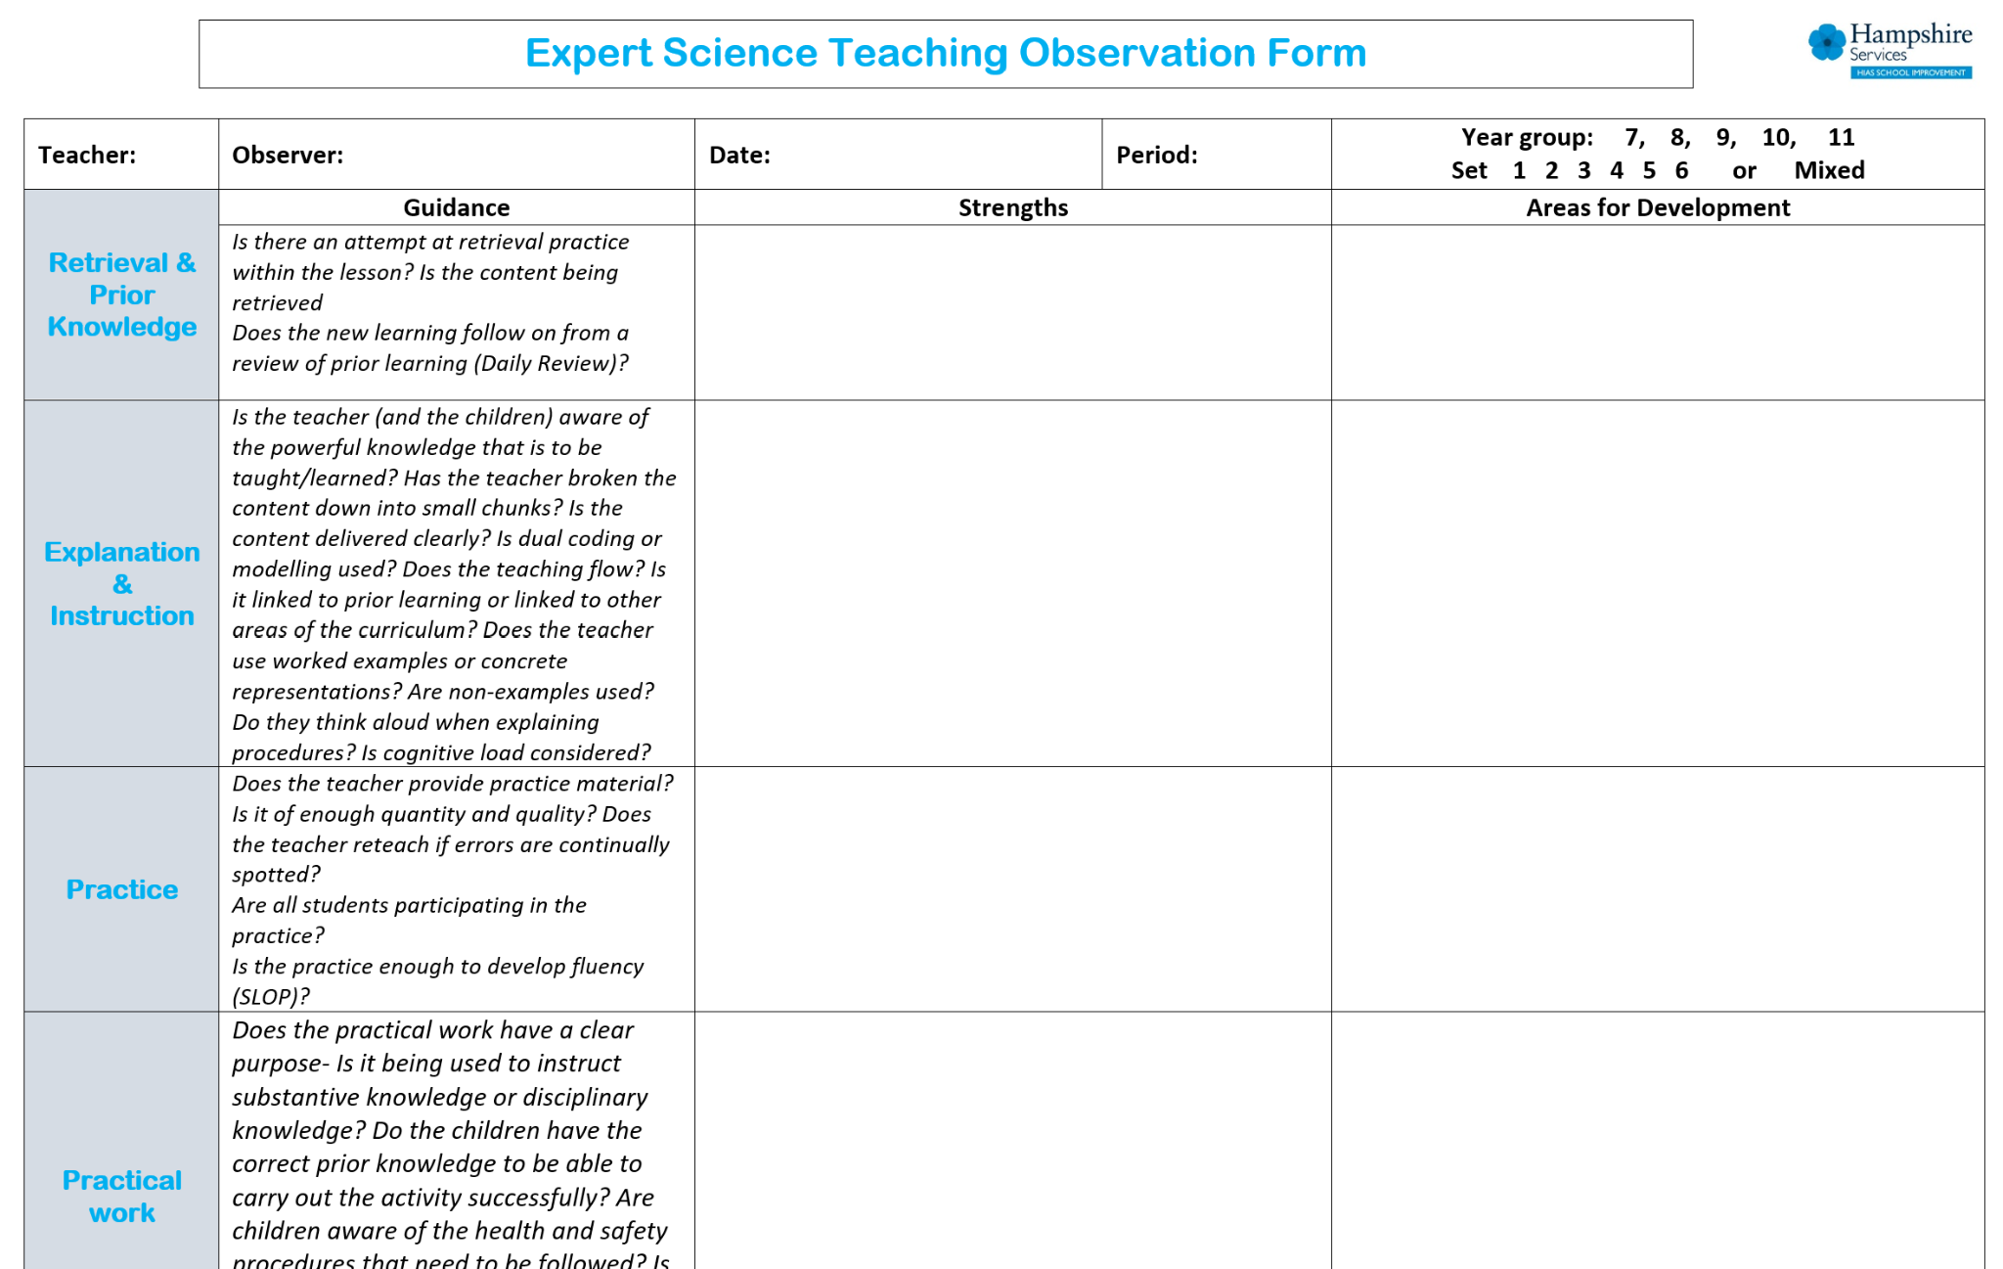
Notes:
Kevin, I updated this slide- Emma

Slide 9
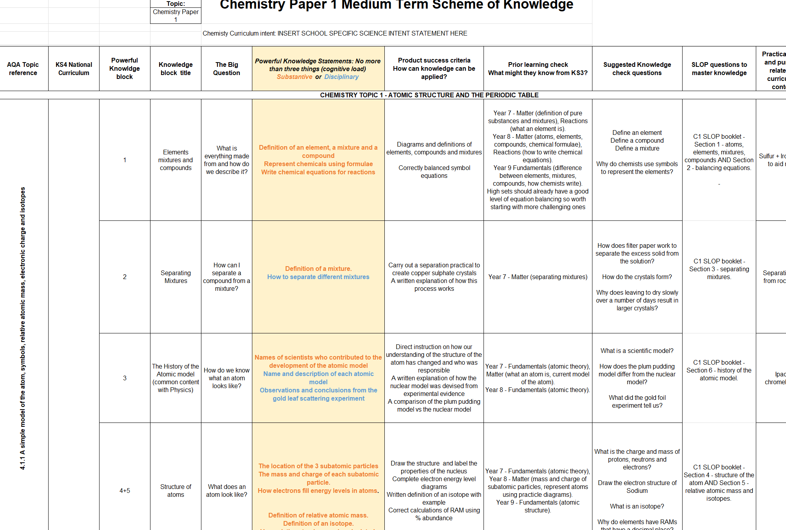

Slide 10
New resources uploaded into the open access site. SLOP booklets, learning walk proforma for expert teaching.
New Moodle+ resources
Notes:
Kevin, I updated this slide- Emma

Slide 11
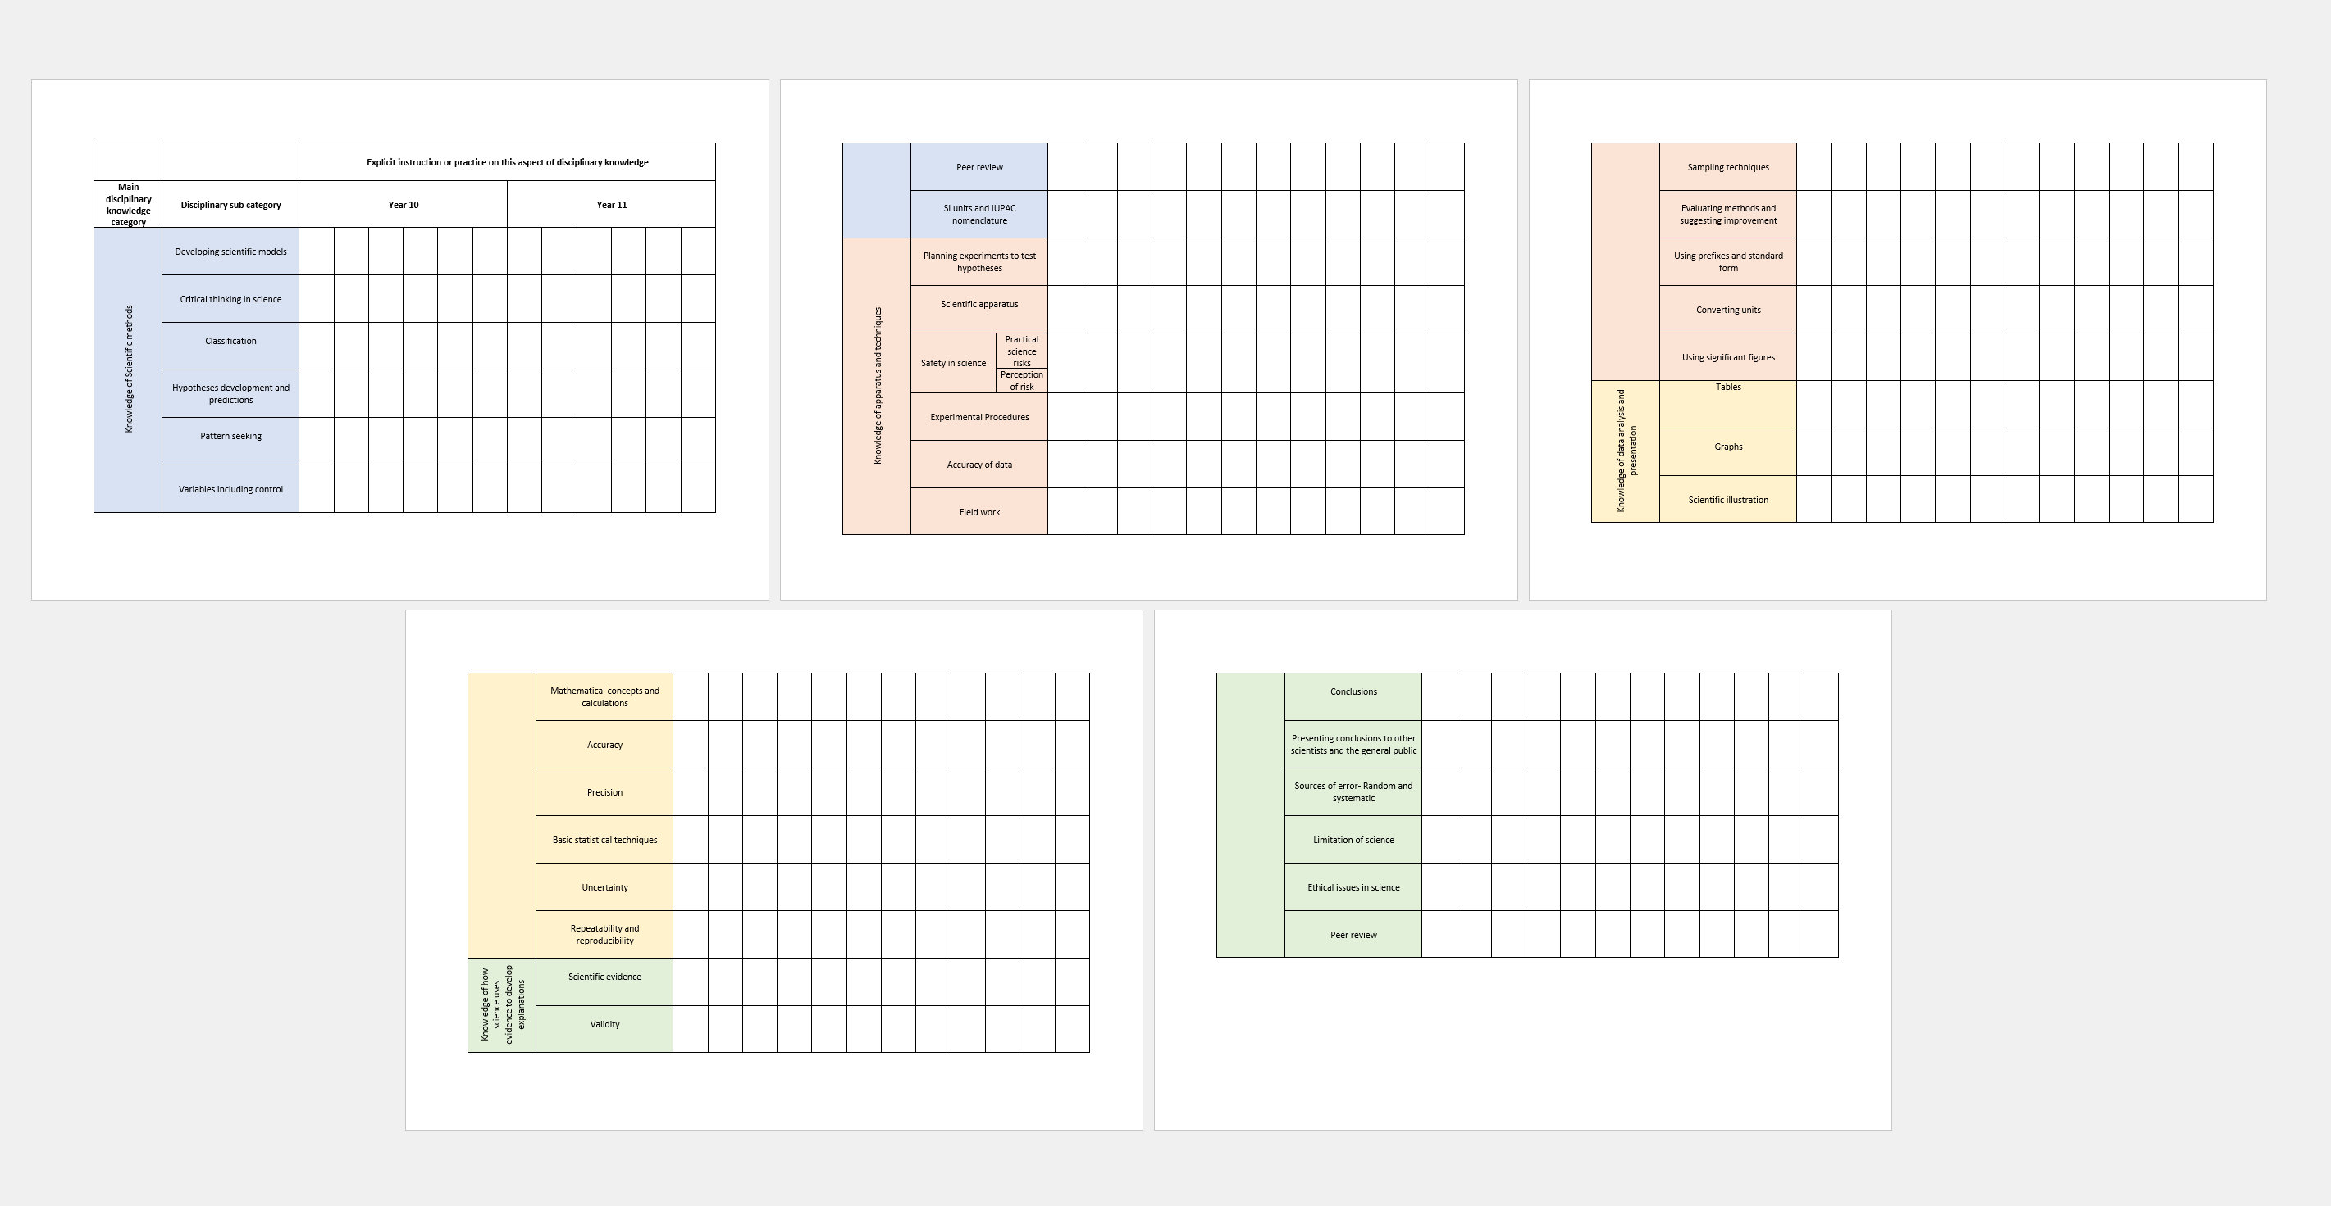
Tracking disciplinary knowledge instruction across KS3 & 4

Slide 12
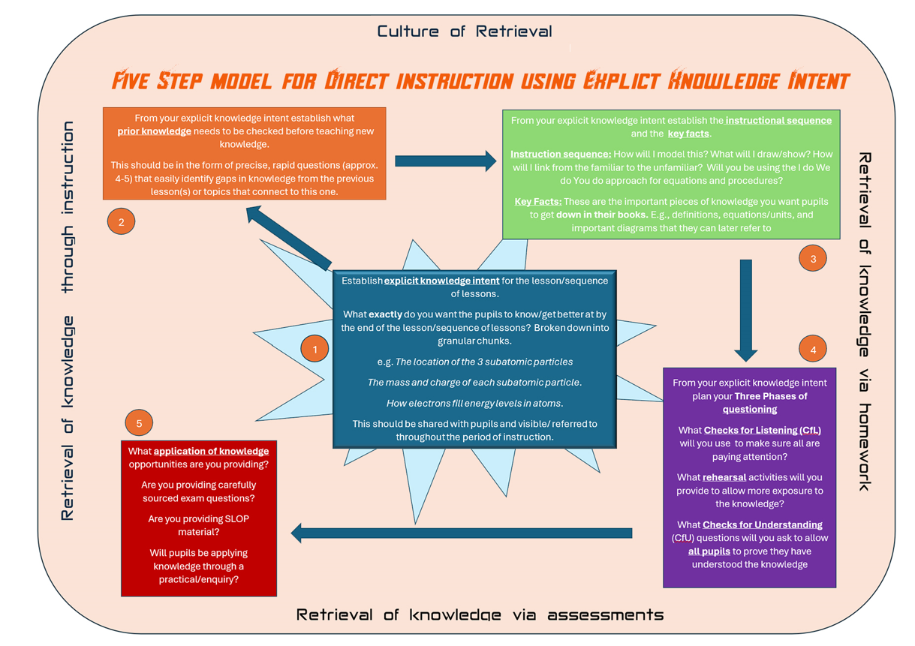
5 Steps for Expert Science Teaching

Slide 13
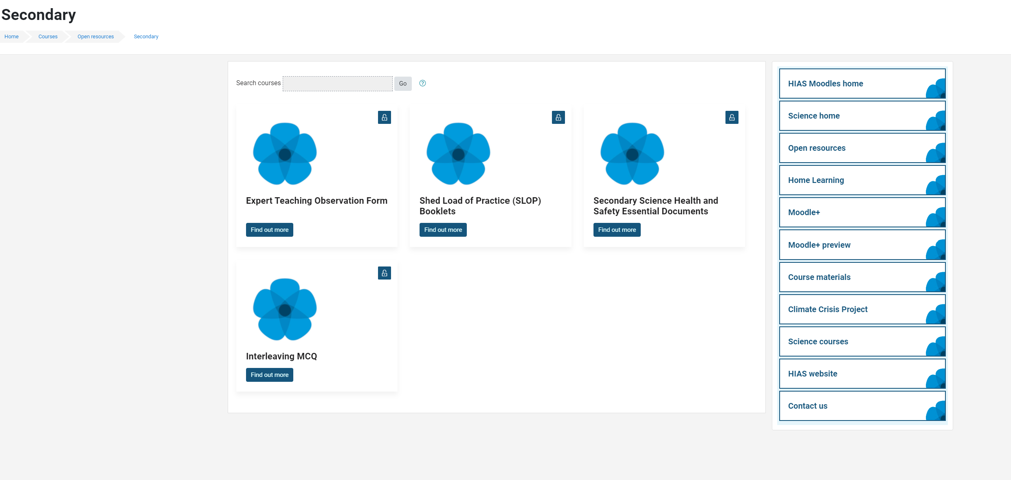
Updated Safety in Secondary Science documents

Slide 14
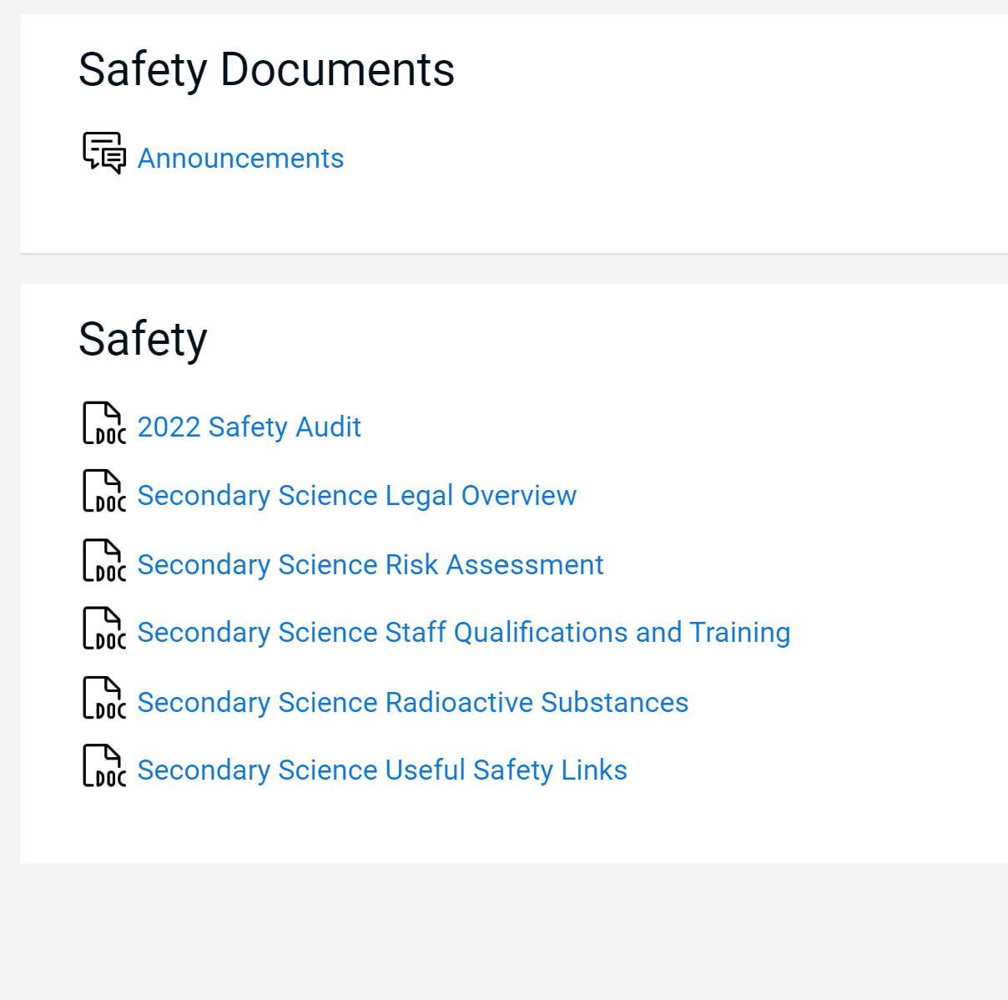
Updated Essential Safety in Secondary Science documents

Slide 15
Agenda for this afternoon
Catch up
AQA- Science
Science updates
Year 11 progress review
AI tool for teachers
Successfully implementing a software package
Excellence in Science- What does it look like?
Steering group agenda BCM
AOB
Notes:
Welcome back- Share course details with new sci-cos
Open discussion for 5 minutes to share the good things that have been happening
Ofsted review paper for science-learning journeys link- Who has read this? What did you think? Share key points- discuss. …’ majority no. of primary schools- reduced amount of curriculum time to teach science which led to a narrowing of the curriculum.’
Unpick the reason for the remodel and explain their importance in this first draft

Slide 16
Catch up
Welcome back.
Share some positives from the term so far.
What have been the challenges of the term so far?

Slide 17
AQA presentation

Slide 18
Science updates

Slide 19
Updates for RPS and Radioactive sources
The HSE is continuing to do inspections this term and into the summer so making sure your sources, storage and paperwork are up to date is vital.
New edition of L093 published end of February.
Here are some of the main changes in the 2024 edition of L093 – for a full list of changes search CLEAPSS for document GL114.
The HSE has stipulated that refresher training must be done at least every five years.
Reclassification of the radium cup source as one to keep under review (brown-dotted border). If there are signs of foil discolouration, dispose of the source.
Dispose of any expansion (Wilson) cloud chamber radium sources.
No longer advise transporting school sources by private car or school minibus.
The monthly store check has been revised so it records that each source has been checked

Slide 20
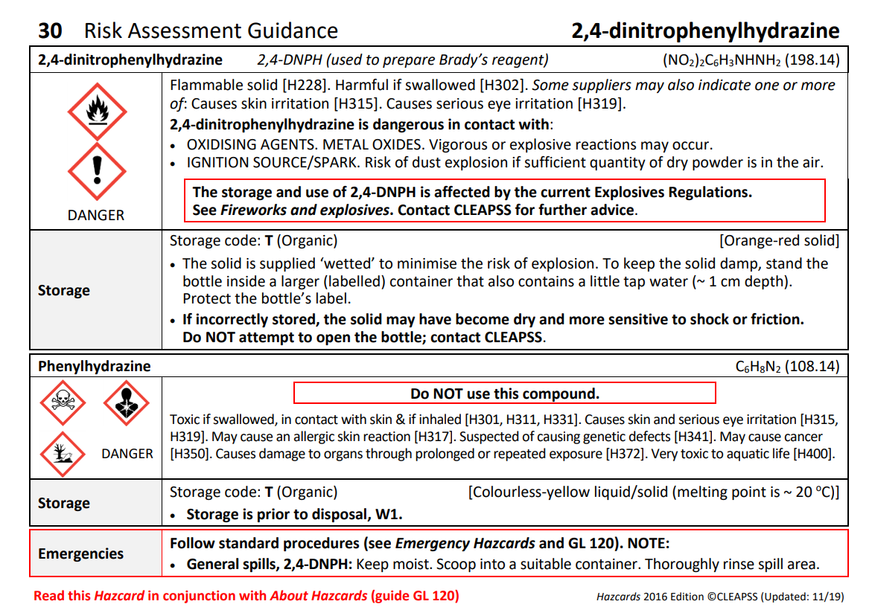
Incident with 2,4-DNP-H
A school in Hampshire recently had an incident with this specific chemical
The chemical should have been kept damp as it is highly explosive. Crystallisation occurred and it required a controlled explosion on the school field by the police and fire team.
This chemical is used predominately in A-Level organic chemistry.
Worth checking if some of it is lurking in the back of chemical stores, and it’s being kept under the correct conditions.

Slide 21
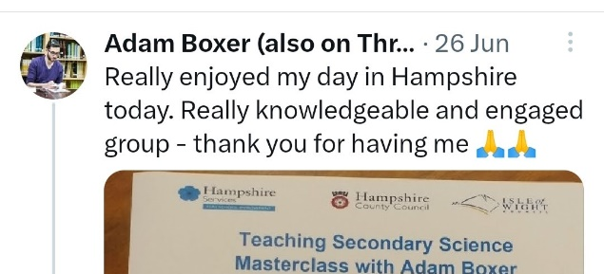
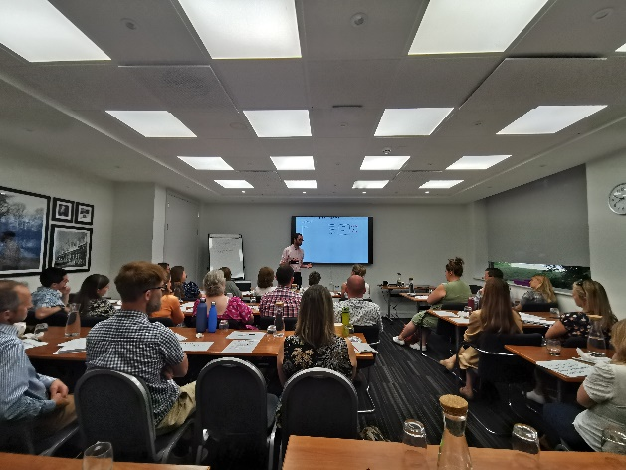
Adam will be back next year
Now bookable on the Learning Zone
Monday 24th June 2024
More in depth focus on one or two areas from his book: Teaching Secondary Science. A Complete Guide.

Slide 22
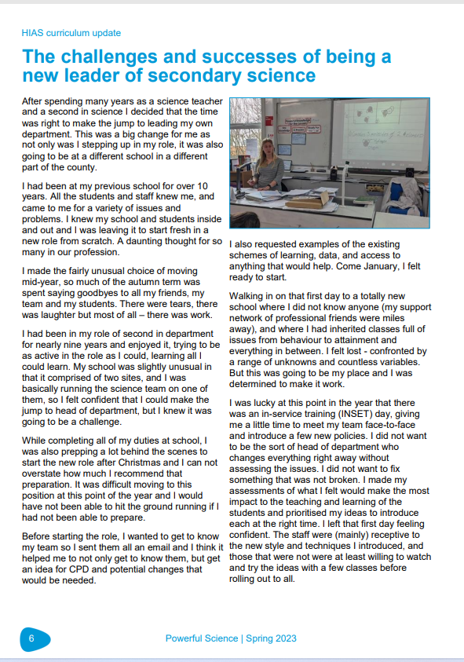
Powerful Science magazine

Slide 23
Powerful Science magazine
Establishment Name
Aldworth Science College
Applemore College
Brookfield Community School and Language
Crestwood Community School
Crookhorn College
Fernhill College
Hamble Community Sports College
Harrow Way Community School
Henry Beaufort School
Horndean Technology College
Hounsdown Academy
Kings' School
Park Community School
Portchester Community School
Swanmore College of Technology
Testbourne Community School
The Hayling College
The Henry Cort Community College
The Mountbatten School
The Toynbee School
The Vyne Community School
The Wavell School
Thornden School
Warblington School
Wildern School
Spring edition just published. Should be arriving to your school soon.
Secondary articles include:
High quality use of exam questions in lessons at Swanmore College
KS3 assessment
AI tools

Slide 24
Year 11 Progress Review

Slide 25
Year 11
In small groups – share thoughts and experiences on these areas regarding Year 11.
What are the current barriers to success?
Have you changed direction or strategy since the last discussion --based upon new data/mocks round 2?
What revision strategies/programmes are you running?

Slide 26
AI tools for Teachers Katie Bax

Slide 27
Successfully rolling out a software package Sonia Atkins

Slide 28
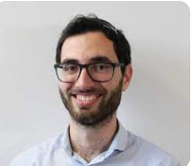

Slide 30
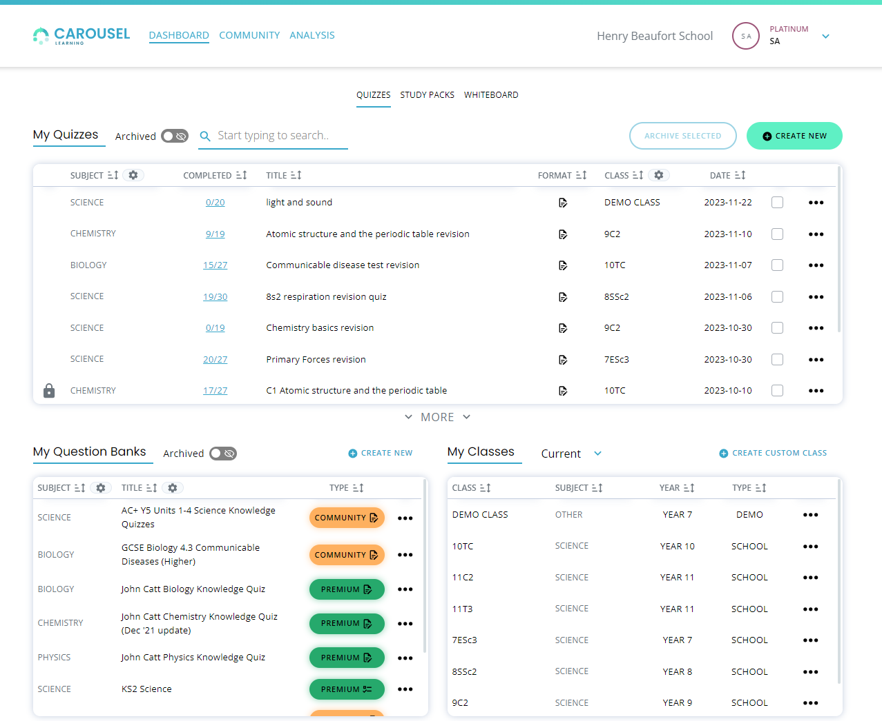
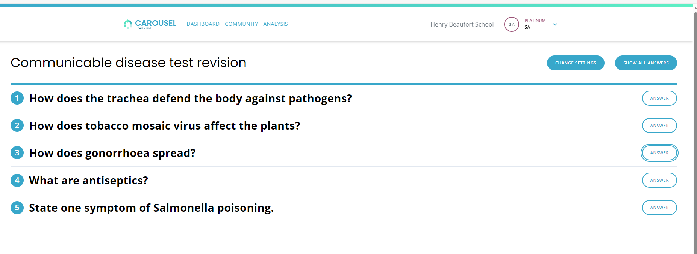

Slide 32
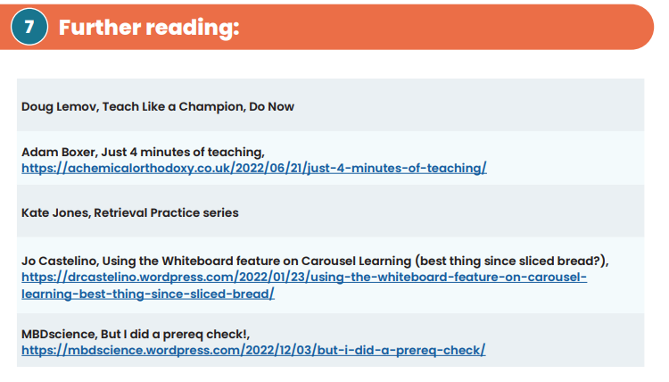

Slide 33
What does excellence in science look like?

Slide 34
Excellence in KS3
Spring 1 Assessment discussion
End points being clear
Are we all clear about what our end points are at Year 7 and Year 8?
What does excellence look like?
Can you define it?
Could you show examples or identify individual pupils who have achieved that excellence?

Slide 35
Steering Group Focus

Slide 36
Steering Group Focus: Dual coding and blank canvas modelling
HIAS Science Steering group
Wanted to have one area which was a repeated focus for a period.
Dual coding and blank canvas modelling was requested to be the first.

Slide 37
Steering Group Focus: Dual coding and blank canvas modelling
Discuss, try, review
HIAS Science Moodle
Course Materials
Secondary
HODs Network 2023-2024
Section of the chapter on Dual Coding and BCM

Slide 38
Steering Group Focus: Dual coding and blank canvas modelling
The Science Steering groups have been experimenting with aspects of BCM
Specific examples of the use of Johnstone’s Triangle in AQA Chemistry Topic 4
Brigette Drabble–Thornden
Amy Bateman- Hamble

Slide 39
Steering Group Focus: Dual coding and Blank canvas modelling
Discuss, try, review
Have a go if you are interested.
Members of the steering group will continue to be sharing at the next face to face meeting in July we will review and discuss some more.

Slide 40
Book of the Term

Slide 41
Subject knowledge enhancement course
Six half-day sessions taking place half-termly, commencing Spring Term 2 - 2023/24
• Short, helpful intersessional tasks for participants to put their theoretical learning into practice and to facilitate learning from colleagues on the course.
• A webinar with the facilitator between sessions, to discuss learning, ask questions and seek advice.
• An opportunity to visit high-performing subject departments.
• Moodle area providing practical teaching resources and sources of further support.

Slide 42
In School CPD offer
Delivered in your own school
Bespoke to your needs
Flexible timings-afterschool, inset days, etc.
Coaching model also available.
Email me directly to enquire
further about these or to book.

Slide 43
AOB

Slide 44
Thank you
All 23/24 network sessions now bookable on
Learning Zone
Have a relaxing and enjoyable Easter break.
See you online in May and face to face in July.
Please complete the feedback form for this session

