Slide 1
Heads of Science Network Meeting 2023-24
Autumn 2023 Session 1

Slide 2
Catch up
Welcome back.
Share some positives from the term so far.
What have been the challenges of the term so far?

Slide 3
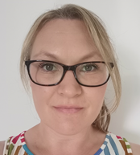
Welcome
The HIAS Science Team:
Kevin Neil
(County Science Inspector/Adviser)
Radiation Protection Officer
kevin.neil@hants.gov.uk
Emma Cooper (General Inspector/Advisor for Science)
emma.cooper3@hants.gov.uk

Slide 4
HIAS on Twitter
@HIAS_today
@Mrneil1859
@emmahantsprisci

Slide 5
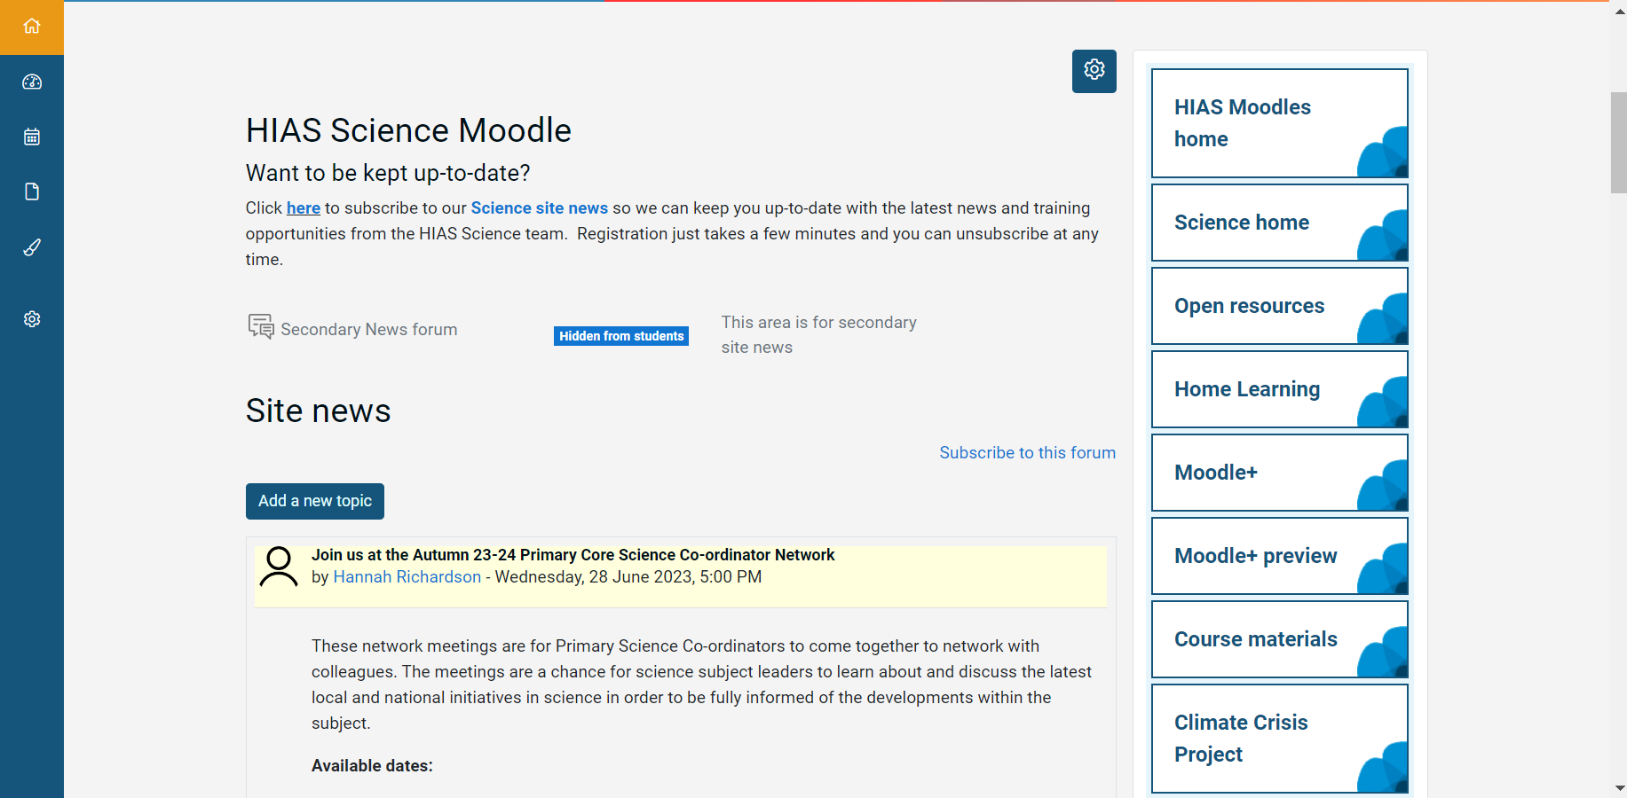

Slide 6
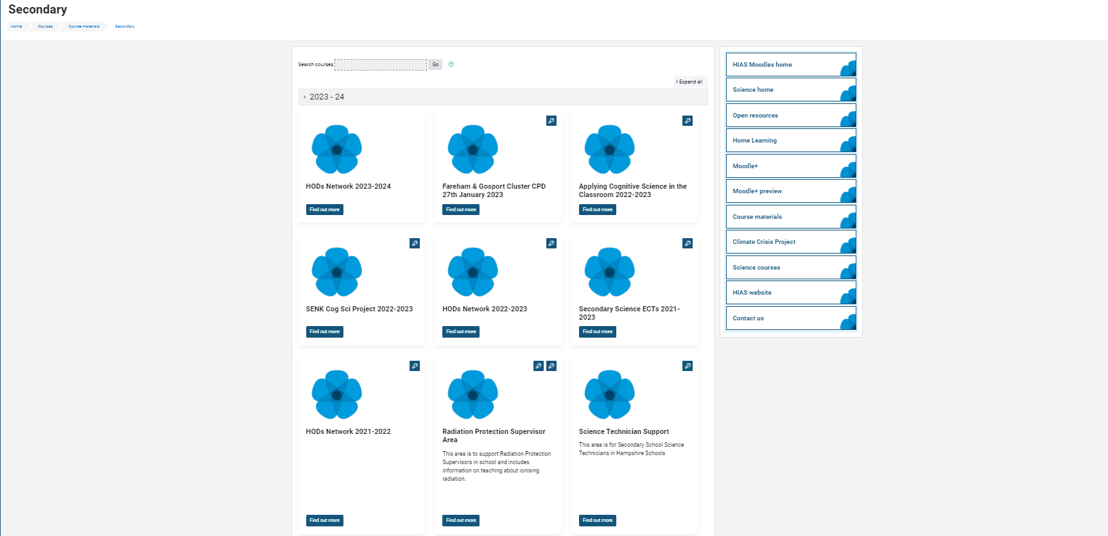

Slide 7
resources in the open access site.
Notes:
Kevin, I updated this slide- Emma

Slide 8
New resources uploaded into the open access site. SLOP booklets, learning walk proforma for expert teaching.
New Moodle+ resources
Notes:
Kevin, I updated this slide- Emma

Slide 9
Notes:
Kevin, I updated this slide- Emma

Slide 11
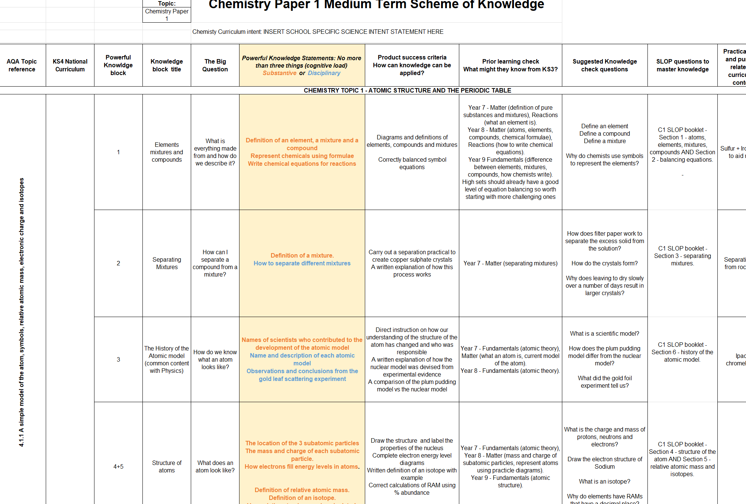

Slide 12
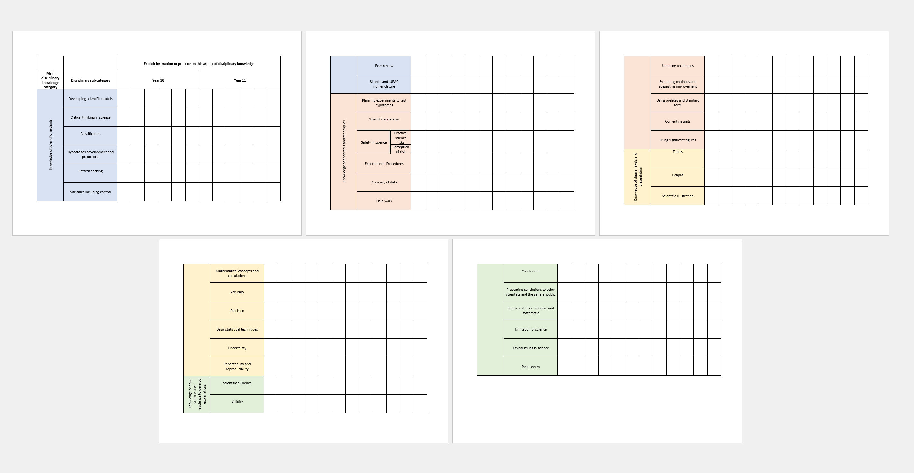
Tracking disciplinary knowledge instruction across KS3 & 4

Slide 13
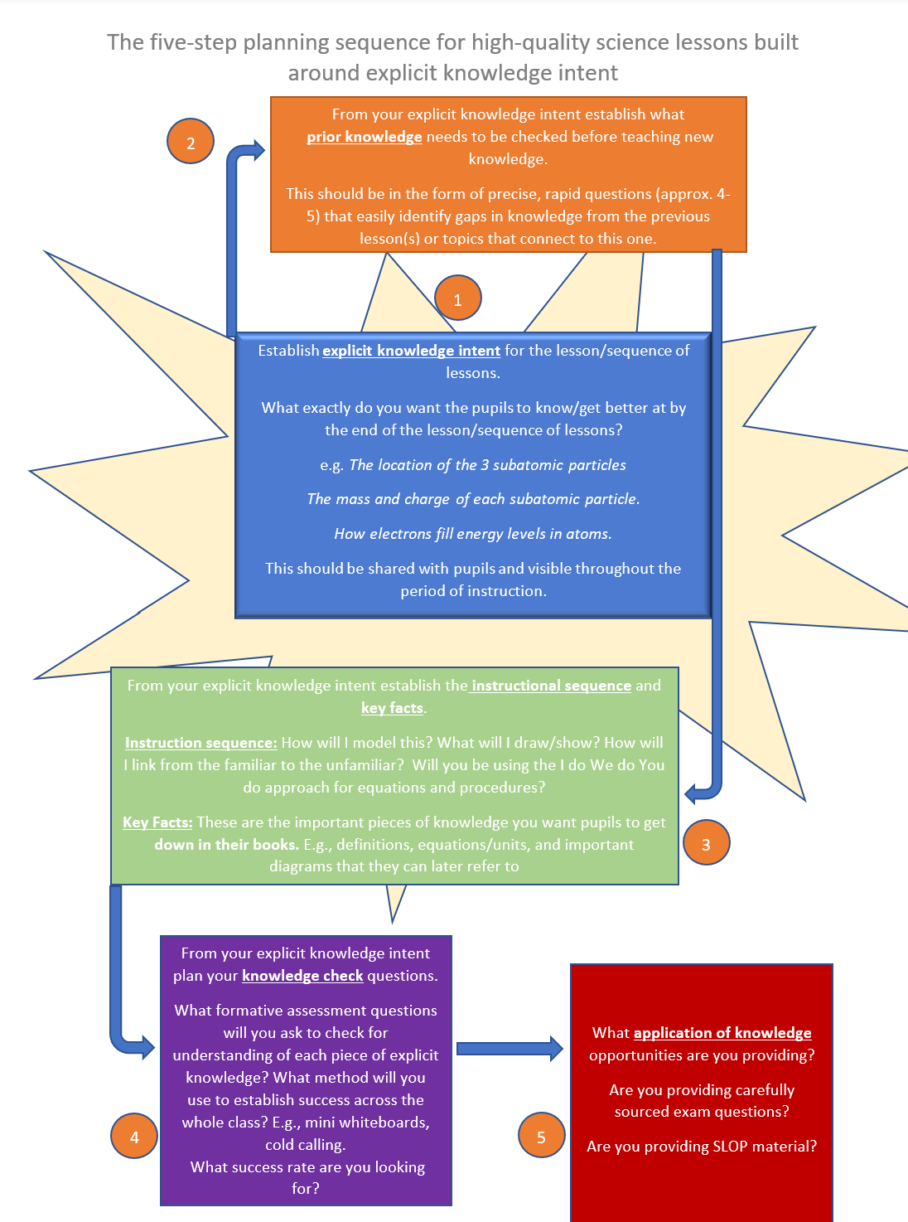
5 Steps for Expert Science Teaching

Slide 14
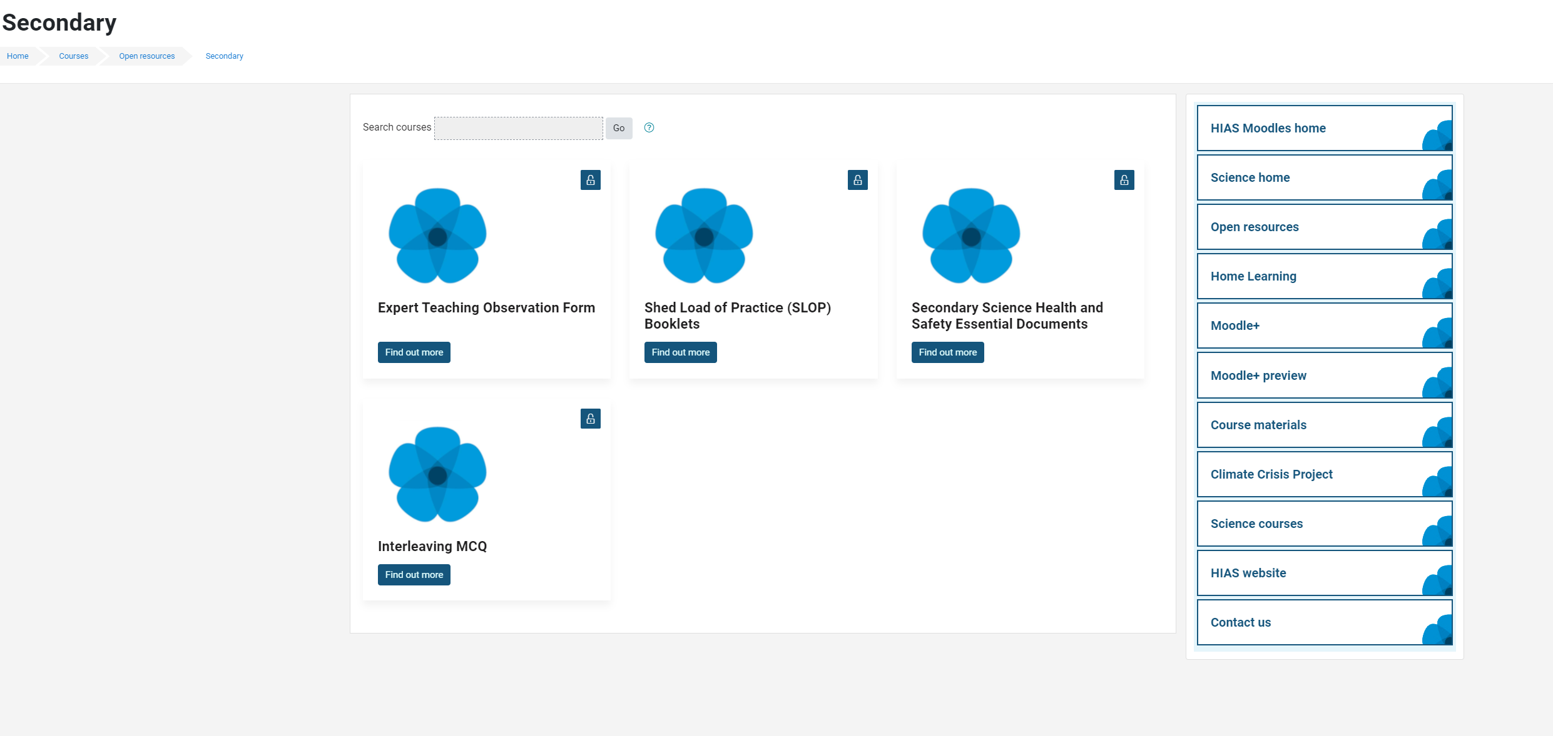
Updated Safety in Secondary Science documents

Slide 15
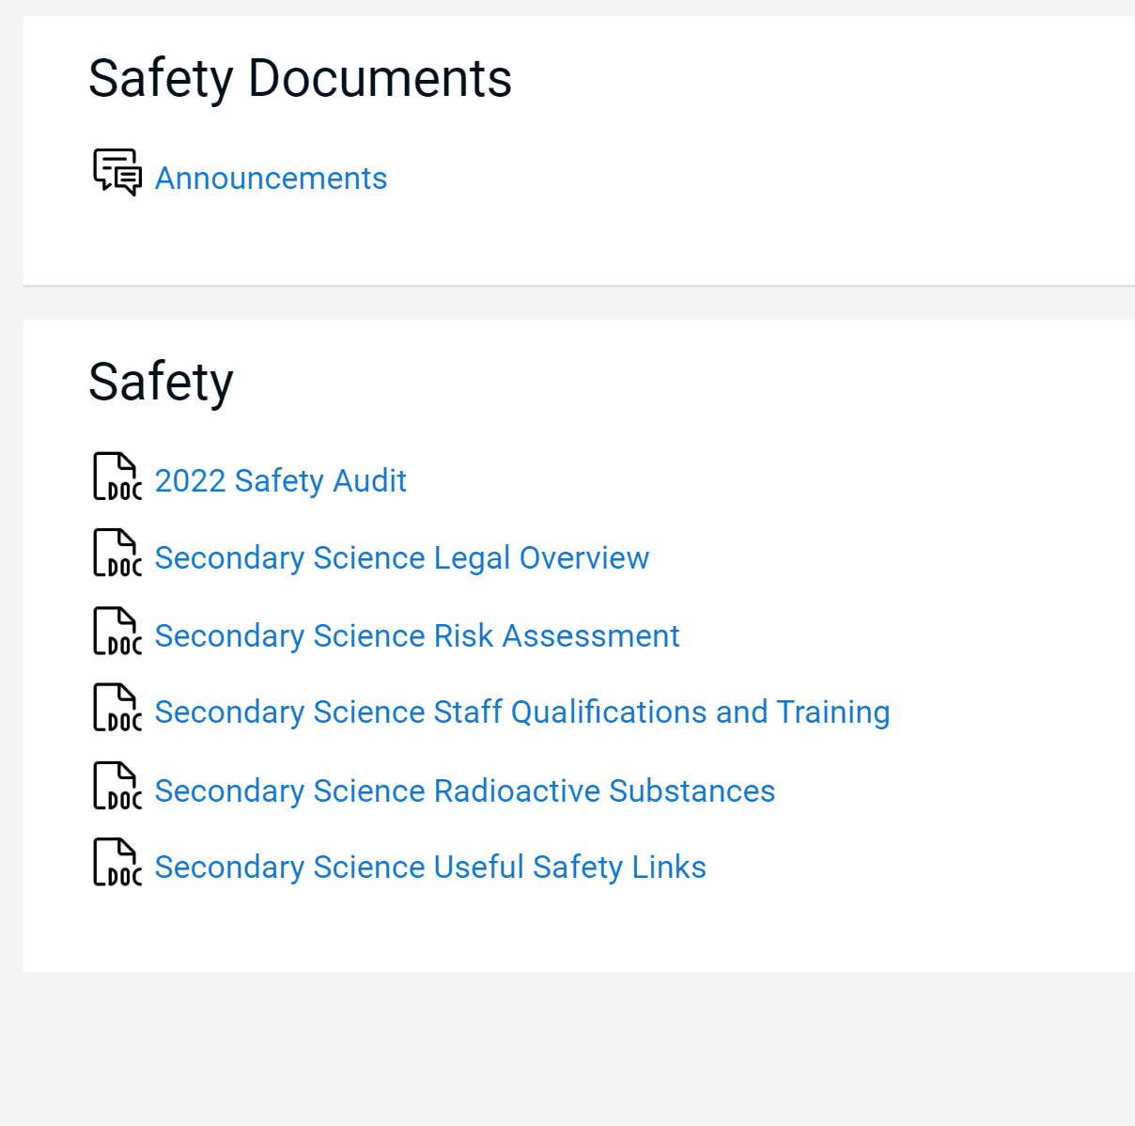
Updated Essential Safety in Secondary Science documents

Slide 16
Agenda for this afternoon
AQA update
Lifelab
Science Updates
GCSE Summer 2023 analysis and discussion
Year 11 action plans
Steering group agenda BCM
AOB
Notes:
Welcome back- Share course details with new sci-cos
Open discussion for 5 minutes to share the good things that have been happening
Ofsted review paper for science-learning journeys link- Who has read this? What did you think? Share key points- discuss. …’ majority no. of primary schools- reduced amount of curriculum time to teach science which led to a narrowing of the curriculum.’
Unpick the reason for the remodel and explain their importance in this first draft

Slide 17
AQA presentation

Slide 19
Science updates

Slide 20
Updates from CLEAPSS
Radioactive materials:
Full round of HSE inspections finished…..
…….still visiting but less often now
149 inspections
56% material breach rate
Large fines issued to some schools

Slide 21
Updates from CLEAPSS
Radioactive materials:
L93 update coming in January 2024
Some changes will require the RPS to sign certain parts to confirm compliance.
Signatures will be checked as part of RPO visit.

Slide 22
Updates from CLEAPSS
Radioactive materials:
I will be visiting all maintained schools with sources from January 2024
Make sure you have submitted an up-to-date FORM 1 (should have done this when the renewal info went out in April).

Slide 23
Updates from CLEAPSS
Latest updates for action:
1. Many schools still have legacy sources – any source that is double red-bordered in L093 (or does not appear in L093) must be disposed of because the school does not have a risk assessment to keep these. The HSE are concerned because many of these old sources have degraded to an unsafe condition. Any non-CLEAPSS risk assessed source MUST BE DISPOSED OF IMMEDIATELY following the correct procedures in L093.
2. The HSE found schools with out-of-date or incomplete inventories. Sources were in the store which were not recorded anywhere. There were also records of sources that could not be located or accounted for in terms of disposal records. Inventory must match what is in the store.
3. The HSE wants the monthly store source check to itemise each source individually and involve actual visual confirmation the source is in its container.
4. The current edition of L093 & GL016 both need to be available in the science department and the RPS needs to be aware of dose rates in GL016.

Slide 24
Updates from CLEAPSS
Latest updates for action:
5. The source user log must record that information has been given to 6th form students using the sources, along with a record of the students’ names.
6. Staff and RPS(Schools) training must be refreshed at least every 5 years. Staff training can be done by the RPS (schools). It must be recorded.
7. Contingency plans – staff need to be aware of what to do. There is no need to physically rehearse the plan, but it must be part of the training and refresher training as a discussion (what the HSE calls a desktop rehearsal). There must be a note of this in the training records. An example would be what to do if a source is missing. *Note that dropping a sealed source is not a radiation accident and does not need a formal contingency plan, but the training should still cover how to deal with this.

Slide 25
Radiation incident examples- staff should have awareness but no rehearsal required | Radiation accident examples- require a desktop rehearsal
A small spill, e.g., a few flakes from a rock A cup source dropped onto table or floor A fire alarm causing an evacuation while using a source | Contamination to a person spread over clothing or skin A spill of a compound that caused dust that could have been inhaled A protactinium generator dropped onto the floor A loss or theft of a source A major fire or other incident affecting the sources, e.g., flooding.

Slide 26
Radon Gas
The HSE decided to also look at Radon gas in schools and had the presumption that this was monitored and dealt with by the RPS. This will be a big focus for them this year.
CLEAPPS advice is this is not a job for the RPS but for the senior site team or Headteacher. However, some teachable opportunities may arise from having some involvement. Make sure you know who is responsible for Radon gas in your school.

Slide 27
Safety Audit
Have extended the deadline due to several requests.
Analysis on 13th October
If LA school and not submitted, then risk an H&S inspection
Link has been emailed out by me several times
Also sent out to all schools via school comms
https://forms.office.com/e/DAxW83CBW0

Slide 28
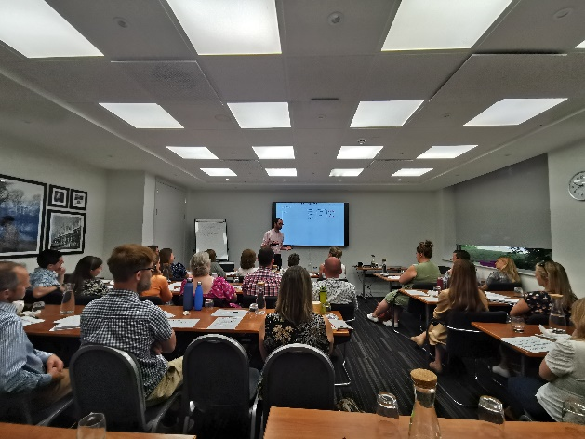
Adam will be back next year
Save the date
Monday 24th June 2024
More in depth focus on one or two areas

Slide 29
Springboard science Webinar 18th October 3.30pm -4.30pm

Slide 30
Technicians network
Next meeting will be in early December.
Will contact you and the technicians with the details. Will share more from the CLEAPSS safety conference.

Slide 31
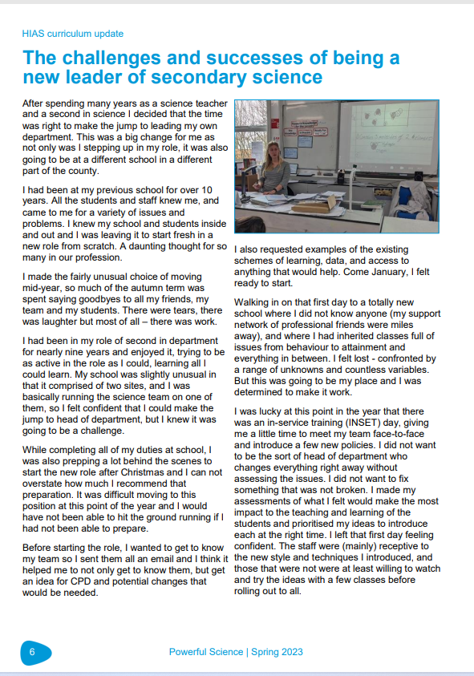
Powerful Science magazine

Slide 32
Powerful Science magazine
Establishment Name
Aldworth Science College
Applemore College
Brookfield Community School and Language
Crestwood Community School
Crookhorn College
Fernhill College
Hamble Community Sports College
Harrow Way Community School
Henry Beaufort School
Horndean Technology College
Hounsdown Academy
Kings' School
Park Community School
Portchester Community School
Swanmore College of Technology
Testbourne Community School
The Hayling College
The Henry Cort Community College
The Mountbatten School
The Toynbee School
The Vyne Community School
The Wavell School
Thornden School
Warblington School
Wildern School
Autumn edition coming soon

Slide 33
SEN Project continuation
Third year funding approved
Want to work with one (possibly two) schools to focus on one area of Cog Sci approaches in a rigorous study into the effectiveness.
Would require some adjustment of topic rotation etc, so two classes are studying the same material and same tests etc.

Slide 34
ASE Southern Regions Event
ASE Southern Regions Science event | www.ase.org.uk

Slide 35
Free ECT session
Wednesday 1st November 2pm-3pm
Free online ECT session for 1st or 2nd Year ECTs
Will cover an overview of high-quality science teaching approaches and touch on practical work
Open to any ECT regardless of who provides their ECT training.
Further sessions will then be available to book onto.
Booking at this link for the first free session. https://forms.office.com/Pages/ResponsePage.aspx?id=tdiBPwfuF0yGnB20OQGNm3qJnwgG6LNBmsw6W1ROU0VUMllaWko1REdZTkdYQUpFOEE2V0I2TzAzMi4u

Slide 36
GCSE Summer 2023 analysis and discussion

Slide 37
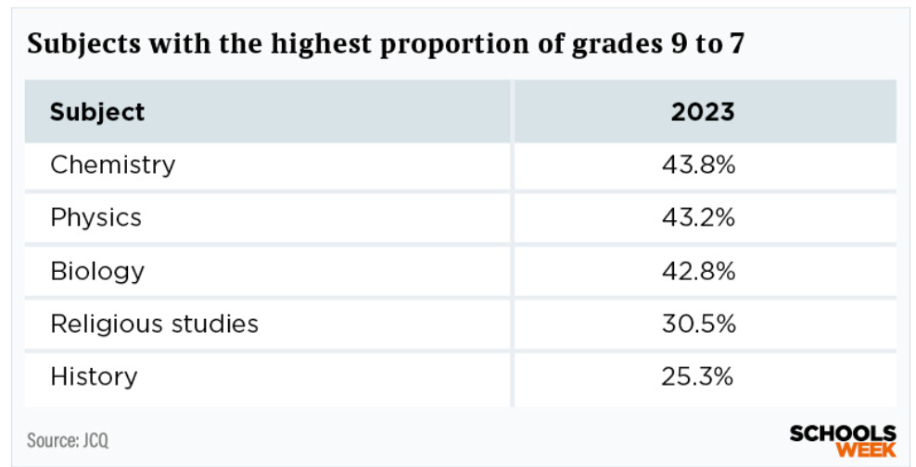

Slide 38
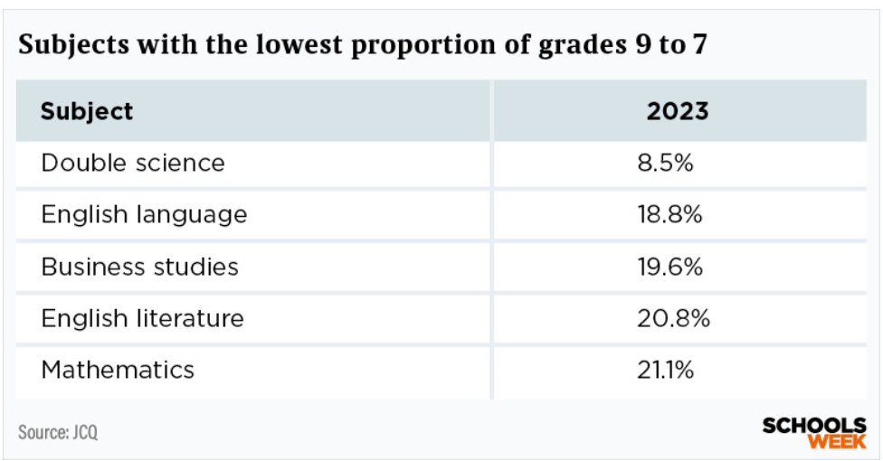

Slide 39
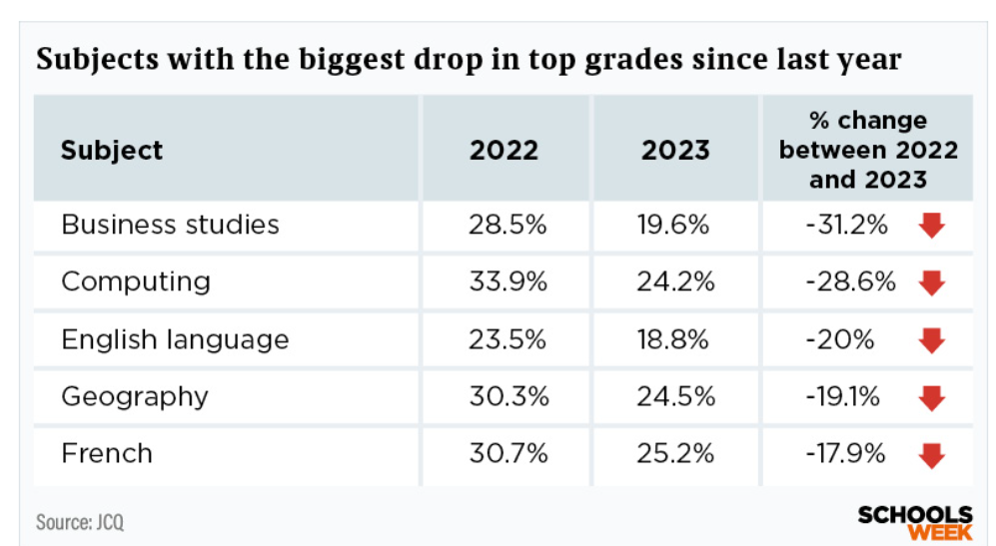
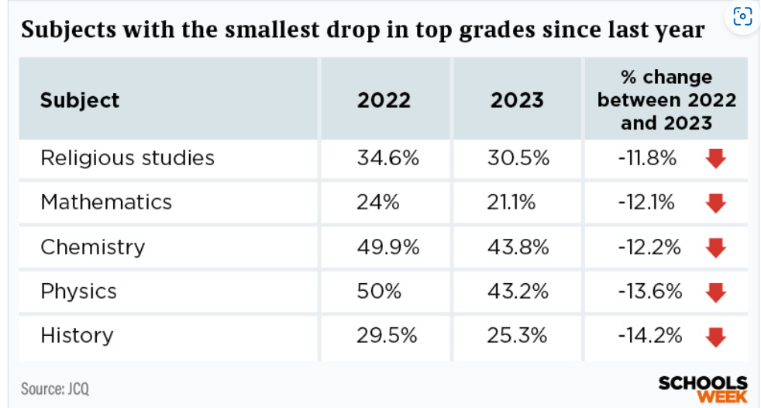

Slide 40
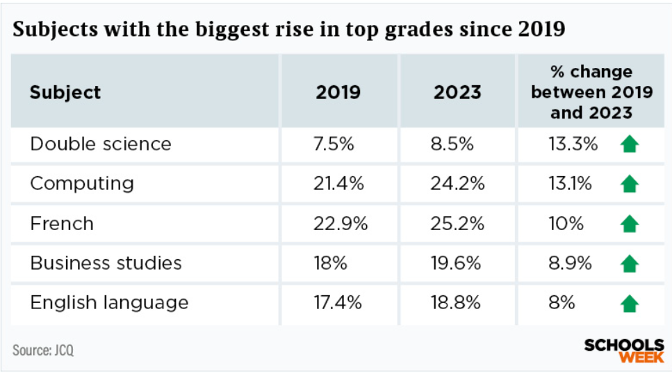
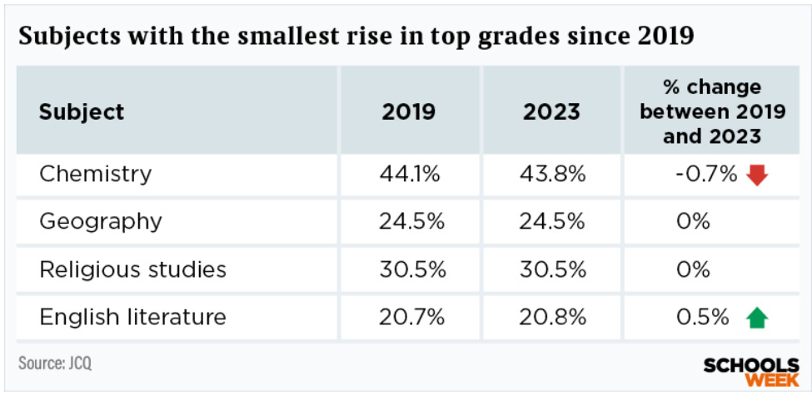

Slide 41
Local data
Slightly below national here, gap is wider than 2022
Very close or better than national here

Slide 42
Local data
Slightly lower than national here but gap is closing

Slide 43
Local data
Slightly lower than national here but gap is closing

Slide 44
Local data
Slightly lower than national here but gap is closing

Slide 45
Individual department data
If you have not completed the online forms for your department data for combined and triple the forms are still open.
This allows more rapid analysis and identification of areas of strength and development before the release of this data to the public in Jan/Feb time.
Never shared outside of HIAS
Links are on the letter I emailed to you.

Slide 46
Year 11 action plans

Slide 47
Year 11 action plans
Action planning
Training
Systems
Motivating
Monitoring

Slide 48
Year 11 action plans
Action planning | Establish your “Key 25” at this point Meet with each of the pupils on this list. Make sure staff are clear about expectations regarding “Key 25” Plan retrieval activities to focus more on areas of weakness identified from QLA in Year 10 Mocks Plan specific and frequent department time to review and adjust the “Key 25” Plan in specific points to carry out year 11 learning walks, include pupil voice and book looks focusing on exam practice. Identify pupils who do not have revision materials- supply oxford revise books if possible Create a shared areas (G-Drive etc) for resource sharing with pupils Plan department time to review teaching of exam technique and frequency of exposure to exam style questions Plan department time to review the teaching of the required practicals.
Training
Systems
Motivating
Monitoring

Slide 49
Year 11 action plans
Action planning | .
Training | Establish and maintain a climate and culture of success and drive- Make sure there is a shared belief that success can happen. Carry out a department audit on subject knowledge- take action to improve weak areas Share outcomes of learning walks with the team, discuss how positive changes can be made and agree actions moving forward. Use your clear vision for what great teaching is like in your department as a reference point
Systems
Motivating
Monitoring

Slide 50
Year 11 action plans
Action planning | .
Training
Systems | Head of department has a clearly mapped out timeline of key events Department time is planned and protected to allow for required cpd and key 25 discussions Head of Department of Second in department meets with Key 25 regularly to review and motivate Clear and easy system for moving pupils on and off the key 25 Teaching methodology in department is clear and consistent across the department, teacher held accountable to this Use of exam pro merit or similar is used to provide high quality data from mock exams Regular opportunities to celebrate success with staff and pupils
Motivating
Monitoring

Slide 51
Year 11 action plans
Action planning | .
Training
Systems
Motivating | Share and celebrate examples of good practice when seen from teaching, book looks, data harvest. Celebrate successes in the classroom often. Always use positive language even if dealing with disappointing outcomes in mocks etc. Carry out team planning and team teaching to develop expertise. If using retrieval software, consider regular events like Tassomai parties or leader boards to motivate pupils with usage. Exam review/feedback lessons focus on improvement of areas and build confidence in those, rather than cover whole paper Focus on percentages rather than grades with pupils, ask - where is my next 5%
Monitoring

Slide 52
Year 11 action plans
Action planning | .
Training
Systems
Motivating
Monitoring | Line manager and HOD meet regularly to check progress against action plan and to refine / add actions where necessary to address emerging issues (e.g., attendance by a group of pupils, staff absence. The Key 25 are reviewed at least half termly, and future intervention is decided. Formal learning walks are tied to the department vision for teaching and learning. Book looks (years 10 & 11) focus on pupils having opportunities to develop fluency (SLOP) and exposure to exam questions. Teachers identify and respond to underperformance / gaps for specific pupils / groups of pupils. Teachers refer pupils who do not improve to HOD for further action or addition to the Key 25. Monitoring of use of retrieval software -make sure that each teacher is on top of this for their classes.

Slide 53
What are you currently doing or planning to do with your Year 11 cohort to improve outcomes?
Share on your tables- Link to the headings-
Action planning
Training
Systems
Motivating
Monitoring

Slide 54
Steering Group Focus: Dual coding and Blank canvas modelling
Steering group meeting in July
Wanted to have one area which was a repeated focus for a period.
Dual coding and blank canvas modelling was requested to be the first.

Slide 55
Steering Group Focus: Dual coding and Blank canvas modelling
Discuss, try, review
Gemma Allan

Slide 56
Science Teaching at Future You
Lockdown might be over, but online provision continues

Slide 57
Hampshire Achieves – Secure and Specialist Education
Who are we?
Swanwick Lodge
Leigh House
Bluebird House and
Austen House
Future You

Slide 58
Future You
Hybrid provision
Short-term intervention
Commissioned by schools, Hampshire Education and Inclusion, SEND teams and Social care
Designed to build independence and build confidence
Match school curriculum
Last academic year 50 students returned to full time provision – 74% with an EHCP

Slide 59
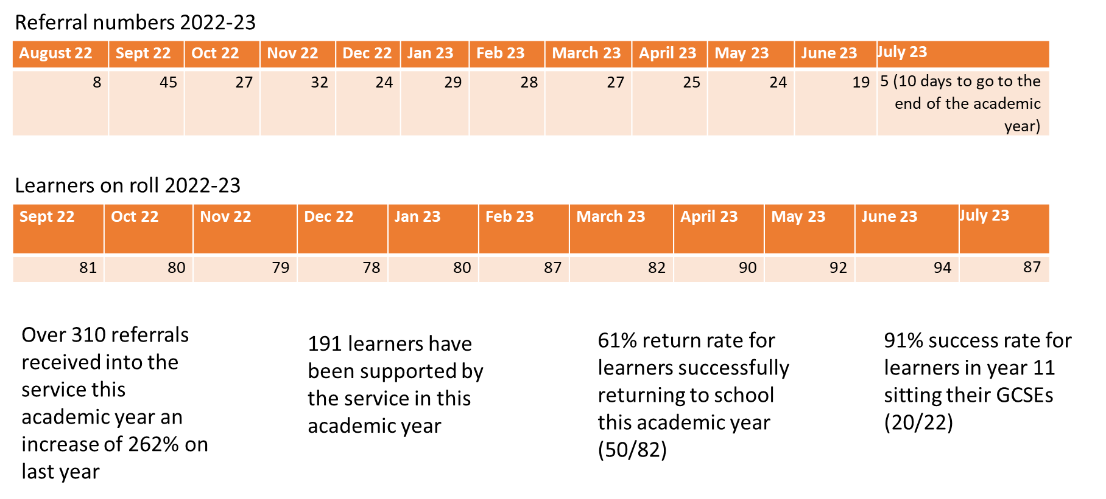

Slide 60
Science curriculum
All online
AQA Combined Science – higher tier is targeted
All lessons are differentiated to individual students
Teams – Class notebook
3x 50 minute lessons a week
8 week learning cycles

Slide 61
Teaching online – post pandemic
How do I make it engaging?
What can they actually do at home?
How can I make sure they have the equipment?
Notes:
KS4 – required practicals – some are not possible either for them or me
Biology – Osmosis, photosynthesis, reaction rates and field investigations
Chemistry – temperature changes and chromatography
Physics – Resistance, VI characteristics and Density and forces and extension

Slide 62
Steering Group Focus: Dual coding and Blank canvas modelling
Discuss, try, review
HIAS Science Moodle
Course Materials
Secondary
HODs Network 2023-2024
Section of the chapter on Dual Coding and BCM

Slide 63
Steering Group Focus: Dual coding and Blank canvas modelling
Discuss, try, review
Hints and tips to get started:
Need a decent visualiser
Have a variety of books to use-
squared, plain, lined
Start with something familiar-
connect to existing related knowledge
Using a framework like Cornell notes can help
organise thoughts and explanations
Pupils should watch before they copy anything down

Slide 64
Steering Group Focus: Dual coding and Blank canvas modelling
Discuss, try, review
Have a go if you are interested.
Members of the steering group will be sharing at the next face to face meeting in February, and in the virtual meeting in December, we will review and discuss some more.

Slide 65
Book of the Term
Has helped me think on my explanations and sequencing of knowledge in curriculums and lessons

Slide 66
In School CPD offer

Slide 67
Thank you
All 23/24 network sessions now bookable on
Learning Zone
Enjoy the rest of the half term and have a great half term break
Please complete the feedback form for this session

