Slide 1
Heads of Science Network Meeting
2024/2025- Autumn 1
24/10/24
Kev Neil
Science

Slide 2
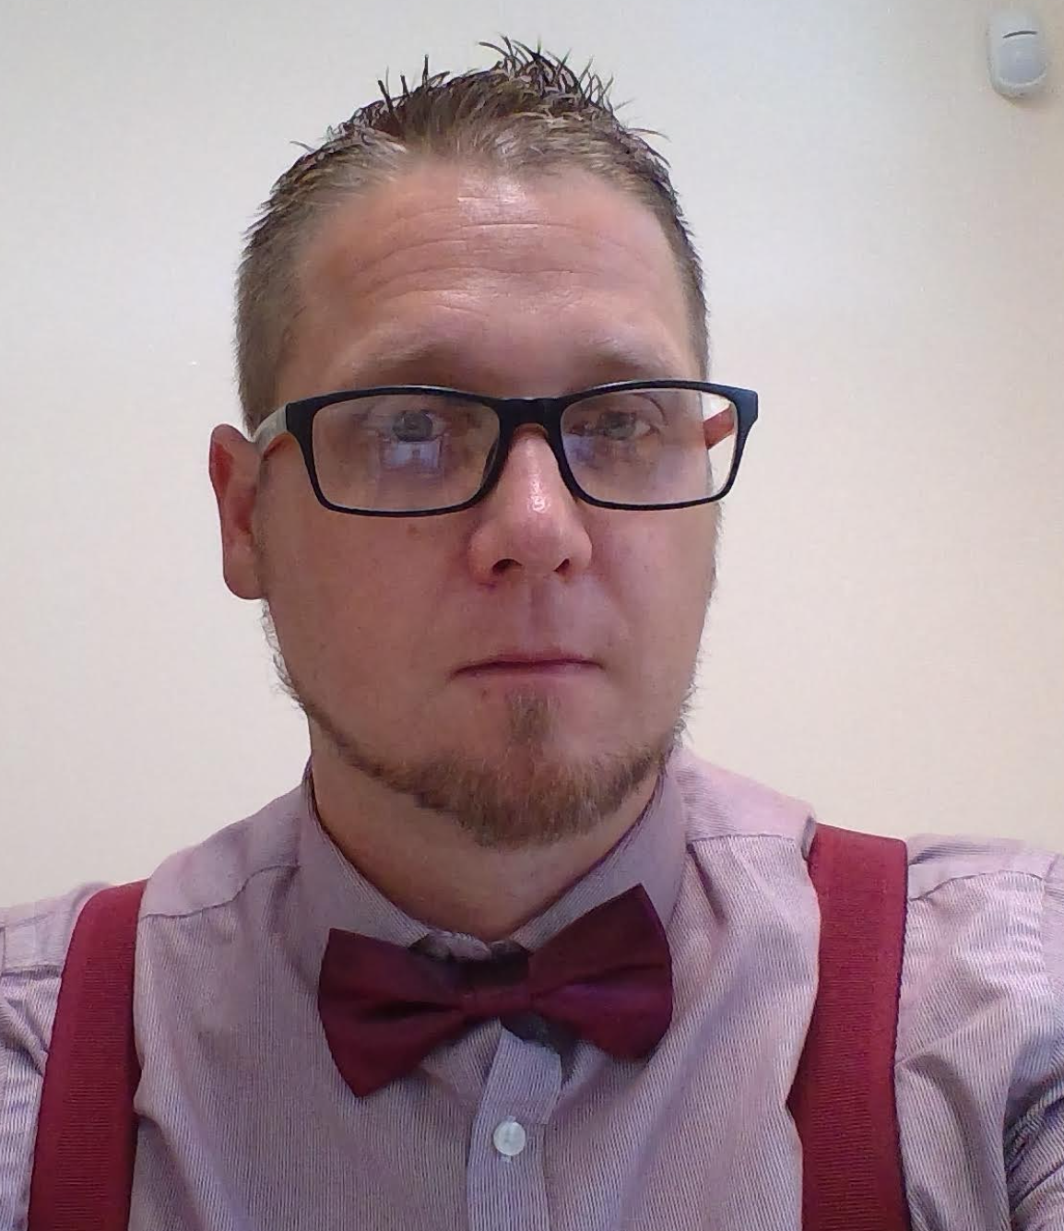
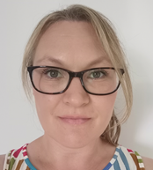
Welcome
The HIAS Science Team:
Kevin Neil
(County Science Inspector/Adviser)
Radiation Protection Officer
kevin.neil@hants.gov.uk
Emma Cooper (General Inspector/Advisor for Science)
emma.cooper3@hants.gov.uk

Slide 3
HIAS on Twitter
@HIAS_today
@Mrneil1859
@emmahantsprisci

Slide 4
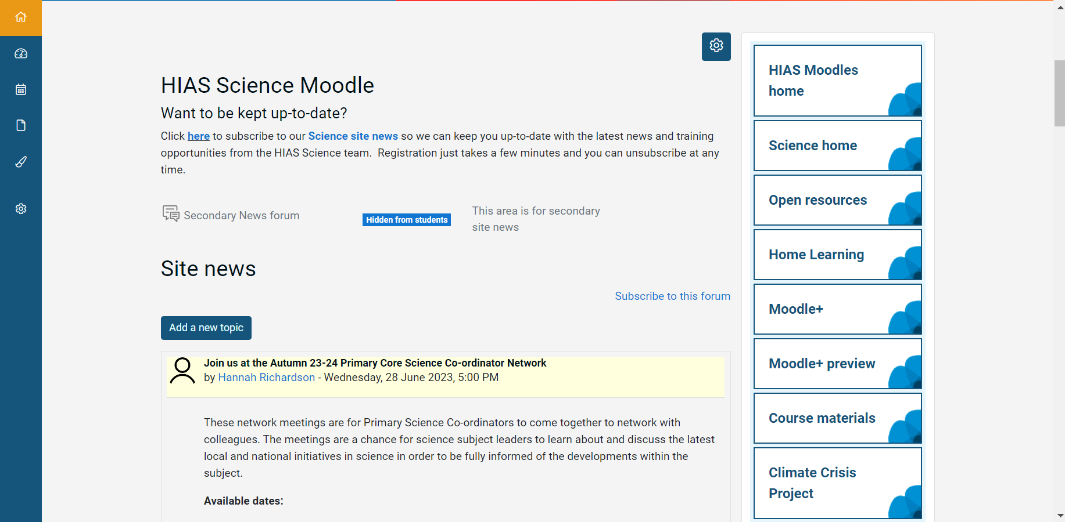

Slide 5
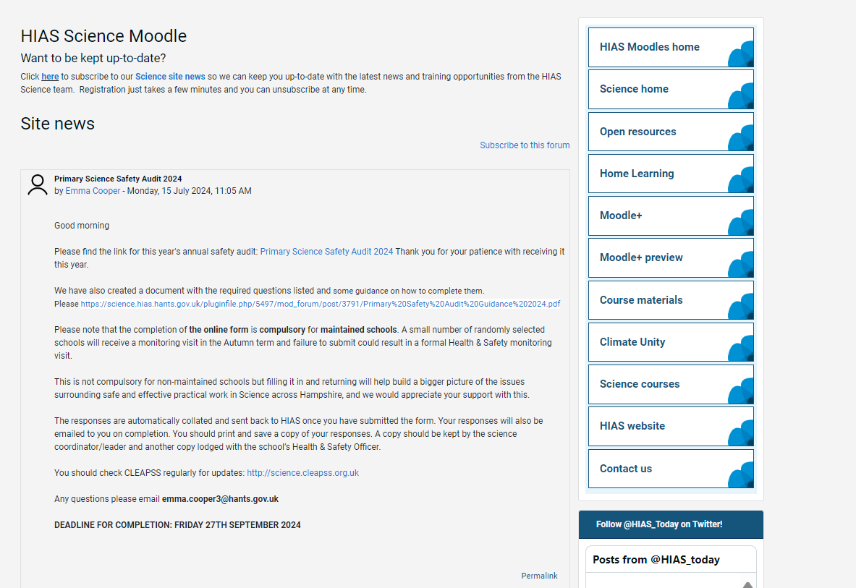
resources in the open access site.
Notes:
Kevin, I updated this slide- Emma

Slide 6
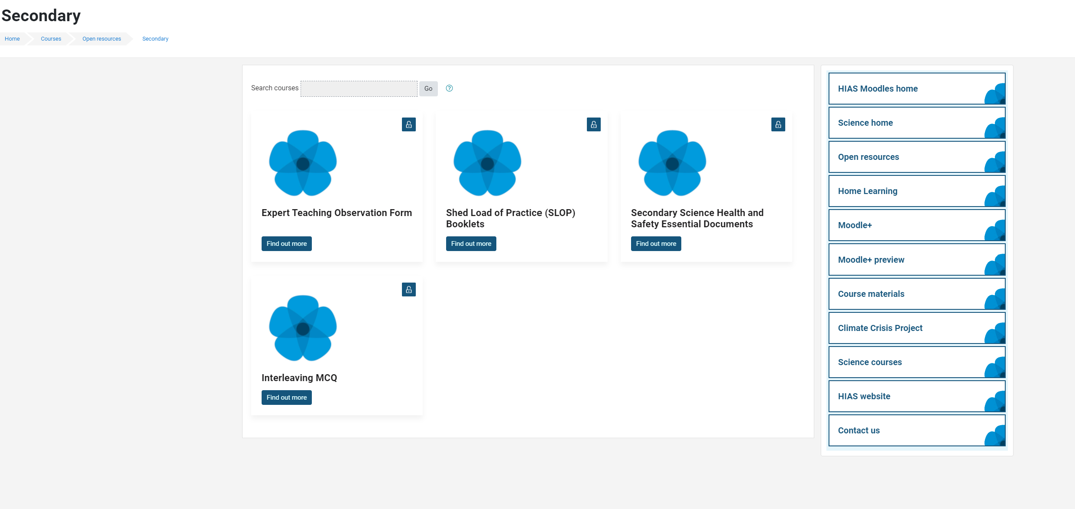
Updated Safety in Secondary Science documents

Slide 7
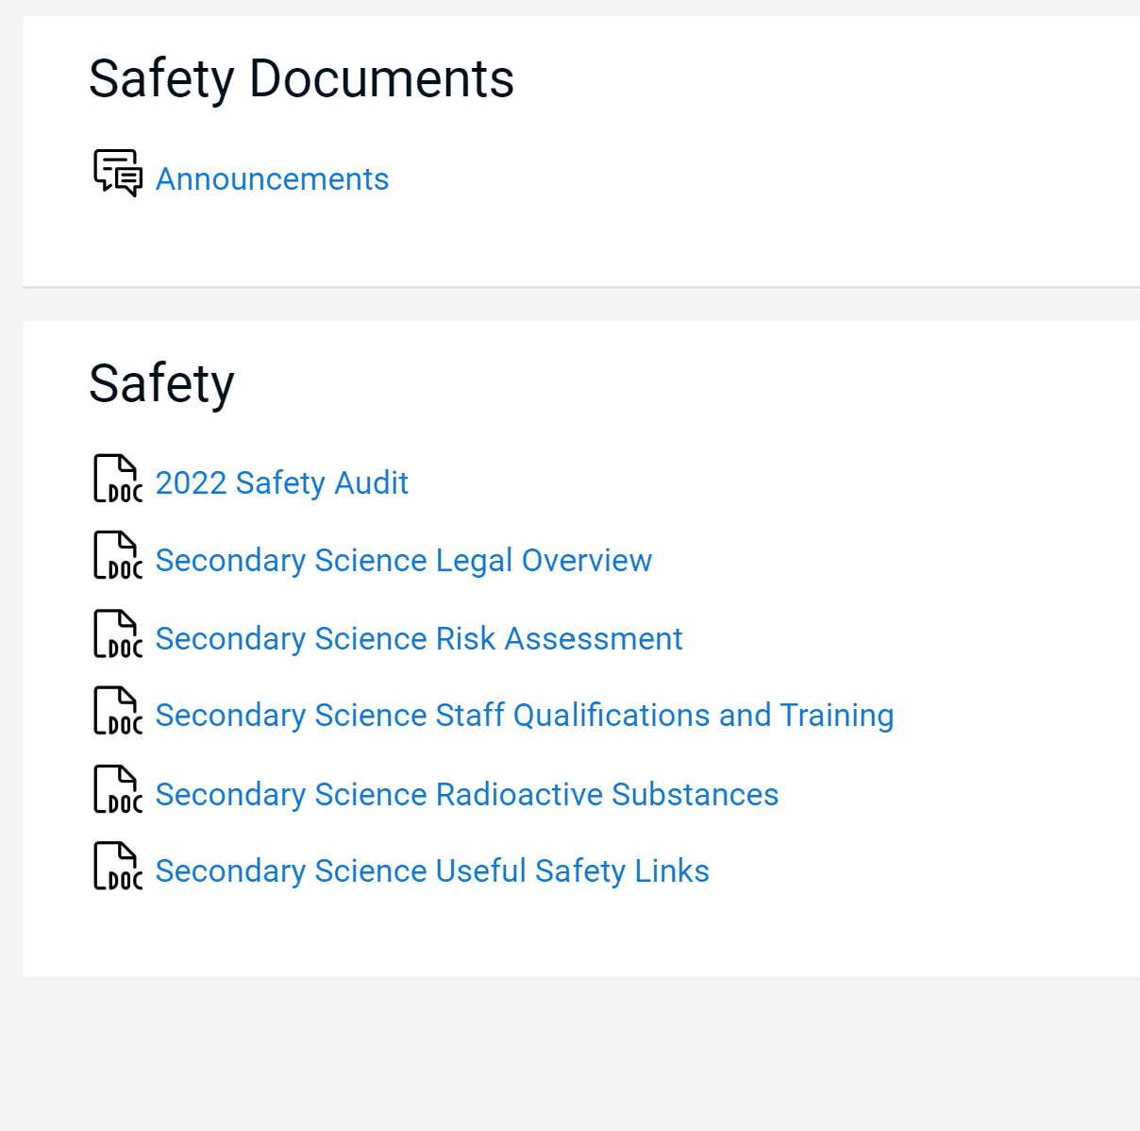
Updated Essential Safety in Secondary Science documents

Slide 8
resources from this meeting and previous HODs
Notes:
Kevin, I updated this slide- Emma

Slide 9
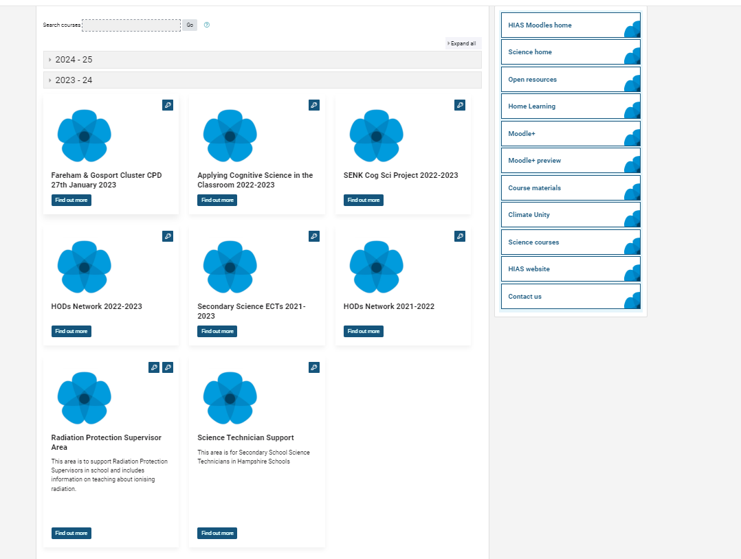
Click 24/25

Slide 10
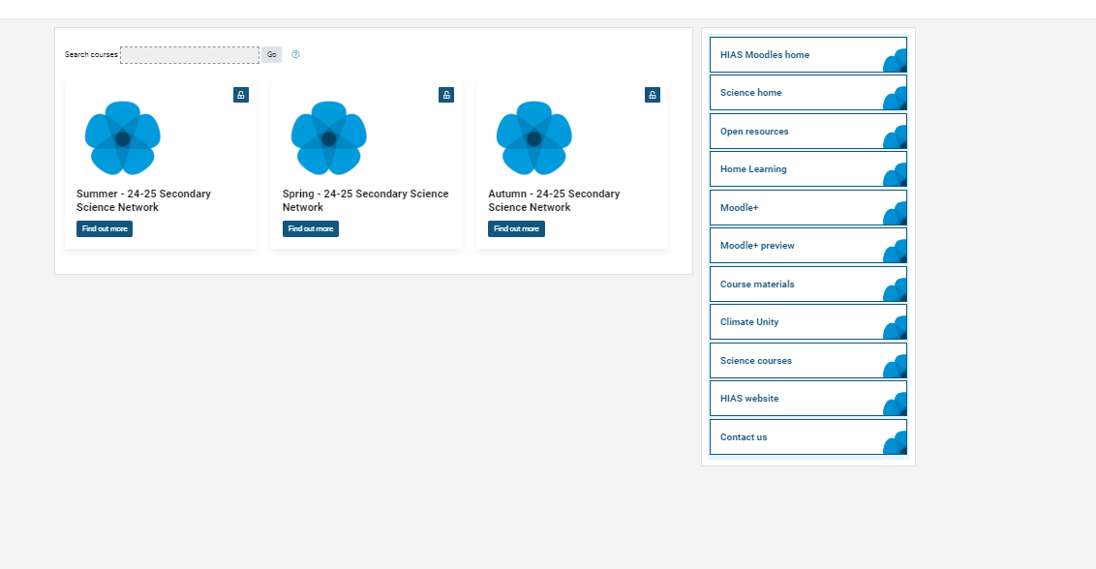
Resources from today are here.

Slide 11
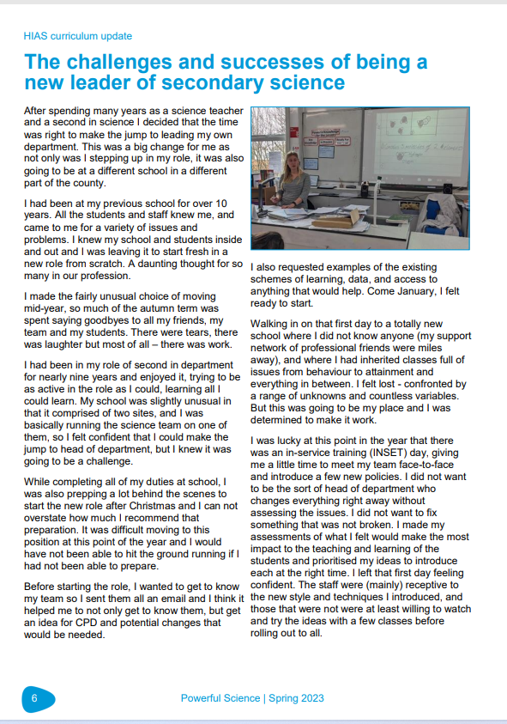
Powerful Science magazine

Slide 12
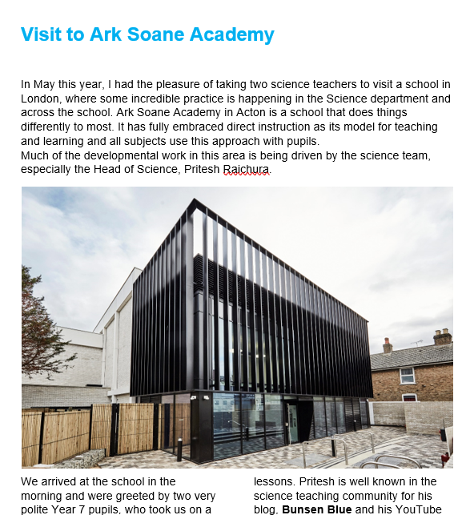
Powerful Science magazine
Rowhill School
Greenwood School
Alderwood School
The Westgate School
The Toynbee School
The Hamble School
The Hayling College
Swanmore College of Technology
Aldworth Science College
Crookhorn College
Horndean Technology College
Henry Beaufort School
The Vyne Community School
Crestwood Community School
The Wavell School
The Henry Cort Community College
Kings' School
Park Community School
Warblington School
Testbourne Community School
Applemore College
Osborne School
Prospect School
Oak Lodge School
The Mark Way School
Hollywater School
Brookfield Community School and Language
Autumn edition out soon
Secondary articles include:
Visit to Ark Soane
CLEAPSS safety conference updates

Slide 13
Agenda for this afternoon
Catch up- Sharing positives and challenges
AQA Science presentation- Summer results review
Science updates
Discussion-Summer 2024 results, lessons learned, actions taken
Challenges to great middle leadership
Strong procedures and routines for participation –TLAC
Making it “sticky”
AOB
Notes:
Welcome back- Share course details with new sci-cos
Open discussion for 5 minutes to share the good things that have been happening
Ofsted review paper for science-learning journeys link- Who has read this? What did you think? Share key points- discuss. …’ majority no. of primary schools- reduced amount of curriculum time to teach science which led to a narrowing of the curriculum.’
Unpick the reason for the remodel and explain their importance in this first draft

Slide 14
Catch up
Welcome back.
Share some positives from the term so far.
Discuss what have been the challenges of the term so far?
Try not to talk about results or year 11. We will share these later..

Slide 15
AQA

Slide 16
Science updates

Slide 17
CLEAPSS Safety Conference
Key Updates:
Individual logins for CLEAPSS website
Radium cup sources (L93)
Risk assessments in Science (PS090)
Top 20 Hazards found during H&S inspections (GL238)

Slide 18
Safety Audit
Low response.
Deadline extended to 25th November.
Compulsory for Maintained Schools
https://forms.office.com/e/DAxW83CBW0

Slide 19
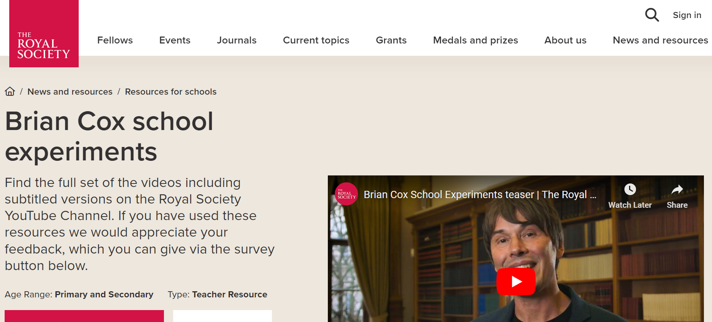
Brian Cox- Secondary resources
Brian Cox and the Royal Society have teamed up to provide some resources for KS3 Brian Cox school experiments - secondary level | Royal Society

Slide 20
Summer 2024 results, lessons learned, actions taken

Slide 21
Summer 2024 initial analysis
Entries
Combined
Bio
Chem
Physics
Hampshire and National

Slide 22
Summer 2024 initial analysis
Entries
Combined

Slide 23
Summer 2024 initial analysis
Combined Science

Slide 24
Summer 2024 initial analysis
Biology

Slide 25
Summer 2024 initial analysis
Chemistry

Slide 26
Summer 2024 initial analysis
Physics

Slide 27
Summer 2024 initial analysis
Overall:
Very positive shift in outcomes from 2023 to 2024.
The movement toward 100% triple entry in schools seems to have slowed from the 2022 rush
Hampshire is closing the gap on national and reversing the trend post covid in most areas
In combined 4-4+ and 5-5+ better than national
Although Triple has improved, still a growing gap in the grades 7 to 9 range from national

Slide 28
Summer 2024 initial analysis
On your tables, consider and discuss the following:
Your own summer 2024 results- the highs and the lows.
What specific areas are you working based upon your own analysis?
Why are we struggling with the 7-9 grades- what can we do to close this gap?
Any specific strategy you used last year that was successful and any new approaches you are looking at this year.

Slide 29
Challenges to great middle leadership

Slide 30
Middle leadership is the heartbeat of any school.
It’s a rewarding but challenging role and no two middle leaders will share an identical experience.
A report published in 2022 found that most middle leaders enjoyed their role, but significant challenges were present for many. pressure-on-middle-leaders.pdf (educationsupport.org.uk)

Slide 31
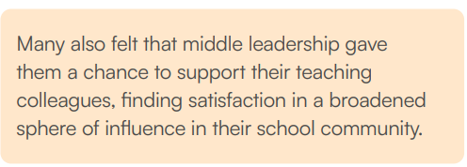
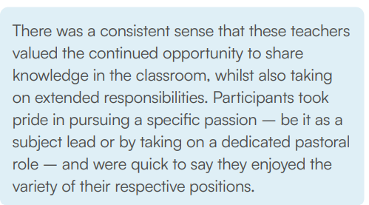
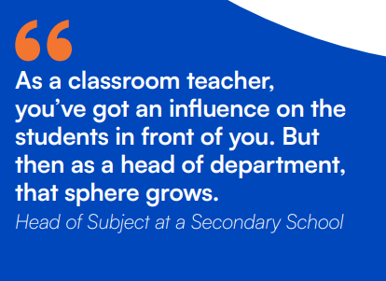
Positives

Slide 32
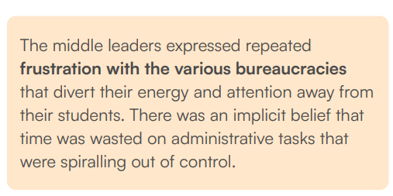
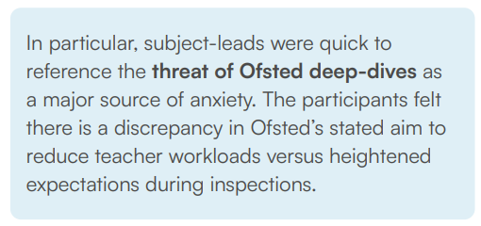
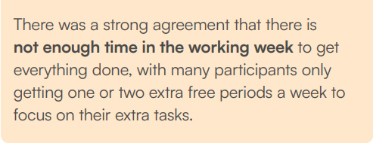
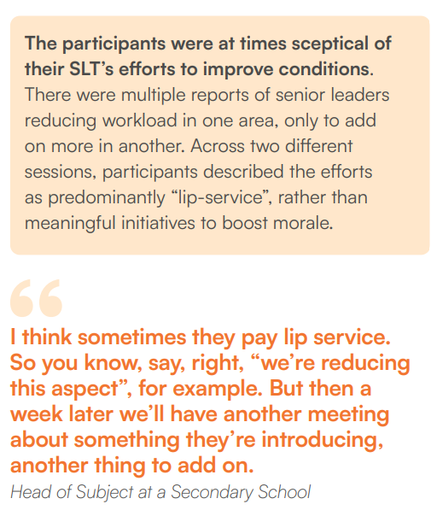
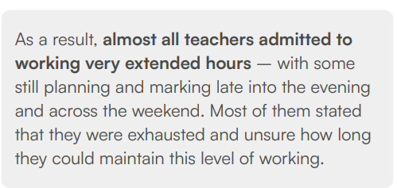
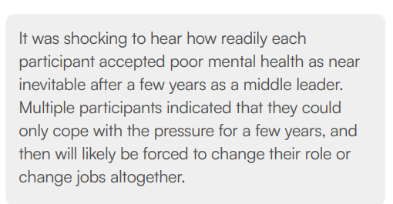
Challenges

Slide 33
On your tables discuss your own positives and challenges of being a Head of Science in your school.
What could be done to reduce the barriers to successful, enjoyable, and sustainable middle leadership?
We will share as a group afterwards.

Slide 34
Strong procedures and routines for participation –TLaC

Slide 35
Teach like a Champion
Full of great techniques that can drive the quality of teaching and outcomes.
Many schools have this book, but few have read/used it.
Schools which have embraced “Lemov Techniques” can’t praise them enough

Slide 36
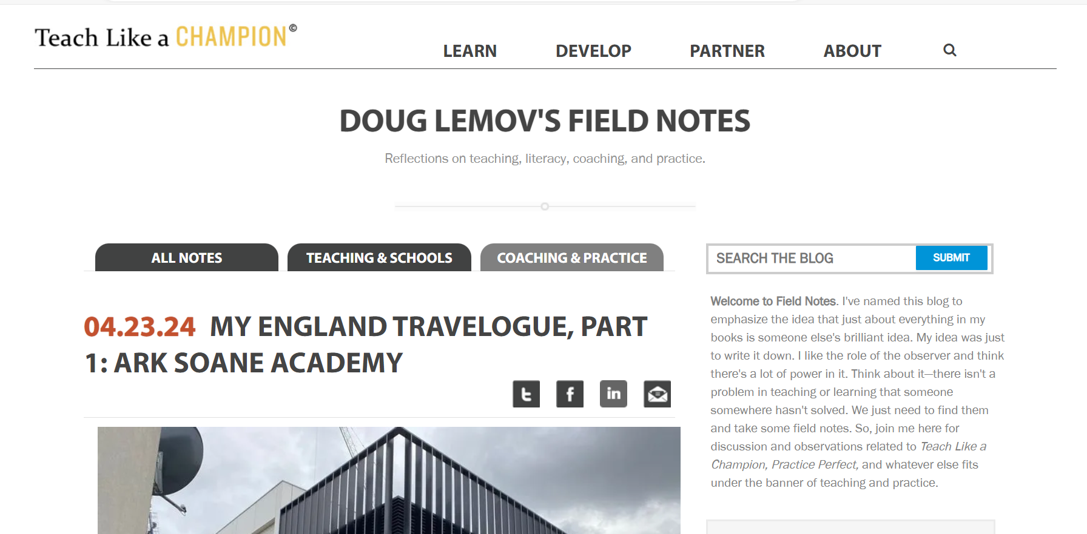
Teach like a Champion
The TLaC website is also fantastic.
Full of blog articles and visit reports from the best schools around the world.

Slide 37
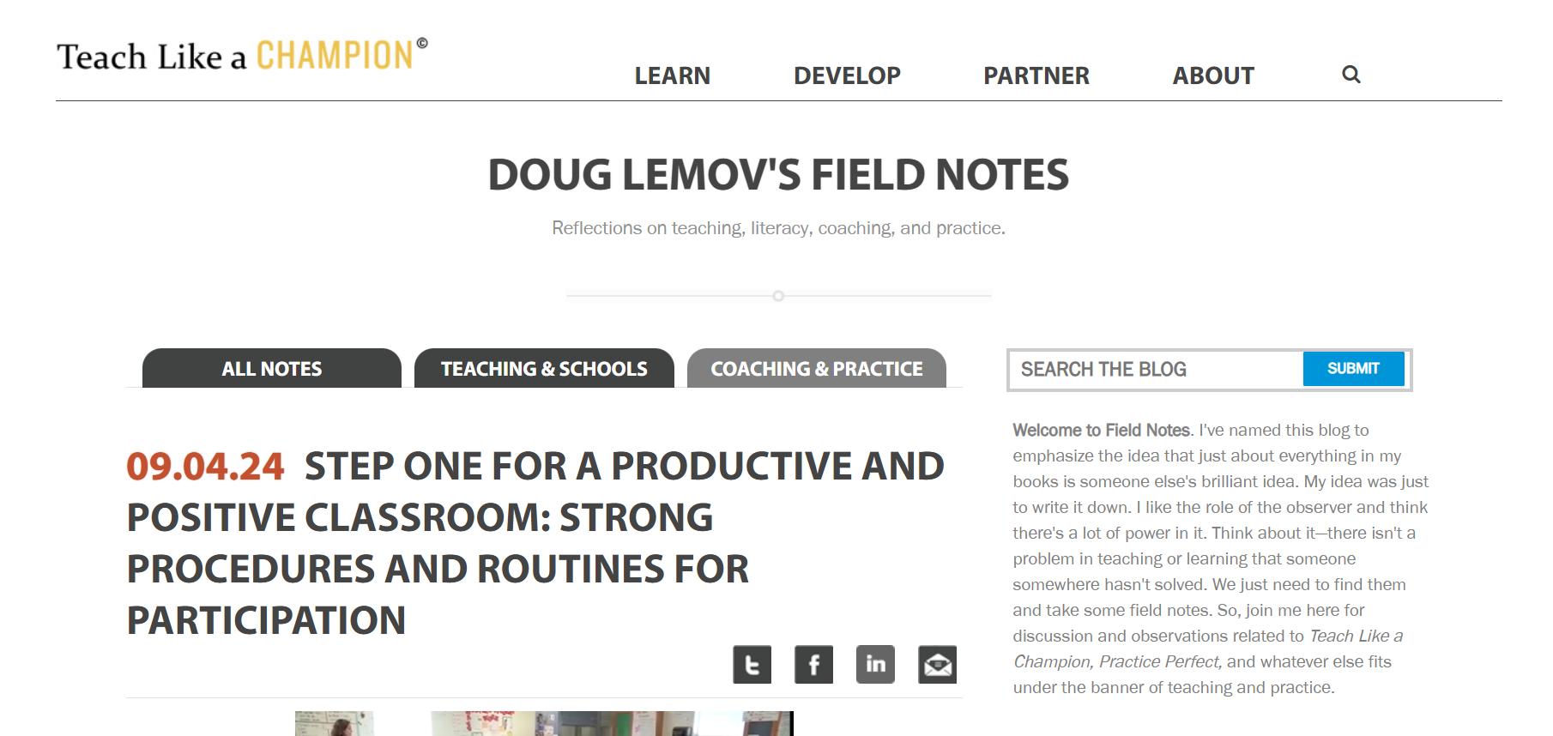
Teach like a Champion
A blog post this September really focused in on a lot of work I have been doing in schools through CPD sessions or support work.
Means of Participation

Slide 38
Teach like a Champion
A blog post this September really focused in on a lot of work I have been doing in schools through CPD sessions or support work.
Means of Participation
Reflect on your tables on this article and video clip.
How well do pupils participate in your department?
What procedures/routines for teachers do you currently have?

Slide 39
Making it “Sticky”

Slide 40
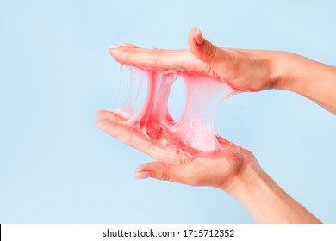
Making it “Sticky”
I have heard this phrase several times in the past few months.
Often quoted from Ofsted inspectors during feedback.

Slide 41
Making it “Sticky”
I have heard this phrase several times in the past few months.
Often quoted from Ofsted inspectors during feedback.
What does this mean?

Slide 42
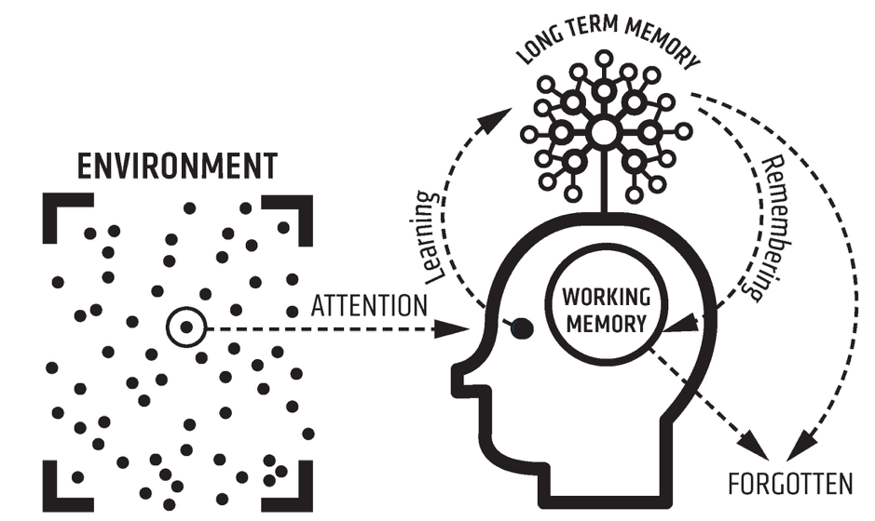
Making it “Sticky”
Prior knowledge is not secure enough for new material to “stick” within the schema?
Knowledge builds upon knowledge.
Many schools have implemented retrieval and review into their practice but as Tom Sherrington has said this has become the next lethal mutation in education.
When daily quiz regimes become lethal mutations of retrieval practice. – teacherhead
Intrinsic Load
Extraneous Load
Remaining Capacity

Slide 43
Making it “Sticky”
Simply doing a “DNA” at the start of the lesson, isn’t going to cut it.
Especially if that is something like last year, last month last week.
It requires more purposeful strategies, which include a range of different approaches at various times including at start, within, at end, and through assessment.
Intrinsic Load
Extraneous Load
Remaining Capacity

Slide 44
Making it “Sticky”
Discuss on tables what strategies you have in place in your departments to make sure knowledge is “sticky”

Slide 45
Journey of a piece of core knowledge to make it sticky
New Core Knowledge
e.g. ions and ionic bonding
Initial instruction
Next lesson
Next lesson
Direct instruction & CfL
CfU and application
Two weeks
Rehearsal of material
Homework
One year
New knowledge
e.g. electrolysis
Focus of prior knowledge check
End of topic assessment as part of the 40/60 split
Two weeks
End of topic assessment as part of the 40/60 split
End of topic assessment
Nine months
Six months
Three months
One month

Slide 46
Book of the Term
Written in an easy-to-understand style, this book delves into the cognitive mechanisms that govern learning and memory. You'll also discover the socioemotional factors that influence students' motivation and performance.

Slide 47
AOB

Slide 48
Thank you
Please complete the feedback form for this session
Next meeting is on 12th December Virtual MS Teams
Have a great Half Term

