Slide 1
Heads of Science Network Meeting 2023-24
Autumn 2023 Session 2

Slide 2
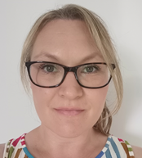
Welcome
The HIAS Science Team:
Kevin Neil
(County Science Inspector/Adviser)
Radiation Protection Officer
kevin.neil@hants.gov.uk
Emma Cooper (General Inspector/Advisor for Science)
emma.cooper3@hants.gov.uk

Slide 3
HIAS on Twitter
@HIAS_today
@Mrneil1859
@emmahantsprisci

Slide 4
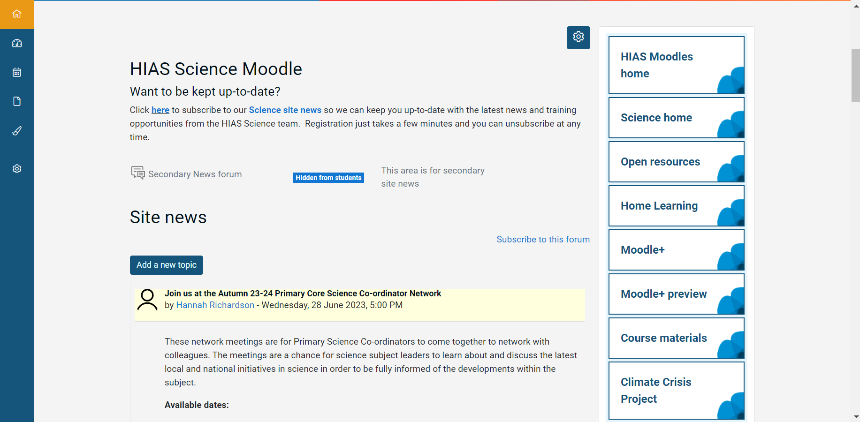

Slide 5
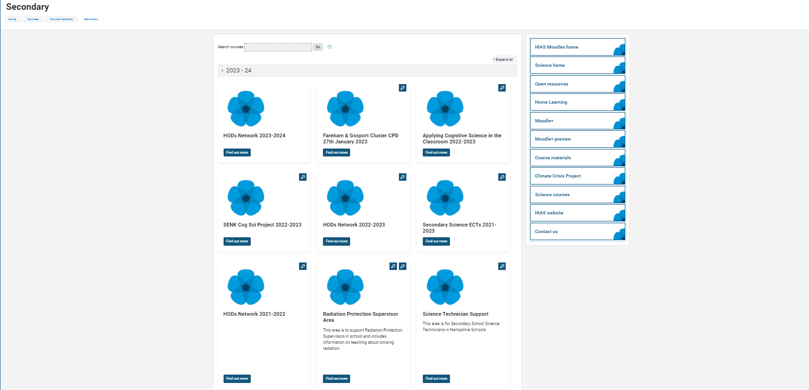

Slide 6
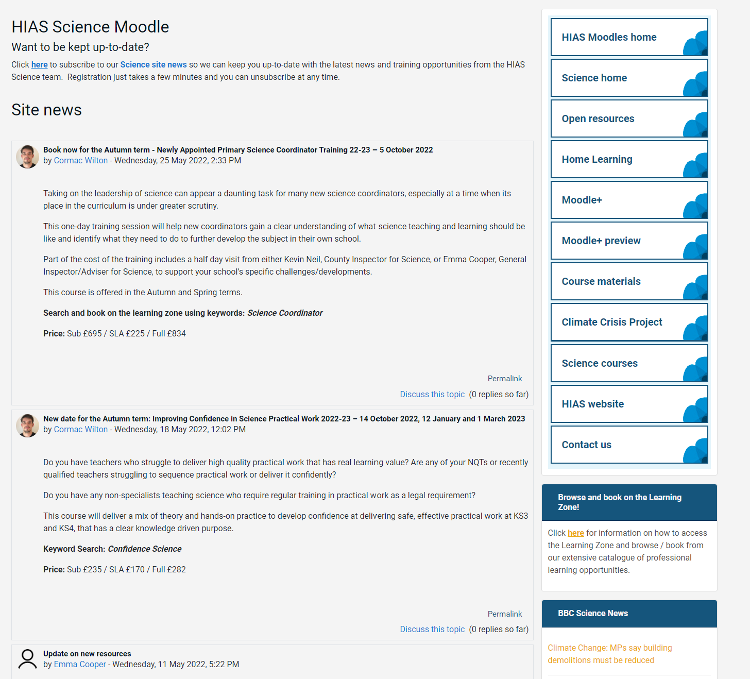
resources in the open access site.
Notes:
Kevin, I updated this slide- Emma

Slide 7
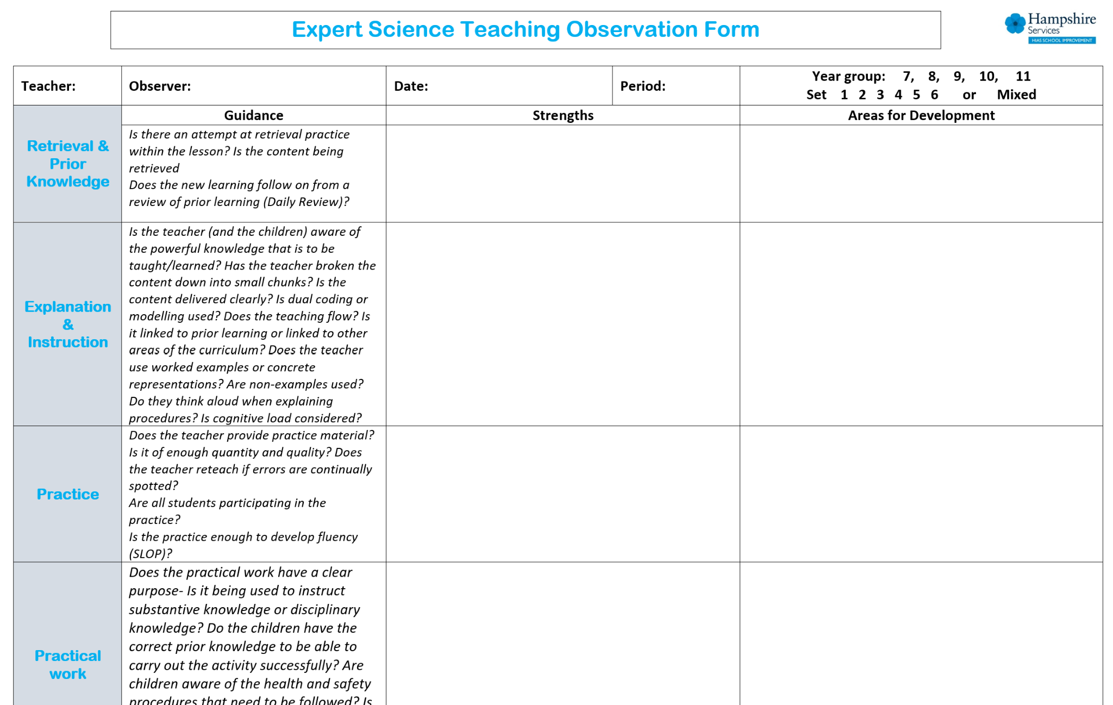
New resources uploaded into the open access site. SLOP booklets, learning walk proforma for expert teaching.
New Moodle+ resources
Notes:
Kevin, I updated this slide- Emma

Slide 8
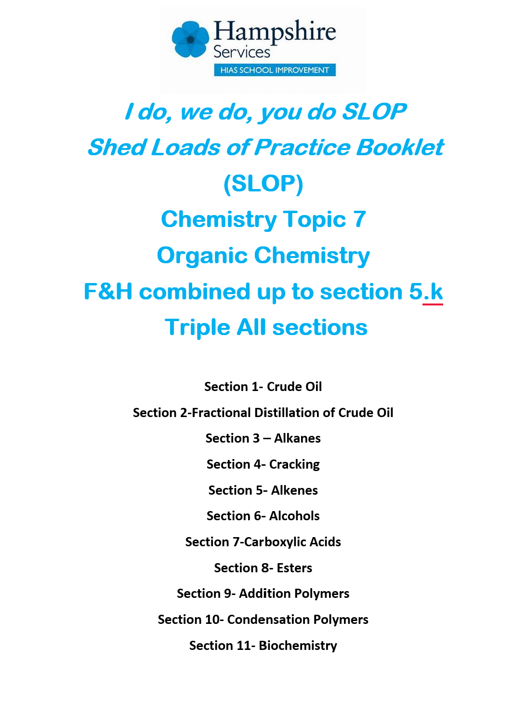
Notes:
Kevin, I updated this slide- Emma

Slide 10
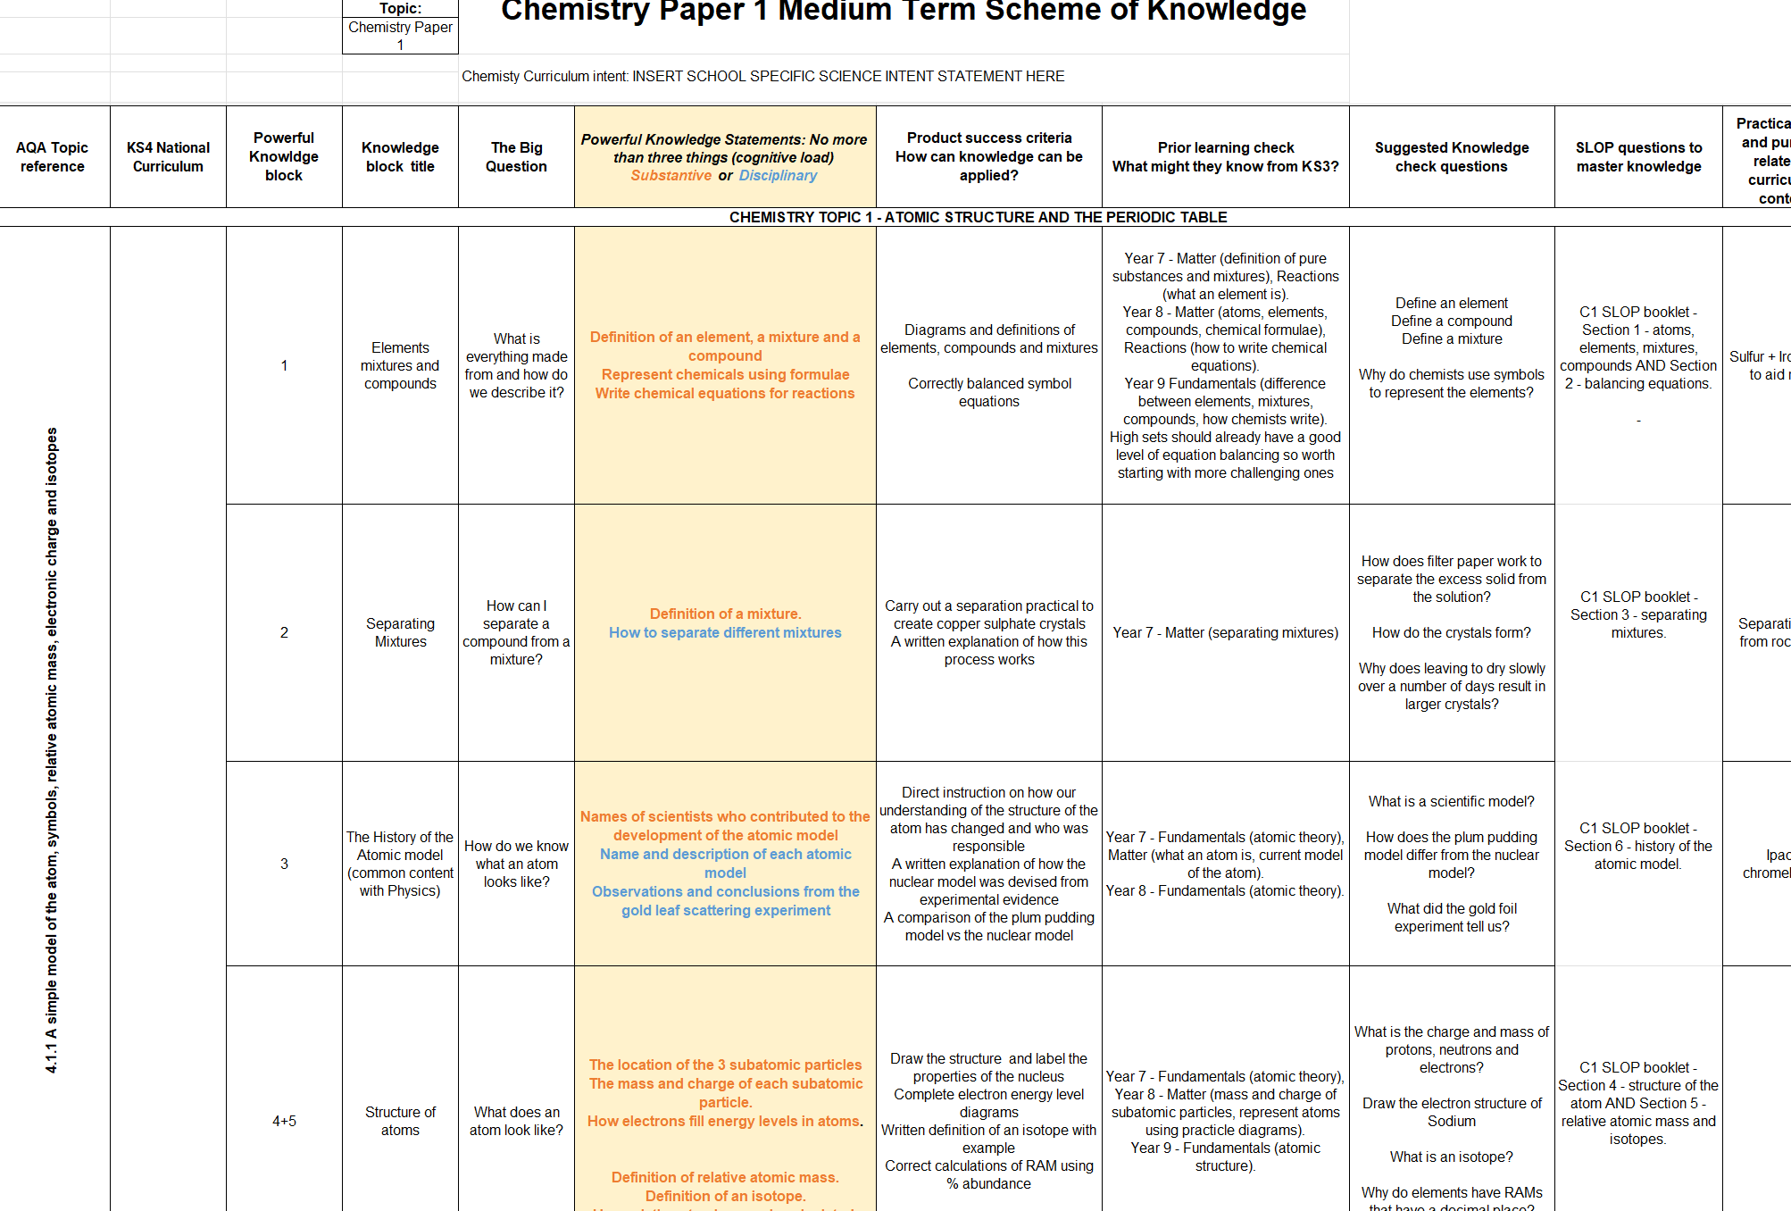

Slide 11
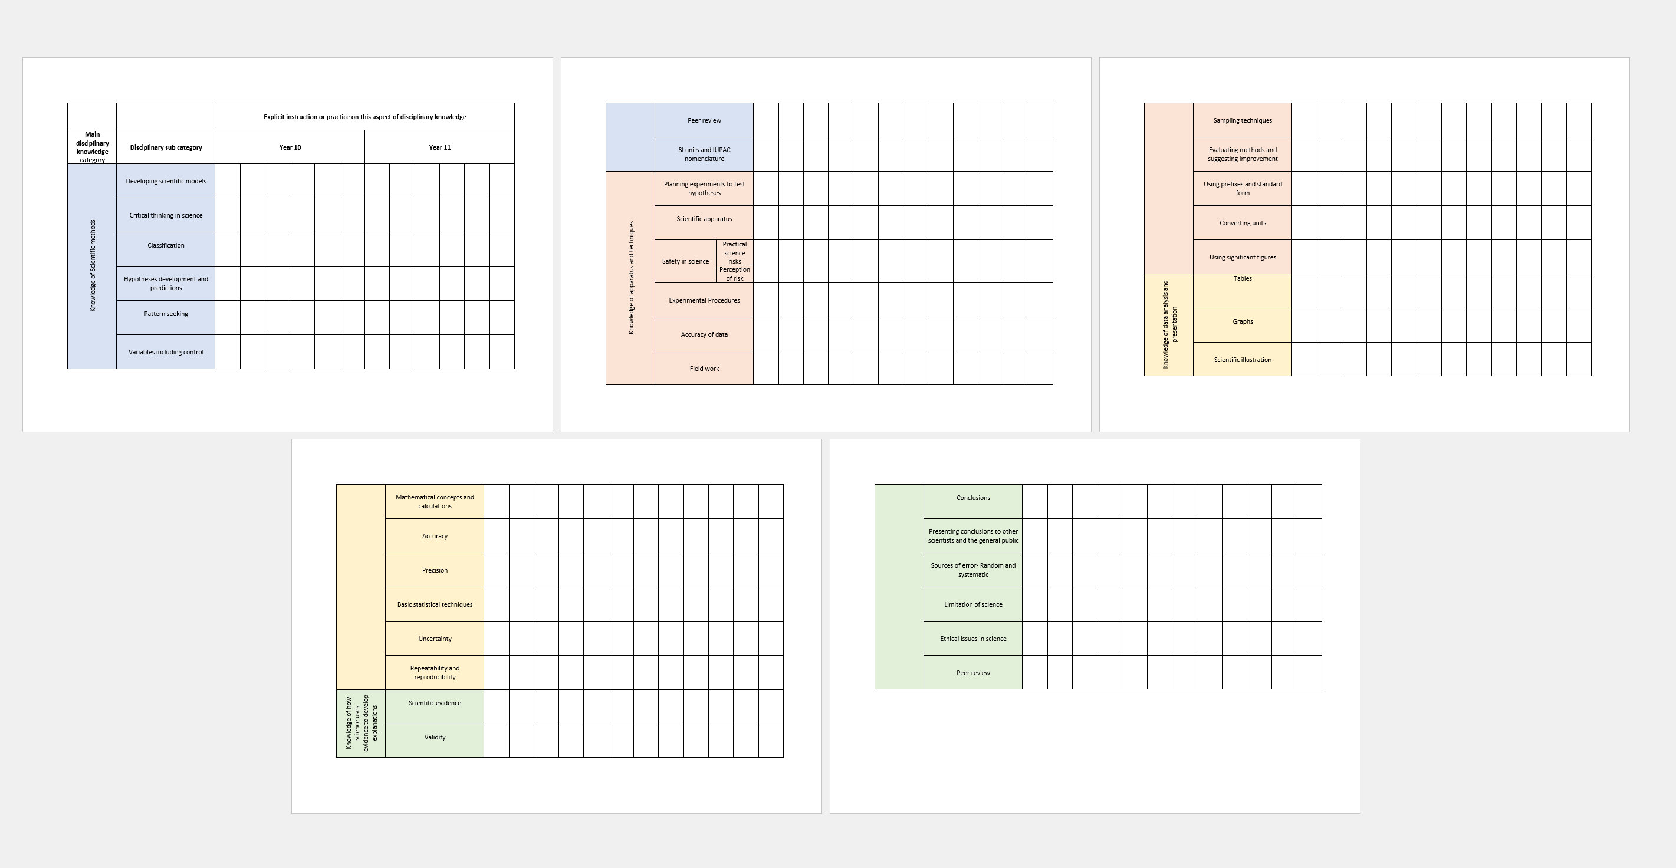
Tracking disciplinary knowledge instruction across KS3 & 4

Slide 12
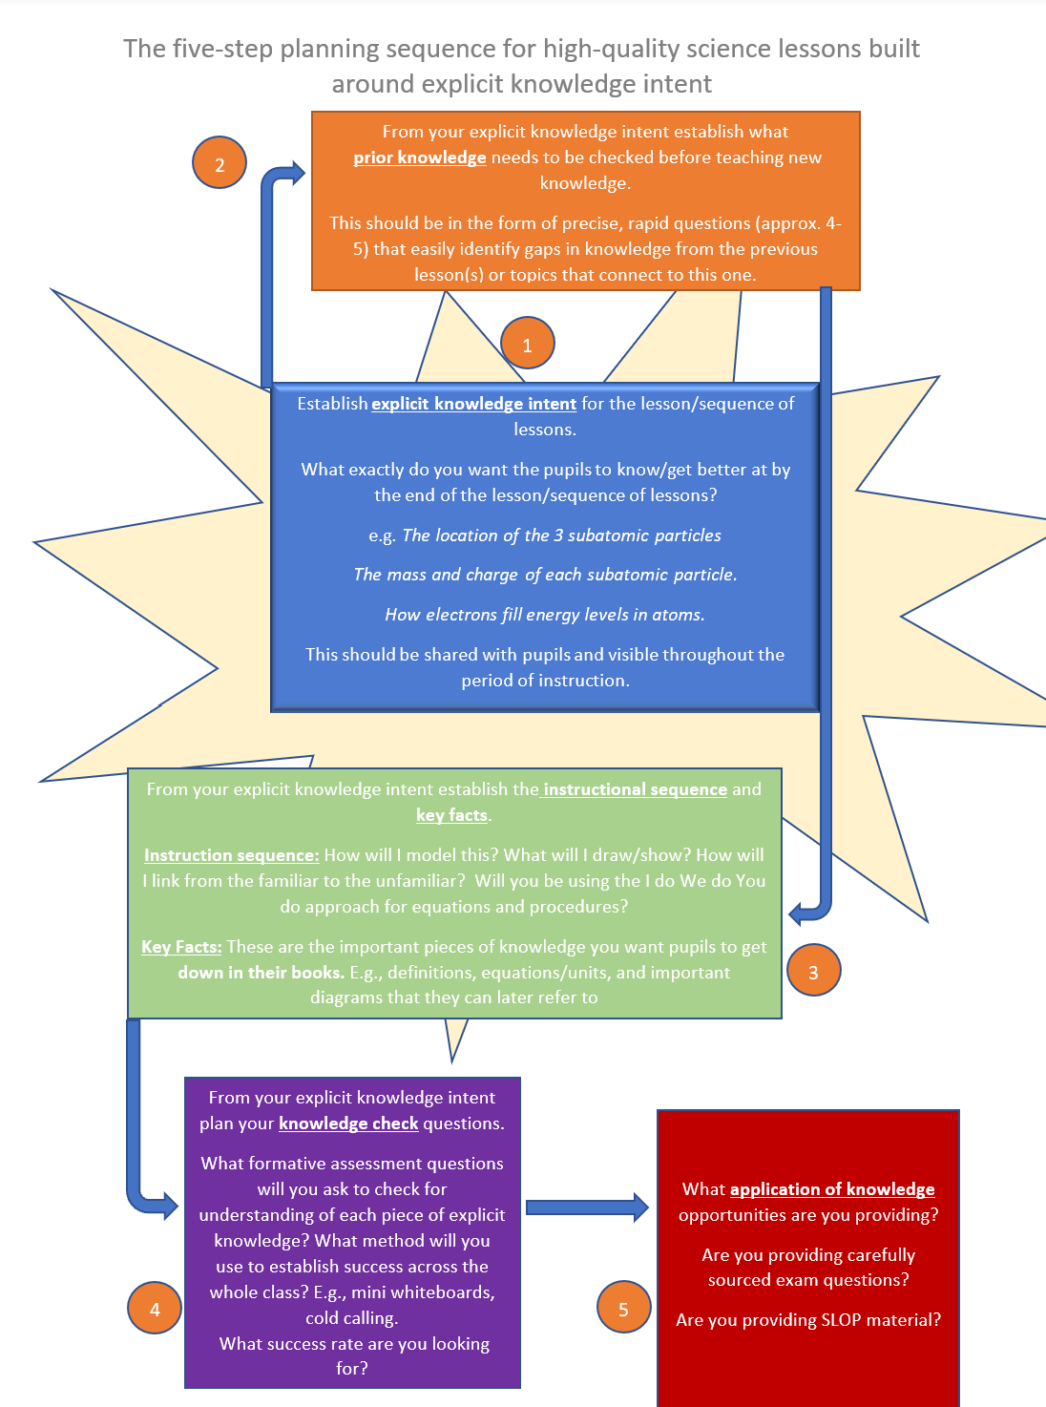
5 Steps for Expert Science Teaching

Slide 13
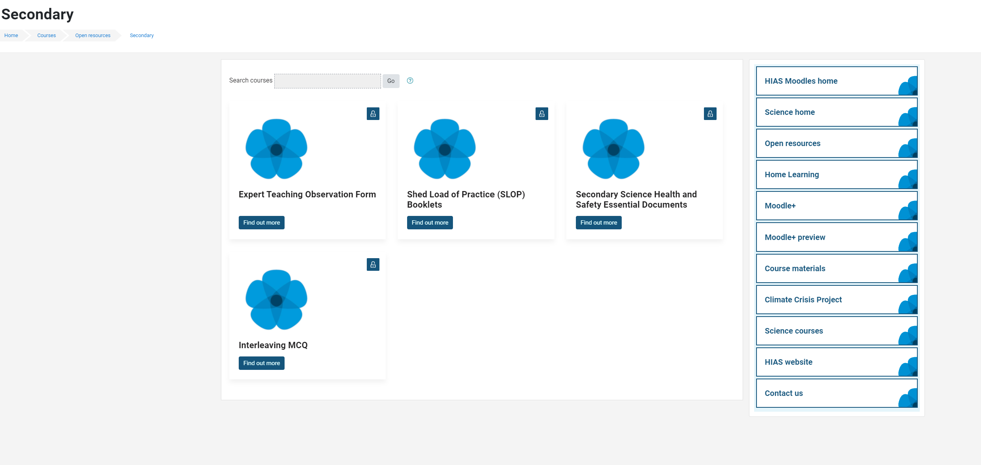
Updated Safety in Secondary Science documents

Slide 14
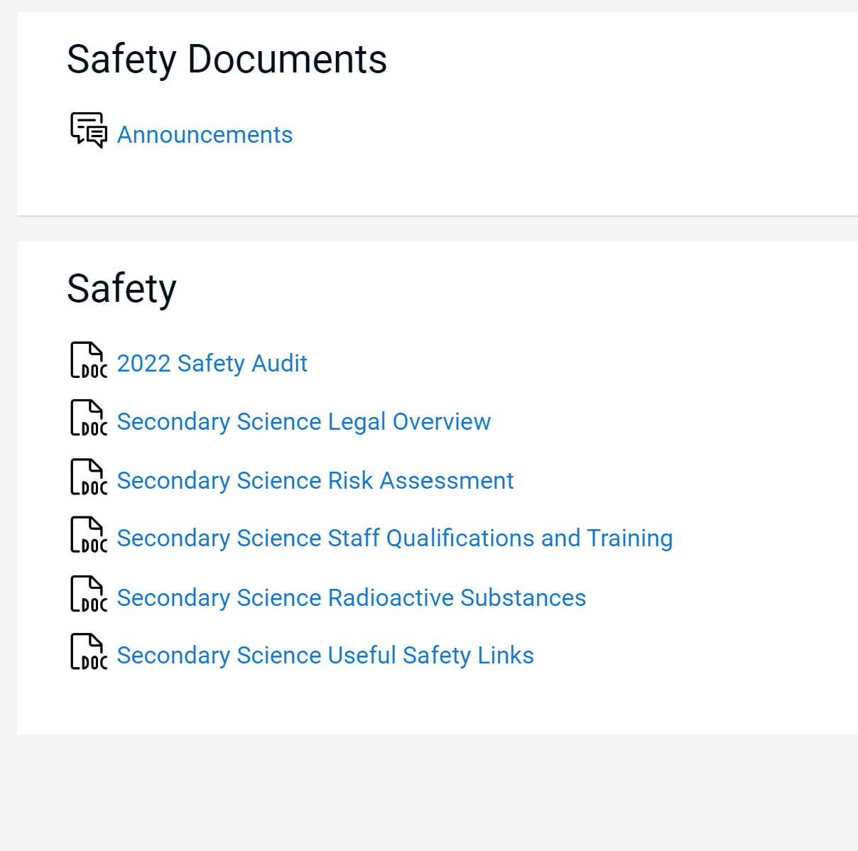
Updated Essential Safety in Secondary Science documents

Slide 15
Catch up
Welcome back.
Share some positives from the term so far.
What have been the challenges of the term so far?

Slide 16
Agenda for this afternoon
AQA- Martin Hanney
Springboard Science -Hodder
Science updates
Year 11 progress review
The disappearing science technicians
Primary science impact on KS3
Steering group agenda BCM
AOB
Notes:
Welcome back- Share course details with new sci-cos
Open discussion for 5 minutes to share the good things that have been happening
Ofsted review paper for science-learning journeys link- Who has read this? What did you think? Share key points- discuss. …’ majority no. of primary schools- reduced amount of curriculum time to teach science which led to a narrowing of the curriculum.’
Unpick the reason for the remodel and explain their importance in this first draft

Slide 17
AQA presentation

Slide 18
Springboard Science

Slide 19
Science updates

Slide 20
Exampro on-screen

Slide 21
Exampro on-screen

Slide 22
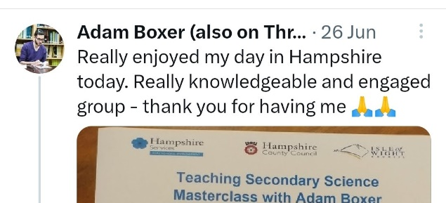
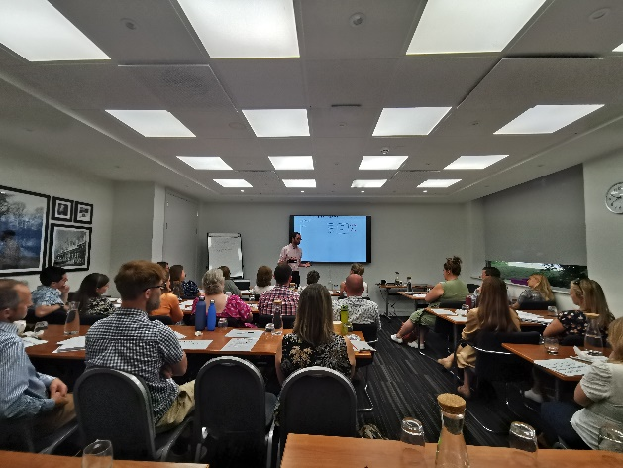
Adam will be back next year
Now bookable on the Learning Zone
Monday 24th June 2024
More in depth focus on one or two areas

Slide 23
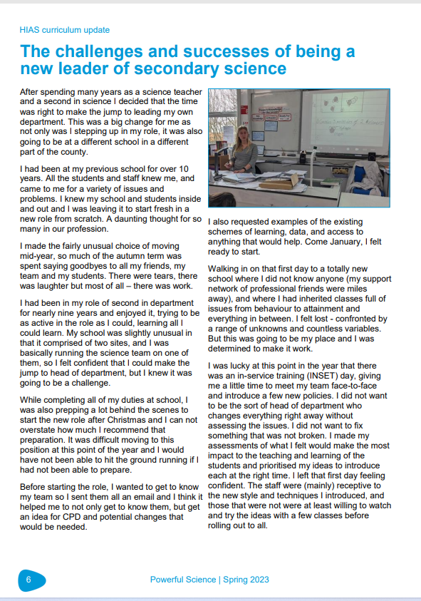
Powerful Science magazine

Slide 24
Powerful Science magazine
Establishment Name
Aldworth Science College
Applemore College
Brookfield Community School and Language
Crestwood Community School
Crookhorn College
Fernhill College
Hamble Community Sports College
Harrow Way Community School
Henry Beaufort School
Horndean Technology College
Hounsdown Academy
Kings' School
Park Community School
Portchester Community School
Swanmore College of Technology
Testbourne Community School
The Hayling College
The Henry Cort Community College
The Mountbatten School
The Toynbee School
The Vyne Community School
The Wavell School
Thornden School
Warblington School
Wildern School
Autumn edition out now.
Let me know if you have not received it if on this list

Slide 25
RPO update
New L93 document coming in January 2024. Make sure you, your RPS, and the Technician review the changes and take appropriate actions.
Biggest change is Radium cup sources are being Brown banded -------------- which means their continued use should be reviewed very carefully. Any discolouration or flaking will require immediate disposal. They will have a separate risk assessment from the other cup sources.

Slide 26
RPO update
Local Authority School visits begin in January 2024. You will be contacted by my support assistant Jackie Gerry to book in a visit of around 1 hour to inspect your paperwork and storage and quality of sources.
Based upon what I find an allocated revisit of between 3 months to two years will be provided.
Academies et al, will continue as normal.

Slide 27
RPO update
Some Schools have not completed the registration form or submitted the required Form 1 which was sent out in March.
If you are on this list, can you use the QR code to do this ASAP in preparation for visits.

Slide 28
RPO update
Registered
FORM 1
Some Schools have not completed the registration form or submitted the required Form 1 which was sent out in March.
If you are on this list can you use the QR code to do this ASAP in preparation for visits.

Slide 29
RPO update
Some Schools have not completed the registration form or submitted the required Form 1 which was sent out in March.
If you are on this list can you use the QR code to do this ASAP in preparation for visits.
https://forms.office.com/e/4xnrZYZWNg

Slide 30
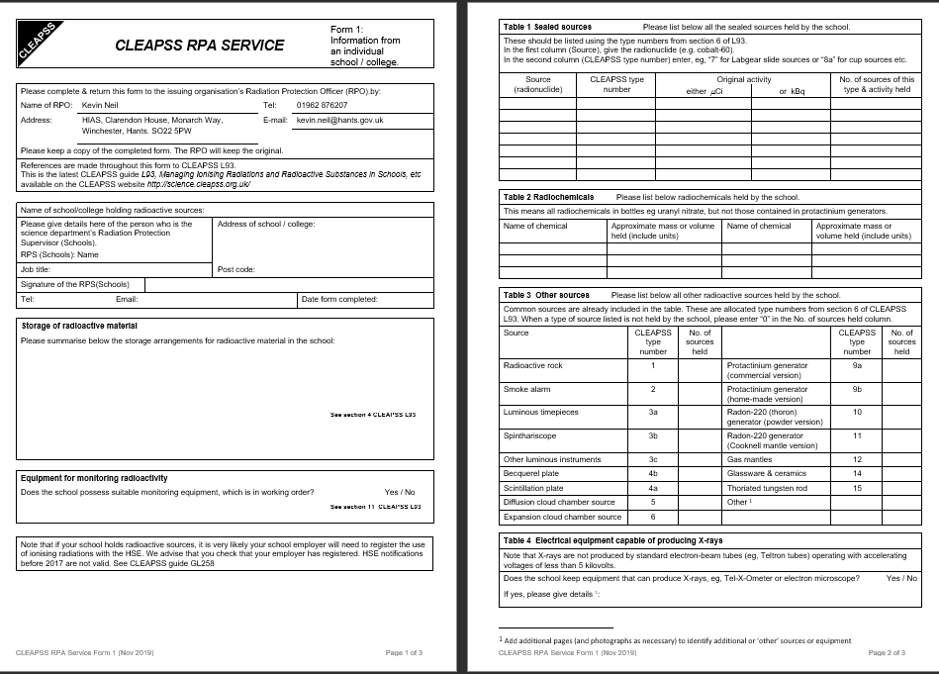

Slide 31
Year 11 Progress Review

Slide 32
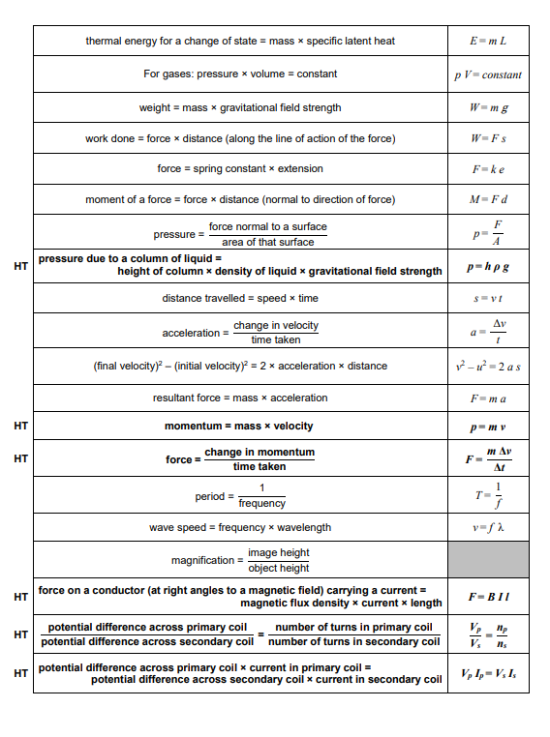
OFQUAL Consultation
Consultation on allowing students access to the equation sheet for one more year.
Closed now.
This is highly probable to remain the case after consultation.

Slide 33
Mock and action plan review
In small groups – share thoughts and experiences on these areas regarding year 11.
Mocks are either done or just finishing and you should have some idea about how well they have gone.
Are you using Exampro merit or your own system to undertake QLA? How will you make this impactful?
Did you use the “Key 25” approach to intervention and tracking? Or your own system? How is it going? How impactful is it so far?
What other strategies are you using and are they impactful?

Slide 34
The Disappearing Science Technicians

Slide 35
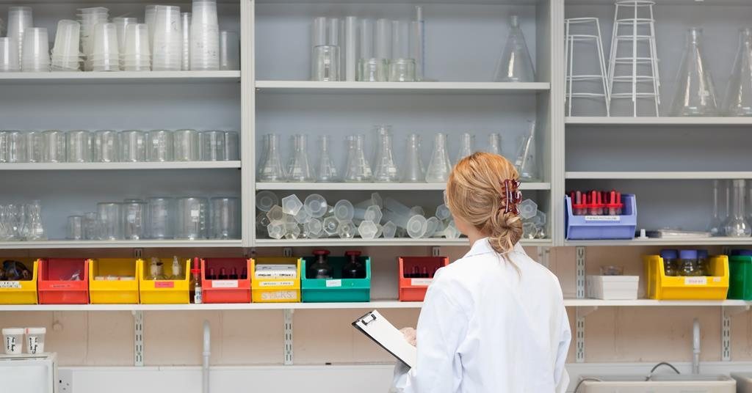
The Disappearing Science Technicians
There is a growing shortage of Lab technicians.
Combination of relatively low pay, high level of retirement and lack of apprenticeship or training opportunities has made finding a replacement difficult for many schools.

Slide 36
The Disappearing Science Technicians
How is this situation in your department?
Do you have a full technician support?
How long will this continue? E.g. retirement?
Are they supported with access to CPD/training?

Slide 37
Primary Science Impact on KS3

Slide 38
Primary Science Impact on KS3
Since the removal of KS2 SATS for Science, the subject has been sidelined in Primary curriculums.
However, there is almost a dogmatic view in secondary that primary science teaching is rubbish and pupils arrive in year 7 starting at zero.
In a lot of cases its simply forgetting, not hugely different than when pupils return after summer break and have forgot all of year 7 content.

Slide 39
Primary Science Impact on KS3
Understanding what pupils learn and can do in primary science can help massively with their progress in KS3.
In the second Ofsted research report- Finding the optimum. It was noted that schools that did well had KS3 curriculums did not needlessly revisit core concepts and disciplinary knowledge from KS2 but retrieved, and then developed and refined them over the course of the key stage.
HIAS primary science work is driving up standards of sciene curriculum and delivery in Hampshire.

Slide 40
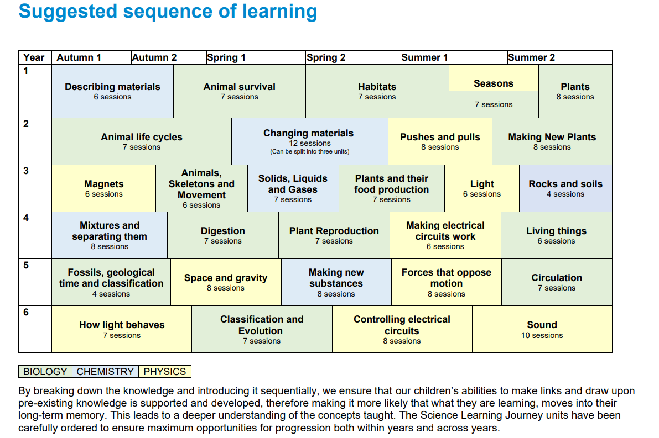

Slide 41
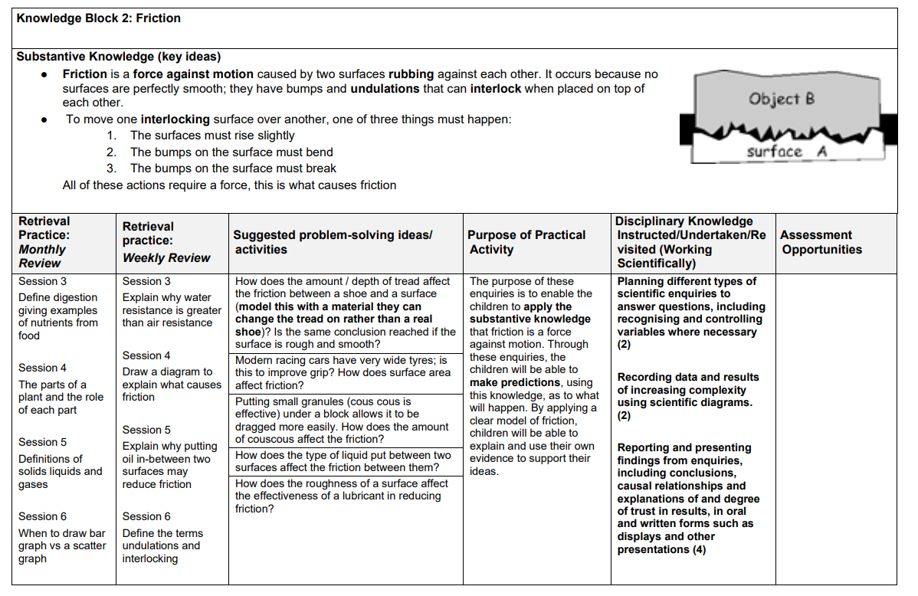
Primary Science Impact on KS3

Slide 42
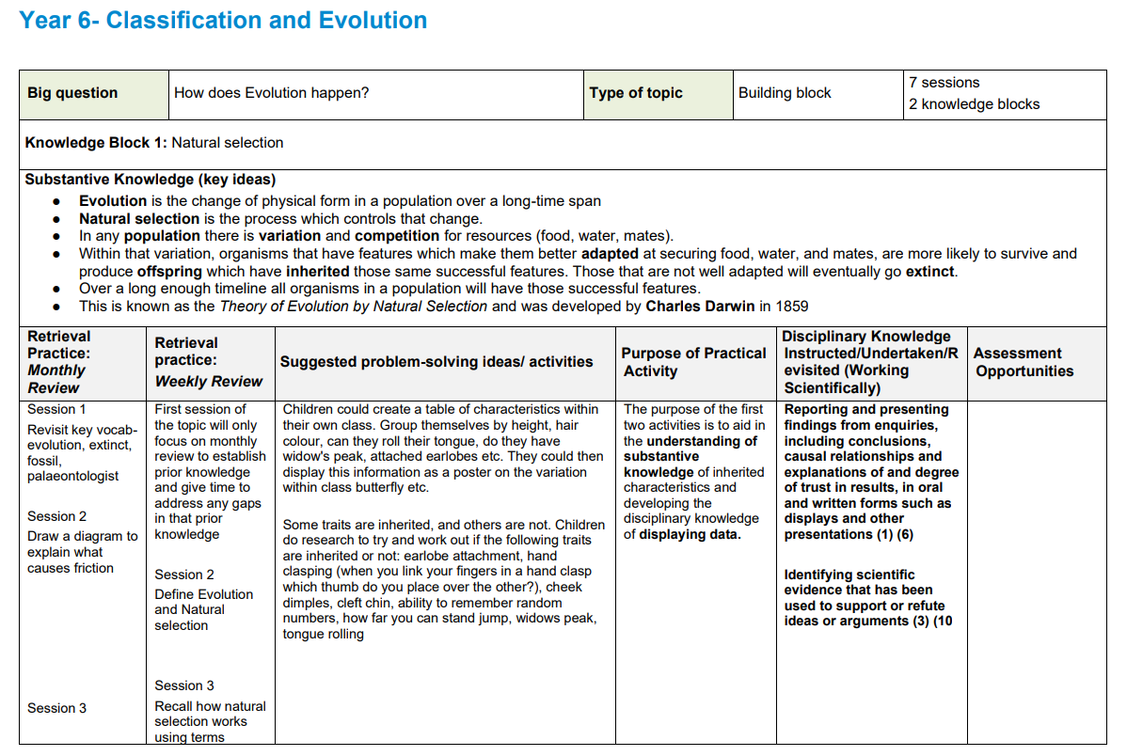
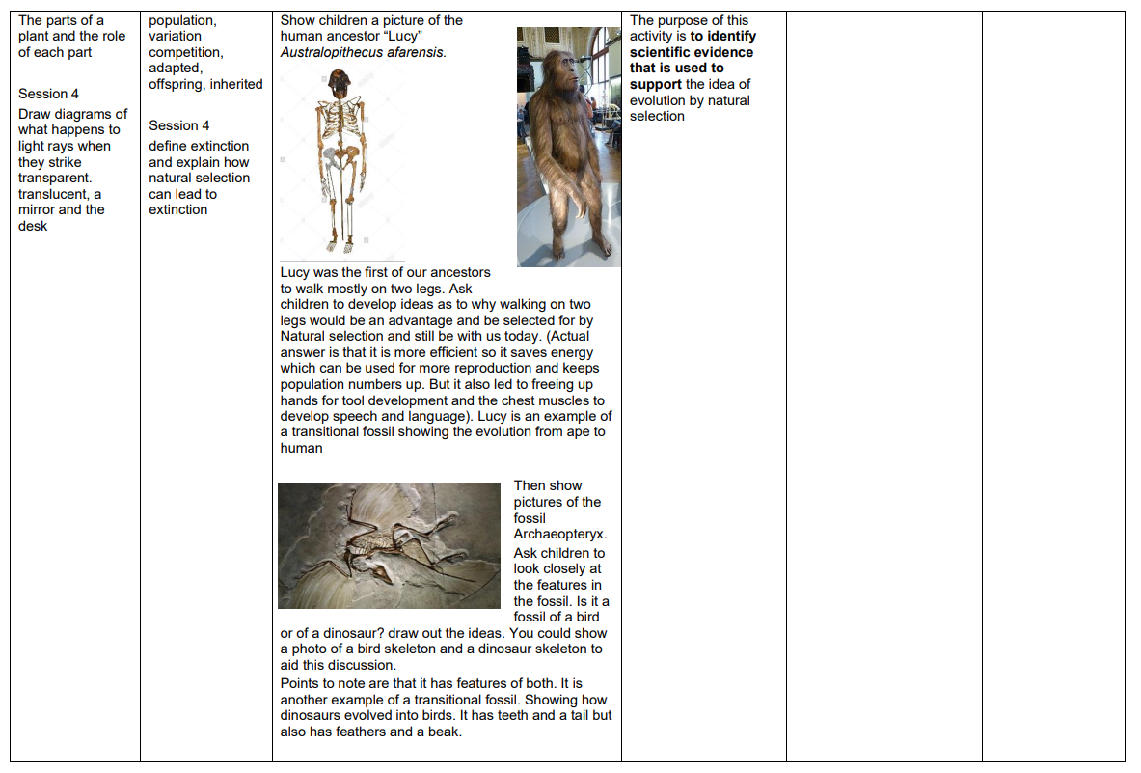
Primary Science Impact on KS3

Slide 43
Primary Science Impact on KS3
End of KS2 assessment on substantive knowledge.

Slide 44
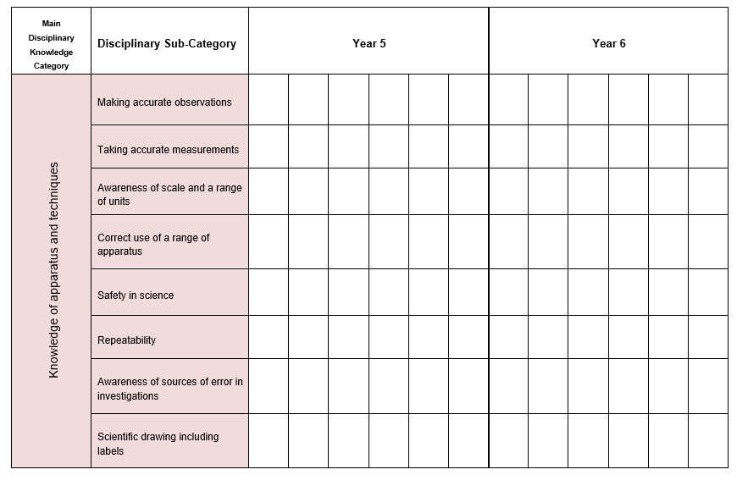
Primary Science Impact on KS3

Slide 45
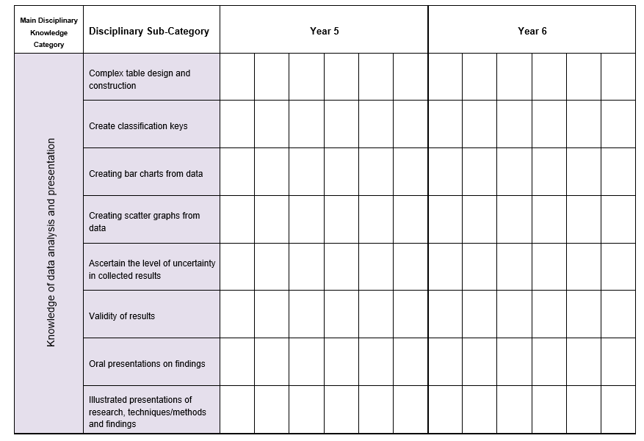
Primary Science Impact on KS3

Slide 46
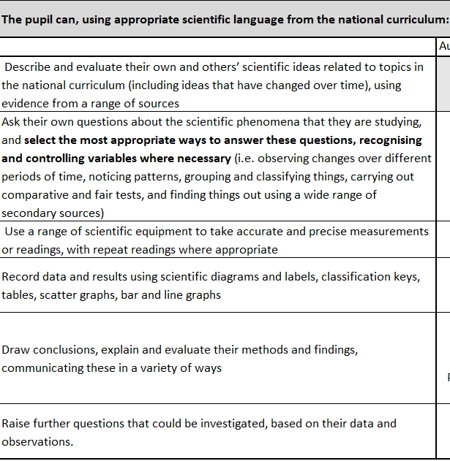
Primary Science Impact on KS3
End of KS2 assessment on disciplinary knowledge.

Slide 48
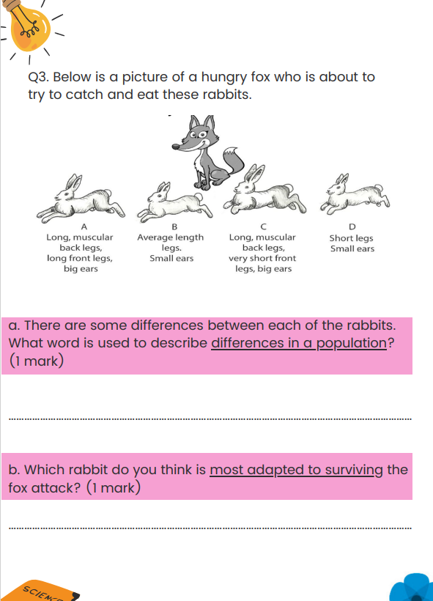
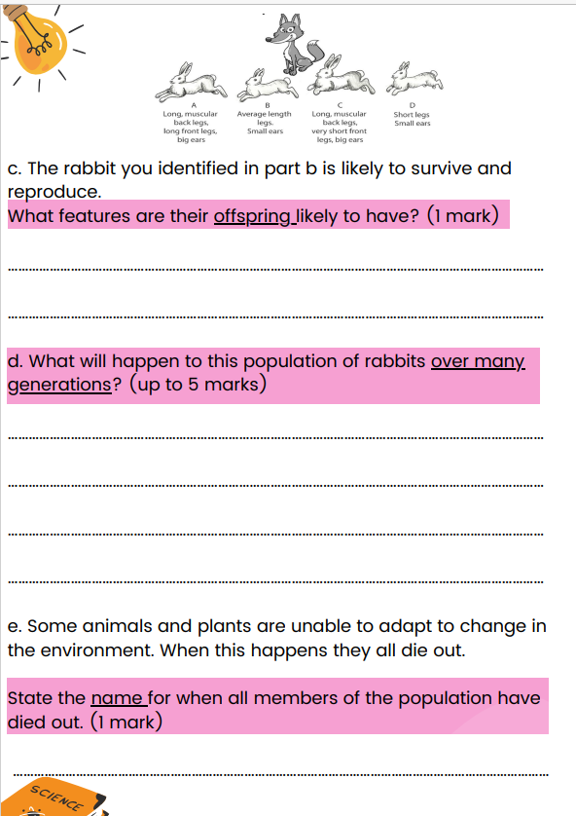

Slide 49
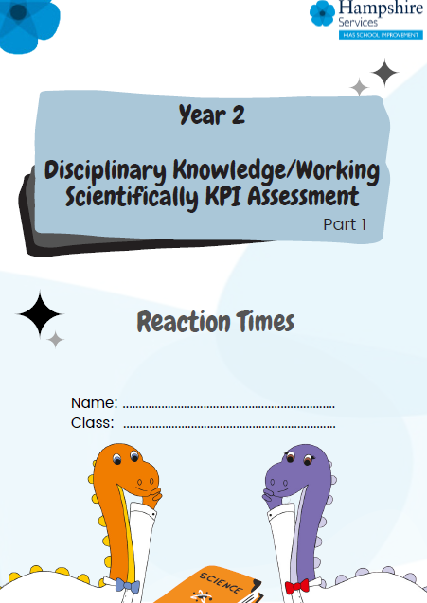
End of Key Stage disciplinary Knowledge Teacher Assessment
Year 2
Year 6
One off assessment booklets which will cover all the expected standard areas of disciplinary knowledge from the TA framework.
Same style and structure as current assessment booklet.

Slide 50
Primary Science Impact on KS3
In small groups discuss the following and be prepared to feedback to the group:
How familiar are you with the KS2 science (and even the Maths) curriculum?
Does your KS3 build upon KS2 or revisit (especially in disciplinary areas)?
Do you have retrieval in year 7 (and possibly year 8) that specifically links to knowledge learnt in KS2?
What is your relationship with your feeder schools like. Do you do any work together? Visit, co-teach, projects?

Slide 51
Steering Group Focus: Dual coding and Blank canvas modelling
Steering group meeting in July
Wanted to have one area which was a repeated focus for a period.
Dual coding and blank canvas modelling was requested to be the first.

Slide 52
Steering Group Focus: Dual coding and Blank canvas modelling
Discuss, try, review
HIAS Science Moodle
Course Materials
Secondary
HODs Network 2023-2024
Section of the chapter on Dual Coding and BCM

Slide 53
Steering Group Focus: Dual coding and Blank canvas modelling
Two of the Science Steering groups have been experimenting with aspects of BCM and are going to share their work with us today.
Jo Sinclair – Applemore
Gavin Rothwell- Testwood

Slide 54
Steering Group Focus: Dual coding and Blank canvas modelling
Discuss, try, review
Have a go if you are interested.
Members of the steering group will also be sharing at the next face to face meeting in February we will review and discuss some more.

Slide 55
Book of the Term
Has helped me think on my explanations and sequencing of knowledge in curriculums and lessons

Slide 56
In School CPD offer

Slide 57
Thank you
All 23/24 network sessions now bookable on
Learning Zone
Have a restful and happy Christmas break.
Wishing you all a Happy and successful 2024
See you in February
Please complete the feedback form for this session

